Slide 1

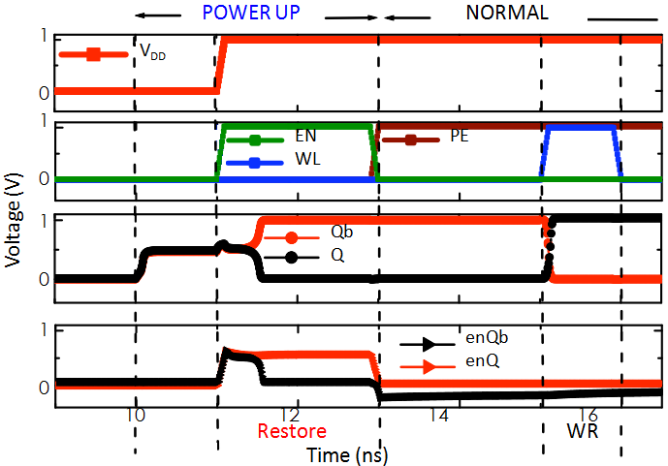
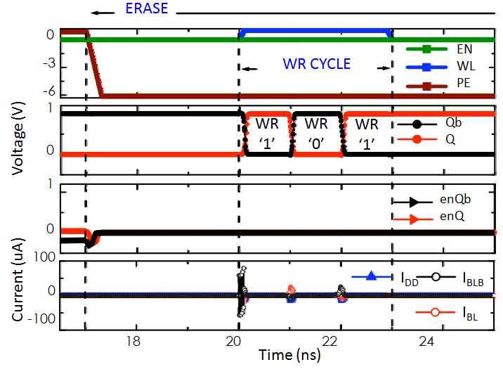

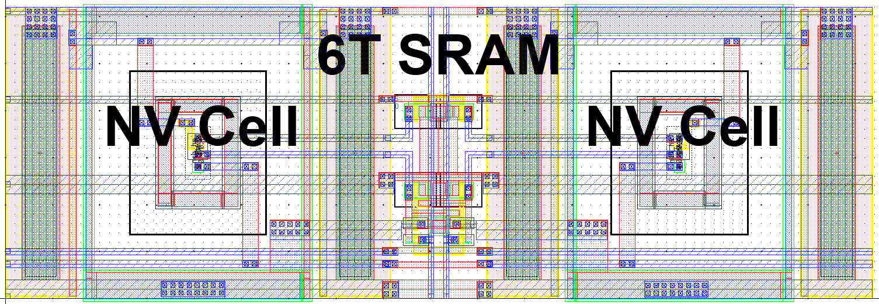
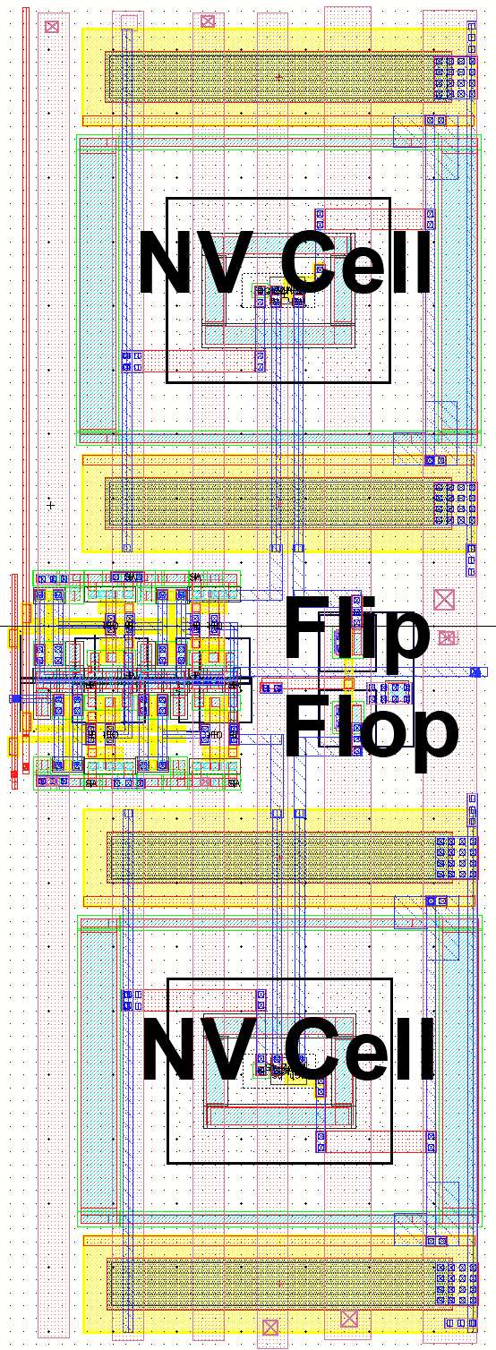
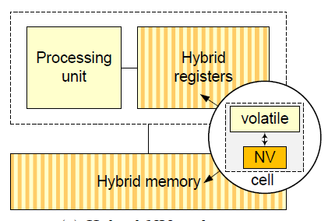
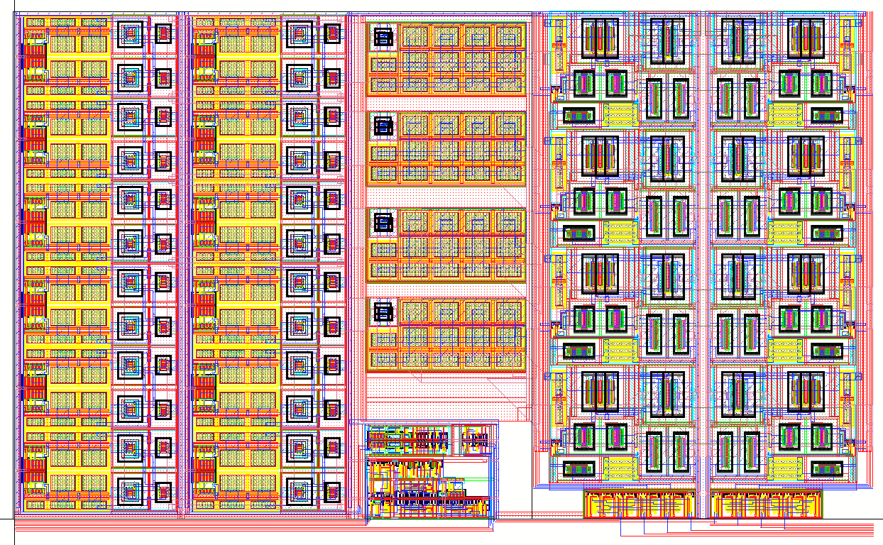
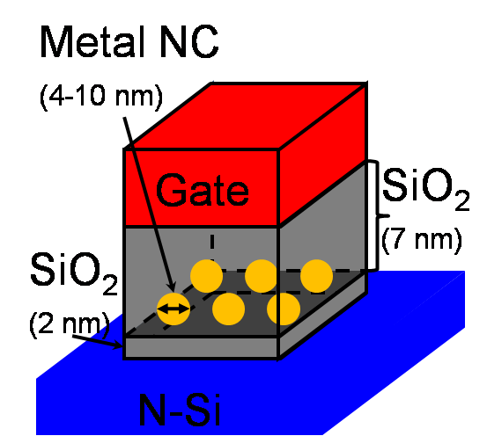
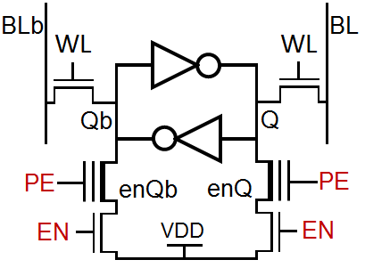
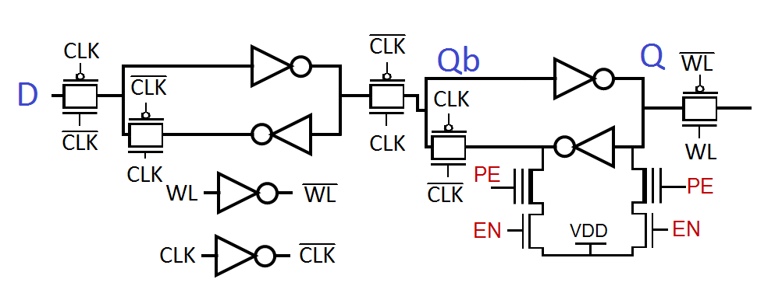
Nonvolatile Computing for Embedded Cyber-Physical Systems
Wing-Kei S. Yu, Shantanu Rajwade, Sarah Q. Xu, Sung-En Wang, Bob Lian, Yu-Yuan Kuo, Edwin C. Kan and G. Edward Suh
School of Electrical and Computer Engineering, Cornell University, Ithaca, NY 14853
Nonvolatile Computing
Nonvolatile Cell Operation
Prototype Simulation
Goal: Enable seamless computations on highly energy constrained cyber-physical systems
  Self-powered or battery-limited embedded devices: human body, rural areas, sensor networks, etc.
  Approach: Build nonvolatile microprocessors that preserve state across power interruptions
Benefits: Compute with unreliable power sources; Eliminate virtually all idle power consumption
Restore and Erase operation diagrams
OpenMSP430 microcontroller
  Synthesized on TSMC 0.35um with double poly
  Typical standard cell ASIC flow: Synopsys + Cadence
  Standard cell DFFs replaced with our NV version
  Simulated in HSIM with TSMC models and actual layout
Synthesized OpenMSP430
System-level area overhead
  NV area estimate: 2,700,000 um ² (without program Flash)
  Volatile only area: 1,276,000 µm² (without program Flash)
  Overhead can be reduced significantly on an NV compatible process.
Architecture
Prototype Design
Requirements: Nonvolatility with Low Overheads
  Instantaneous save and restore on power cycles with minimal energy consumption and bandwidth requirements
  Low impact on normal volatile operations
  Hybrid Volatile/Nonvolatile Storage
  Low normal operation penalty
  Explicit nonvolatile store and erase
  Low energy synching
  Compact area
Components designed and simulated on TSMC 0.35µm:
NV SRAM
Charge Pumps and Transmission Gates NV DFF
235,600 µm²
16-bit ultra low-power microcontroller
  TI MSP430 clone (OpenMSP430)
  10MHz, 16 General Purpose Registers (GPR)
  128 byte SRAM, 1 KB program Flash
Hybrid Memory Cells
Other Research Highlights
Enabling Technology
  Metal nanocrystal Flash
  High endurance
  Relatively low voltage
  Similar technology in production
High-level Operations
  No change to normal operation
  Added NV STORE, NV RESTORE, NV ERASE
Hybrid SRAM-DRAM
  Combined SRAM with DRAMs, integrated at cell level
  Enables quick and low energy transfer between the two memory types; increased density vs. SRAM only
  Test circuit was fabricated and tested successfully
Security functions using unmodified Flash memory
  Unique per-device fingerprints
  True quantum random number generation
  Information hiding
NV SRAM
6 transistor baseline
4 extra: 2 NV devices,
2 access devices
NV DFF
22 transistor baseline
4 extra: 2 NV devices,
2 access devices
On-going Work
Prototype microcontroller implementation
  Finish full-chip design (analog integration)
  Fabrication and test
Supported by NSF Award CNS-0932069

