Slide 1



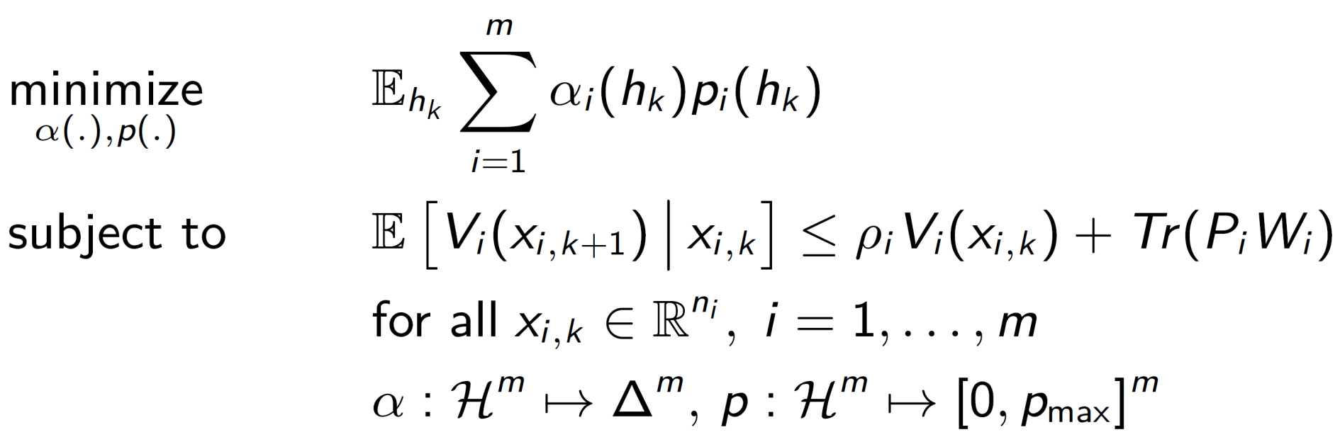

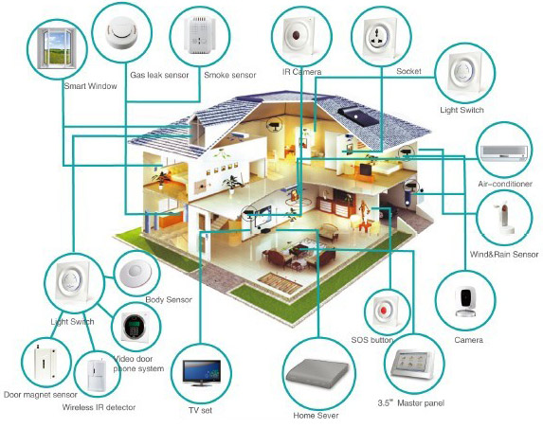


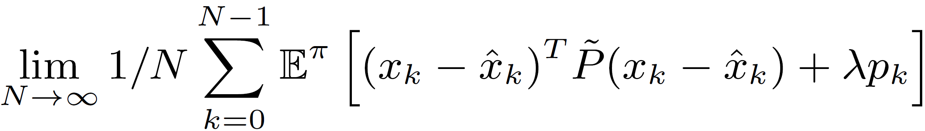
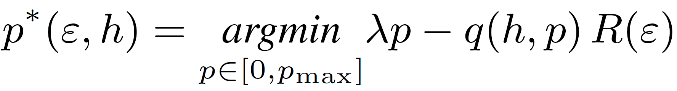
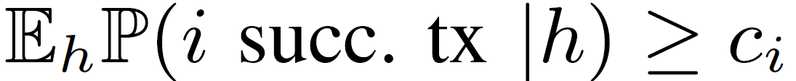
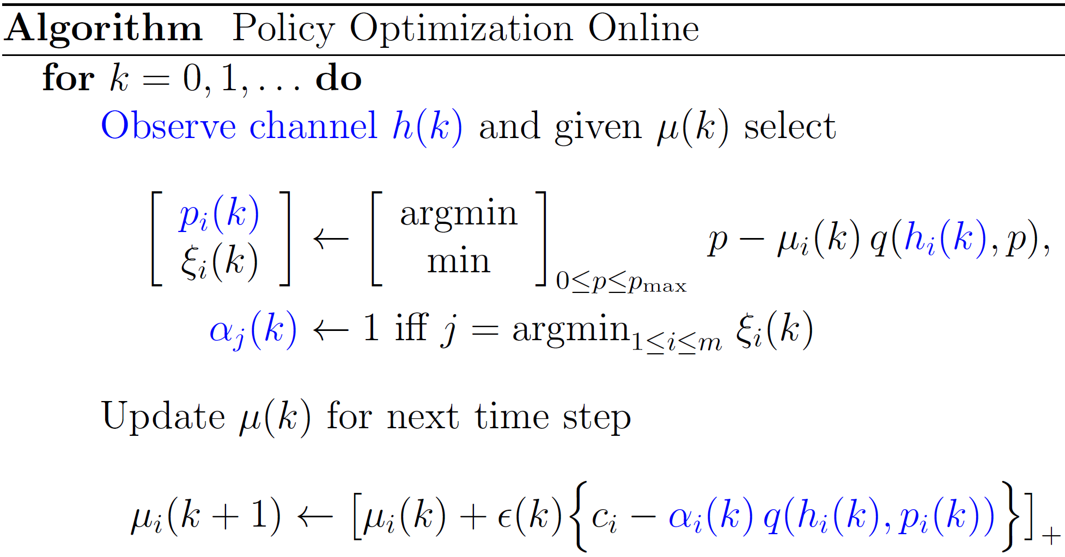
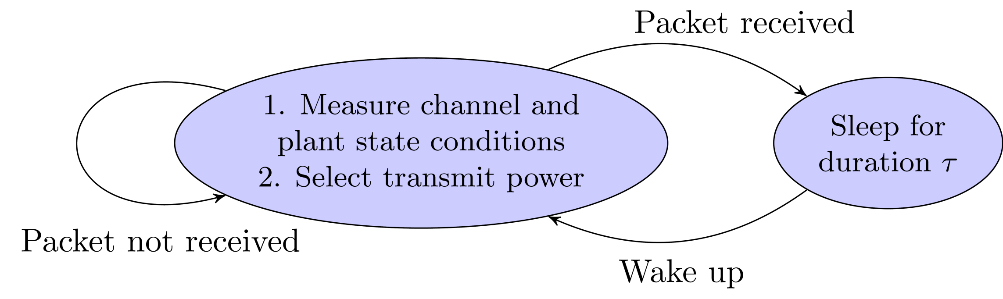
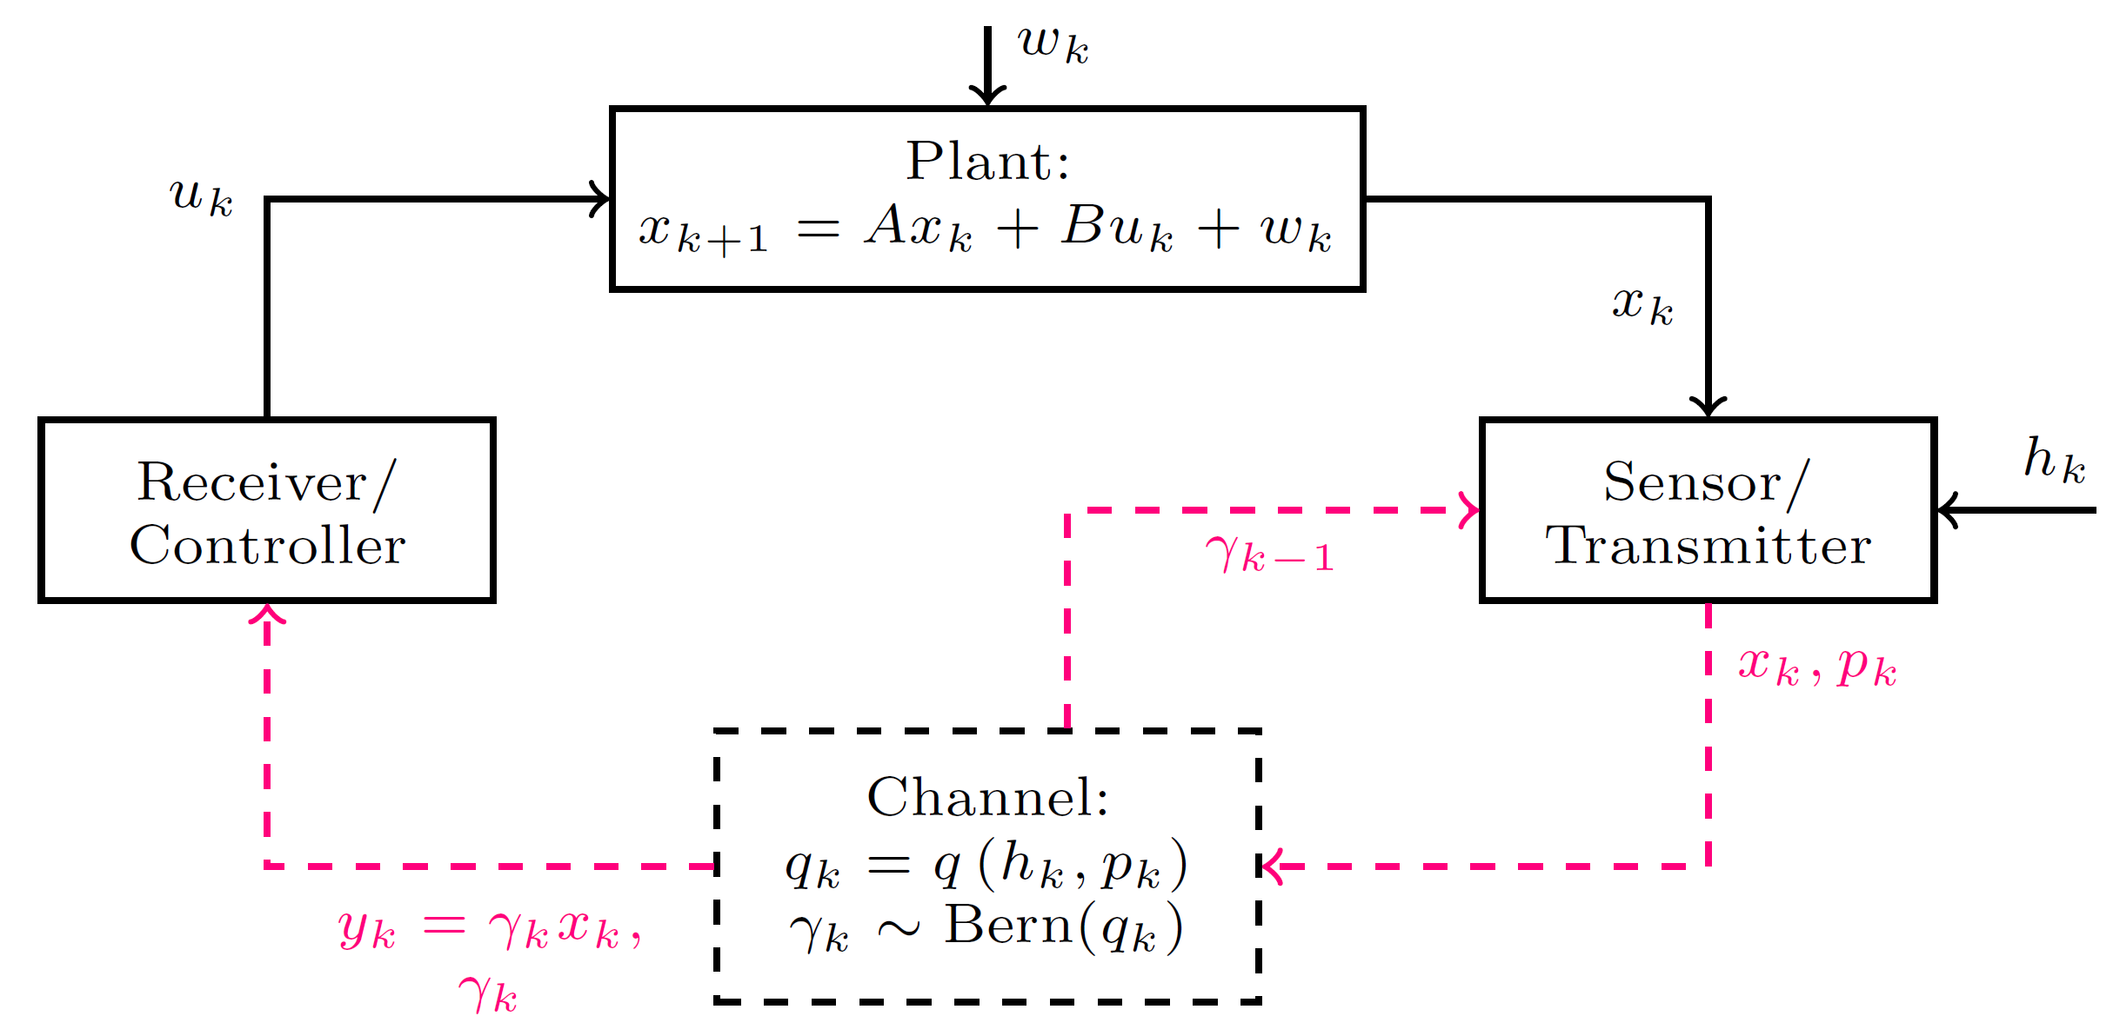
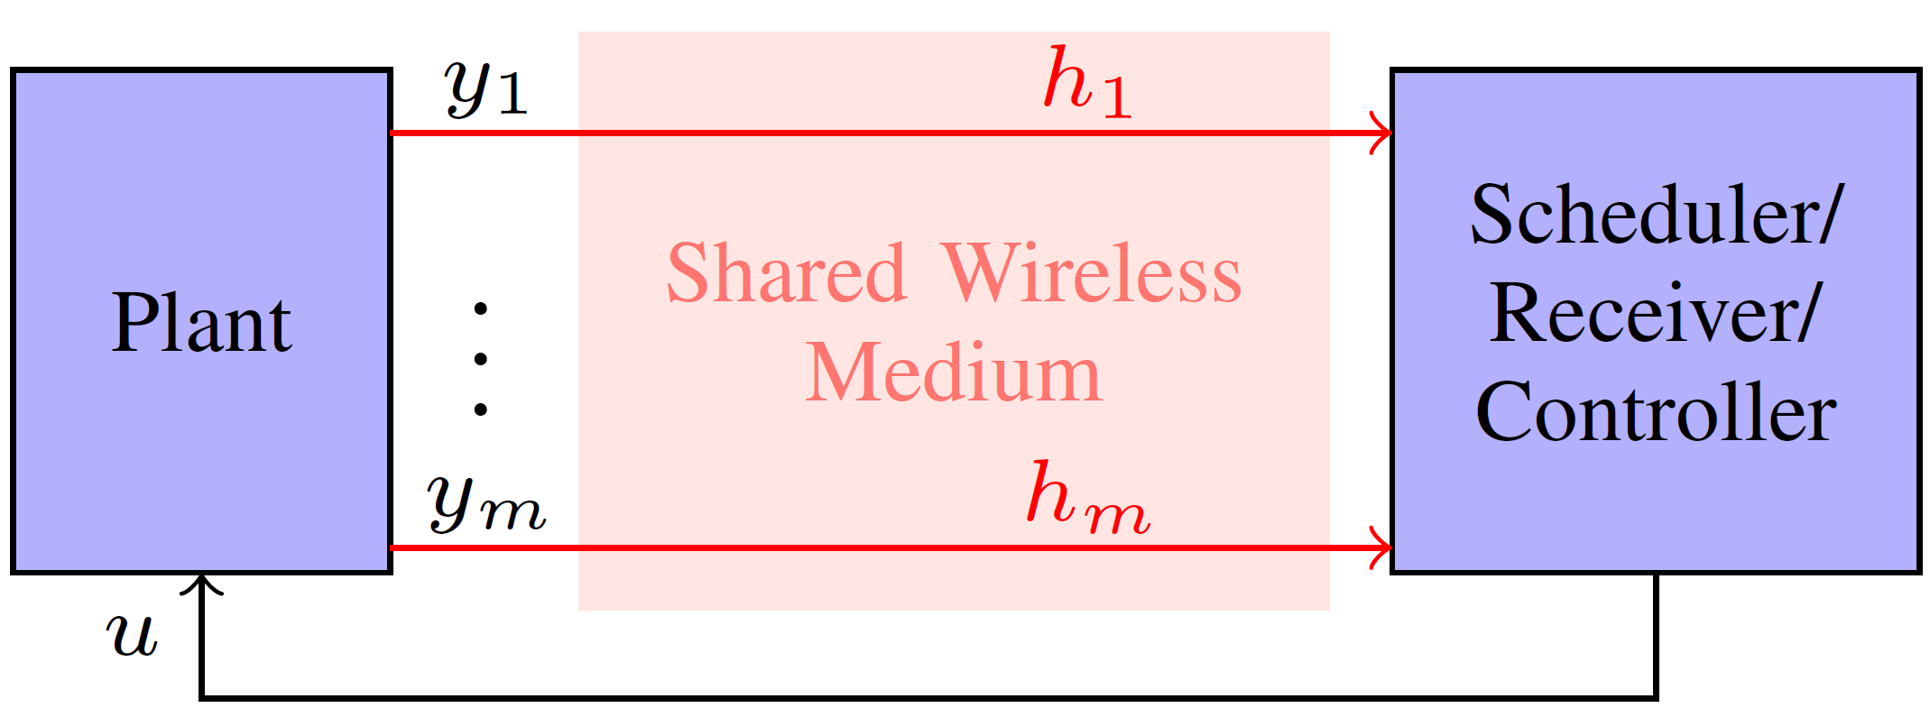
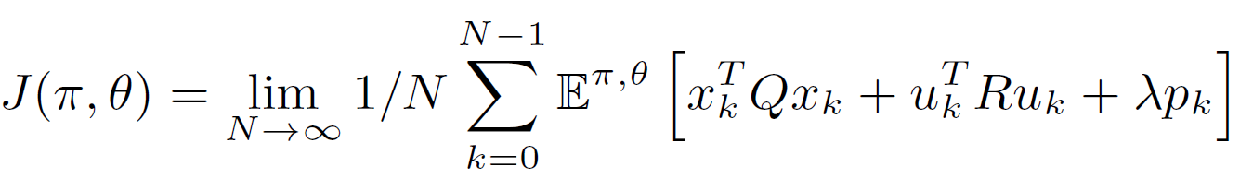
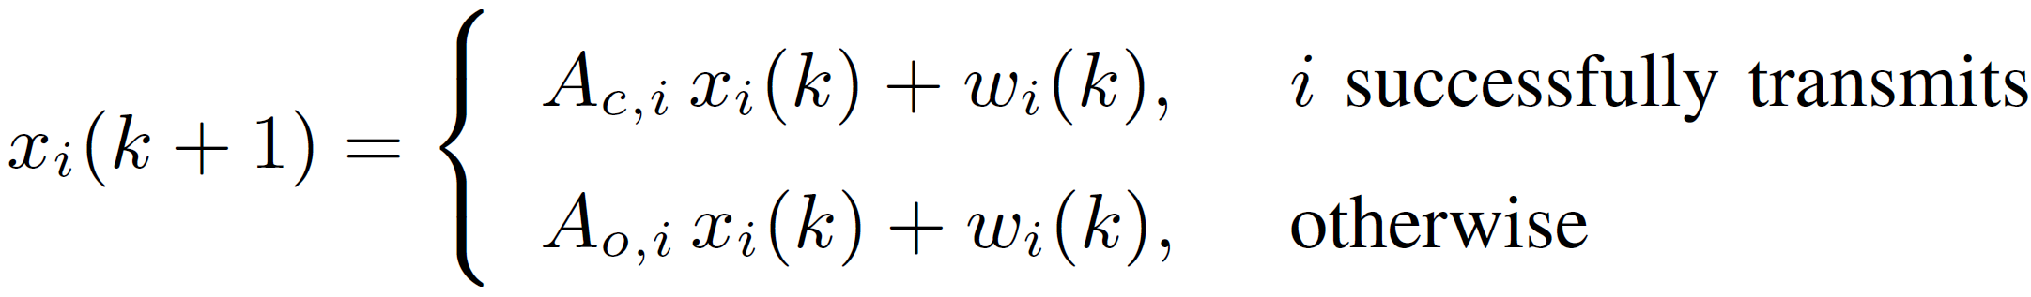
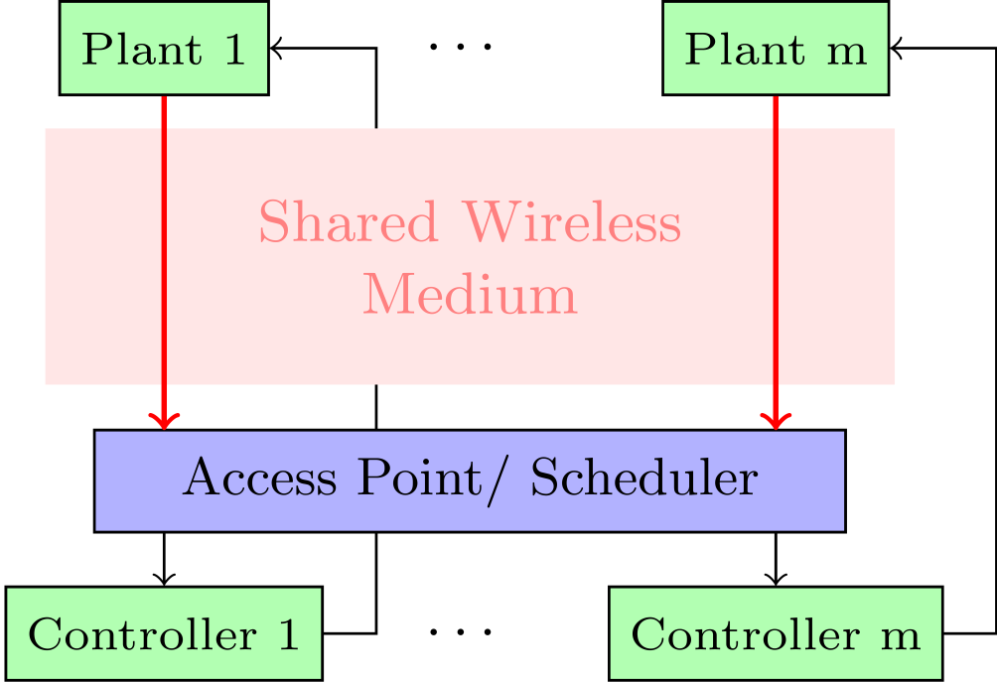
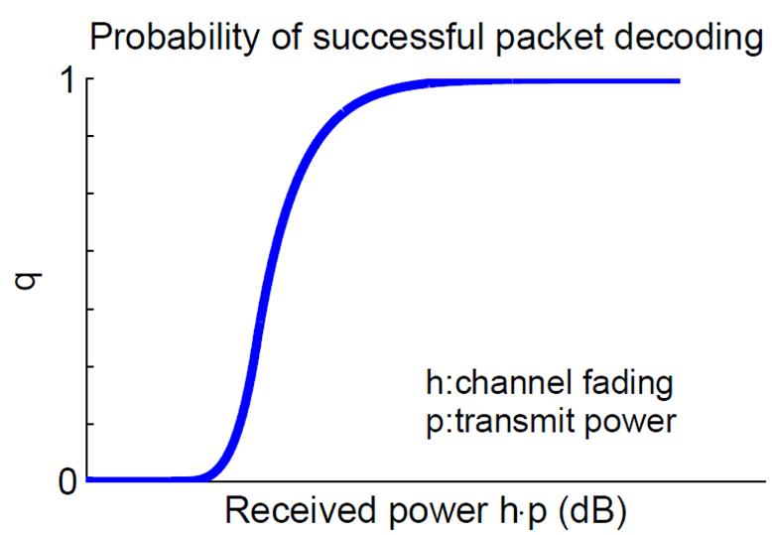

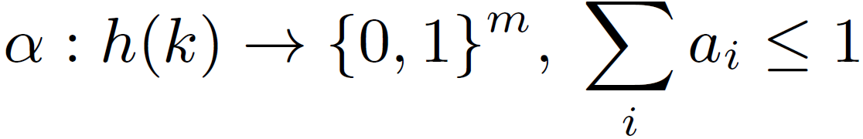
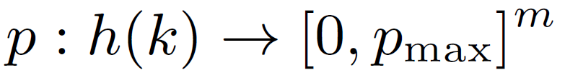

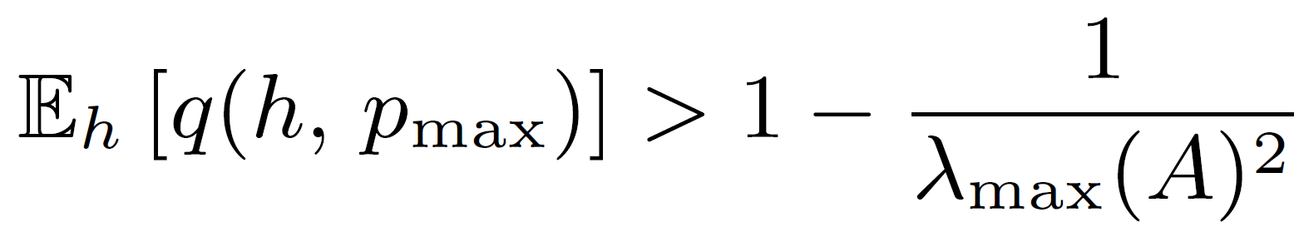
Optimal Resource Management in Wireless Control Systems
Konstantinos Gatsis, Miroslav Pajic, Alejandro Ribeiro, George J. Pappas
Electrical & Systems Engineering, University of Pennsylvania
Wireless Control Systems
Control & Power Policy Design
Opportunistic Scheduling & Power Policy
Control applications in, e.g., smart homes, building/ industrial automation, need to exchange information between sensors, controllers, actuators over wireless channels
Separation principle if power adapts to channel and innovation error
Theorem 1: The optimal control policy is given by the standard LQR (solution of discrete-time algebraic Riccati equation)
Theorem 2: The optimal power policy minimizes average estimation error and power
and has the following form for some function R(.)
Minimize average power subject to control performance
All given Lyapunov functions decrease with desired rates at each time step in expectation over channel conditions
Quadratic V_{i}(x_{i}): equivalent to expected transmission rate
Wireless communication ↔ Control performance
Power resource limitations (battery-operated devices)
Transmission uncertainties (packet drops, delays, etc.)
Random channel variations (fading)
Shared wireless medium (interferences, scheduling)
Higher power if plant away from stability or channel quality less favorable
Do not transmit if channel adverse and plant close to stability
Event-triggered for capacity achieving codes
Single-time-step scheduling vs. timing abstractions, sequences, etc.
If problem is feasible (schedulable), optimal policy can be found offline (known channel distribution) or online (one channel measurement sequence)
Meets control performance and power optimality in the limit a.s.
Research goal: Develop techniques for efficient resource management with control performance guarantees and energy awareness, opportunistically based on control task requirements & channel conditions
Optimal R(.) from Bellman equation - hard to compute:
Approximate dynamic programming (rollout) to find suboptimal quadratic R(ε) in closed form
Power Management for single sensor-actuator systems*
Structure of optimal policy:
Decentralized power allocation
Opportunistic access scheduling
*ACC’13 Student Best Paper & O. Hugo Schuck Best Paper awards, TAC’14
Power management at receiver (CDC’13):
Switch to sleep after transmission, duration adapted to observed channel
Transmission decision upon wake-up adapted to channel and plant states
Co-design: transmit power policy for sensor & control input policy for controller
Goal: minimize joint average control and power costs
Schedule “harder” plant under most conditions
Schedule “easier” plant when its channel quality is much more favorable
Do not schedule under adverse channels
Scheduling Over Shared Wireless Channels*
*ICCPS’14 Best Paper Award Finalist, TAC’14 (submitted)
Scheduling multiple sensor outputs (CDC’14) of same plant to central controller
Stability if plant is stabilizable w.r.t. selected Lyapunov function
Independent control systems
Shared wireless medium: channel conditions vary
Scheduling and power adapted to channel
Control performance guarantees for all systems
Wireless channel model:
Transmit power and channel fading determine packet decoding probability
Depends on error correction code
Measured experimentally or in simulation
Channel state h_{k} i.i.d., estimated before transmission
Future Work
Decentralized & random channel access mechanisms for wireless control systems
Design of control Lyapunov abstractions for resource allocation
Controller & resource management co-design
Resource management for control over wireless multi-node networks
Cloud resource management for sensing/control applications
Assumption (sufficient for stabilizability):
Acknowledgement
This work is supported by the NSF CNS-0931239 grant:
Quantitative Analysis and Design of Control Networks

