Slide 1
Partnership For Innovation: Broadening Innovation Capacity
Gurdip Singh
CISE Computer and Network Systems
National Science Foundation

Slide 2
Partnerships For Innovation: Building Innovation Capacity (PFI:BIC)
Academe-industry partnerships
Interdisciplinary academic research team
At least one industry partner
Build technological and human innovation capacity.
NSF Engineering Directorate, Industrial Innovation and Partnerships
NSF CISE Directorate, Computer and Network Systems

Slide 3
What Innovation Capacity Is Being Built? .
Technological Innovation Capacity
Advancement and adaptation for integration and perhaps new thoughts about extending the technology to other application areas.
Human Innovation Capacity
Growth and development of academic faculty and research scientists and industrial partners through interdisciplinary and cross-organizational collaboration.
Preparation of next generation entrepreneurs: mentoring plan for each undergraduate or graduate student (as well as for postdoctoral researchers) so that exposure to and participation in this kind of collaboration is explicitly emphasized.

Slide 4
FY14 and FY15 Focus: Smart Service Systems
Service systems
socio-technical configurations of people, technologies, and information
designed to deliver services that create and deliver value
Smart service system
capable of learning, adaptation, and decision making
Improved response to a future situation.

Slide 5
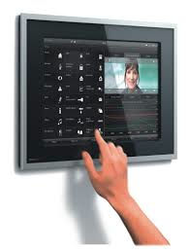
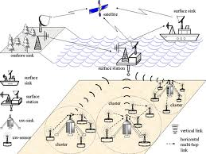
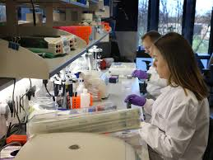
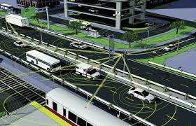
PFI: BIC program
Existing
Research and Technologies
Commercialized services
PFI: BIC Goals:
Integration of technologies to create innovative services
Research needed to realize market value

Slide 6
Smart Service Systems
Analysis
Learn
Human-Centered
Smart Service
Sense
Actuate
Coordinate
Proposal Teams:
Engineering
Computer Science
Behavioral science
Cyber-Physical Systems

Slide 7
Successful Integration into a Smart Service System Requires a Range of Disciplines in Addition to those Related to the Technology
(1) Systems Engineering or Engineering Design
To provide knowledge of service system design and system integration issues.
(2) Computer Science/Information Technology
To provide knowledge of considerations involving data transfer, communication and/or data processing needed for successful integration of the technology into a “smart” service system.
(3) Human Factors/Behavioral Science/Cognitive
Engineering
To provide knowledge of the potential effects of human factors as they interact with the technology proposed. These findings will have an impact on ensuring that the design of the “smart” service system is human-centered.
Notes:
((1) above) In addition to providing systems understanding, engineers in different areas can play a role in the technology development and/or ((2), above) data processing requirements, etc.
In short, the role of individual partners may be tied to one of the “3 categories” of coverage needed to build the system and/or these partners or others may play other roles vis-à-vis the project.

Slide 8
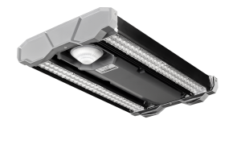
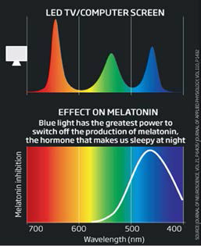
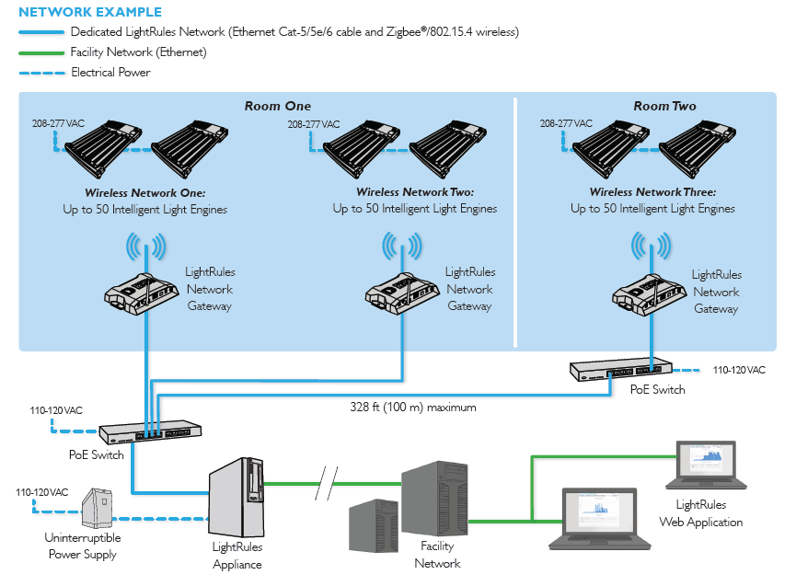
A Wireless Networked Biophilic Lighting System for the Delivery of Lighting for Enhancing Secondary School Student Performance
Brown University
Digital Lumens, Inc.
Intelligent
Light Fixture
Prescription Lighting
- enhance student performance
Studies showing impact of light
Proposed tasks:
Develop and deploy a prototype system
Quantify the effects of biophilic lighting on human behavior
Collect relevant data for further investigation

Slide 9
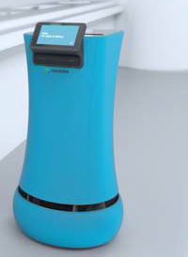
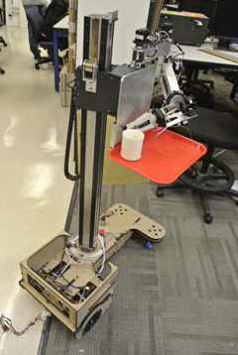
Affordable and Mobile Assistive Robots for Elderly Care
University of Pennsylvania
Savioke, Inc.
Software
ROS
Mobility software
Manipulator software
Service robots
limited set of manipulation tasks on elders’ behalf.
SaviBot mobile base
Proposed tasks:
Will service robots lead to smarter monitoring of elder adult health?
Proactive services
Integration activities
New arm development
Evaluate and assess how elders interact with robots.
Persona mobile manipulator

Slide 10
Solicitation: NSF 14-610 Key Facts
Letter of Intent (LOI) required: December 3, 2014
Full proposal submission deadline: January 28, 2015
Awards: up to $1,000,000/3-year duration
Estimated: 10 awards
Anticipated funding: $10,000,000
Submission restrictions:
One (1) submission opportunity/year
Two (2) proposals per institution, each proposal, respectively, pursuant to its own LOI .
Principal Investigator (PI) who proposes
Cannot be concurrently a PI on an active award from the NSF PFI:BIC program
PI cannot submit both to the PFI:BIC and to the PFI:AIR program for funding with FY 2015 fund
10
Notes:
10

Slide 11
Cognizant Program Officers
Sara B. Nerlove, ENG/IIP/PFI:BIC, Program Director, telephone: (703) 292-7077, email: snerlove@nsf.gov
Alexandra Medina-Borja, ENG/OAD, telephone: (703) 292-7557, email: amedinab@nsf.gov
Gurdip Singh, CISE, telephone: (703) 292-8950, email: gsingh@nsf.gov
Chris Paredis, ENG/CMMI, telephone: (703) 292-2241, email: cparedis@nsf.gov
Leon Esterowitz, ENG/CBET, telephone: (703) 292-7942, email: lesterow@nsf.gov
Alexander Leonessa, ENG/CBET, telephone: (703) 292-2678, email: aleoness@nsf.gov

Slide 12
Projects funded in FY 2014
Enhanced Situational Awareness Using Unmanned Autonomous Systems for Disaster Remediation
Affordable and Mobile Assistive Robots for Elderly Care
Self-Learning Algorithms for Advancement of Smart Stormwater Green Infrastructure Systems
Making Full Use of the High-Resolution Image Capability of Smartphones to Collect Data through Ophthalmic Devices for Smart Mobile- and Tele-Health
A Wireless Networked Biophilic Lighting System for the Delivery of Lighting for Enhancing Secondary School Student Performance
Nutriphone: A Nanoparticle-based Optical Contrast Assay to Monitor Vitamin and Micro-nutrient Levels Using Smartphones
Fraud Detection via Visual Analytics: An Infrastructure to Support Complex Financial Patterns (CFP)-based Real-Time Services Delivery

