Slide 1
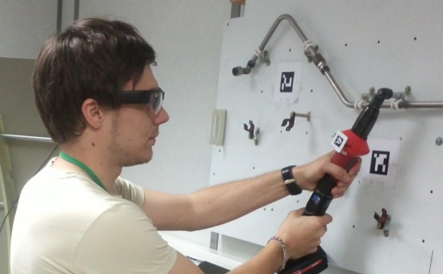
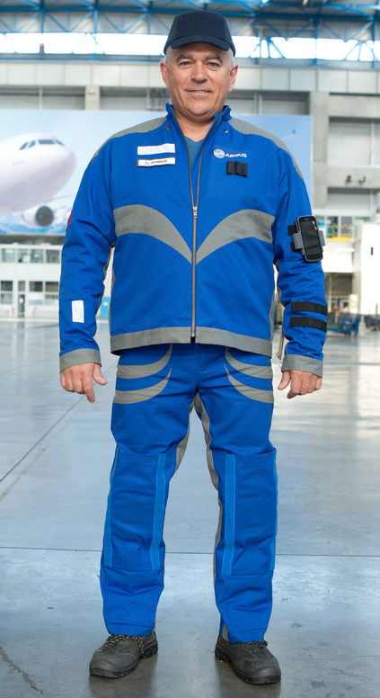
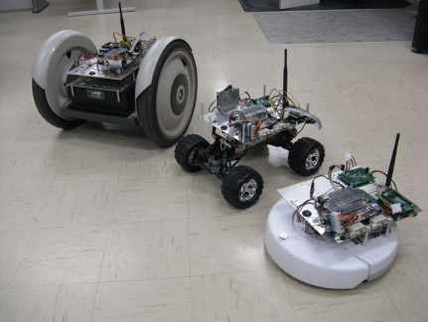
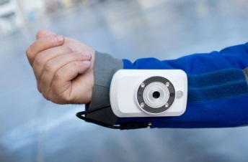
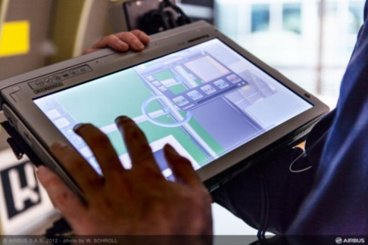
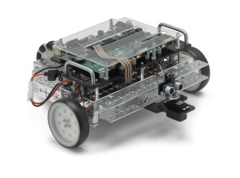


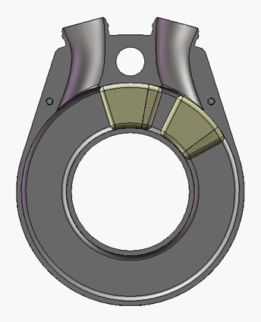
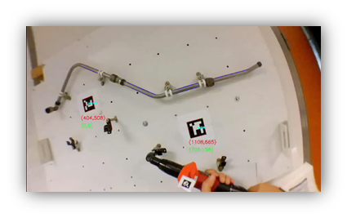
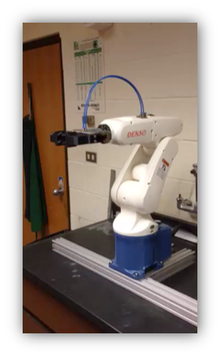
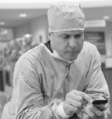
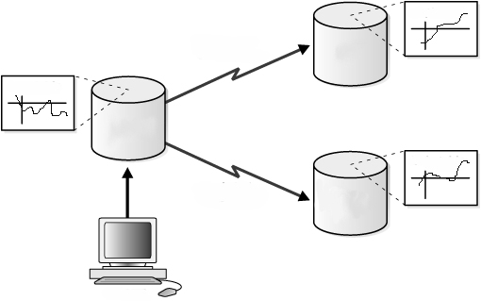


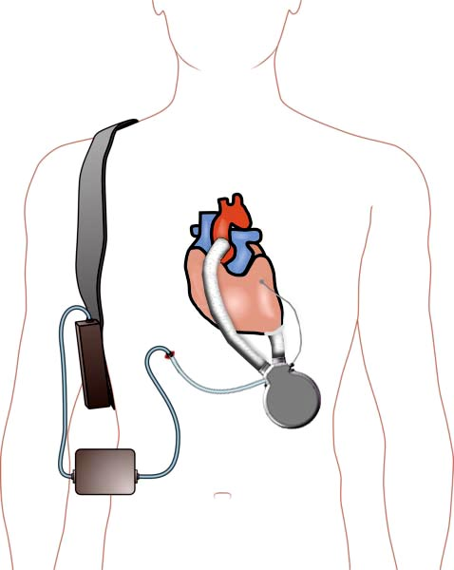

Physically Informed Assertions for CPS Development and Debugging Progress in Test-Bed Development
Project Description and Goals
Identifying Development Test Beds
Progress and Challenges
Hypothesis: An assertion-driven approach that balances logical (cyber-side) and physical system constraints and characteristics facilitates CPS development and debugging
Current Goals:
Identify application test beds that demonstrate needs, motivate assertion-based development, and promote integration with evolving CPS development tools and frameworks
Develop methodology for formulating CPS assertions to aid developers that bridge cyber and physical domains
Develop and assess runtime verification methods for CPS systems
Develop assertion approach that can be applied on multiple platforms and languages to aid automated verification and validation (V&V) procedures
Propose test beds for developing and evaluating assertion-driven framework that contain key CPS elements:
  Physical motion, sensing and actuation hardware
  Adjustable level of complexity and failure modes
  Distributed computing and embedded architectures
  Data aggregation and communication
  High level programming language
Conducted empirical study of V&V in CPS
  Surveyed and interviewed CPS developers and researchers
  Confirmed that traditional and state of the art V&V methodologies are not sufficient for CPS
Developed new course in Mechanical Engineering titled Cyber Vehicle Systems
Established multiple industry collaborations and applications test-beds
Exploring run-time verification using model-based assertions
Developing general approach to systematically formulate model-based assertions
Investigating ways to integrate and assess assertion-usage in time-critical application areas, particularly ongoing collaborations
“Cyber Side”
of System
“Physical Side”
Of System
System Software
Transducers
Physical System
Assertions
Communication
&
Signaling
Cyber Domain
Physical Domain
Communication
Research and Teaching Platform
Cooperative Human-Robot Interaction with Human Embedded Sensing
Cardiovascular Assist Device Design, Sensing and Control
Objectives
Introduce assertion-driven development
Establish realistic development conditions and challenges
Graduate Research
Advance model-based assertions
Develop run-time verification platform on mobile robot platform
Transform Course in Vehicle Dynamics into Cyber Vehicle Systems Course with Laboratory
Blend physics of vehicle dynamics with sensing, actuation, and programming for autonomy
Introduce a laboratory component (LabVIEW_{TM}-based real-time platforms)
Safe CPS in production
Real-time information from design to production
“Smart” components that interact with automated machines to enhance reliability
Human-centered enhancement
Smart wearable devices
Smart production robots
Smart hand-tools
Connected factory
High data volumes through safety standards
Safety-critical need for validation processes from early development to FDA approval
New type of left-ventricular assist device (TORVADTM) with cyber-enhanced monitoring and control
Custom embedded controller with sensing, drive, and communications
Fault detection, monitoring, and compensation algorithms
Actuators
Sensors/Actuators
Data Acquisition and
Control Systems
The Edge
IT Infrastructure
System Software
RFID
Real-Time Vision
Assertions
Physical System
Environment
RGB Camera
Switches
Network & PLM
Sensors
Estimation of distance/position
Situational awareness
Update/reprioritize required tasks in real-time
Log tasks for verification
Processes & Rules Management
Model of Physical System
PC
Plant Node Server
Supervisory
Cyber Domain
PWM
Physicians
Computational models
Physical Domain
RFID
Real-Time Control and FPGA
Communication
Motor Drives
Internet
Monitoring
Wireless sensors
Sensing wish list:
Heart rate (HR) – from ECG
Rhythm – from ECG
Aortic Pressure (AoP)
Left-atrial Pressure (LAP)
Left-ventricular Pressure (LVP)
Cardiac Output (CO) - flow
VAD output flow
Additional patient monitoring (motion, respiration, etc.)
Reliable and user-friendly framework
Open-robot interface development (LabVIEWTM)
Integration of assertion-driven framework
Battery pack
Epicardial
ECG
DaNI 2.0 Robotic
Ground Vehicle
Drive line through skin
LVAD
Network-enabled LVAD controller
Course site: http://www.me.utexas.edu/~longoria/CyVS
Collaboration with National Instruments (Austin) and Airbus (France)
Collaboration with Windmill Cardiovascular Systems, Inc. (Austin) and UTHealth/Cardiology (Houston)
Christine Julien, Sarfraz Khurshid, Miryung Kim, and Raul Longoria
The University of Texas at Austin
r.longoria@mail.utexas.edu

