Slide 1
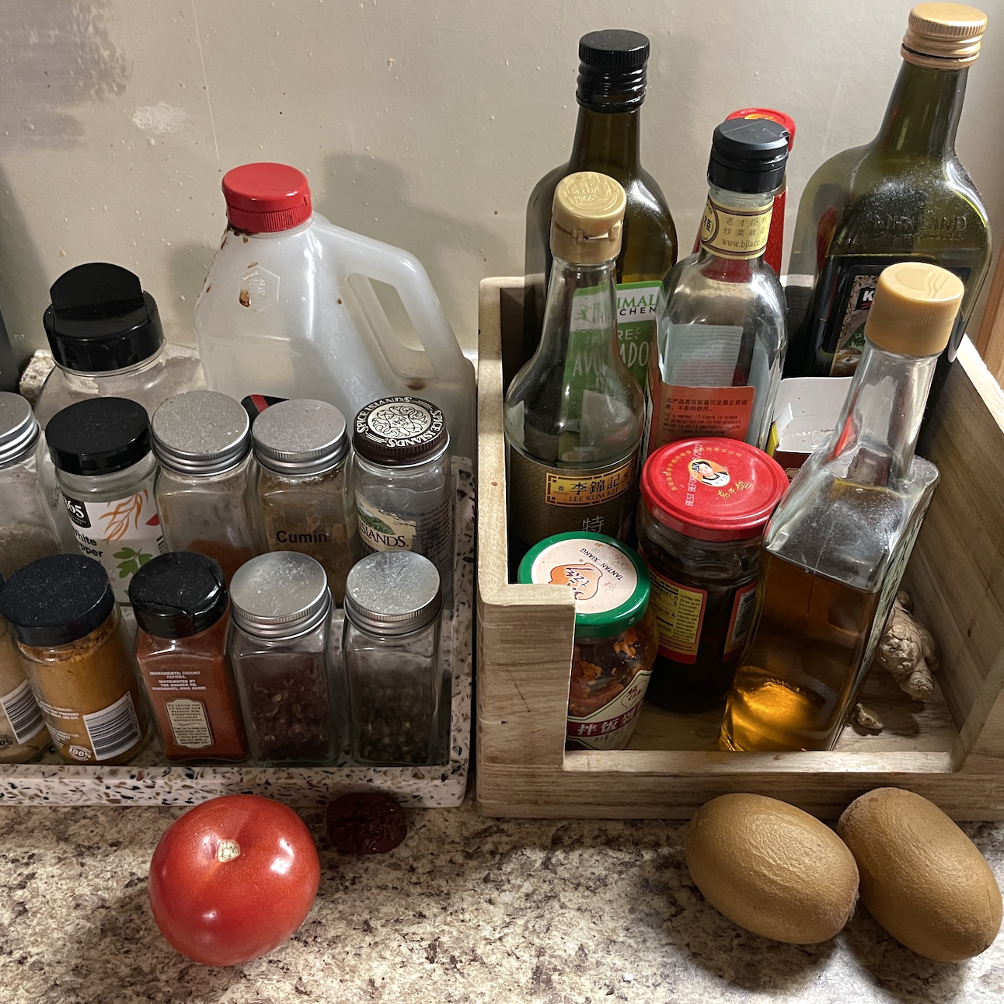
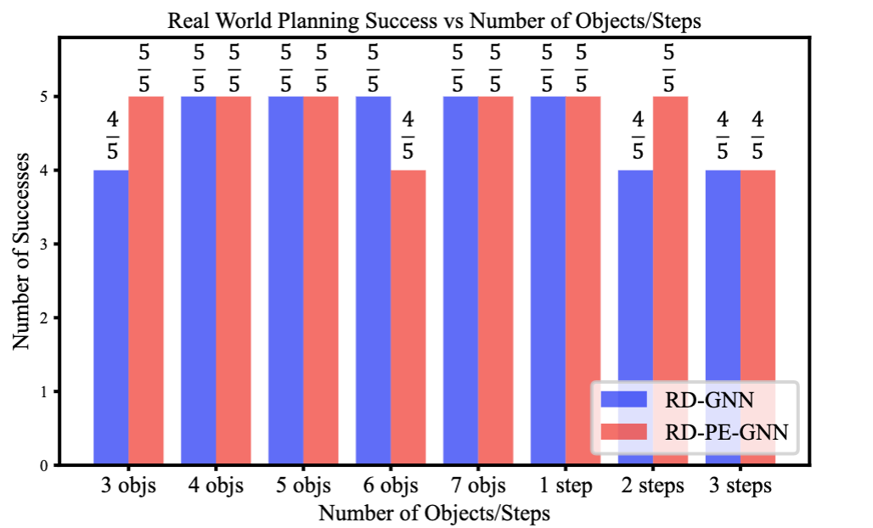
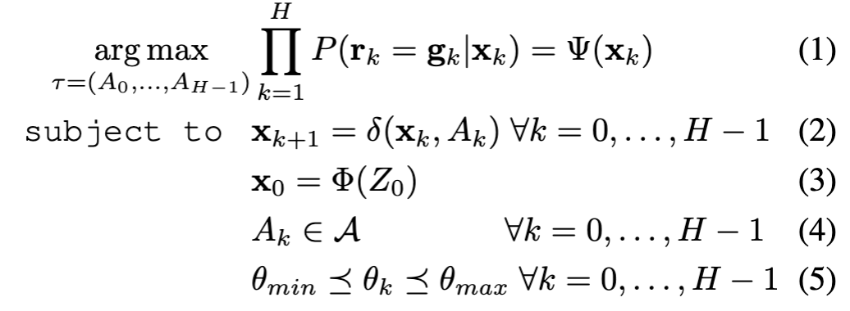
Planning for Multi-Object Manipulation with Graph Neural Network Relational Classifiers
Tucker Hermans; University of Utah
https://robot-learning.cs.utah.edu/project/graph_nets
Motivation
Objects rarely sit in isolation in human environments. As such, we'd like our robots to reason about how multiple objects relate to one another and how those relations may change as the robot interacts with the world.
Challenges
Multi-object interaction.
Sim-to-real transfer without finetuning.
Partial-view point clouds as input.
Multi-step planning based on multiple logical goal relations.
Generalization to a variable number of objects with different shape.
Main Contributions
Proposed a novel graph neural network framework for multi-object manipulation to predict how inter-object relations change given robot actions.
Achieved multi-step planning to reach target goal relations.
Showed our model trained purely in simulation transfers well to the real world
A system to rearrange a variable number of objects with a range of shapes and sizes using both push and pick and place skills.
For the same initial scene (left) we show different valid states found by our planner and model for two different goal settings
Problem Definition
2023 FRR & NRI Principal Investigators' Meeting
May 2-3, 2023
Award ID#: 2024778

