Slide 1

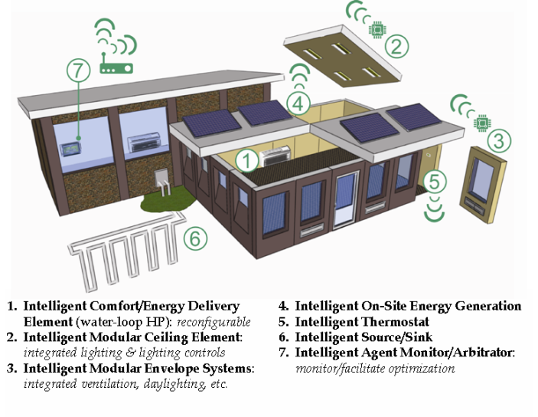


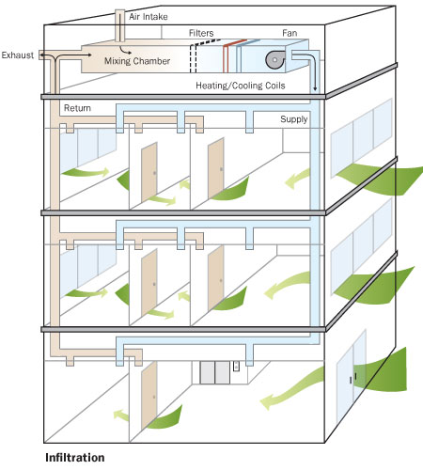
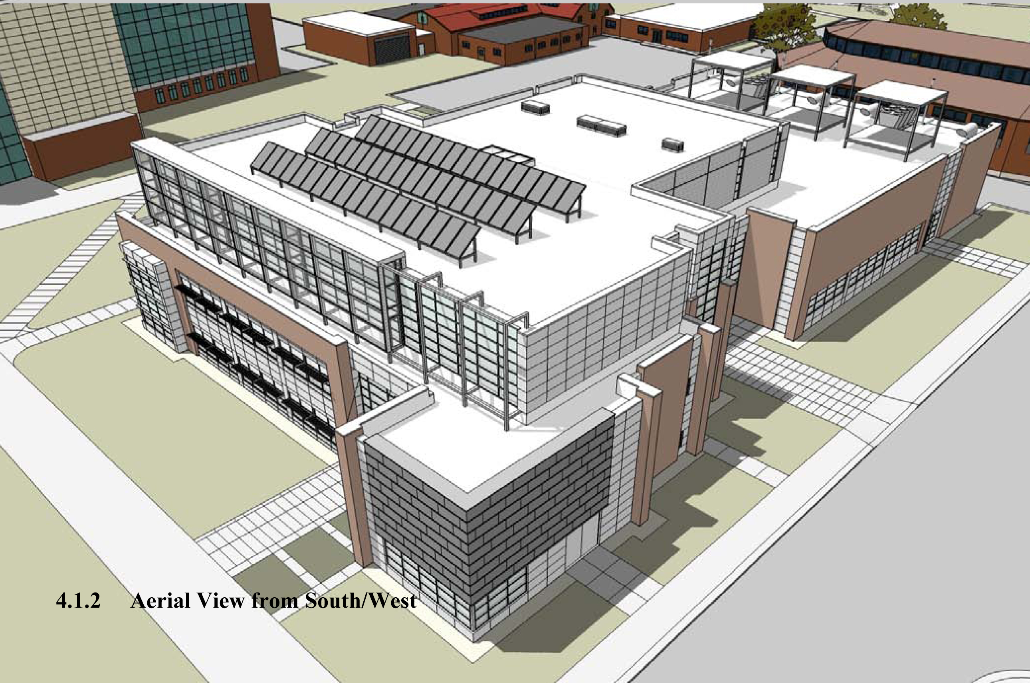
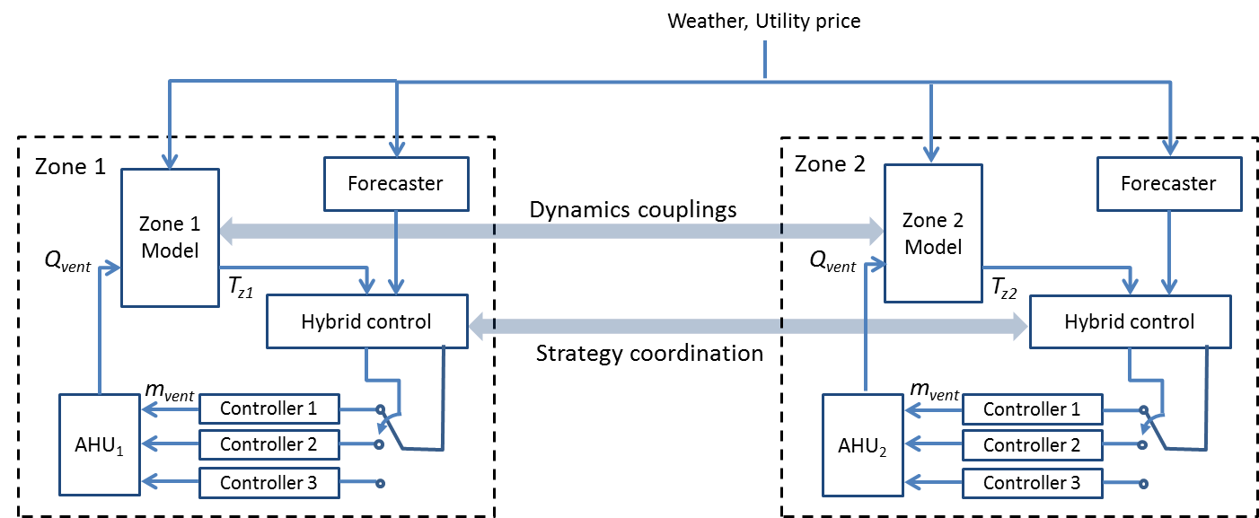
CPS: Synergy: Plug-and-Play Cyber-Physical Systems to Enable Intelligent Buildings
PI: Jianghai Hu, Co-PI: Panagiota Karava, Thanos Tzempelikos, James Braun, Purdue University
CPS Award 1329875, 1/1/2014-12/31/2016
Vision
Enabling Technology
Validation
Modular plug-and-play buildings design
Multi-Agent System Model of Buildings
Simulation Platform
A set of pre-engineered intelligent modules
Commissioned on site in a plug-and-play (LEGO) way
Flexibility to meet individual design objectives
Reconfigurability in building retrofit
weather
Power grid
BMS
AHU
Zone agent
actuators
sensors
Occupant agent
Purdue Living Laboratories
human
Supervisor agent
Sensing agent
Actuating agent
Agent-Based Controller Design
Housed in new Purdue Center for High Performance Buildings
Operational and fully instrumented starting October, 2013

