Slide 1
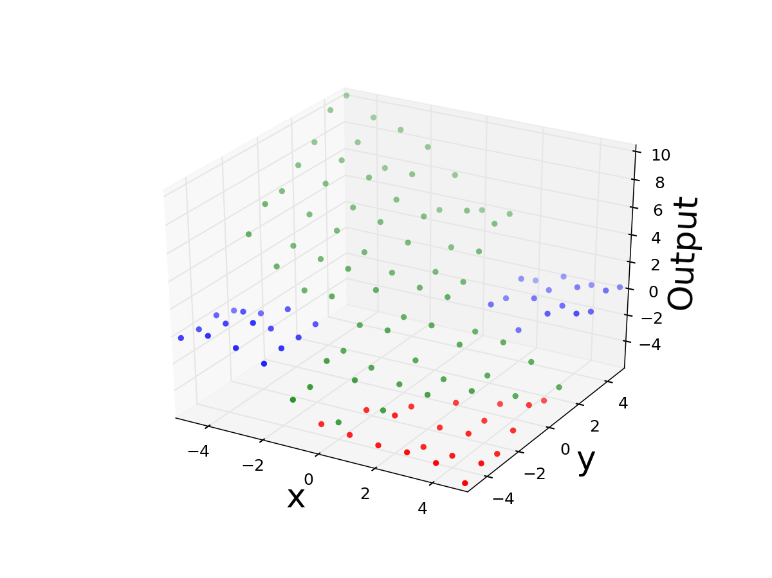
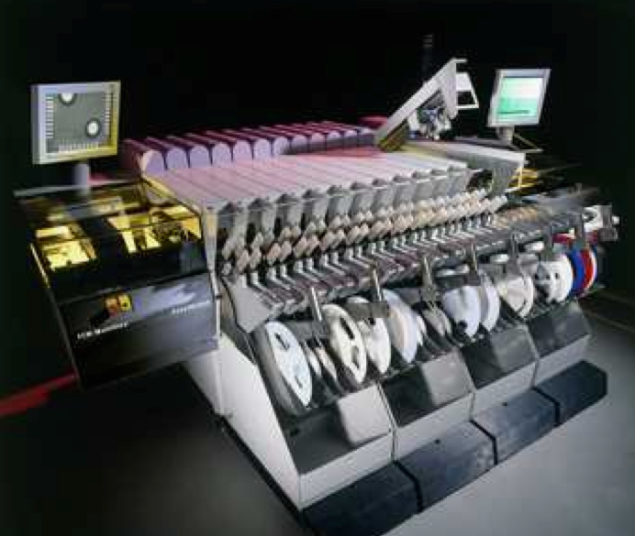
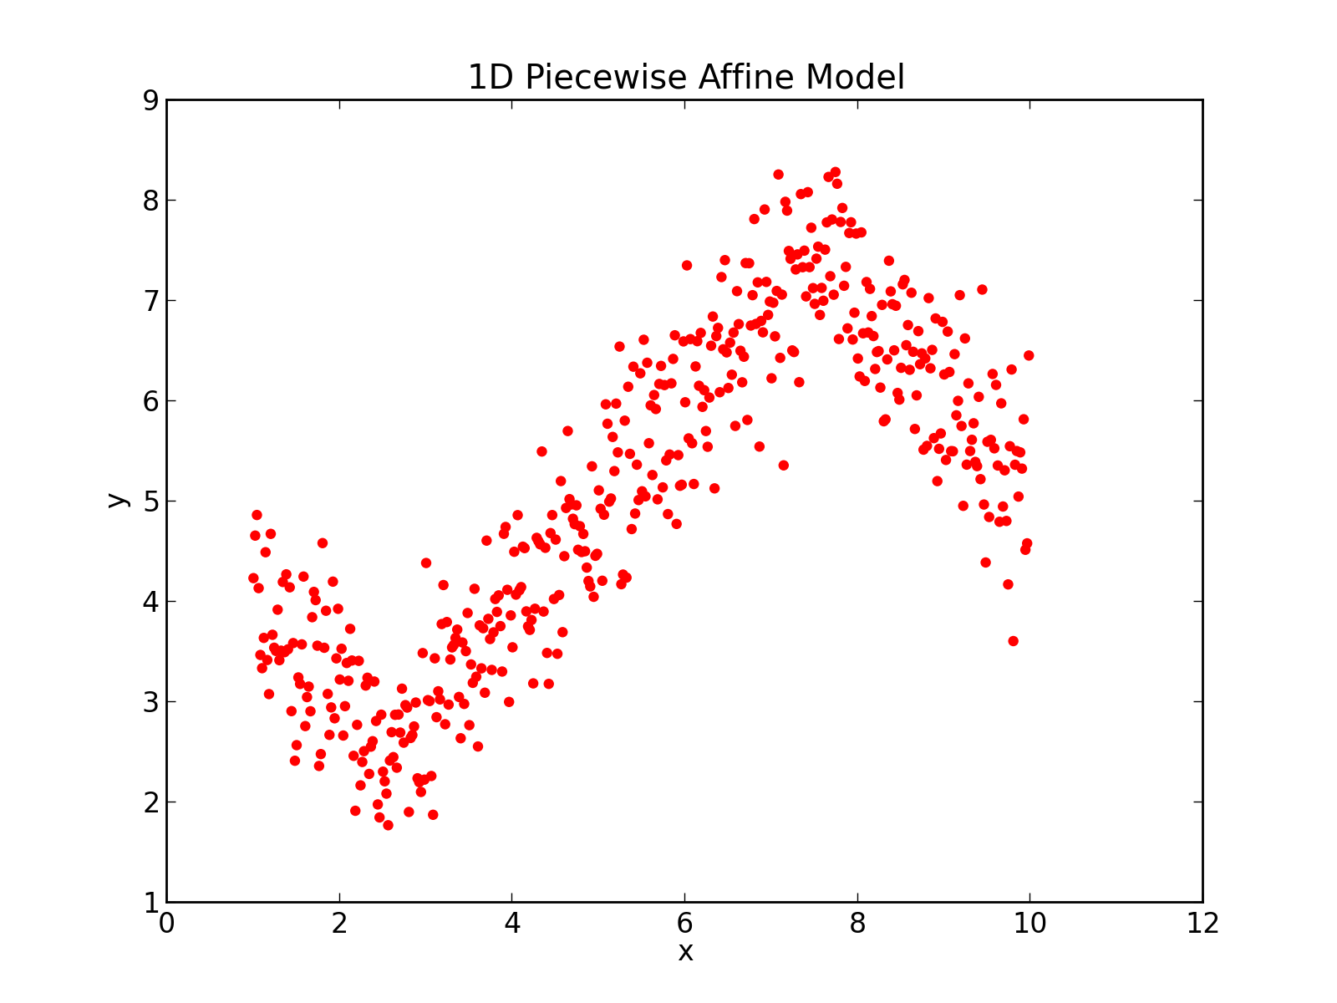
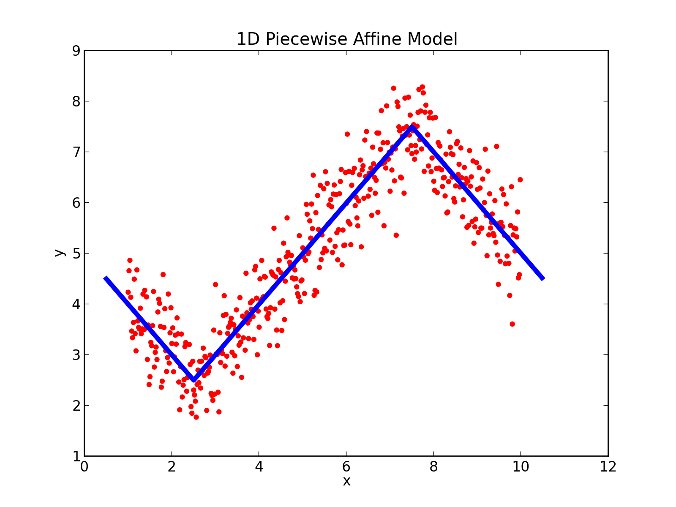
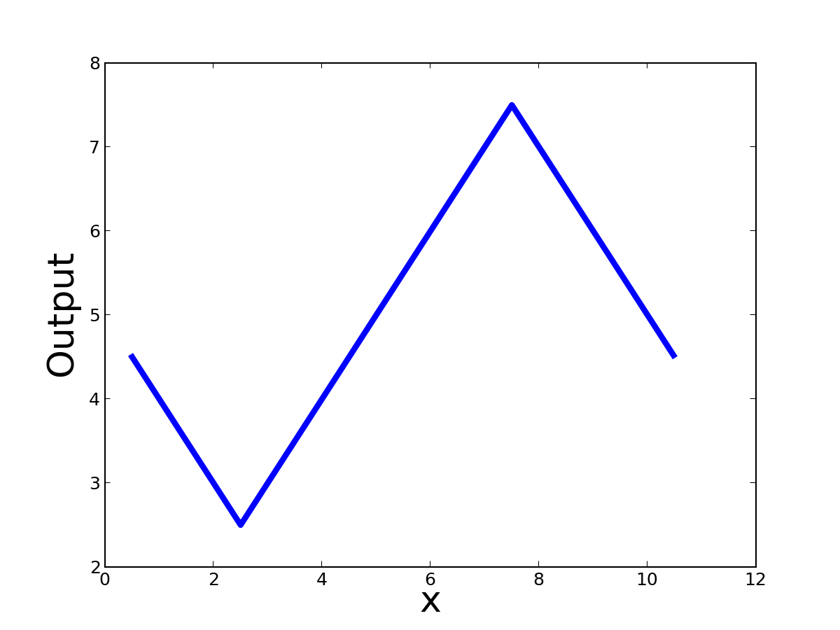
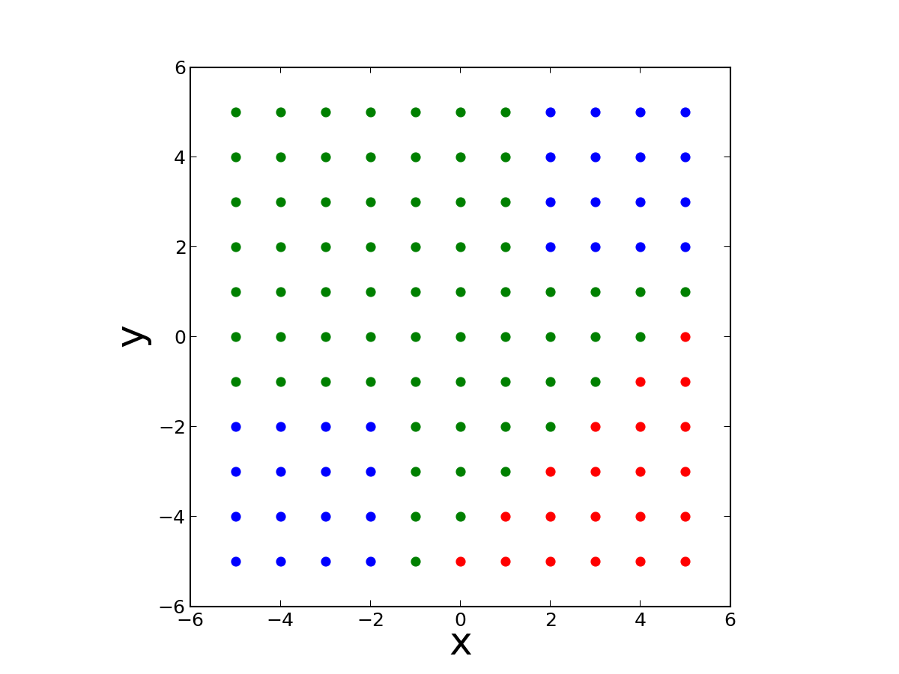
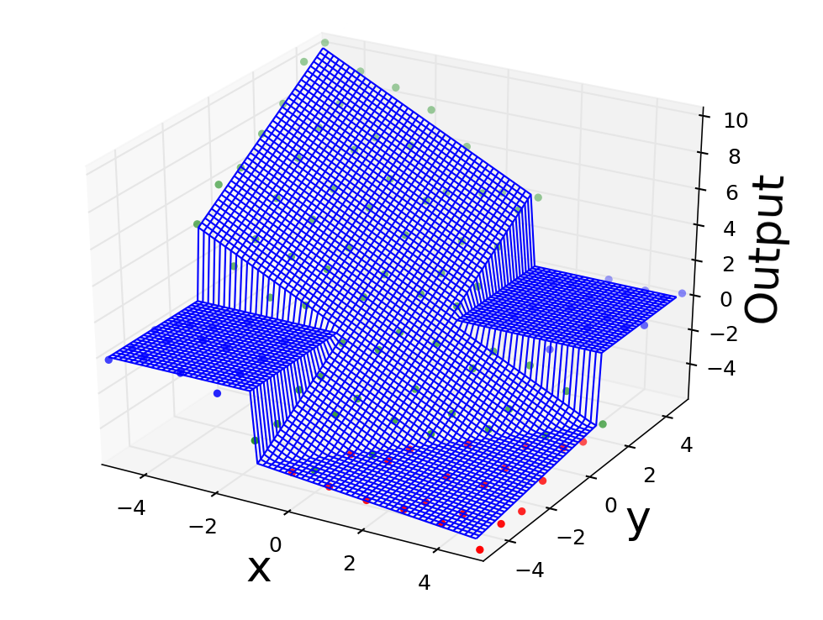
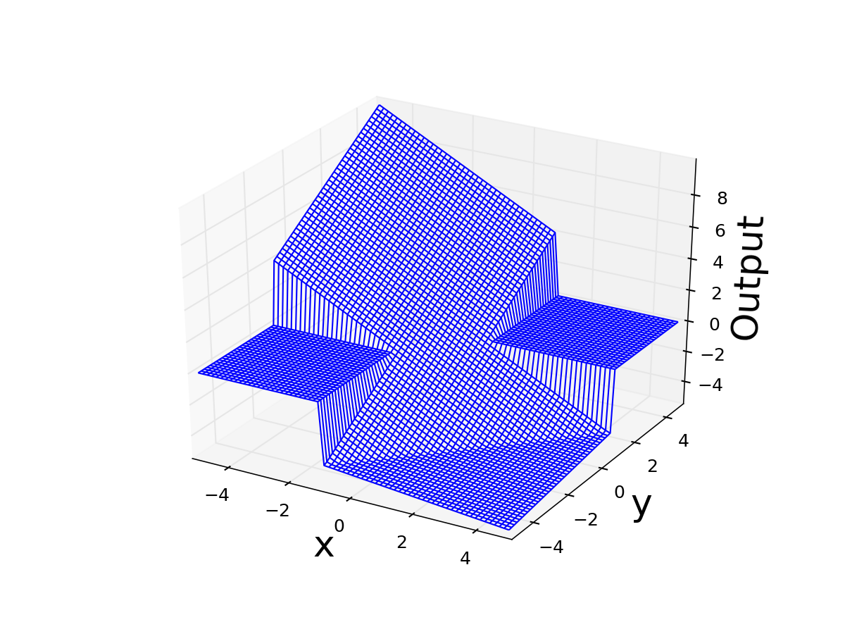
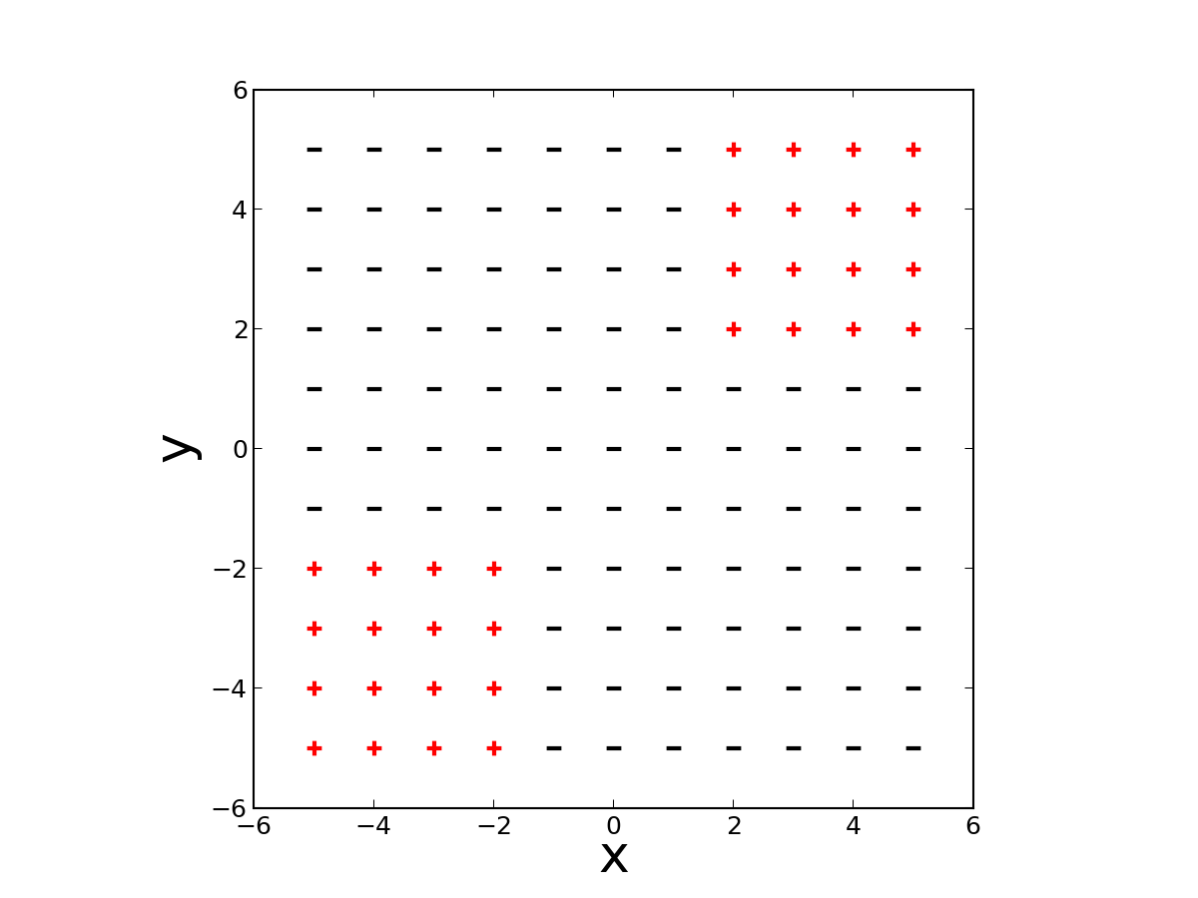
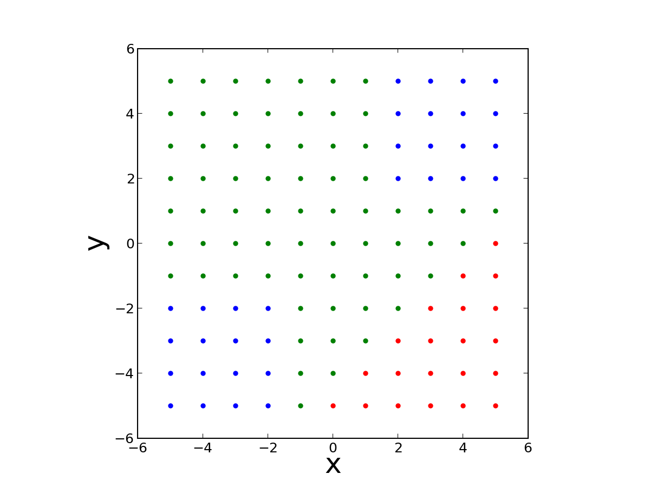
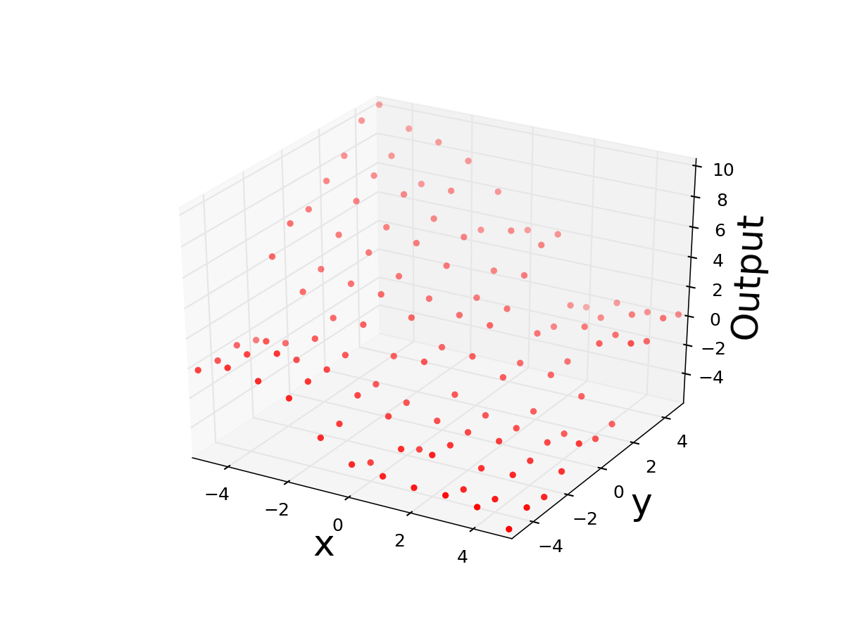
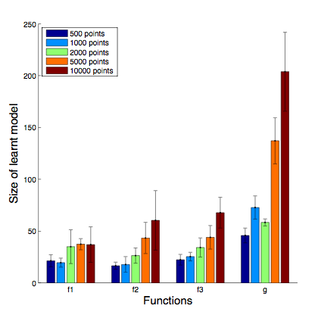
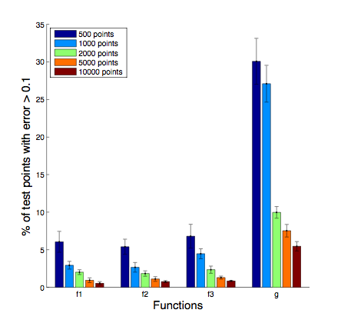
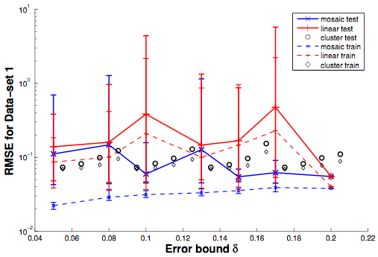
Precise Piecewise Affine Models from
Input-Output Data
Rajeev Alur and Nimit Singhania, University of Pennsylvania
Motivation
Solution
> δ
Real World Systems
Input Output Data
Piecewise Affine Model
l1: 0
l2: y - x
Complex
Data Driven Approach
Easy to Analyze
l3: (y - x + 16)/5
Piecewise Affine Models
Learning linear functions
l2: y - x
guard predicate
if ((x<-1 and y<-1) or
(x>-1 and y>-1))
0
else if (y < x-4)
(y-x+16)/5
else
y-x
if ((x<-1.5 and y<-1.5) or
(x>-1.5 and y>-1.5))
0
else if (y<x-4)
(y-x+16)/5
else
y-x
l1: 0
(x < -1 and y < -1) or
(x > 1 and y > 1)
y < x - 4
linear function
l3: (y-x -16)/5
(x<-1.5 and y<-1.5)
or
(x>-1.5 and y>-1.5)
2D Piecewise Affine Model
Learning guard predicates
￼
Problem
Evaluation
Synthetic Data
Data from Electronic Placement Process
Original size
Used to compare against existing approaches
MOSAIC - our tool
LINEAR - SVMs to learn guard predicate
CLUSTER - Clustering technique by Ferrari-Trecate et al. to learn linear functions
Input-Output Data D
Piecewise Affine Model f
Given Input-Output Data D: R^{d}xR and error bound δ,
learn a piecewise affine model f: R^{d}->R, s.t. for all (xi, yi) in D, |f(xi) - yi| < δ
Manually constructed 4 piecewise affine functions (f1, f2, f3, g) and 3 non-linear functions (p, q, r)
Works well for low dimensional data sets (f1, f2, f3)
< 5% test points with error > 0.1 (error bound δ) for models learnt with 1000 points and model size 2-3 times original size
Data by courtesy of A. Juloski and G. Ferrari-Trecate
Test RMSE generally smaller for MOSAIC in 3 out of 4 data sets - validates need for our algorithm in real scenarios
Train RMSE significantly small - Useful for representing data

