Slide 1
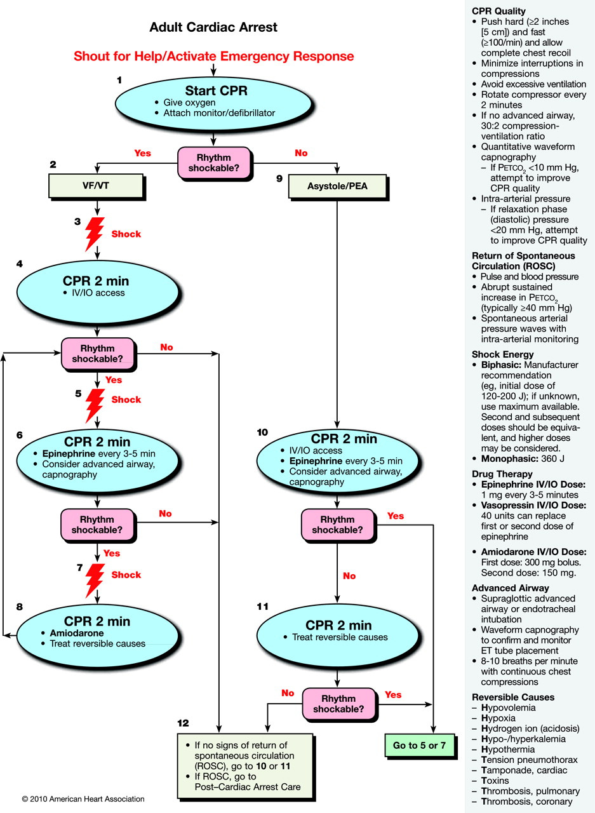
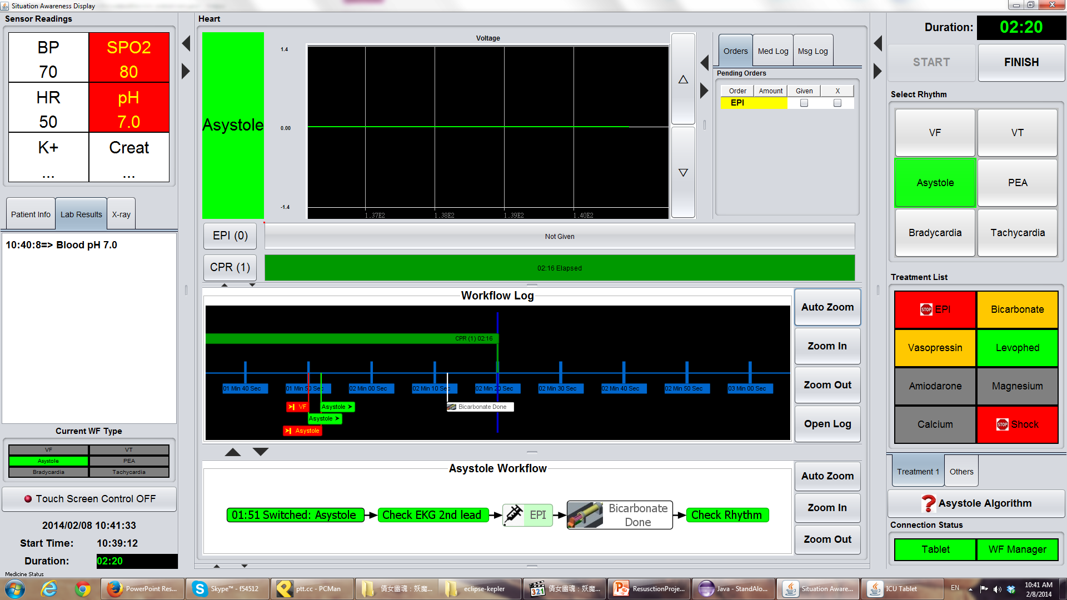
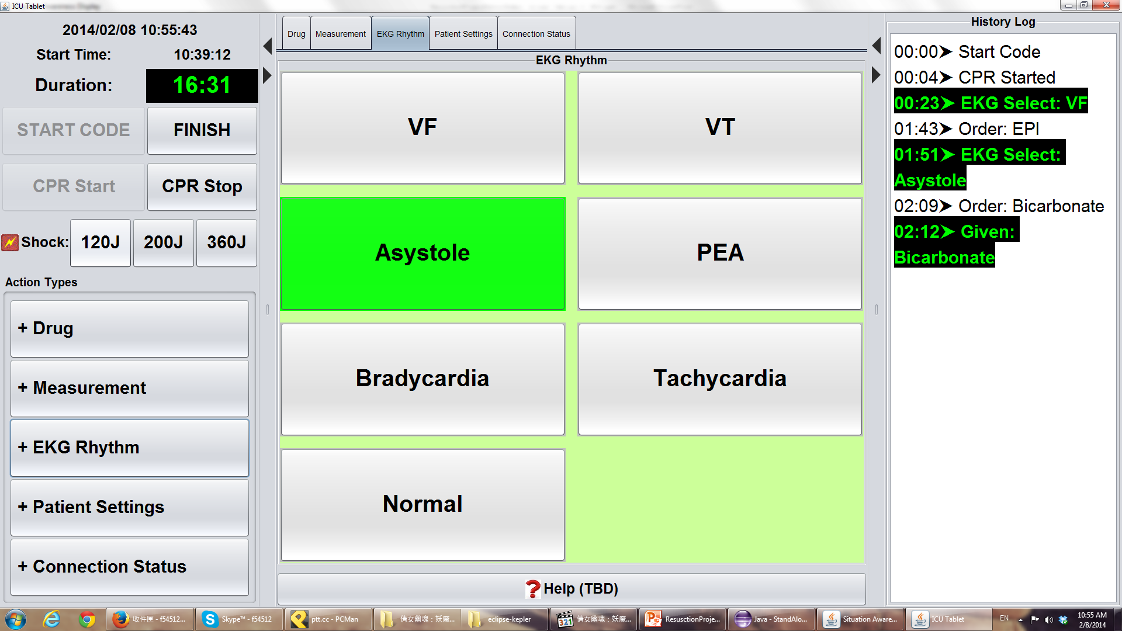
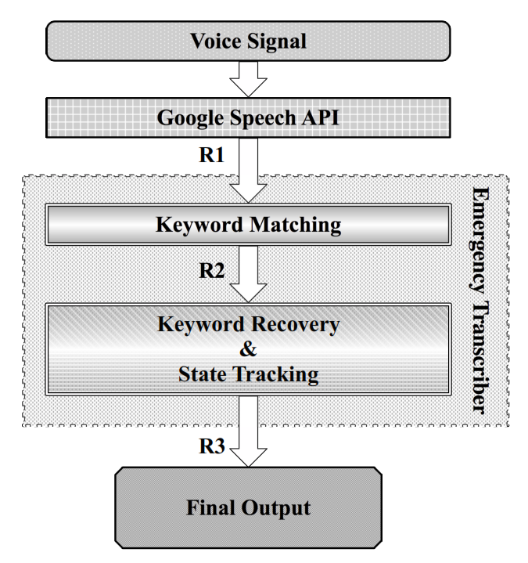
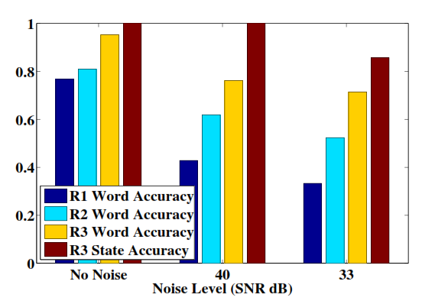
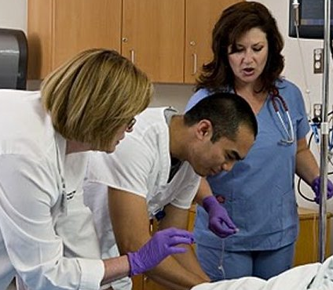
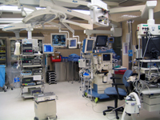
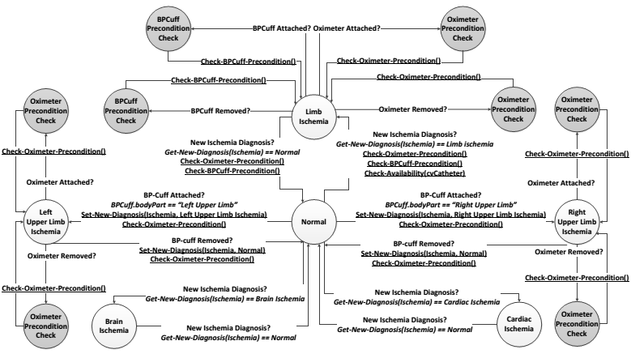
Department of Computer Science, University of Illinois
Intensive Care Unit, Carle Foundation Hospital
Lui Sha and Tarek Adel, CS UIUC; Richard Berlin, MD, and Karen White, MD, Carle Foundation Hospital
Poliang Wu and Yunlong Gao
Integrated Emergency Cyber Physical Human Systems
Abstract
Researchers from the University of Illinois at Urbana-Champaign in collaboration with physicians and nurses from Intensive Care Unit, Carle Foundation Hospital are developing a new initiative on engineering next generation of medical systems. This project is part of the initiative and focuses on exploring the efficient and safe operation of integrated Emergency Cyber Physical Human (ECPH) systems in emergency scenarios from the Intensive Care Unit (ICU) environment.
This project advances the science, technology, and engineering for a class of cyber-physical systems; namely, team emergency response systems, defined as those involving a small team of humans, who collaborate with engineered artifacts (e.g., sensors) and computing devices in life-critical, fast-changing environments, to avert imminent loss of life or property.
The Emergency Transcriber
Improving Team Situation Awareness
Developed Resuscitation Assistant System
Situation-Aware Data Recovery and State Tracking: In a medical environment, sensor data can be noisy. Data quality can be improved based on workflow knowledge, if different states were associated with different eligible data value distributions.
Application: The emergency transcriber. Records the operation of emergency teams using workflow knowledge to improve recording quality.
Results show improved resilience to acoustic noise and interference
Situation Awareness Display
Head Nurse
Physicians
Workflow Manager
Microsoft Surface
Treatment validation
Workflow Configuration
Medical Device Configuration Management
Requirements
Requirement 1: Integrity under fast-changing conditions.
ICU patents’ condition deteriorate
New initially-overlooked internal injuries uncovered
Requirement 2: Integrity in the face of errors, uncertainty and failures.
Errors and uncertainty will arise in data measurements
Failures will arise in tools to complete mission.
Device Interoperability
Treatment Validation
ActivateDefibrillator
Airway
&
Rhythm
==
Breathing
Shockable
Urine flow rate become lower than 12 due to kidney function degradation.
The side effect of bicarbonate may adversely affect patient’s breathing.
AssistedVentilation
InjectEPI
BloodPH
>
UrineFlow
7
.
4
>
12
mL
/
s
Challenges
Inject
IncreaseIVFluid
Device Configuration Safety in Acute Care
-
SodiumBicarbonate
High mental workload increases the likelihood of medical errors
Timely and correctly perform treatments while monitoring patient responses is critical for patient safety.
Treatment validation is essential and consists of three aspects
Precondition
A treatment can be performed only if the preconditions are satisfied
Potential side effects
The side effects of a treatment may adversely affect other treatments or invalidate previously satisfied preconditions
Expected patient responses
The effectiveness of a treatment is non-deterministic
The purpose of this work is to assist medical staff to correctly perform treatments rather than automatically performing treatments.
The safety and efficacy of acute patient care depends on continuously proper use of medical devices.
The device configuration safety depends on the rapidly changing patient condition
Ex: a blood pressure cuff can give erroneous measurements for a patient with limb ischemia.
We model the patient condition as communicating organ state machines
The states are represented based on a pathophysiological model
The medical errors may cause severe complications
The degradation of patient conditions further increases the cyber-physical complexity
The Cardiovascular Organ State Model for Ischemia Syndrome and Relevant Device Configuration Safety Constraints

