Slide 1
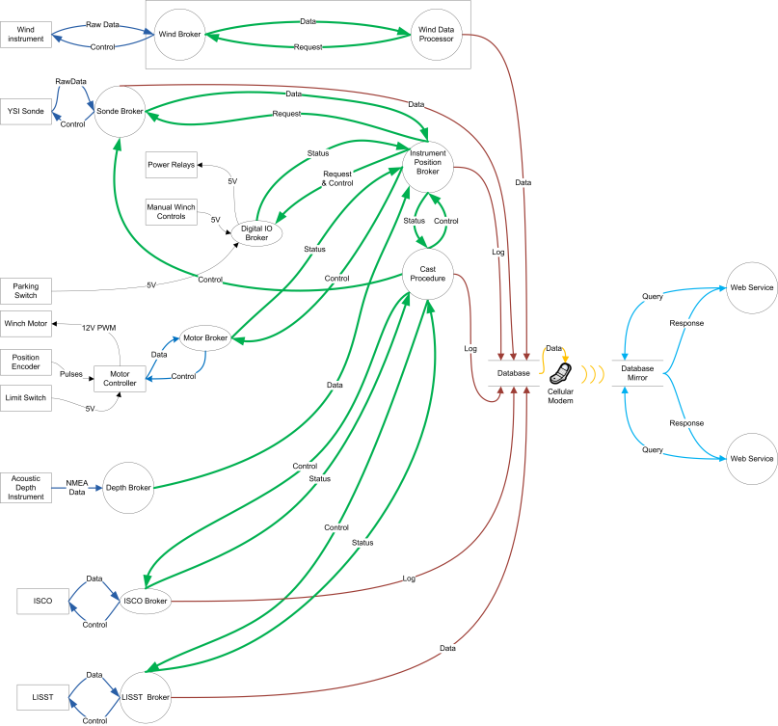
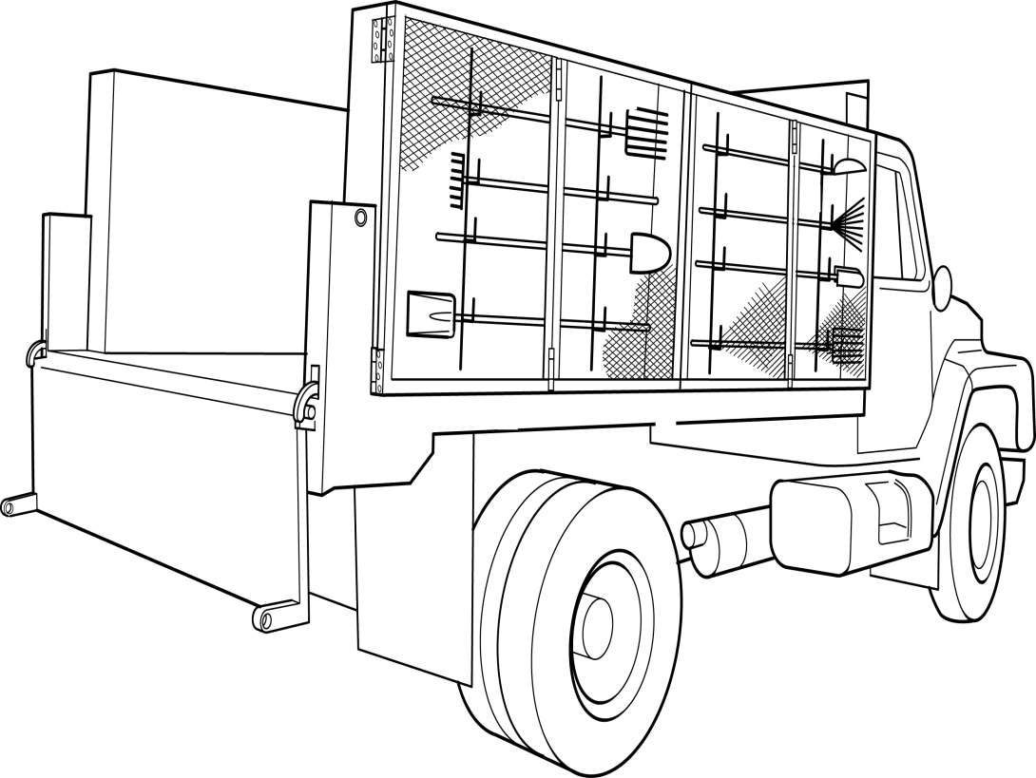
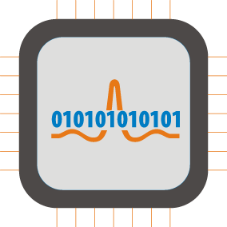
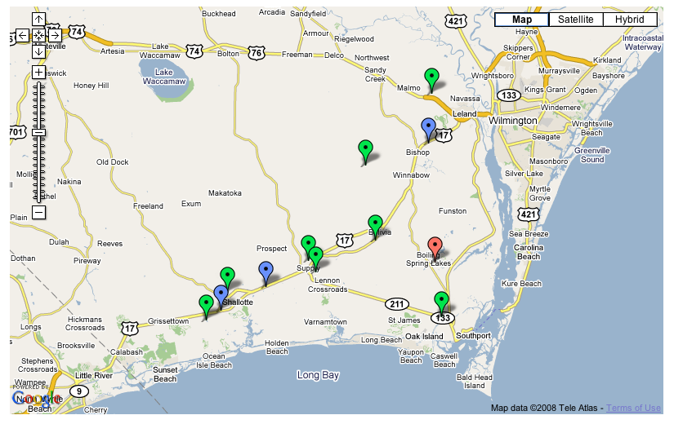
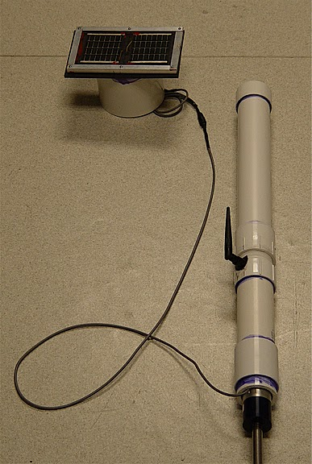
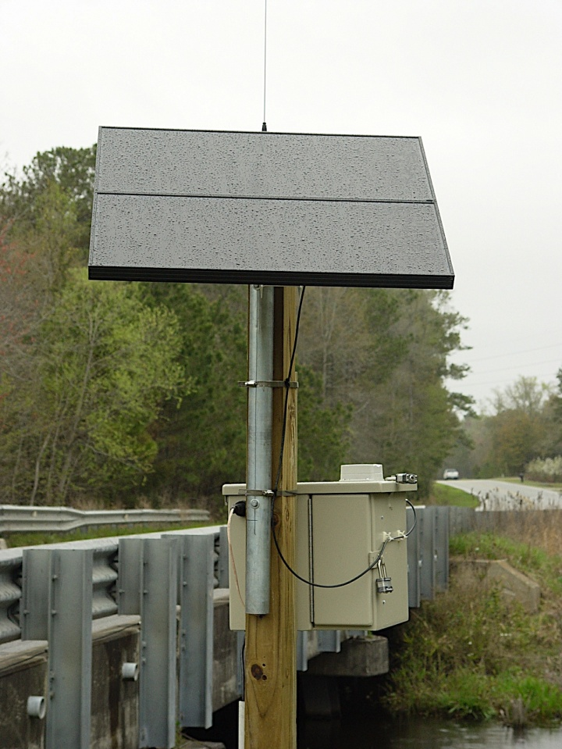
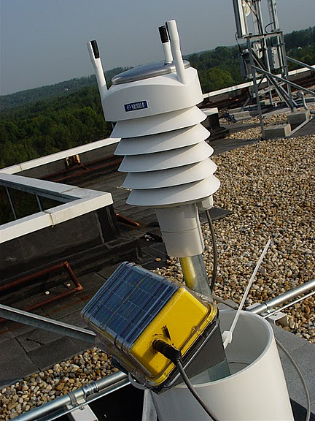
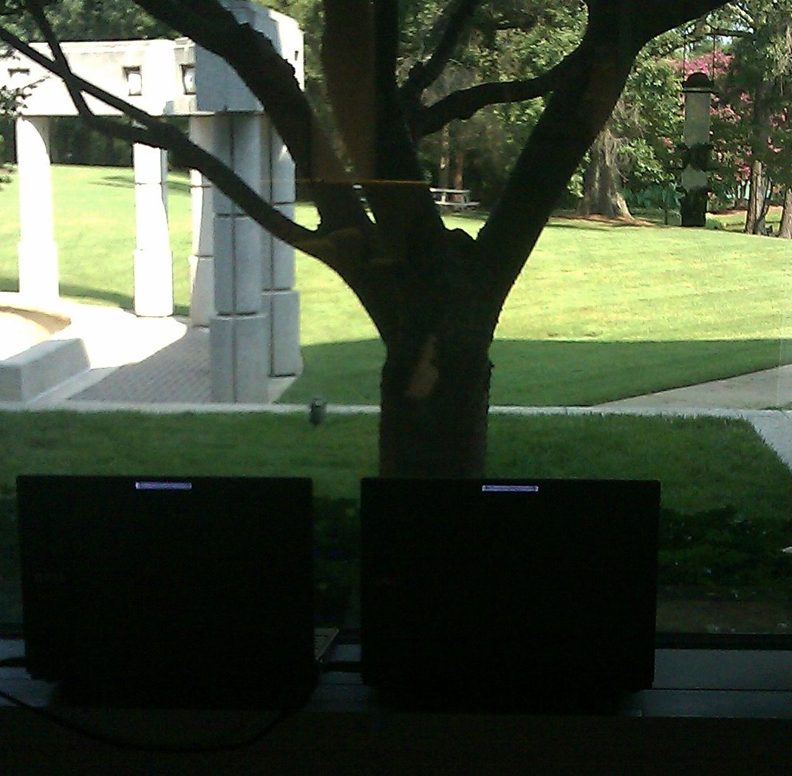
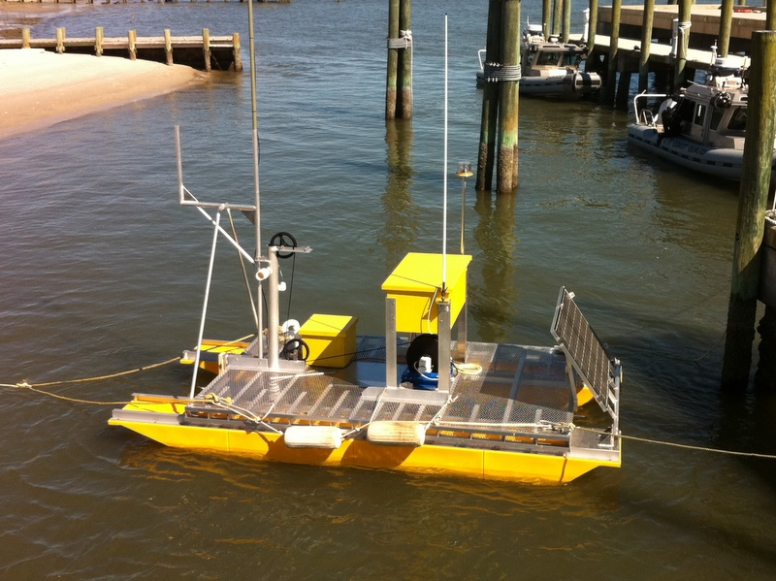
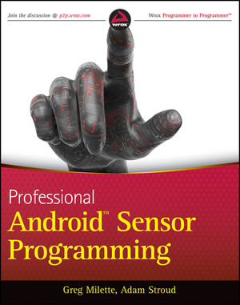
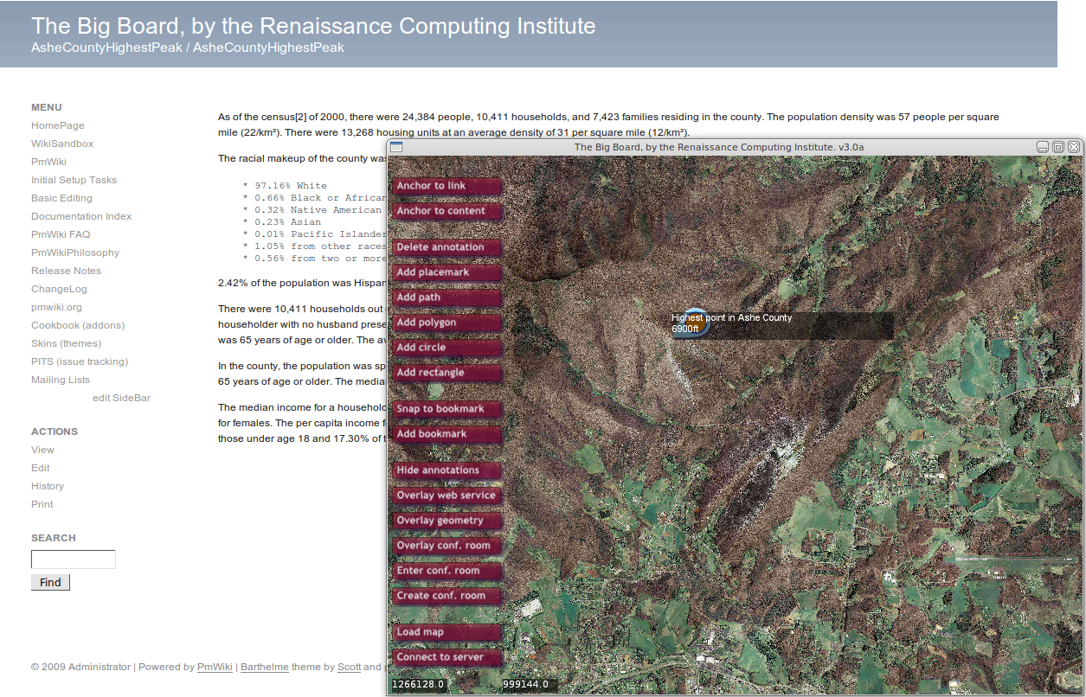
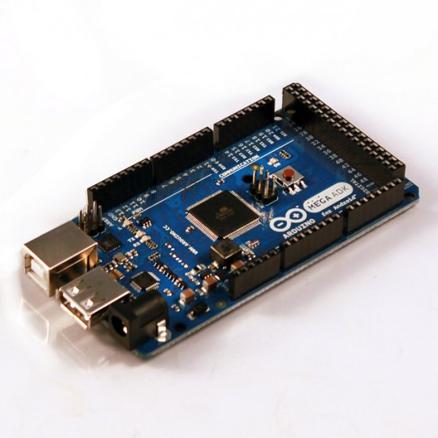
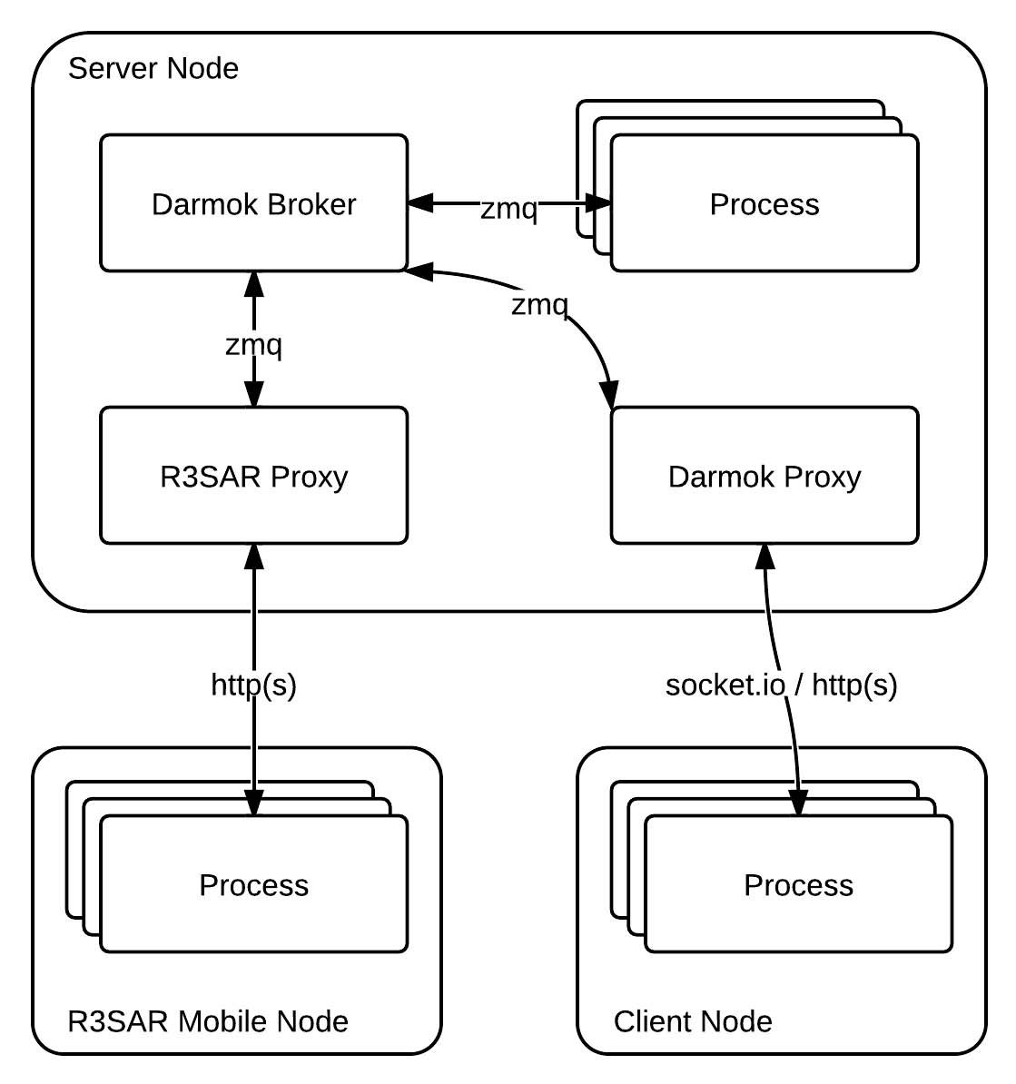
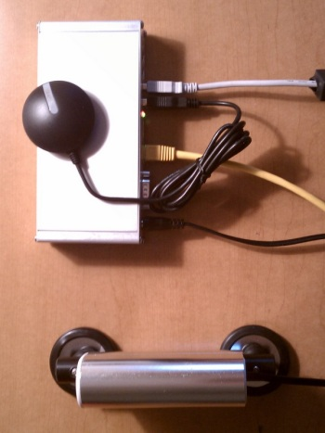
Programming Environment and Architecuture for Situational Awareness and Response* Robert Fowler, Jefferson Heard, Daniel Bedard, Yusuf Simonson, Roberto Rodriquez Renaissance Computing Institute (RENCI) rjf@renci.org jeff@renci.org
* This work is supported by NSF CNS-0932011
Vehicle-mounted sensor cluster architecture:
Use emergent consumer hardware:
Android devices for processing, integrated sensing and communication.
Arduino controllers to act as a hub for external sensors.
Administrator registers device sensor configuration with SensorCollection, which produces a QR-code to be mounted near the sensor environment, e.g., the dashboard the vehicle.
Hardware mounted on the truck: Sensors + Arduino + Bluetooth dongle
Android phone scans code
Code registers device with SensorCollection, which returns an APK app to the device to download.
User starts app, which collects data in the background.
Symbiotic Projects
Rapidly deployable, Robust, Real-time Situational Awareness and Response (R³SAR)
RENCI’s Standard Approach for Sensing Platforms
Goal: Improve deployability of sensing systems
Efficient design and deployment; reduced costs in hardware, labor and operation
Dynamically configurable sensor platforms and collection facilities.
Driving Problems: Environmental sense/react
Civil response to environmental emergencies: fire, flood, wind, etc.
DHS and DoD problems
Cost-effective sensing for field sciences
General Approach:
Explore and extend data-oriented, declarative abstractions
Relational data
Composable, streaming “pipelines and filters” implementations
Abstract “overlay networks” for communication
QoS constraints and properties
Optional lossy filtering
Annotation of plug-n-play components
Exploit economies of scale by leveraging consumer market hardware.
Netbooks, Linux tablets, Android devices.
“Maker”-inspired hardware: Arduino, etc.
Industrial embedded Linux processor, solid state disk
Additional microcontrollers
3G modem, other radios.
On-board database: SQLite, PostgreSQL
Synchronize platform DB with base RDBMS
Analysis and decision support layers query RDBMS
Geo-referenced data displayed on The Big Board; client apps use web services
Understood by specialist engineers. Can we do better?
Storm surge flood sensing in estuaries RENCI and Brunswick County EMS.
1. Scan
2. Register Device
4. Collect data and send
Sensor +
Arduino +
Bluteooth
Internet base stations (PC104/Linux) connected to EMS with failover using wired service, cellular modems, AV.25 on trunked EMS radio.
Results distributed via (Mobile) Web.
Base-station to sensor node (SunSpot) connectivity via wire, Bluetooth, Zigbee.
Sensors: flood level, robust weather stations.
Ample battery capacity for hurricane events with PV chargers.
→ Real time data to County EMS
→ Data assimilation for calibration of ADCIRC storm surge model.
Early R3SAR Activities:
Deployed experimental platforms: TelosB and
Sunspots mote-like devices, embedded Linux
MAEMO, Android, …) netbooks and handhelds.
Software prototyping and experimentation.
Evaluation and (re-)design of related project software.
Sense/reduce prototype.
Campus WiFi base station signal strength capture and mapping using Nokia Linux tablet.
Control interface for “Tables” on early Android phone. (Spreadsheet-like device for sensor control/filtering.)
Video streaming and filtering pipeline.
Bird feeder monitoring/response.
No seed, no birds → Alert staff
3. Download app and configure to collect
Geoanalytics Sensor Collection Infrastructure
Automated Vertical Profiler Buoy
Metamodel for sensor data
Based on MongoDB, PostGIS.
Takes mobile or stationary sensor data, metadata, and provides indexing, query, RESTful API, and reporting capability.
Integrates with Geoanalytics Framework to provide sensor data management and publishing through IRODS and OWS web-services (WFS,WMS)
UI provided through Geoanalytics BigBoard collaborative environment (Teleconferencing over maps)
Multi-parameter (T, salinity, turbidity, depth) sonde
Water sampler/lab
GPS
Precision winch with depth indexing
Low-power x86 controller with SSD
On-platform PostgreSQL
Cell modem connectivity to server
Stereo video with Linux netbooks.
Metadata
indexes
Spatiotemporal
indexes
Meanwhile …
SensorCollection
Static Sensor
(X,Y,Z) or geometry.
Sensor Metadata.
Smartphones have become ubiquitous and cheap.
Phone processors exceed the capability of 1970s Cray-1 supercomputer.
Open source Android application programming is widespread.
With care, if radios are used at ~5min intervals, battery lives of up to 1 week possible. ~1 minute interval → 2.5 day lifetime.
Android systematizes sensor interfaces, provides on-device RDB.
Bluetooth communication is universally available.
Many Android devices support Android Open Accessory (AOA) API and driver to connect to an external microcontroller acting as a USB host and sensor controller.
Highly-capable, powerful, compact, economic sensor hub devices are here.
But … Systems are not fully open, cluttered with consumer apps, vendor and provider tracking services, …
T.
Data.
Metadata.
The Big Board
Mobile Sensor
Recent data points
Visualization wall for situational awareness
Base map + state orthophotos
Database/GIS interfaces
Interactive annotations
Mobile interfaces
Sensor Metadata.
IRODS
Older data
And indices
Collection
Metadata
(X,Y,Z,T)
Data.
Metadata.
Recent data points
Darmok: Alternative Communication Infrastructure
RENCI Road Surface Temperature Thing (RRSTT)
The Consumer Microcontroller is here
Arduino designed by and for artists.
Integral digital and analog I/O.
Ecosystem of “shields”, add-on sensor and actuator interfaces, radios, etc.
Widely available, e.g., now sold in Radio Shack stores.
Simple real-time programming model and IDE.
Models designed specifically for use with AOA.
Support for scalable implicit communication for crowd-sourced sensing
Combines generative (Linda-like) and publish-subscribe idioms.
Written in Go language for Android sense and respond devices.
Demonstration application using “twitter scraping” for timely earthquake alerts direct to end-users.
An MS Thesis project now being used by a crowd-sourcing startup.
Vehicle-mounted monitoring of rural road conditions
First prototype used industrial embedded Linux, discrete GPS, radios, power, etc. components.
Deployable design uses the R3SAR software/hardware architecture.
To be mounted on public safety vehicles, school buses, etc.
Decision support information on which roads should be salted or plowed, and whether school should be cancelled

