Slide 1



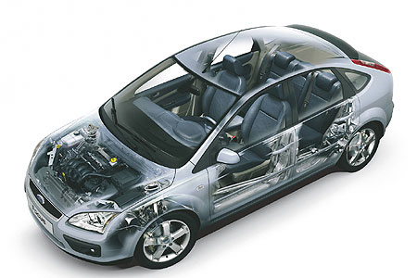
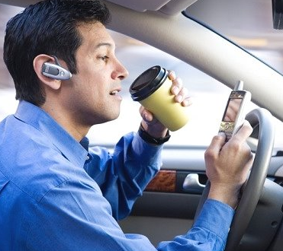
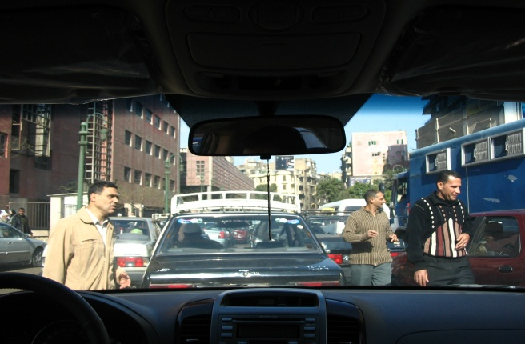
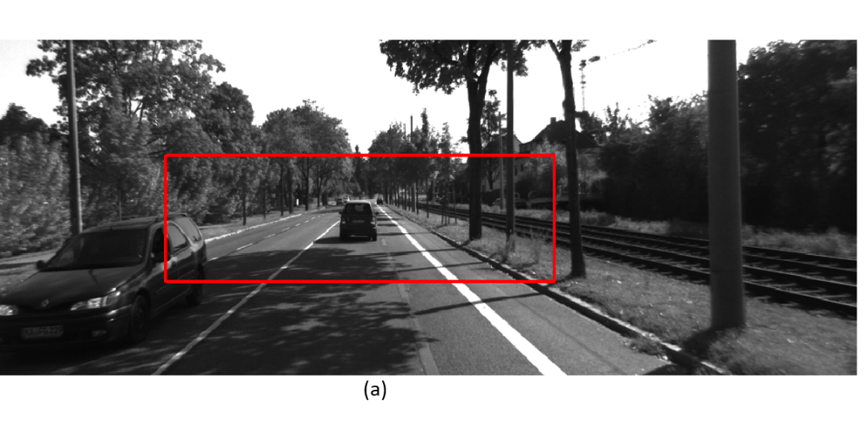
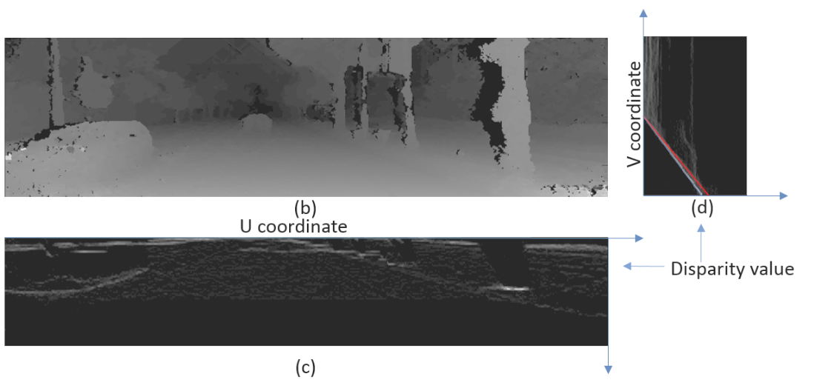
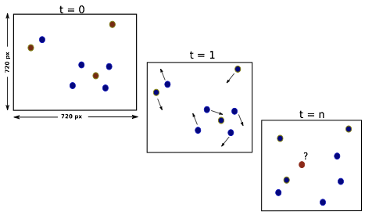
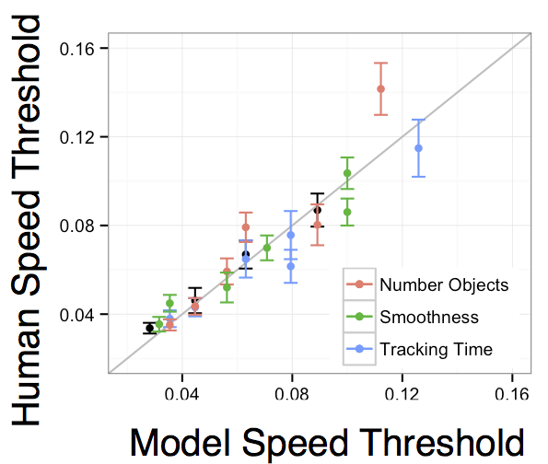
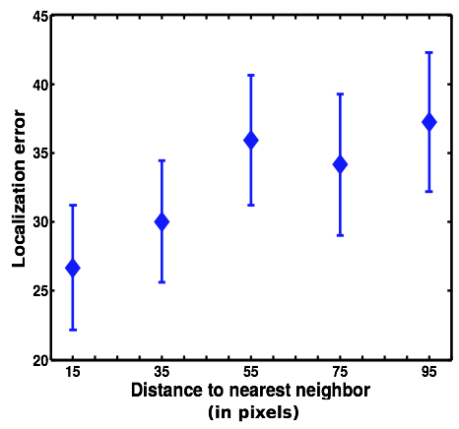
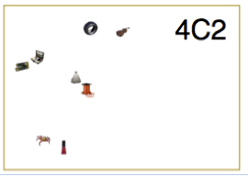
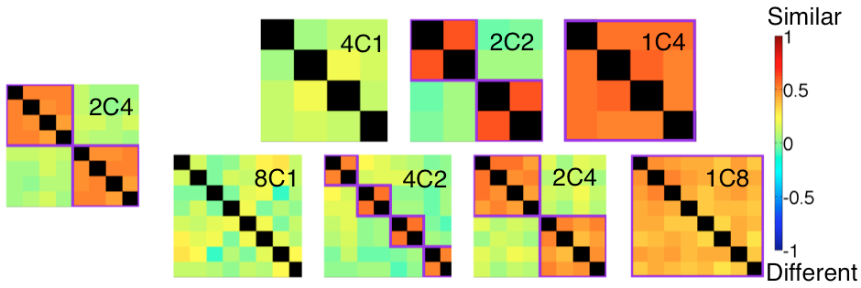
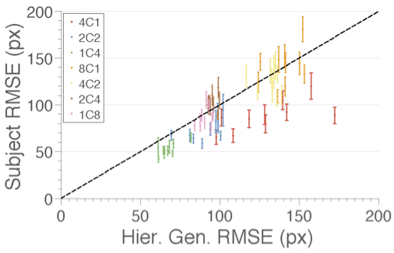
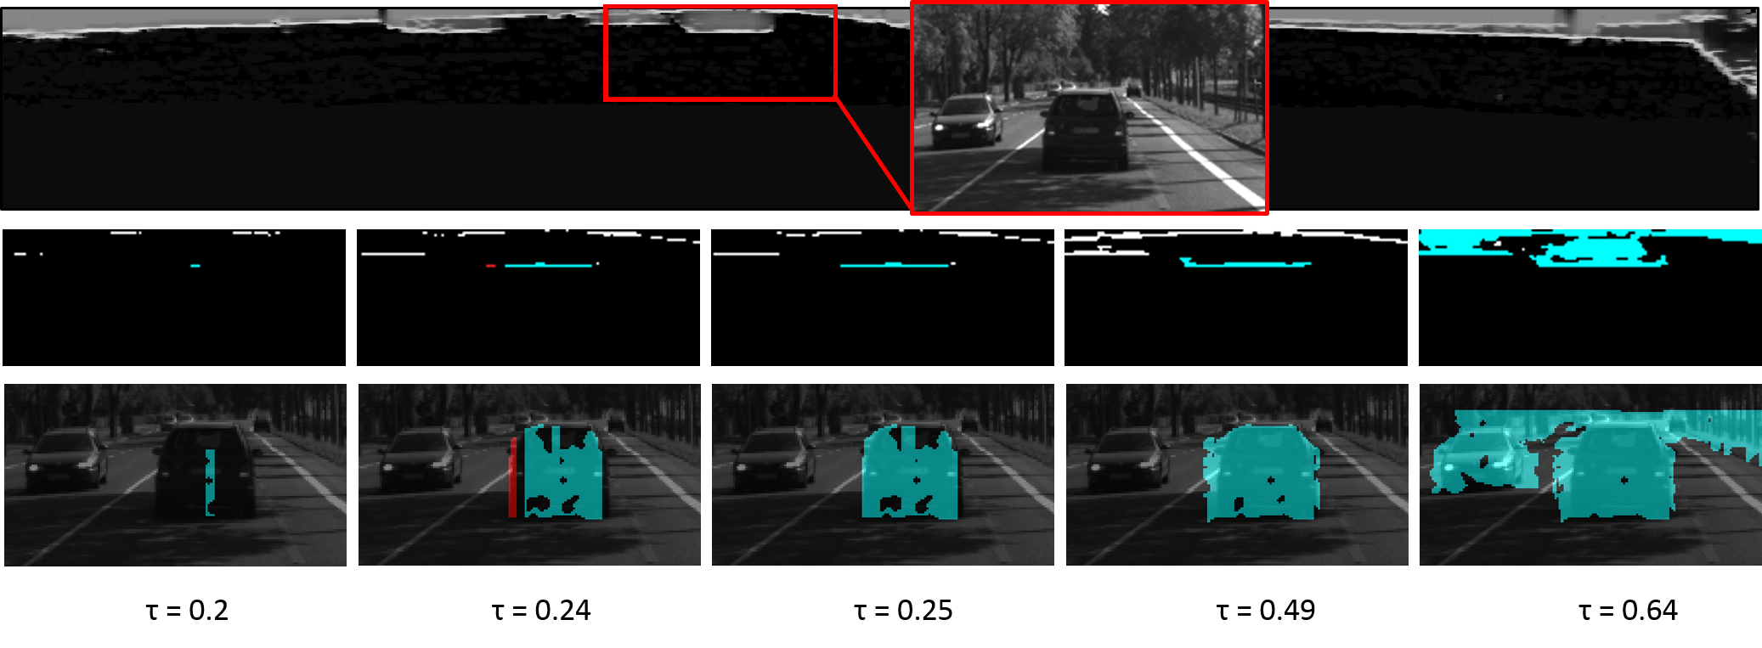
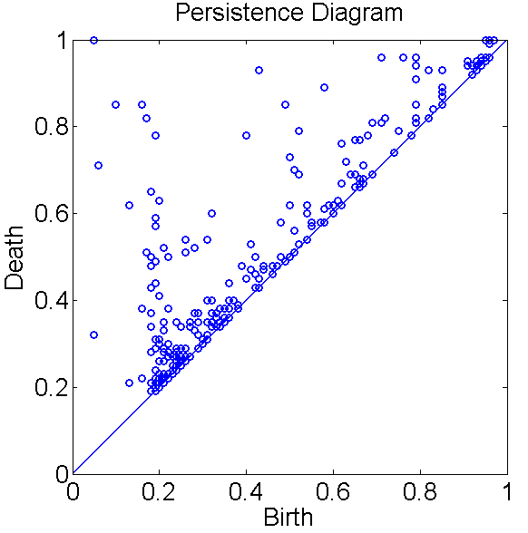
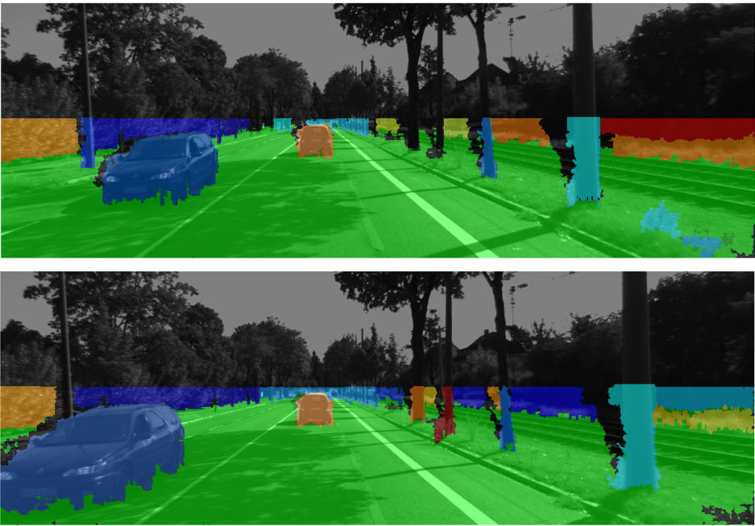
Provably Safe Automotive Cyber-Physical Systems with Humans-in-the-Loop
F. Borrelli, R. Bajcsy, J. K. Hedrick, E. Lobaton, E. Vul
A. Carvalho, K. Campbell, Y. Gao, Q. Ge, A. Gray, T. Lin, C. Reith, V. Shia, K. Smith
University of California, Berkeley
Industrial Partners: Hyundai Motor Company, Ford Motor Company, Volvo Cars
Background
Current Results
Increasing content of electronics, advanced control architectures and communication with the vehicle and environment is changing the way humans interact with vehicles.
Enormous gap between research achievements in autonomous driving and active safety systems available in production vehicles.
Developed a unified framework based on Model Predictive Control (MPC) for the integration of a stochastic driver and environment model with a vehicle controller
Focused on three areas:
Environment
Human
Modeling of uncertain driver behavior
Developed models to predict how humans track multiple objects and allocate memory during tasks that require attention.
Certified 3D scene reconstruction
Improved the robustness of the obstacle detection framework using a topological diagram of occupancy map. Started work on a stereo vision system that will be implemented in the test vehicle.
Design of probabilistically safe active safety controller
Developed a stochastic model predictive control (MPC) strategy to account for uncertainties due to the environment, driver behavior and modeling errors. Performed experiments on a passenger vehicle to show real-time feasibility.
Objectives
Systematic and human-centric autonomy in vehicles:
Develop a vehicle CPS where the degree of autonomy is changed in real-time as a function of certified uncertainty ranges in driver and environment behavior.
Robustly guarantee vehicle safety during design with respect to the certified uncertainty ranges.
Characterize uncertainty in environment and driver using large data sets.
Develop a control and integration framework that is real-time implementable on standard computing platforms.
Active
Safety
System
Vehicle
Driver Models
Provably Safe Real-time Control
3D Scene Perception
Background
Human driving consists of generally calibrated control with occasional lapses of attention.
Driving requires constant updating and extrapolation of the positions of only intermittently observed vehicles.
Background
Control algorithms for semi-autonomous vehicles must account for the uncertainty due to unpredictability in the driver’s actions and the environment
Robust control approaches for dealing with uncertainty assume worst-case disturbances and may increase the intrusiveness of the driver assistance system
Background
Navigation relies on the robust identification and tracking of obstacles in the scene. Depth information can be captured using lidar, radar or visual-stereo information.
Objectives
Develop a model of driver behavior based on approximate (sampling) inference
Characterize how people track and extrapolate world states
Use this model to predict the error of the driver in control of our vehicle, as well as other drivers on the road.
Objectives
Trade-off risk and conservatism by using the framework of stochastic model predictive control
Development of a framework for provably safe execution in real-time.
Objectives
Create an accurate and robust geometric model of the environment in real-time. The model should include obstacles and their trajectories in 3D space.
Quantify the uncertainty of such detections.
View from the vehicle’s perspective.
Current Results
Developed a multiple object tracking model that can capture performance variation across conditions and trials.
Designed a strategic attention/memory allocation algorithm that can account for which objects are remembered more or less well.
Developed a non-parametric spatial encoding model that captures human error patterns in spatial memory for multiple objects.
Current Results
Extended work on stochastic MPC for active safety applications
  Framework can handle linear time-varying dynamics models where the linearization is performed online
  Developed real-time forecast model for surrounding vehicles
Current Results
Robust Obstacle Detection
  Built and calibrated stereo vision system to go on vehicle. Obstacle detection is performed via clustering on the probability of occupancy map obtained from he depth map.
Depth map and its UV-projections are used for obstacle detection.
Scenario in which target vehicle changes lane in front of host vehicle
Environment model detects lane change and plans path around target vehicle
  Robustness is defined based on the number of regions that are introduced or removed as a parameter in the detection algorithm is changed.
  Robust detections are obtained using the topological persistence diagram (a tool from topological data analysis) of the probability of occupancy map.
  We observe an improvement on robustness of a factor of 5.
Multiple object tracking: Our ideal tracking model captures patterns of human speed thresholds across multiple conditions. With a rational cognitive resource allocation policy this model predicts which objects are remembered more or less successfully, indicating that we can predict how people pay attention strategically.
Examined the effect of tuning the risk parameter on controller behavior
  Lower probability of constraint violation leads to more intrusive but safer behavior
Lane keeping assistance with distracted driver
Lower violation probability results in earlier intervention by the controller
Planned paths using nominal approach are closer to lane boundaries
Hierarchical encoding of spatial arrangement of objects: People encode groups objects in a hierarchical structure, as evidenced both by their error correlation patterns in multiple item report, as well as the success of a computational cognitive model that embodies non-parametric clustering to spatial encoding.
Experiments on a passenger vehicle demonstrate real-time feasibility of
MPC-based architecture
Hierarchical clustering on the U-Disparity space used to detect obstacles (left). Persistence Diagram on the occupancy map (middle). Samples of robust segmentation obtained by selecting persistent components (blue dots in shared area of persistence diagram) from the hierarchical clustering (right).
Next Steps
Combine prior physical path-filtering algorithm with multiple-object tracking in real world driving.
Apply hierarchical encoding to driver environment modeling with cognitive capacity limits.
Factor control models into planning and low level controllers to facilitate across-driver generalization
Next Steps
Integrate robust segmentation into robust tracking and object classification and analyze correctness of approach.
Real-time detection and tracking of objects.
Tracking performance
Winding track at proving grounds
Next Steps
Test driver assistance system in more complex scenarios involving other moving vehicles

