Slide 1
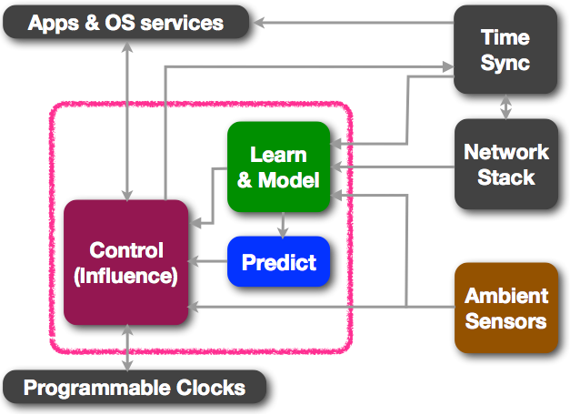
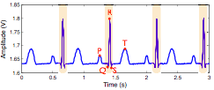
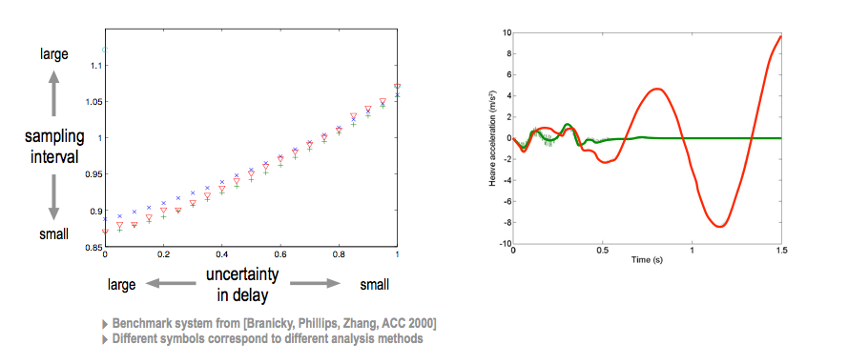
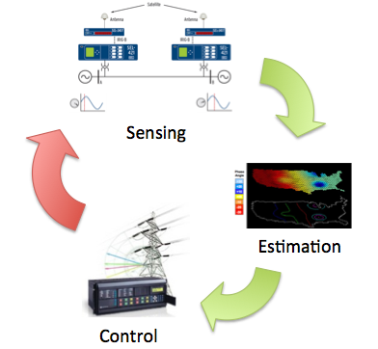
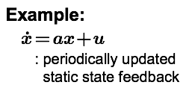
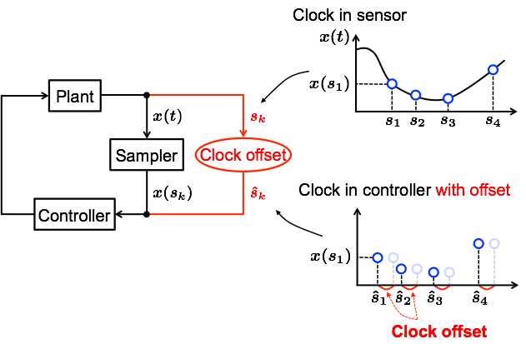
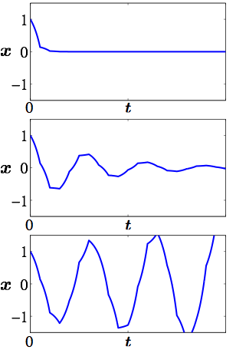
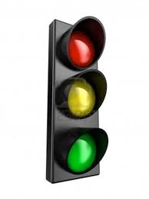
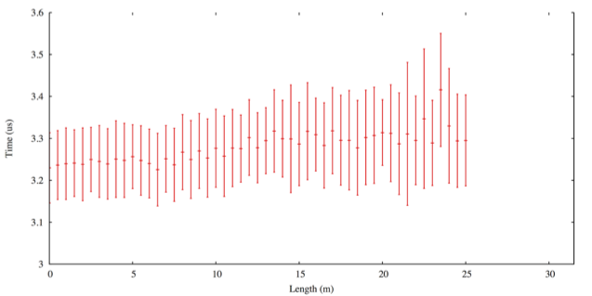
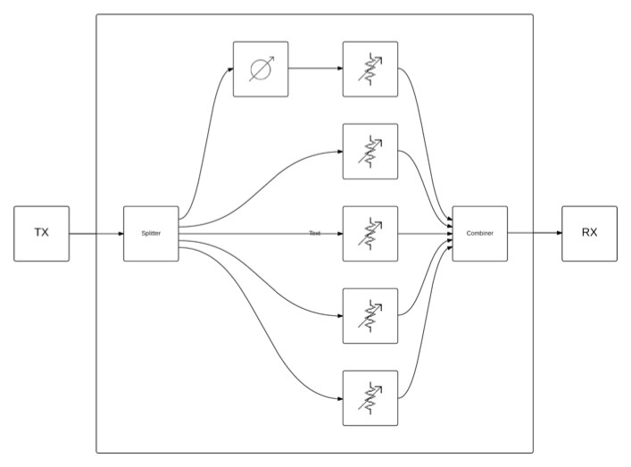
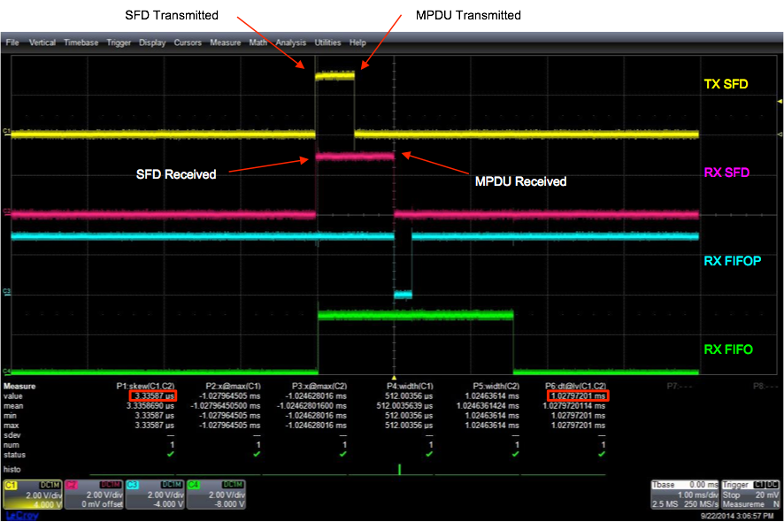
ROSELINE: Enabling Robust, Secure and Efficient Knowledge of Time Across the System Stack
Award # CNS-1329755 (UCLA), CNS-1329644 (CMU), CNS-1329644 (UCSD), and CNS-1329650 (UCSB)
Type: Frontier; Start Date: June 2014
PI: Mani Srivastava (UCLA)
Co-Investigators: Rajesh Gupta (UCSD), Joao Hespanha (UCSB), Sudhakar Pamarti (UCLA), Neal Patwari (Utah), Raj Rajkumar (CMU), Anthony Rowe (CMU), Thomas Schmid (Utah)
Making Quality of Time Visible & Controllable
Rethinking the System Timing Stack
ROSELINE seeks to transform the uncertainty in time in a computing system into a rich structure called “Quality of Time” (QoT) that is observed and systematically controlled throughout the system.
Time-aware
Applications
Apps
adaptation
Time-related
APIs
QoT = f (clock sources, network, ambient)
Time-based
Services
OS
e.g. Δ
adaptation
N/W
Sync
e.g. f, J
Ultra-low Power Wireless Sensors for mHealth
Real-time Structural Health Monitoring
Spectrum-efficient Wireless Devices
Time
Measurement
Hardware
adaptation
Clock
Distribution
e.g. f, J, Tsu
Clock Generation
Clock Generator
Accurate Underwater Location Sensing
Robust Control of Distributed Systems
Secure Smart Electrical Grids
Oscillator
adaptation
From Over-design to Sense-and-Adapt
Autotuning Time Service
QoT in Feedback Control
QoT-Aware OS Mechanisms
Τ₁ { 2,2,5 .. }
Scheduling
Queue
No offset
Τ₂ { 2,2,5 .. }
ROSELINE OS
1. Task Model with QoT
{ T, D, C, Δt , … }
2. QoT support in kernel
QoT-aware scheduling
control clock & time sync protocol
3. Rethink the OS Tick
Τ_{n} { 2,2,5 .. }
Admission Control
Small Offset (20%Ts)
Tasking Timing Requirements
QoT Tolerance
Normal Prog. Flow
Deadline Miss
Normal Flow Resumes
Large Offset (30%Ts)
High resolution clock for sub-jiffy timing
Signal Handler
Precise Scheduling and Time Stamping
Temporal Failure Handlers
Channel Effects in Wireless Time Sync
Highly Programmable Clocks
Propagation delay
Indirect path interference
Fading-induced RX issues
Rise & Fall Time
Short-term
Stability
Long-term
Stability
Digital frequency programmability
Power-performance programmability in the fractional-N PLL
Means of conveying “quality information” to higher layer
Jitter
Stabilization
Time
Frequency
Power
Drive Strength
Five-path channel emulator. Path lengths, phases, attenuations are programmable. (courtesy RF Ranging, Inc.)

