Slide 1




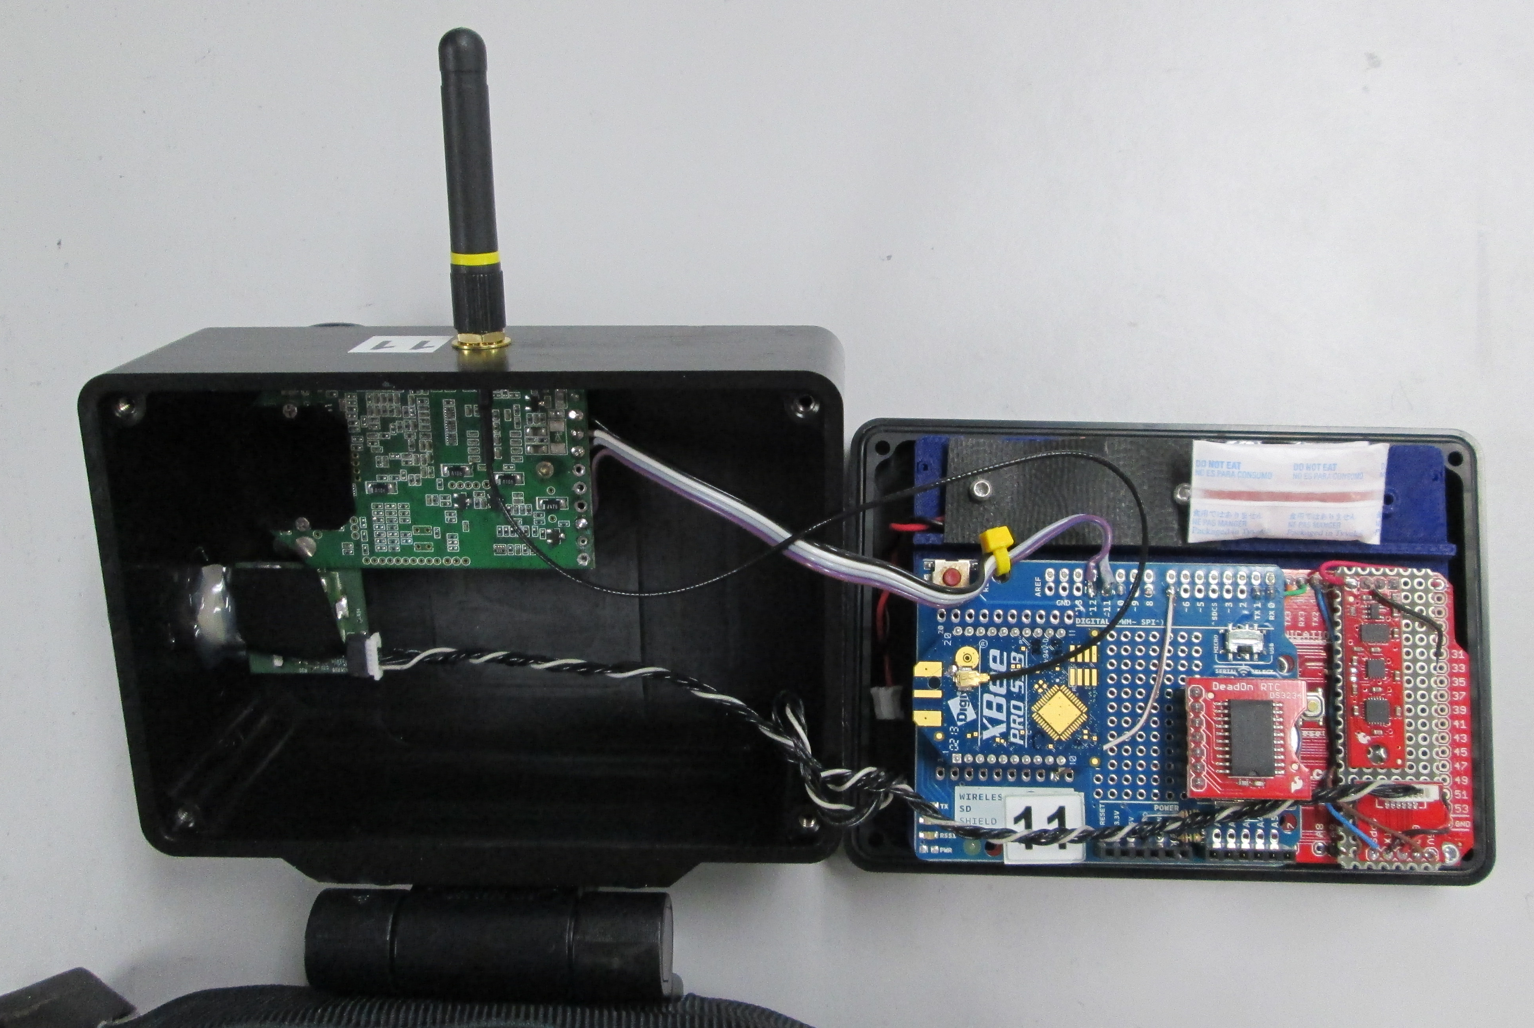
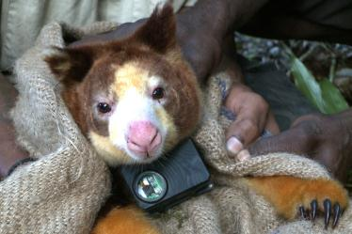
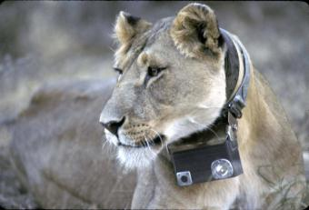

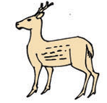

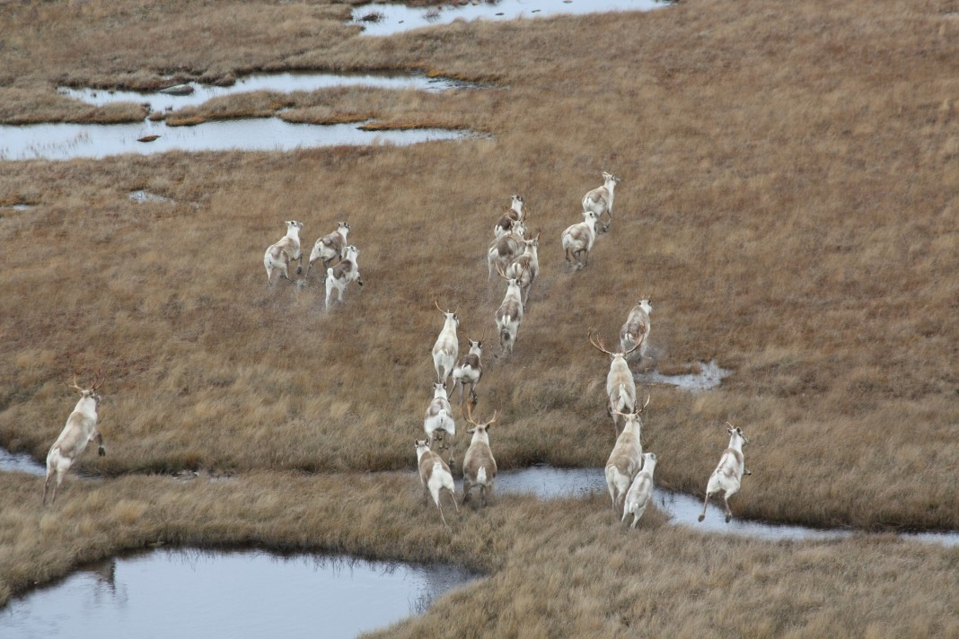

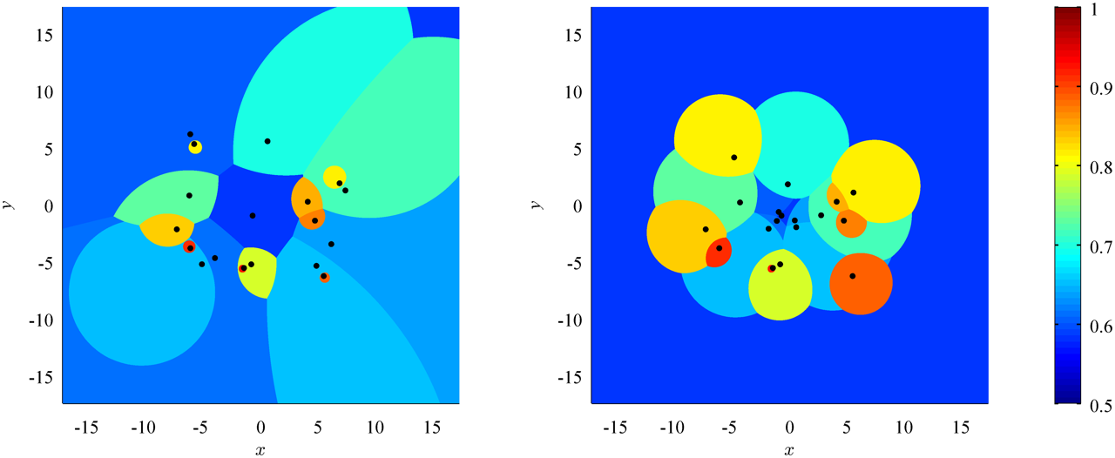

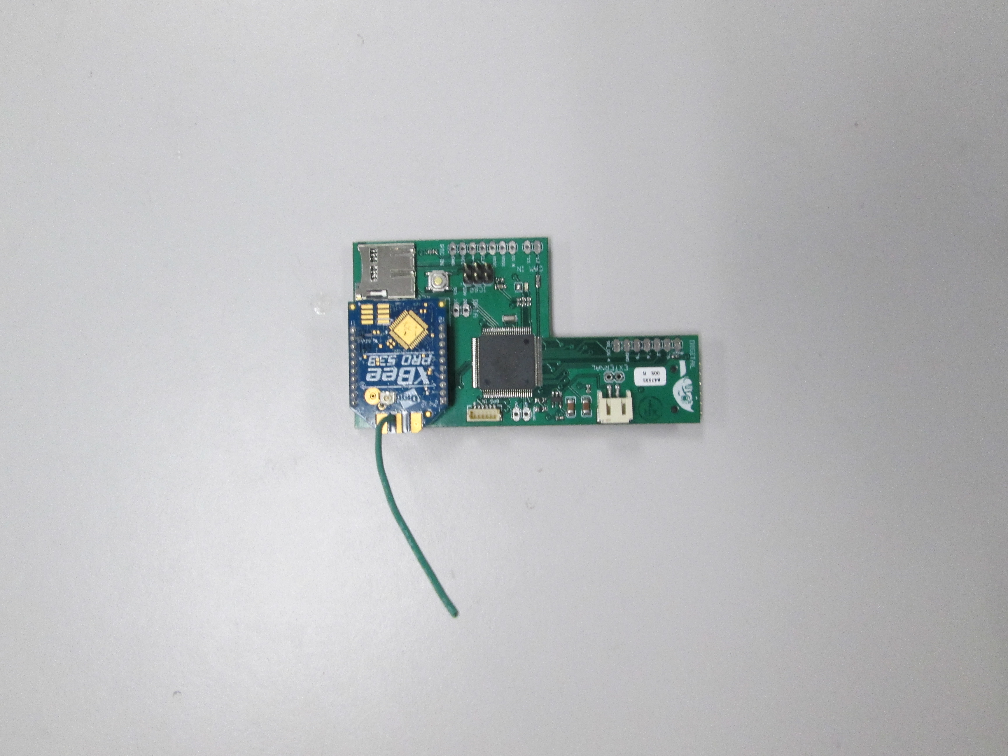
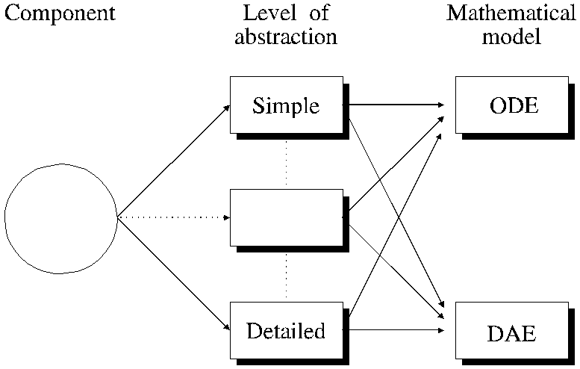

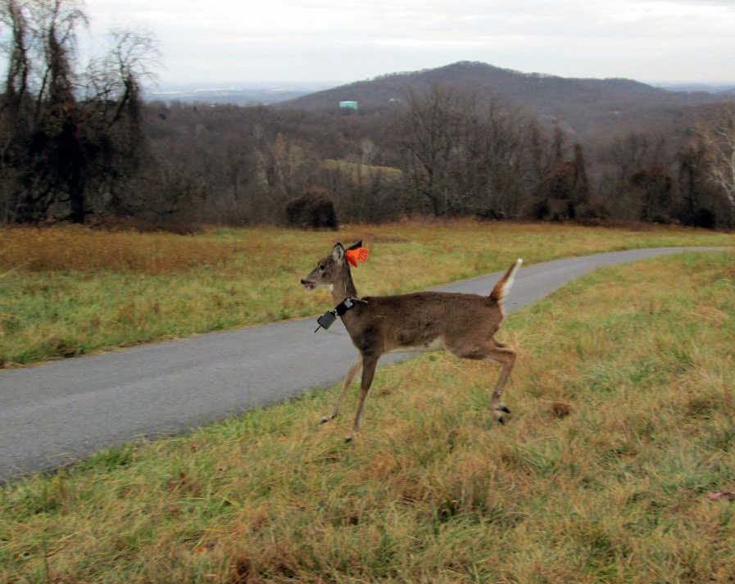
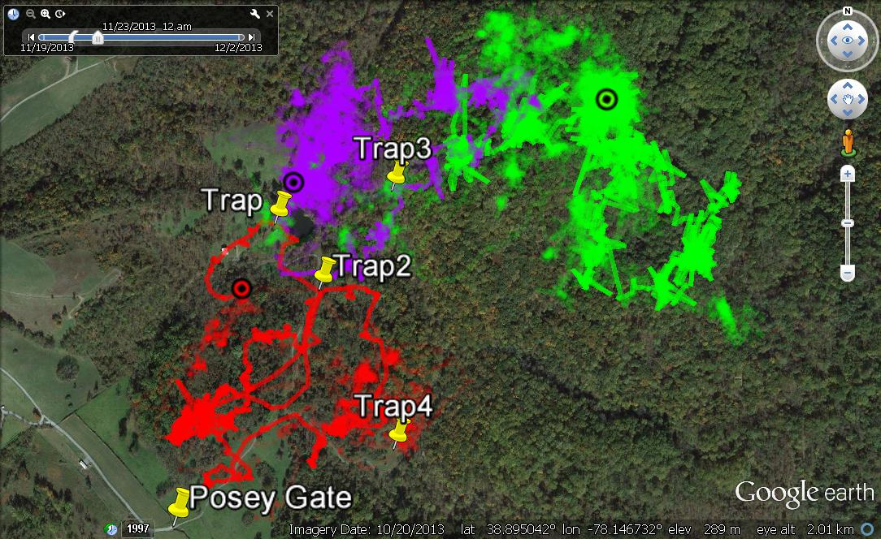
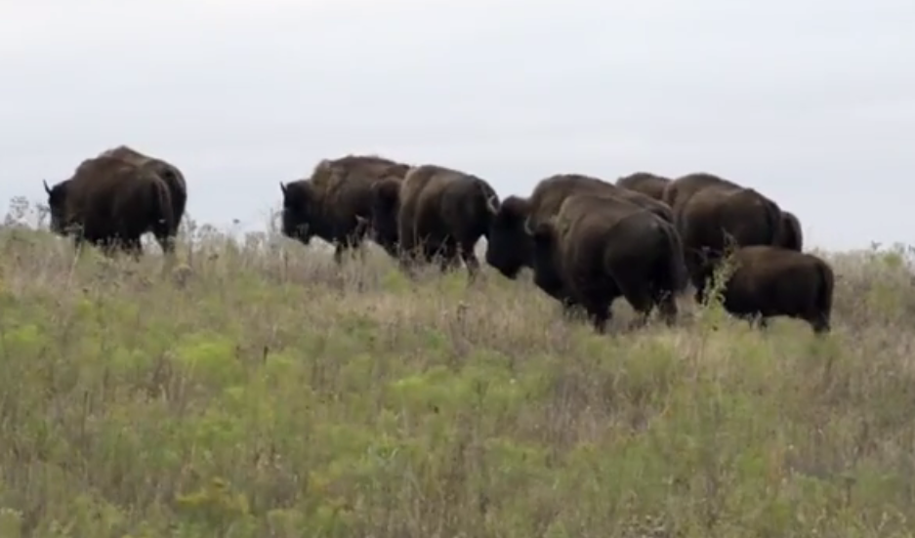
CPS: Medium: Collaborative Research: Remote Imaging of Community Ecology via Animal-borne Wireless Networks
Maryland
Robotics Center
E N G
PIs: Kyler Abernathy(NGS), Naomi Leonard(Princeton U.), and Nuno C. Martins(U. of Maryland)
Award No. 1135726
Key Collaborators: Konrad Aschenbach(NGS) and Greg Marshall(NGS)
Research Goals
Remote Imaging System
Distributed Algorithms
Models and Theories for Collective Motion
Cooperative data collection to extract group behaviors of sociobiological significance
Support networked team decision strategies to save power and extend deployment life
Real-time remote access to data and remote reprogramming and adaptability
Development of a test-bed to validate and foster the development of new model-based principles for the design of power-constrained networked CPS
New Circuit Board Design
Reduction in the size and weight of the overall animal-borne nodes
New system will allow the study of smaller but important animals such as coyotes, lynx, and foxes
Distributed Estimation over the Collision Channel:
Design of optimal transmission policies for multiple sensor transmitters that minimize the estimation error
Challenges:
Sensors do not communicate, and cannot anticipate whether a collision will happen
No convex formulation
Key results:
The problem can be equivalently viewed as a single agent problem
Optimal transmission policies are threshold-type but NOT symmetric
Dynamics of Pursuit and Evasion
Mathematical model of pursuit and evasion for a heterogeneous herd
Key analytical results:
Optimal target selection pursuer strategy gives bounded time to capture
Analytic conditions on capture avoidance for evaders
Strategies for individual risk reduction lead to group aggregation
All evaders but the slowest shrink their domains of danger (multiplicatively-weighted Voronoi partition)
Camera
Microcontroller
(Underneath)
High definition video recording
GPS
Onboard processing capabilities
Sensor
Transmitter 1
PHYSICAL
ENVIRONMENT
Collision
Channel
Receiver
Fusion Center
Communication Module
RTC & IMU
Sensor
Transmitter 2
SENSE
HARDWARE DESIGN
AND PERFORMANCE
EVALUATION
FIRST PRINCIPLES
Distributed Tracking
Design of an optimal remote tracking algorithm to minimize tracking error subject to communication constraints
Key features:
The scheme finds an optimal trade-off between tracking error and communication costs
The algorithm specifies when to communicate with other nodes and how to estimate other node’s location based on received information
DATA
Evader risk reduction strategy for local sensing
ALGORITHM DESIGN
AND PERFORMANCE
EVALUATION
MODELS
Education and Outreach
Expected Volume Reduction by 60%
Collaborating and mentoring 1 post-doctoral researcher, and 3 graduate and 2 undergraduate students
ARDUINO-based architecture enables the effective integration of undergraduate projects
Collaboration with Smithsonian Conservation Biology Institute to monitor wildlife
MISSION PLANNING
AND
SPECIFICATIONS
GPS
Microcontroller, Communication Module, IMU, RTC
Plant
New Circuit Board
Sensing Unit
Estimator
Project Anatomy
System Deployment and Data Collection:
Future Plans
Publications
Collaboration with Smithsonian Conservation Biology Institute (Front Royal, VA) in Fall 2013
Implementation of power-saving protocols and performance verification against SCBI dataset
Design of optimal cooperative strategies for event detection and reduction of redundancy in information exchange
Integration of the new circuit board into Crittercam systems
A new deployment on two herds of bison (Spring 2015)
W. L. Scott and N. E. Leonard, “Dynamics of Pursuit and Evasion in a Heterogeneous Herd,” IEEE CDC 2014
K. Fitch and N. E. Leonard, “Joint Centrality Distinguishes Optimal Leaders in Noisy Networks,” arXiv:1407.1569, 2014
N. E. Leonard, “Multi-agent System Dynamics: Bifurcation and Behavior of Animal Groups,” IFAC Annual Reviews in Control, 2014
D. Pais and N. E. Leonard, “Adaptive Network Dynamics and Evolution of Leadership in Collective Migration,” Physica D, 2014
N. E. Leonard et al, “In the Dance Studio: An Art and Engineering Exploration of Human Flocking,” In Controls and Art, Springer, 2014
M. Vasconcelos and N. C. Martins, “Optimal Estimation over the Collision Channel: the Static Case,” in preparation
S. Park and N. C. Martins, “A Class of LTI Distributed Observers for LTI Plants: Necessary and Sufficient Conditions for Asymptotic State Omniscience,” submitted for journal publication
S. Park and N. C. Martins, “Individually Optimal Solutions to a Remote State Estimation Problem with Communication Costs,” IEEE CDC 2014
System Installed in Deer
GPS Data Visualization

