Slide 1
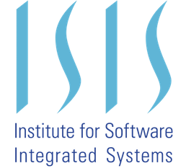
Research on Human Response to System Faults
Elle Summerfield

Slide 2
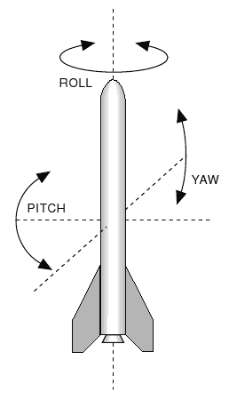
Human Response to Faults in UUV
For my research, I simulated the manual operation of an unmanned underwater vehicle to study human response to system faults.
I operated the eca-a9 uuv using a joystick to control the thrust, pitch, roll, and yaw.
Performance Condition: follow the pipe
Safety Condition: do not crash into pipe or seafloor
Notes:
Problem: understand and model failure modes present in human operation of UUVs
Used these two conditions to simulate the operation of the vehicle
Point out the pipe and 3D omniscient view along with sonar imaging (ended up being low quality because overloading computer)

Slide 3
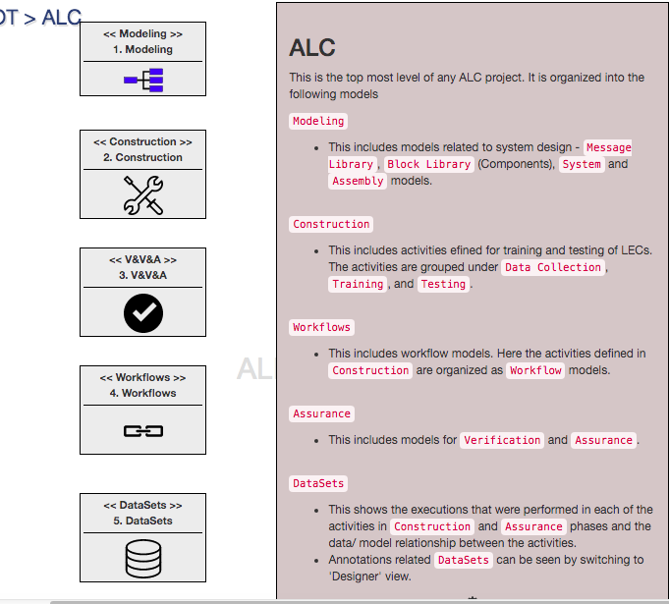
VU - ISIS
TU-Munich
Notes:
I worked with both ISIS and TUM, used these tools to study and model human response to failures in a UUV
Professor Karsai and his team: developing the ALC toolchain which introduces a way to construct CPS with LECs
Professor Pretschner and TUM looking at human interactions with CPS and how to integrate human and system models
Pretschner specifically looking at how to find a good test case for autonomous and semi-autonomous systems

Slide 4
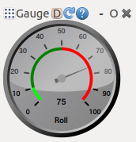
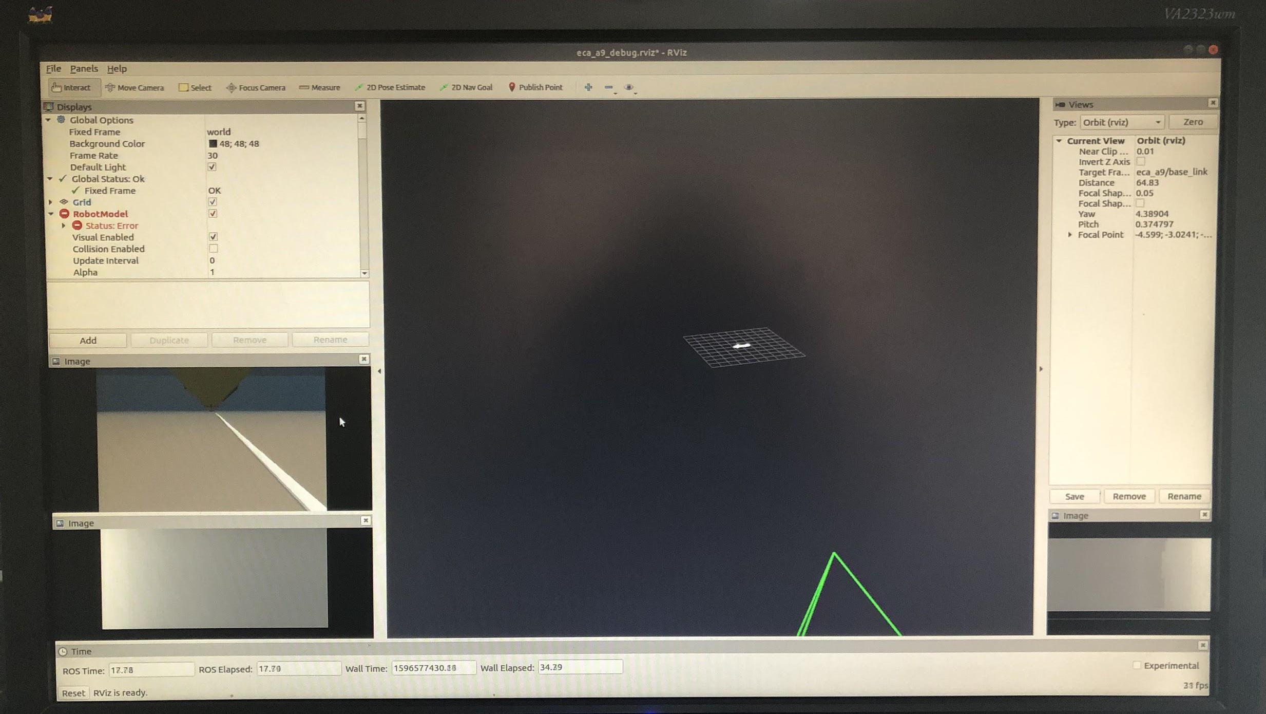
Manual Operation and Fault Injection
Speed
Height
Notes:
Used these gauges along with sonar imaging to manually operate it, saw how challenging it was to operate these vehicles
Used republisher node to republish DVL messages to different topics which gauges could subscribe to
Then could introduced randomly timed faults in a randomly chosen gauge here

Slide 5
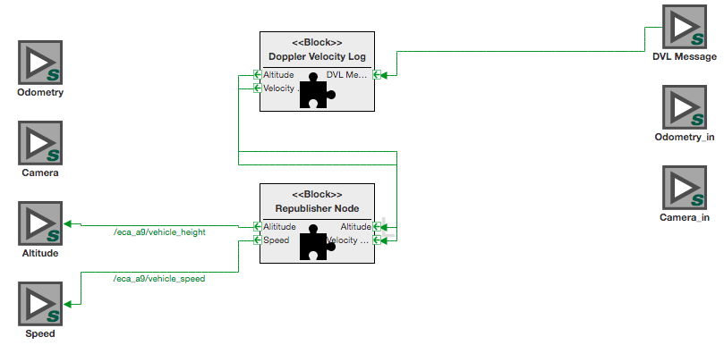
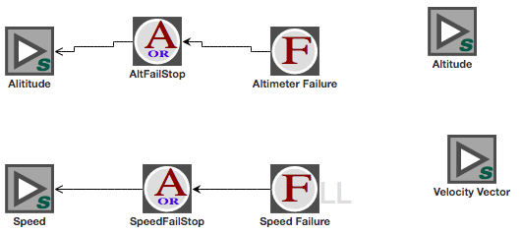
Modeling Potential Failure Modes in the ALC Toolchain
In the system models block of the toolchain, I was able to model how the software components are connected.
The toolchain also allows TFPG models to show how failures propagate through the system.

Slide 6
Lessons and Challenges
Notes:
Biggest challenge was setting up virtually, process of ROS on mac > setting up VM > setting up Ubuntu on a Dell > dell being overloaded
This led to my biggest lesson learned which was how to problem solve (with Charlie’s help) between finding accounts on google, and combining any knowledge i had gained of the systems and software
What went well was the immense amount of knowledge I gained of these softwares and how to problem solve and also my favorite part of getting to add and execute some code to the uuv-sim gitlab to do a new manual launch with fault injection

