Slide 1
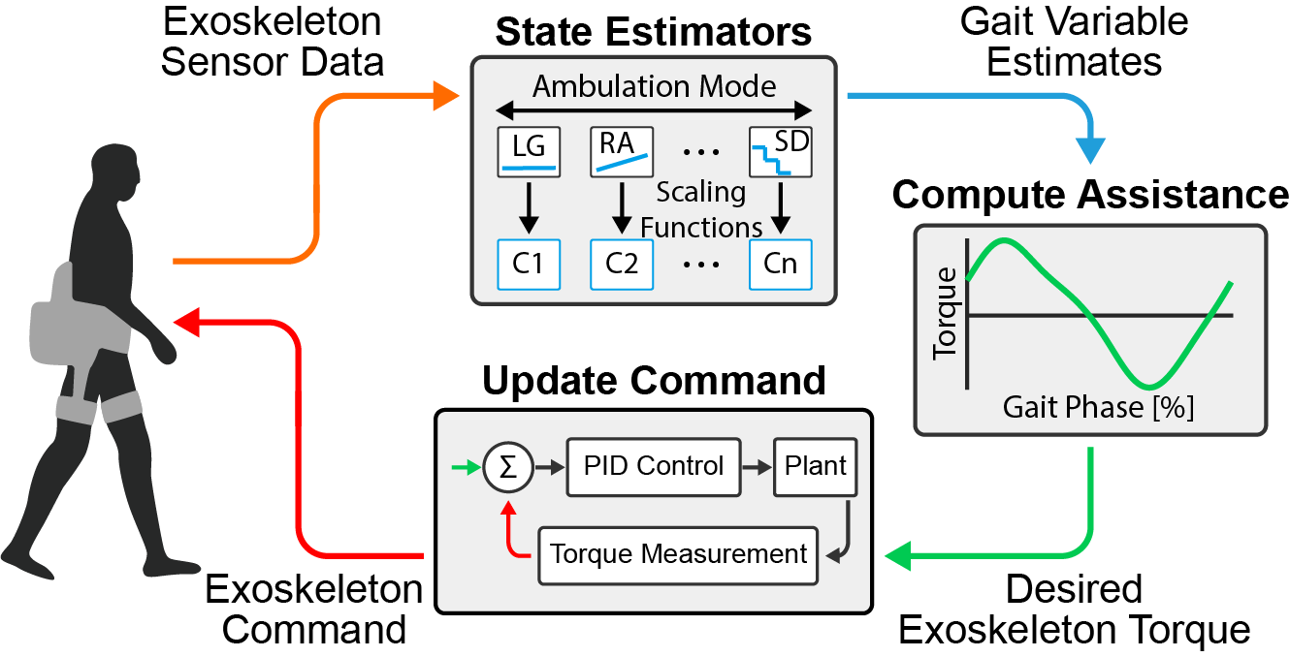
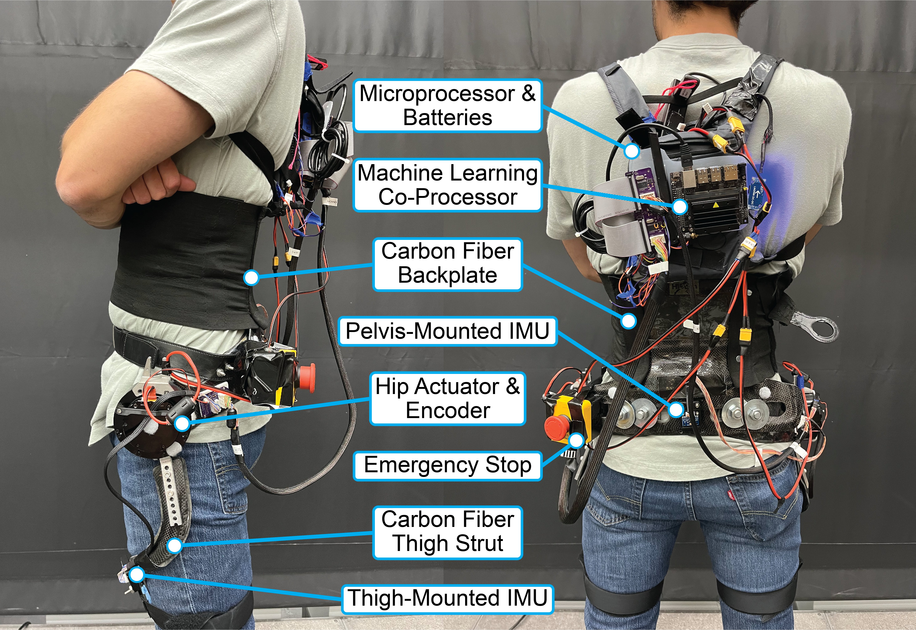
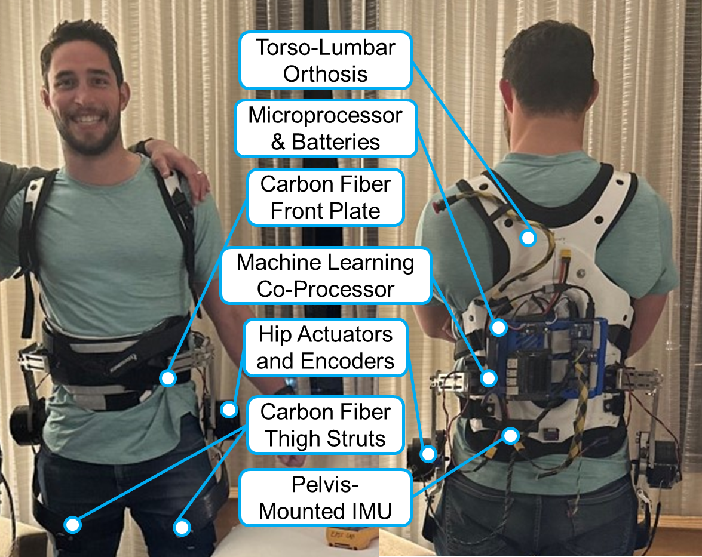
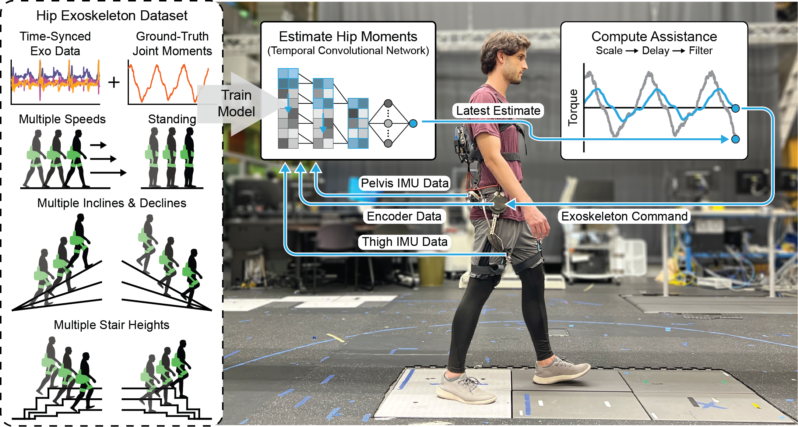
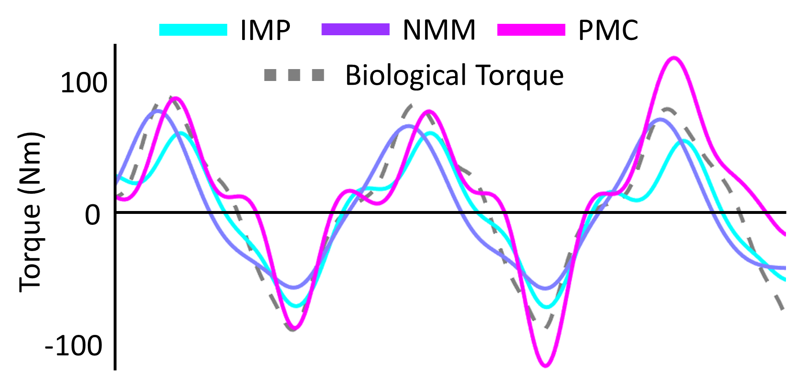
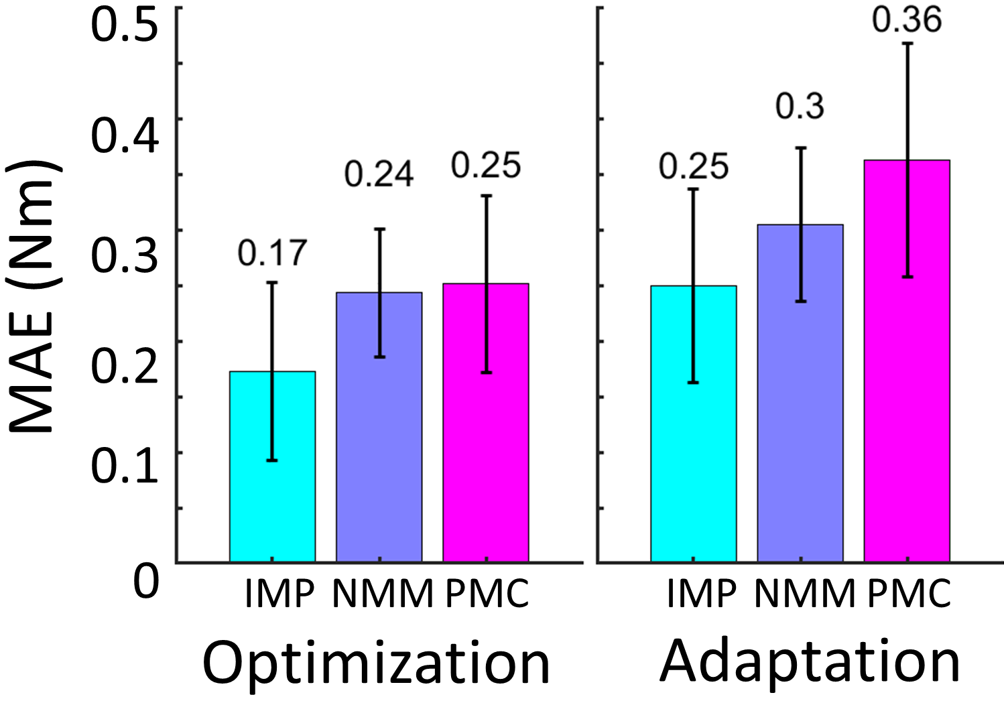
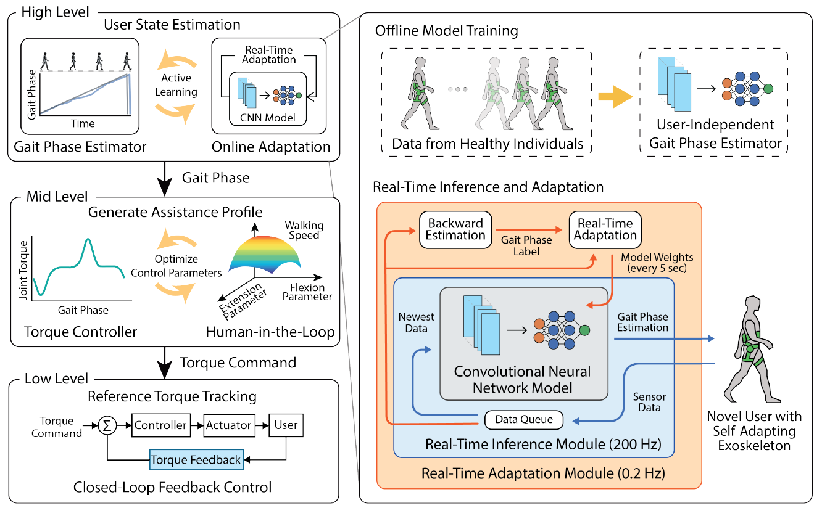
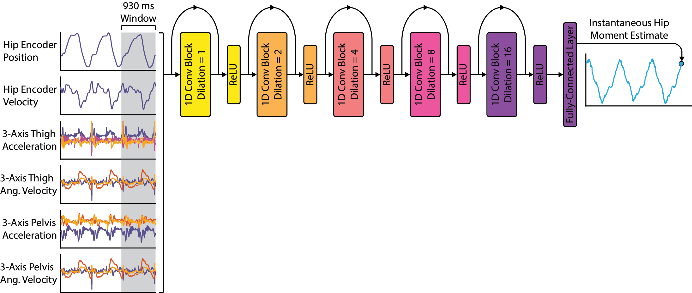
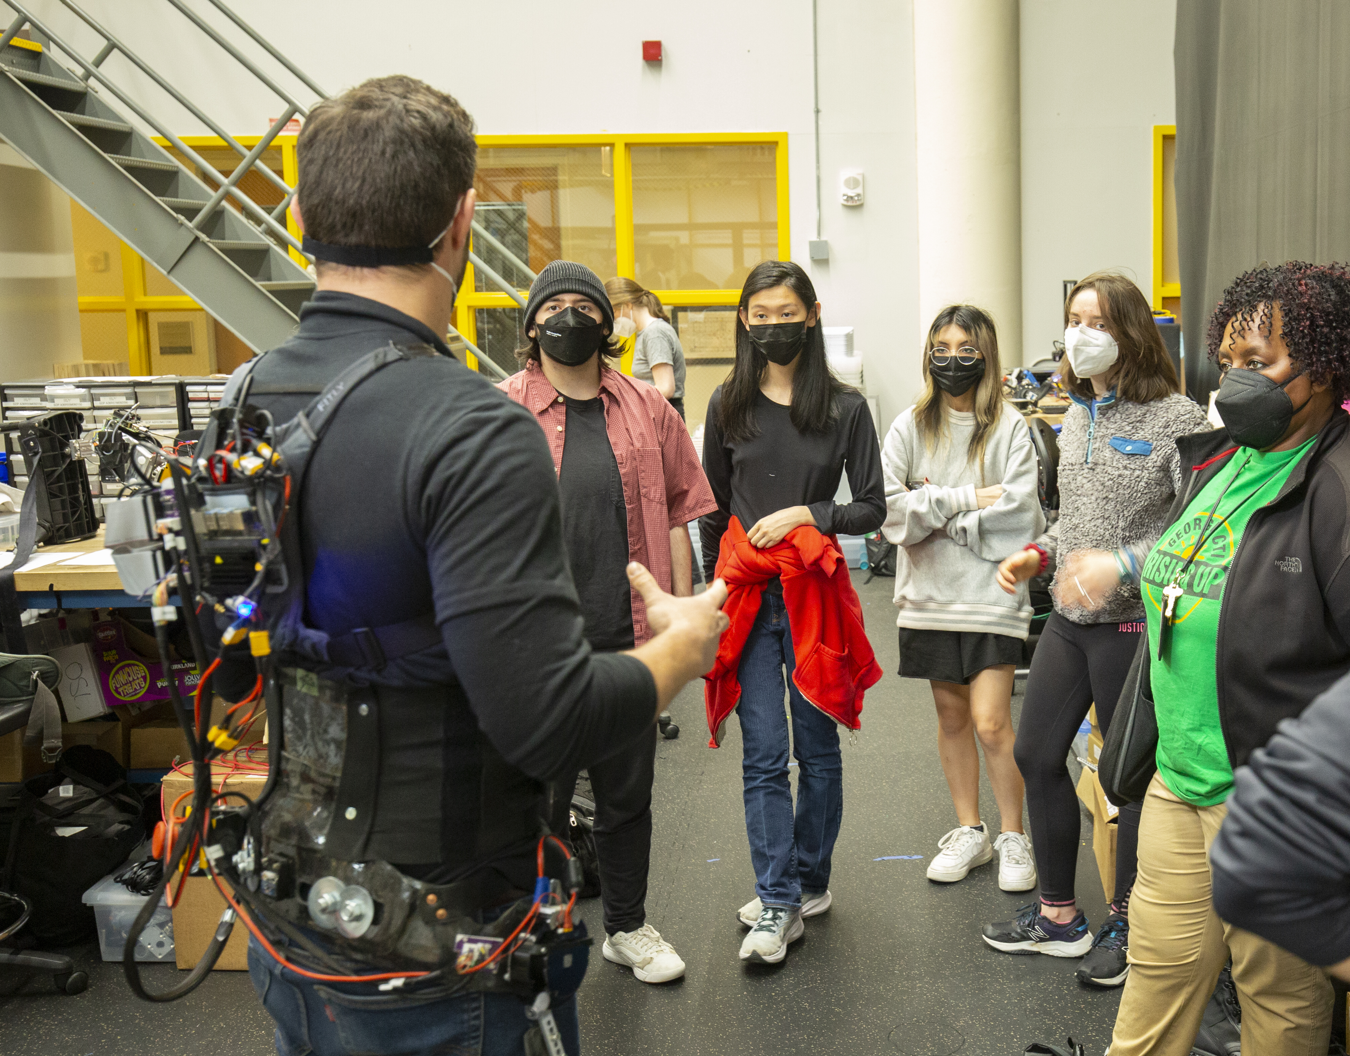
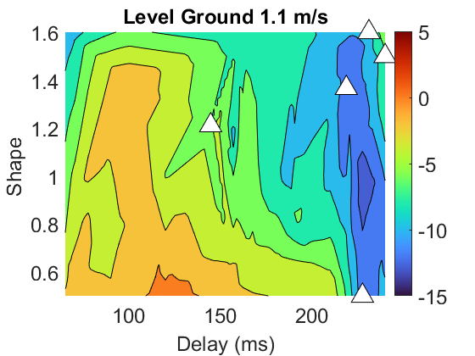
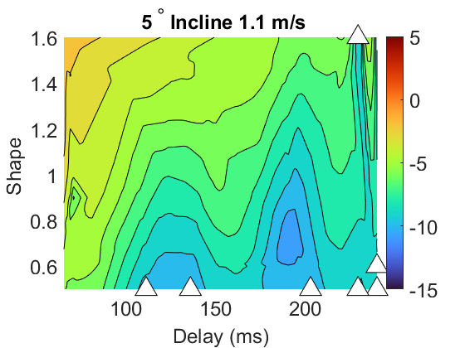
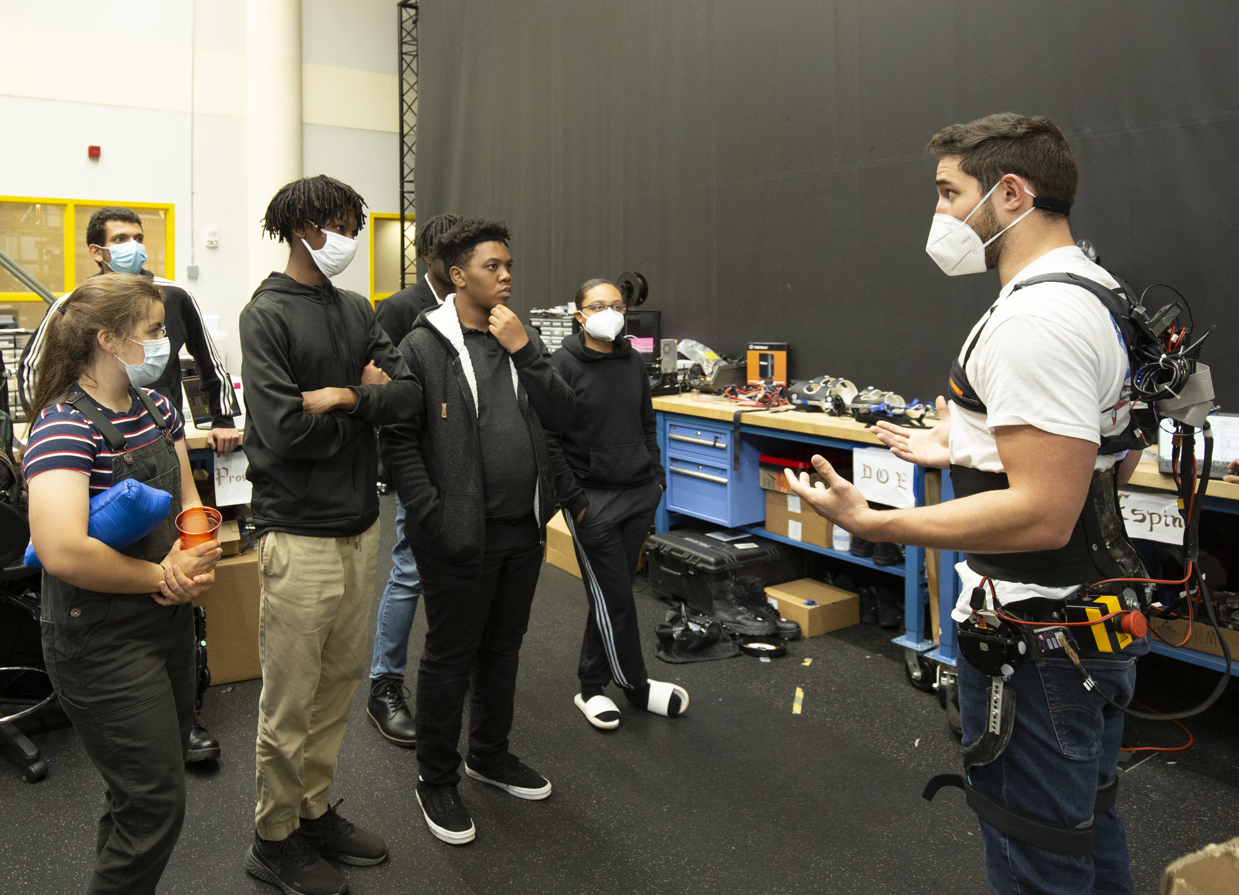
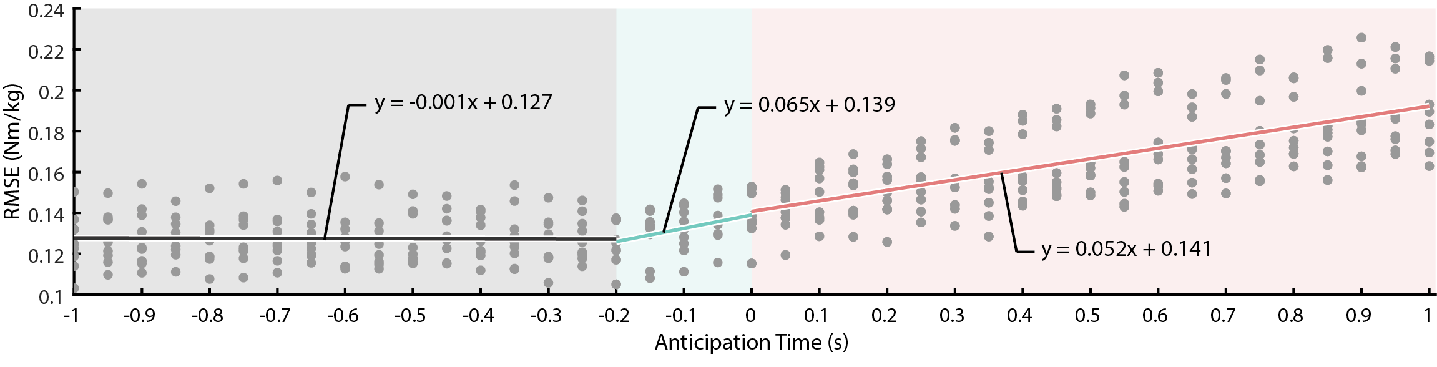
Robotic Human Enhancement Enabled through Wearable Hip Exoskeletons Capable of Community Ambulation
Aaron Young PhD
Woodruff School of Mechanical Engineering, Georgia Institute of Technology, Atlanta, GA
Institute for Robotics and Intelligent Machines, Georgia Institute of Technology, Atlanta, GA
Introduction
Exoskeletons that assist the user’s hip joint can greatly improve human mobility [6].
Exoskeleton technology can be optimized to maximize performance from both a hardware [4, 23] and controller perspective [1, 13, 16].
Wearable sensing on the device (e.g., IMUs) and the user (e.g., EMGs) can enable deep learning-based control able to seamlessly modulate assistance across ambulation modes [5, 11, 12, 18].
Adaptive algorithms can personalize assistance and transfer exoskeleton benefits to heterogenous populations (e.g., patients post-stroke) [19].
Machine Learning Enabled Autonomous Hip Exoskeletons
Clinically Focused Design
Able-body Focused Design
Specifications
Peak Torque: 18 Nm
Continuous Torque: 9 Nm
Max Speed: 35.6 rad/sec
Transmission: 9:1
Total Mass: 4.5 kg
Specifications
Peak Torque: 48 Nm
Continuous Torque: 18 Nm
Max Speed: 26 rad/sec
Transmission: 9:1
Total Mass: 7.0 kg
Unified Control Adapts Assistance Across Modes and Intensities
Analytical Model-Based Hip Control
Driven by hip EMG and kinematics across 26 locomotion modes and 5 subjects
IMP (kinematics), NMM (both), and PMC (EMG) to NMM or PMC
Optimized IMP control best estimates biological torque compared
EMG does not help estimate biological torques at hip
Educational Outreach
Large-scale undergraduate involvement through the vertically integrated projects (VIP) program
Out of institute involvement through National Biomechanics Day and Nakatani RIES programs
Online adaptation framework enables personalization of exoskeleton assistance
Temporal convolutional network (TCN) estimates user hip moments based on exoskeleton encoder and IMU data without subject-specific calibration [20].
Our unified controller significantly reduced user metabolic cost during level ground and incline walking.
Multi-Modal Mid-Level Optimization of Unified Joint Moment Control
HIL-Optimize 2 parameters that transform biological hip joint moment to hip exo assistance
Delay: difference in time between bio-moment and corresponding exo control
Shape: Exponential term curve used to modulate the slope of exo assistance
Subject average surfaces (White triangles show individual subject best parameters).
Delayed moment estimates can improve estimator accuracy and user outcomes [24].
Resulting Publications: [1] . Kang et al., RA-L, 2019. [4] S. E. Lee et al., Prosthet Orthot Int, 2021. [5] I. Kang et al., TMRB, 2020. [6] G. S. Sawicki et al., J Neuroeng Rehabil, 2020. [11] D. Lee et al., RA-L, 2021. [12] I. Kang et al., RA-L 2021. [13] D. Lee et al., TBME, 2021. [16] G. Choi et al., EMBC, 2021. [17] J. Camargo et al., J. Biomech., 2021. [18] M. Shepherd et al., RA-L, 2022. [19] I. Kang et al., Science Robotics, In review [20] D. Molinaro et al., TMRB, 2022. [23] I. Kang et al., J. Mech. Robot., 2023. [24] D. Molinaro et al., ICRA, 2023.
2023 FRR & NRI Principal Investigators' Meeting
May 2-3, 2023
Award ID#: 1830215

