Slide 1

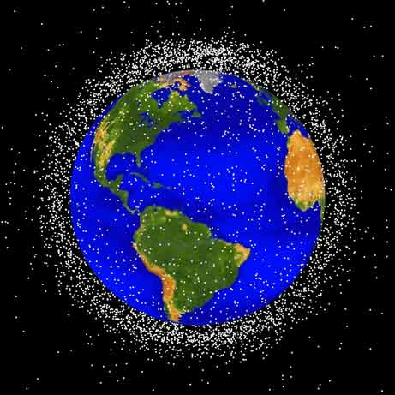
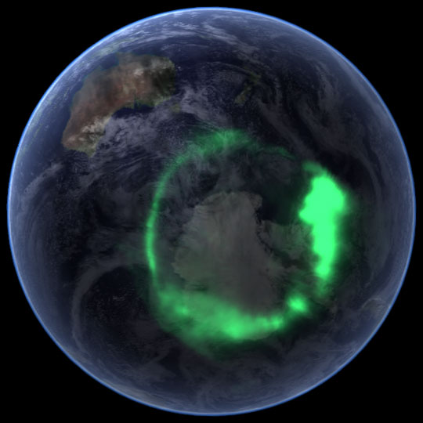
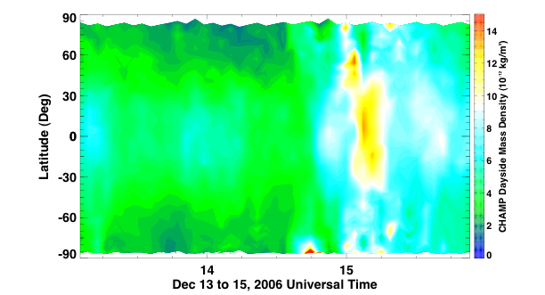
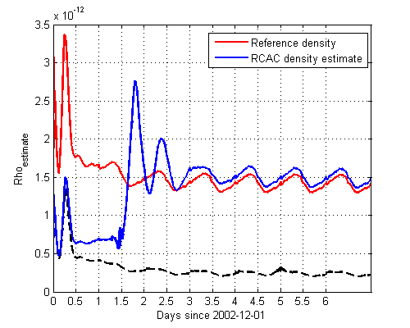
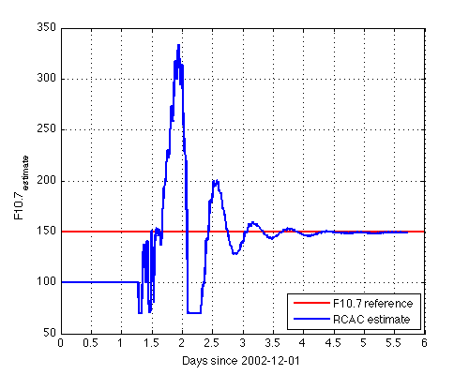
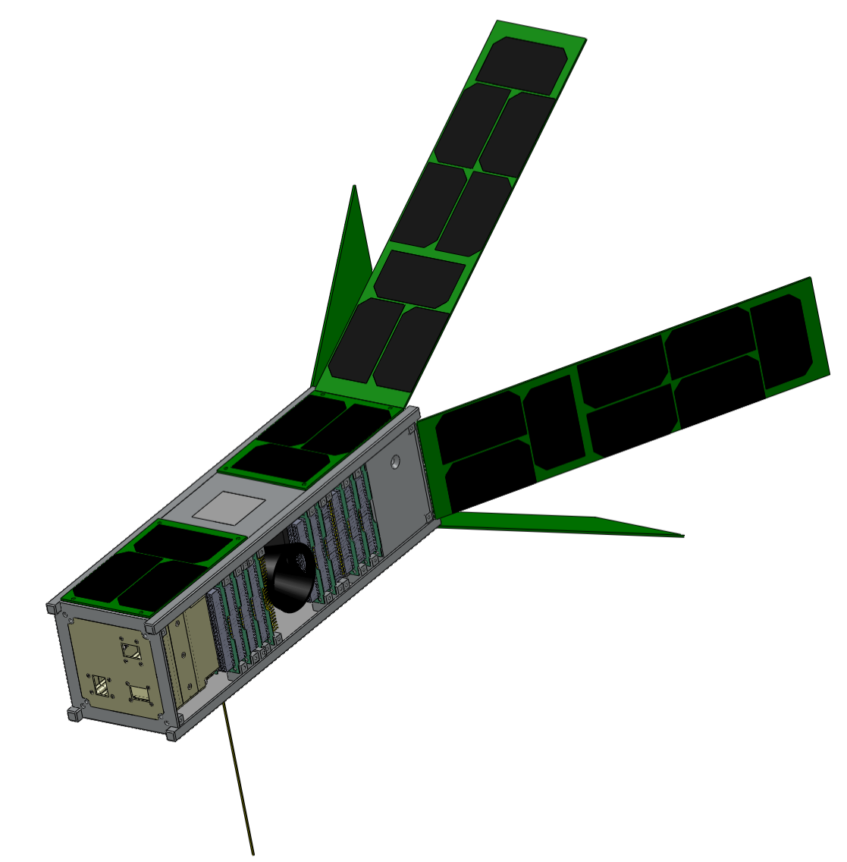
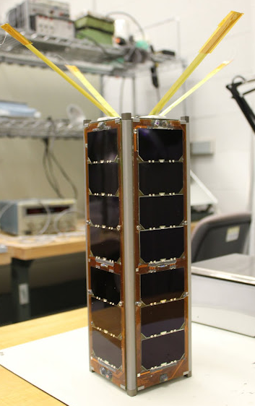
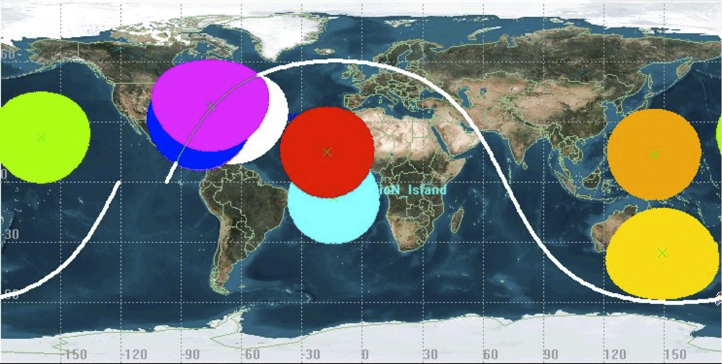
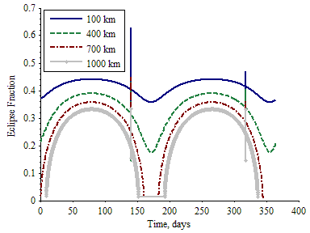
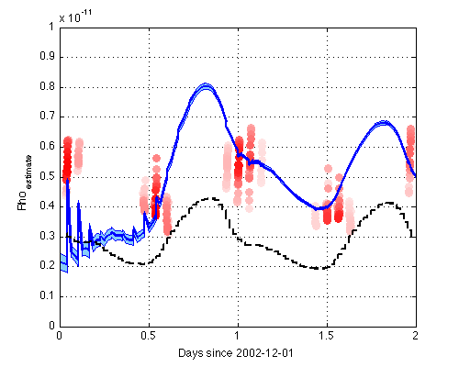
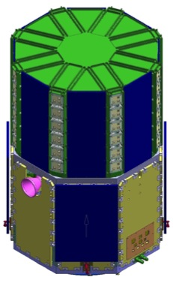
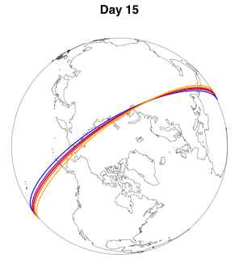
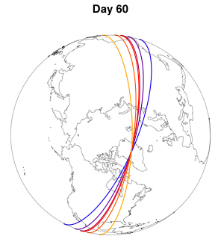
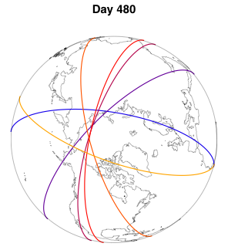
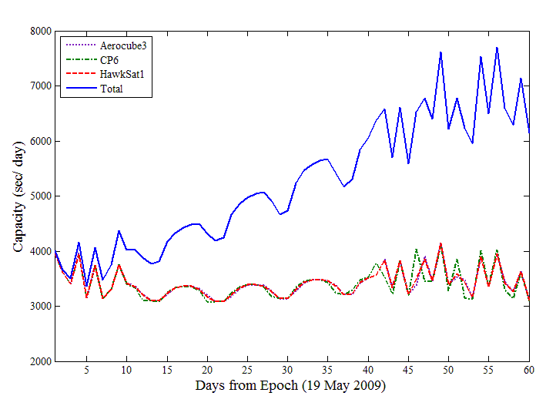
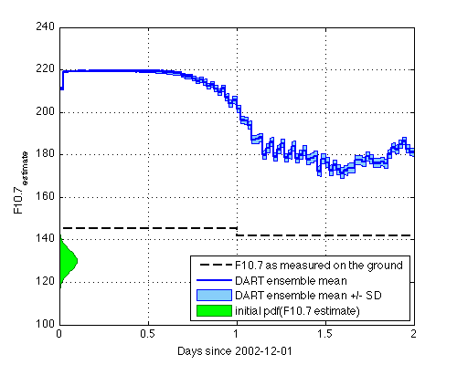
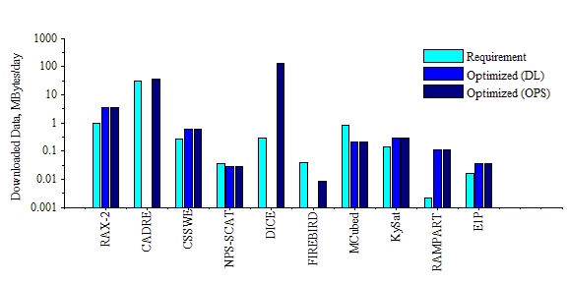
Robust Capacity-Constrained Scheduling and Data-Based Modeling for Enhanced Collision Avoidance in Low-Earth Orbit
Dennis Bernstein (PI), Amy Cohn, James Cutler, Aaron Ridley, Jeffrey Anderson, University of Michigan and NCAR
dsbaero@umich.edu, amycohn@umich.edu, jwc@umich.edu, ridley@umich.edu, jla@ucar.edu, award number CNS-1035236
Collision Avoidance in Low-Earth Orbit
Science Challenges
  State and Input Estimation
More than 13,000 pieces of space
debris are tracked to avoid collision
Predicting the trajectories of space
debris depends on the accuracy of
density estimates, which are
affected by heating events
Upper atmospheric heating due to currents and the aurora takes place on small scales, but over a broad region
GITM (Global Ionosphere-Thermosphere Model) is a 3D space-weather model that does not assume a hydrostatic solution
RCASE (Retrospective Cost Adaptive State Estimation) is a method for estimating states when inputs are unknown
We estimate states in GITM and the solar input F10.7 using density measurements from one satellite
Ionospheric and thermospheric density can vary dramatically, both spatially and temporally, after energy input
Goal: Develop cyber-physical technology in support of a possible future CubeSat constellation (Armada) for modeling the upper atmosphere and tracking space debris
Retrospective Cost Adaptive State Estimation (RCASE)
Neutral density at 82.5°W, 42.5°N, 394 km from GITM simulation with a fixed true value of F10.7
Neutral density from GITM combined with RCASE with wrong initial F10.7
Neutral Density from GITM with wrong initial F10.7 and no RCASE
CubeSat Technology
Winds and the current state regulate the energy input and its global response
RAX—Radio Aurora Explorer
  NSF-sponsored, SRI and University of Michigan
  RAX-1 launched Nov. 19, 2010
  RAX-2 launched Oct. 28, 2011
CADRE—prototype for a future 50-CubeSat fleet
Optimal Operational Scheduling
RCASE uses one measurement of neutral density to estimate the single unknown input F10.7.
The simulated true value of F10.7
RCASE’s estimate of F10.7
Small satellites are constrained in mass, size, and power, limiting their ability to download the large amounts of data they generate
Existing ground networks are not centrally-controlled, have low efficiency, are monolithic, and are underutilized
Armada will have dynamic orbits and data requirements
Goal: Optimize satellite operations and global ground networks
Communication capacity
models and tools enable
analysis of ground
station coverage and energy availability to support missions.
Capacity: Amount of data transferred across network.
Network (N) Capacity:
Ground station (j) capacity:
Data Assimilation Research Testbed (DART)
DART (Data Assimilation Research Testbed) is a suite of ensemble data assimilation algorithms (EAKF (Ensemble Adjustment Kalman Filter), EnKF (Ensemble Kalman Filter), and others)
CHAMP (CHAllenging Minisatellete Payload) is a satellite, whose neutral density measurements are used for input reconstruction
CHAMP measurements of neutral density localized to one GITM gridpoint (82.5°W, 42.5°N, 394 km agl).
GITM with DART matches CHAMP
GITM without DART forecasts density far below CHAMP measurements
Armada—50-CubeSat constellation
    Deployed from mother ship
    Continuously varying orbits
Total network access time
Access and energy opportunities are inputs to scheduling algorithms that maximize download.
In addition to estimating density and other GITM state variables, DART reconstructs F10.7 based on CHAMP density measurements.
F10.7 used in “GITM without DART”
Individual station access time
10 realistic CubeSat missions

