Slide 1
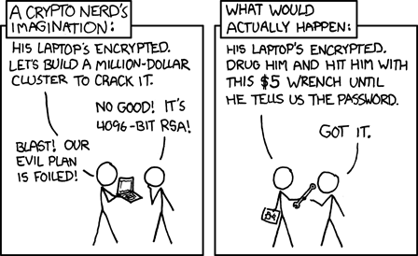
Rubber hose resistant cryptography
Psychology
Northwestern
Hristo Bojinov, Daniel Sanchez,
Paul Reber, Dan Boneh, Pat Lincoln

Slide 2
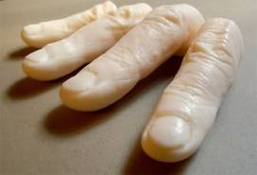
Rubber hose attacks
Problem:
authenticating users at the entrance to a secure facility
Current solutions:
Smartcards: can be stolen
Biometrics: can be copied or spoofed
Passwords: can be extracted with a rubber hoze
Is there a non-extractable credential?

Slide 3
The human memory system
Hippocampus: conscious learning
Learns from single examples
Basal ganglia: “implicit learning”
Learns from many repeated samples
Our work: use implicit learning to teach a credential
Credential can be tested at authentication time
… but credential is not consciously accessible !!

Slide 4
Implicitly learning a credential
Participants exhibit essentially no recognition after training

Slide 5
Challenge-response authentication?
Challenge-response:
Credential is an algorithm
Given challenge, user computes response
What algorithms can we teach the Basal Ganglia?
How does it represent knowledge?
Is it complex enough for one-way functions?

