Slide 1





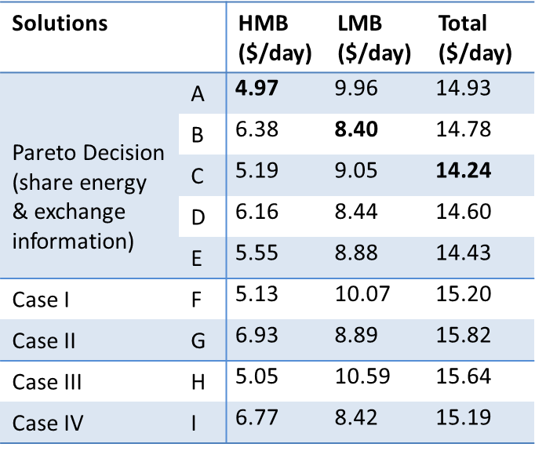
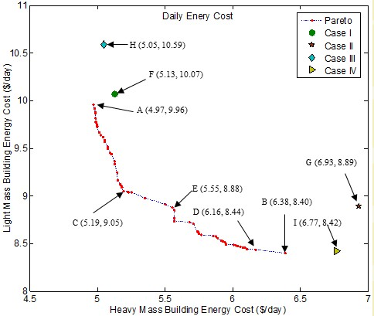
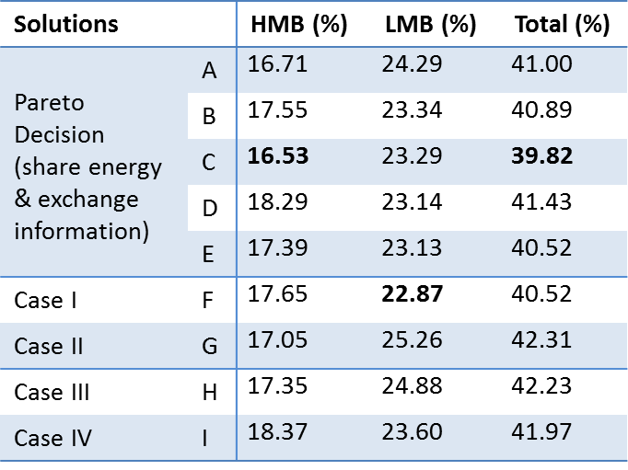
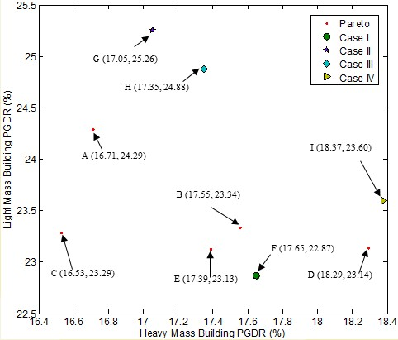
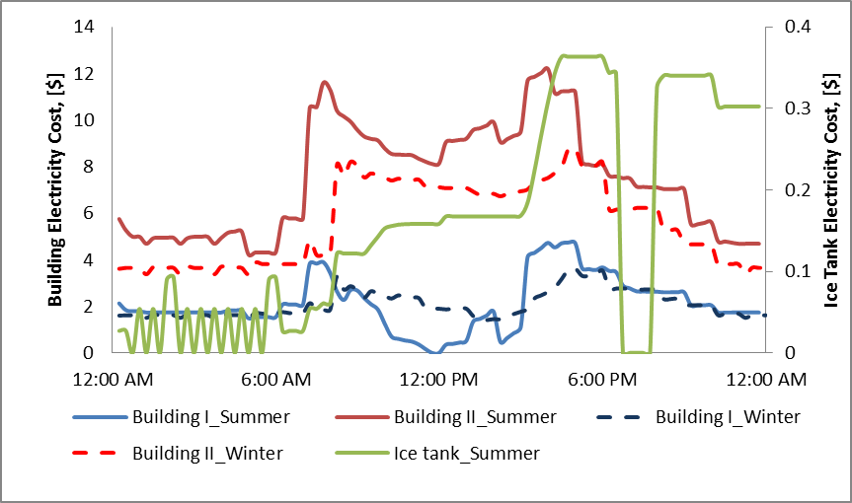

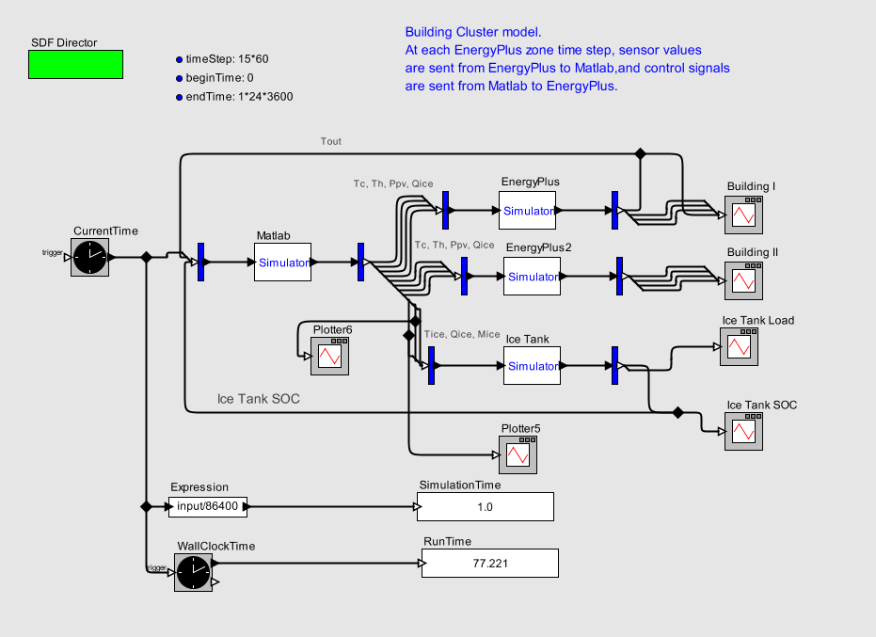
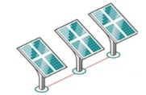

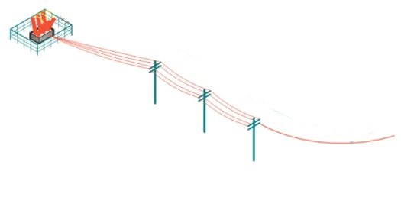

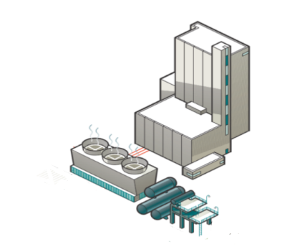



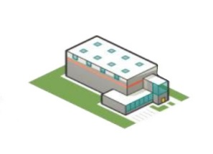
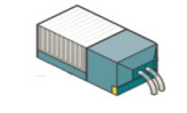


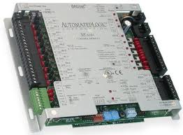
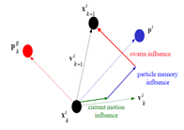
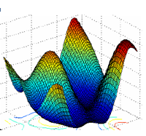
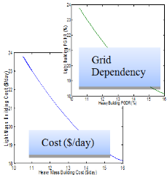
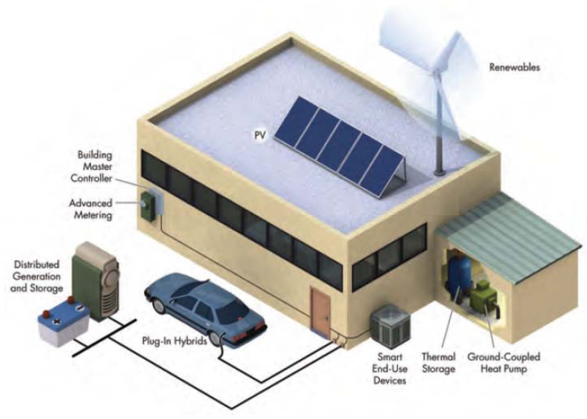
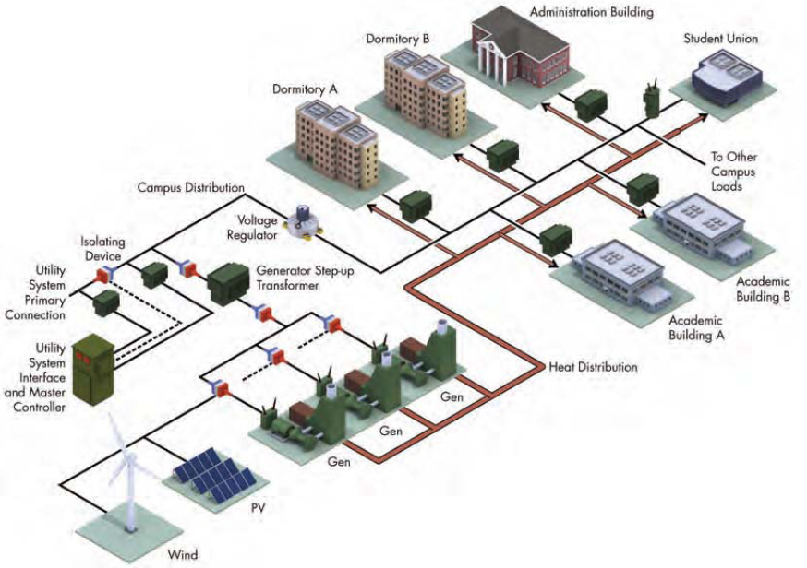
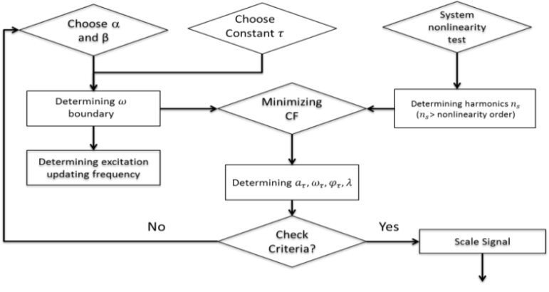
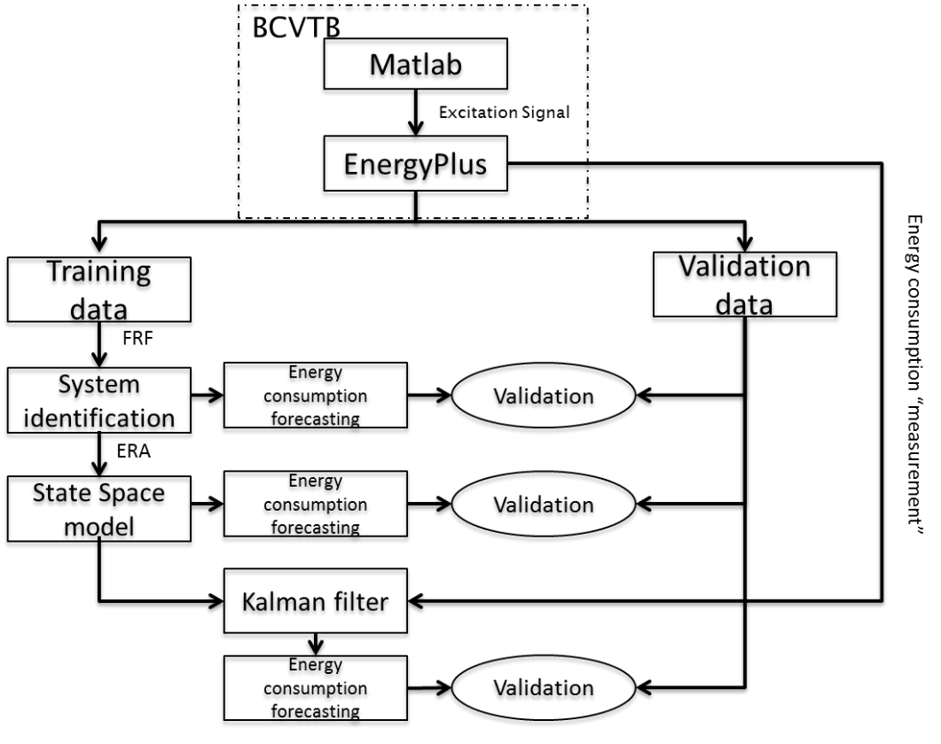
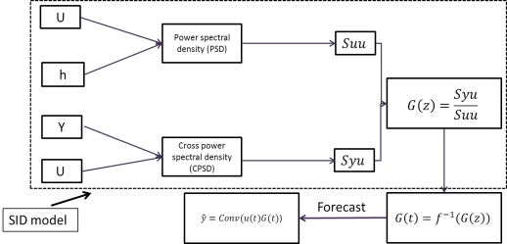
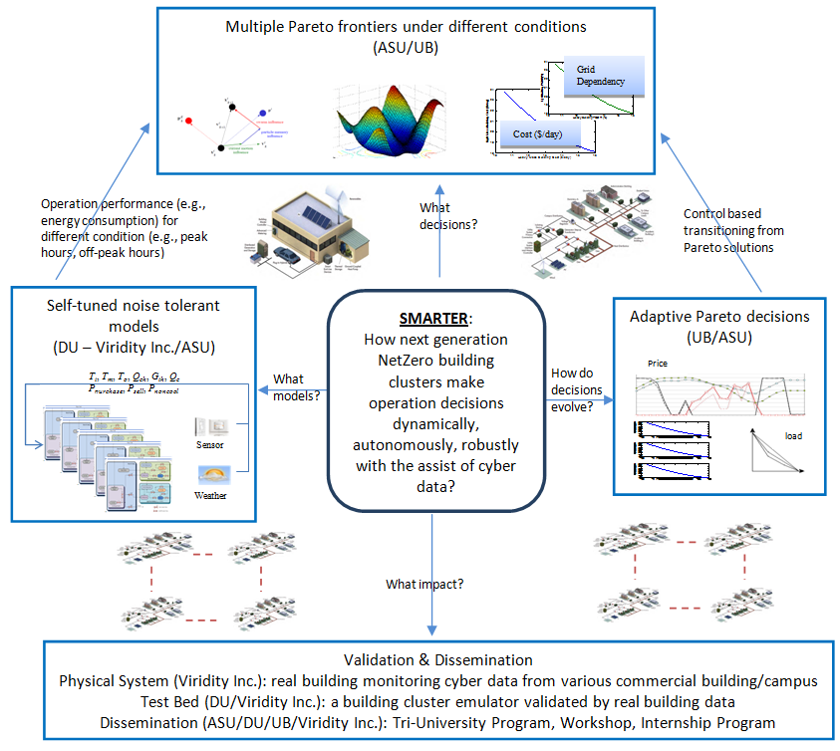
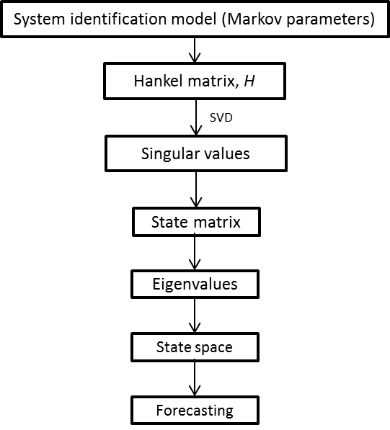
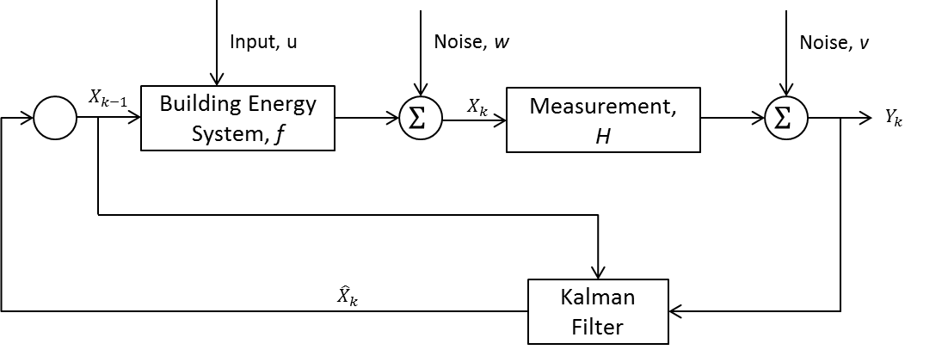
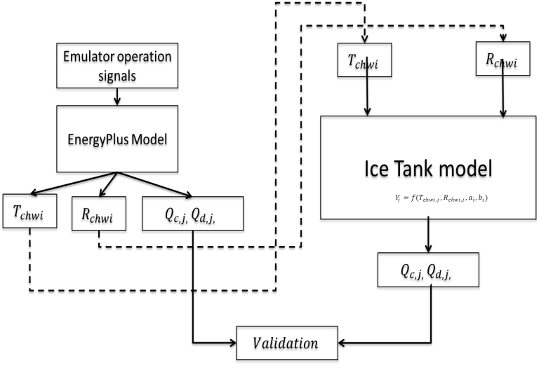
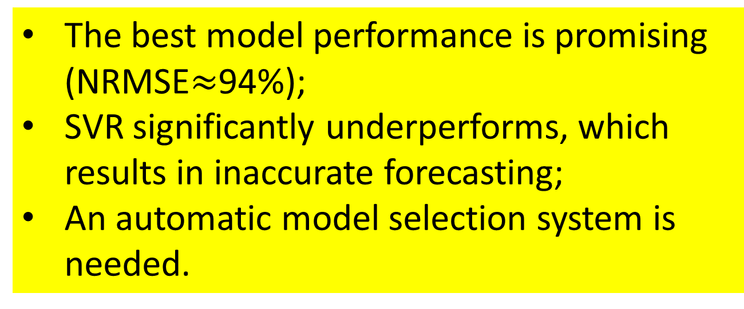
SMARTER -Smart Manager for Adaptive and Real-Time decisions in building clustERs
Teresa Wu
Dep. of Industrial Engineering
Arizona State University, Tempe, AZ 85281
Jin Wen
Dep. of Architectural and Environmental Engineering
Drexel University, Philadelphia, PA 19104
Kemper Lewis
Dep. of Mechanical and Aerospace Engineering
University at Buffalo, Buffalo, NY 14214
Introduction and Motivation
Results
40% of the energy and CO₂ emissions in the U.S. are due to buildings, more than any other industry sector;
The electricity consumption of the U.S. grew 1.7% annually from 1996 to 2006, and the expectation of total growth through 2030 will be 26% with buildings responsible for over 70% of all electricity consumption;
Smart grid technology is a cyber-enabled network of sensors, actuators, computers and power infrastructures that monitors and manages energy usage across a wide range of power loads in an effort to reduce cost and increase reliability and transparency;
Similar to micro-communities in a human society, neighboring buildings have the tendency to form clusters to exploit the economic opportunities provided by a smart grid, distributed power generation and storage devices, and to reduce overall primary energy consumption and peak time electricity consumption.
Swarm Intelligence Algorithm on Two Building Operation Decisions
Table 1 Daily Energy Cost ($/day)
Table 2 Power Grid Dependency Rate (PGDR)
Online Building Cluster Energy Model Results
Building energy modeling and forecasting:
  Cooling energy forecasting accuracy is 97.01%
  Heating Energy forecasting accuracy is 89.73% Energy device modeling and forecasting:
  All models’ forecasting period accuracy are above 90%
Energy Cost Simulation
Methods and Materials
Objectives
Task 2 Develop and Calibrate an Online Building Energy Consumption Model
Develop accurate and robust energy forecasting models for building clusters;
The models are computationally efficient for real-time decision making.
On-line Data Fusion Model Results
Conclusions
The CPS theme of this SMARTER project is to develop a decision framework, including appropriate methods and tools to enable real-time autonomous, robust, and optimal building energy system operation decisions for the next generation energy building clusters.
Task 1 Develop an Emulator for NetZero Energy Impact Building Clusters for Benchmarking and Evaluation of Different Operation Strategies.
Task 2 Develop and Calibrate an Online Building Energy Consumption Model
Task 3 Developing Adaptive Decision Algorithms for Dynamic Operation Strategies
Task 4 Validation and Verification
Grey box and black box models are complementary to each other. Grey box model shall be used to study long term building energy consumption while black box model shall be used for the short term prediction.
A model recommendation system shall be in place to identify the appropriate models for each building with its unique characteristics.
A decentralized decision framework has the potential to significantly reduce the energy cost. This framework shall be adaptive to the system dynamics (e.g., price, non-cooling load).
Task 2.1 Building Energy On-line Forecasting Through Data-driven modeling (Black box approach)
Metamodel is data-driven surrogate model to approximate the behavior of expensive simulation model;
Typical surrogate models are compared to study their accuracy and robustness performance, and a bi-criteria ensemble model is proposed;
Accuracy | Kriging | ARIMA+Kriging | SVR | ARIMA+SVR | RBF | ARIMA+RBF | Ensemble | ARIMA+Ensemble
NRMSE | 0.0792 | 0.0643 | 0.3445 | 0.6134 | 0.0791 | 0.0681 | 0.0659 | 0.0557
The best model performance is promising (NRMSE$≈$94%);
SVR significantly underperforms, which results in inaccurate forecasting;
An automatic model selection system is needed.
Task 2.3 A Meta-learning based Recommendation System for Metamodeling
Methods and Materials
Sampling
Latin hypercube design (LHD)
Model Training
Kriging
Model Testing
Accuracy: NRMSE (Normalized root mean square error)
Bi-criteria Ensemble
RBF
Accuracy maximization
Robustness maximization
SVR
Problem Space
Static problems
Dynamic problems
1. Feature Extraction
Meta-feature Space
Statistical features
Information theoretical features
Task 3 Developing Adaptive Decision Algorithms for Dynamic Operation Strategies
Methods and Materials
Knowledge Database
Task 3.1 Develop Building Energy Consumption Optimization Framework
Construct net-zero objective function
Develop an Genetic Algorithmic driven optimization framework for building clusters
Expand framework to allow for hourly energy optimization with dynamic energy pricing
Introduce Binary Integer programing module for PV State scheduling.
Generate Pareto frontiers for different operating conditions
4. Repository updating
2. Meta-learner
Task 1 NetZero Energy Building Clusters Emulator Development
Multiple experimentally calibrated building models;
An ice tank model shared by building models;
Energy generation and storage devices models such as PV panel, battery and energy generator.
Performance Space
Accuracy
Robustness
Extrapolationability
Algorithm Space
Time Series Forecasting Models
Meta-models
3. Performance Evaluation
Start
MATLAB
    Interactions between buildings and the Grid are simulated in Matlab
Task 2.2 Energy Forecasting Model Development
Metamodeling for energy forecasting is tested on real building energy data;
The data is modeled by an ARIMA model to filter out trend and seasonality, then the surrogate models are built on the residuals.
The system is capable of automatically recommending the appropriate model(s) associated to a specific problem;
The improvement on model performance amounts to 20% in an experimental study on 44 problem cases.
Population Initialization
Replaced Simulated Annealing Optimizer with GA Optimizer
Introduced Binary Integer programing component for PV State scheduling during peak time.
Crossover & Mutation
Fitness Function Evaluation
Select Fittest Parents
Replaced Simulated Annealing Optimizer with GA Optimizer
Incorporated more crossover and mutation functions
    PV panels, battery, and ice storage tanks are all modeled in the testbed and can be freely shared by buildings
Local Building Optimization
Task 3.2 Develop Adaptive Response modules within proposed framework
Develop adaptive response for:
  Change in energy price
  Change in non-cooling loads
  Change in customer preferences
  Sources of uncertainty
Develop feedback control law to ensure smooth transitioning between Pareto frontiers
Coupled Building Optimization
Building Cluster Emulator
    Is able to interact with real building control systems
Pareto Filter
    Multiple building energy models (in E+ environment) are validated using real building measurements contributed by SIEMENS
Multiple Pareto frontiers under different conditions
(ASU/UB)
Preliminary net-zero framework results
Task 2 Develop and Calibrate an Online Building Energy Consumption Model
Operation performance (e.g., energy consumption) for different condition (e.g., peak hours, off-peak hours)
Control based transitioning from Pareto solutions
Task 2.1 Building Energy On-line Forecasting Through System Identification and Data Fusion (Grey box approach)
Frequency response function based active system identification;
Sum of sinusoids function based system excitation;
Kalman filter based data fusion on-line modeling.
Self-tuned noise tolerant models
(DU /ASU)
What decisions?
Adaptive Pareto decisions
(UB/ASU)
Publications:
Building Energy On-line Forecasting
SMARTER:
How next generation NetZero building clusters make operation decisions dynamically, autonomously, robustly with the assist of cyber data?
Li, X., and Wen J. “Review of Building Energy Modeling for Building Control and Operation”, Renewable & Sustainable Energy Reviews, 2014. 37: p. 517-537.
Li, X., Wen J. “Building Energy Consumption On-line Forecasting Using Physics Based System Identification", Energy and Buildings, 2014. 82: p. 1-12.
Hu, M., Wu, T., Weir, J.D., "An Adaptive Particle Swarm Optimization With Multiple Adaptive Methods," IEEE Transactions on Evolutionary Computation, vol.17, no.5, pp.705-720, 2013.
Chu, X., Hu, M., Wu, T., Weir, J.D., Lu, Q., “AHPS2: An optimizer using adaptive heterogeneous particle swarms”, Information Sciences, vol. 280, pp. 26-52, 2014.
Hu, M., Weir, J., Wu, T., “An Augmented Multi-Objective Particle Swarm Optimizer for Building Cluster Operation”, Applied Soft Computing (in print)
Li, X., Wen, J., Wu, T., 2014, “Net-Zero Energy Impact Building Clusters Emulator for Operation Strategies Assessment”. ASHRAE 2014 Annual conference; Jun. 28 –Jul. 2, 2014, Seattle, WA, USA.
Li, X., Wen, J. 2014, “Building Energy Consumption On-line Forecasting Using System Identification and Data Fusion”. ASME 2014 Dynamic Systems and Control (DSC) Conference, Oct. 22-24, 2014, San Antonio, TX, USA.
Hu, M., Wu, T., and Weir, J., 2013, “Multiobjective PSO for Building Cluster Operation Decisions,” Industrial and Systems Engineering Research Conference, Puerto Rico.
Odonkor, P., Lewis, K., Wen J., and Wu, T., 2014, “Energy Optimization in Net-Zero Energy Building Clusters,” ASME International Design Technical Conferences, Design Automation Conference, Buffalo, NY, DETC2014-34970. (*Awarded top 6 papers for the Design Automation Conference)
Cui, C., Wu, T, Hu, M., Weir, J.D., Chu, X., “Accuracy vs. Robustness: Bi-Criteria Optimized Ensemble of Metamodels”, Winter Simulation Conference, 2014
Cui, C., Su, C., Duggan, K., Wu, T, “Meta-modeling on Building Energy Consumption”, 4th Southwest Energy Science and Engineering Symposium, El Paso, Texas, March 22, 2014.
Fig.3 Excitation Signal Generation
System Identification Model Development
What models?
How do decisions evolve?
State Space Model Developing
On-line Data Fusion Implementation
What impact?
Task 2.2 Building Energy Device Simulation Using Simplified Physics Models
Develop and validate simplified physics models for building energy device simulation against emulator simulation results.
Validation & Dissemination
Physical System: real building monitoring cyber data from university campus buildings
Test Bed (DU/Siemens): a building cluster emulator validated by real building data
Dissemination (ASU/DU/UB/Siemens): Tri-University Program, Workshop, Internship Program
Ice Tank Model Development and Validation

