Slide 1





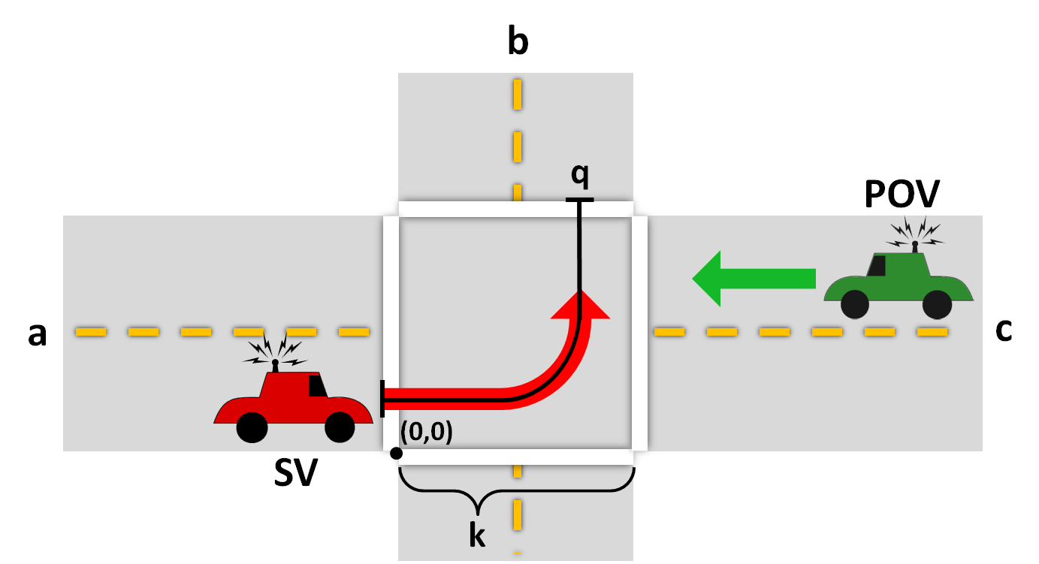
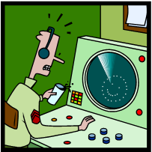
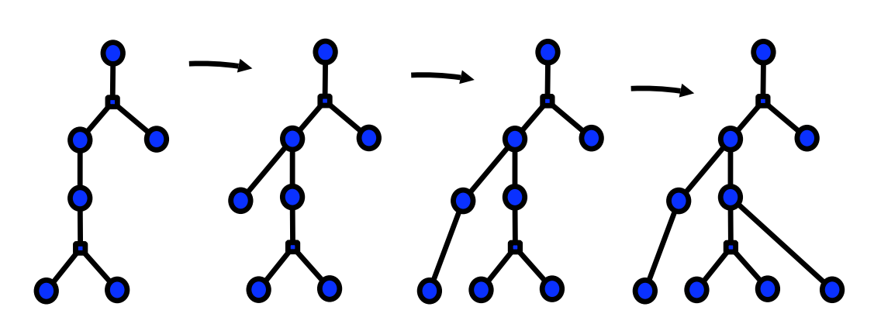
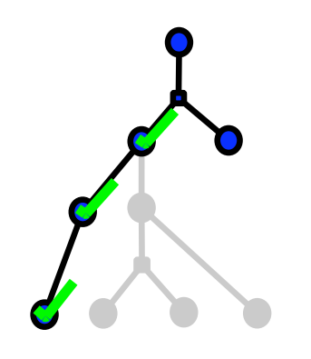
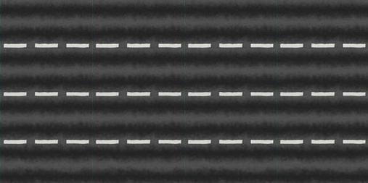



SPLAT!
How to Avoid Bugs while Driving on the Highway
Sarah M. Loos and André Platzer, Carnegie Mellon University
MOTIVATION
METHODS
RESULTS
CONCLUSIONS
A bug on your windshield does little damage, but a bug in the software that controls your engine, brakes or steering is catastrophic. Driver assistance technologies, like adaptive cruise control and automatic braking protocols, have the potential to increase the efficiency of crowded roads, but more compelling is their capacity for reducing the number of accidents and fatalities resulting from driver error. Yet, increased dependence on this next-generation technology is wise only when its reliability has been ensured and regulated.
Our methods can’t protect your windshield from insects as you cruise down the highway, but with continued research we can remove the dangerous software bugs in safety-critical systems that testing and model checking overlook.
Distributed car control systems are distributed hybrid systems, which we model and verify using quantified differential dynamic logic (QdL) [7]. Below are a few selected rules from the QdL proof calculus, categorized loosely as discrete or continuous transitions.
Distributed car control has been proposed repeatedly as a solution to safety and efficiency problems in ground transportation. Yet, a move to this next generation technology, however promising it may be, is only wise when its reliability has been ensured.
This poster presents our formal methods and tools for verifying cyber-physical systems. We discuss automation techniques for theorem proving for distributed hybrid systems using quantified differential dynamic logic. We have implemented KeYmaeraD, the first formal verification tool for distributed hybrid systems.
We also present several case studies where we have successfully verified various properties using these methods and tools. These increasingly difficult case studies are dual-purpose; they demonstrate the implementability of our theories and they present challenges that exposed short-comings in our language and tools, which we have been able to address.
Discrete Transitions
FUTURE WORK
Figure 4. We have formally verified safety for a hybrid program which models cars using adaptive cruise control in highway traffic. In this model, there is an arbitrary number of cars on the road, and each car can move between an arbitrary number of lanes, [5,6].
Increasing complexity of continuous and discrete dynamics
(curved roads, variable road conditions, sensor inaccuracies, etc.)
Verifying liveness properties and providing efficiency guarantees
Automated compilation of controllers into differential dynamic logic
Bridging the gap between verified models and real-world system implementations
Distributed collision avoidance in aircraft, [9]
Developing a tutorial for KeYmaera and differential dynamic logic
Continuous Transitions
REFERENCES
[1] Nikos Aréchiga, Sarah M. Loos, André Platzer, and Bruce H. Krogh. Using theorem provers to guarantee closed-loop system properties. In the American Control Conference, ACC, Montréal, Canada, 2012.
[2] Stefan Mitsch, Sarah M. Loos, and André Platzer. Towards Formal Verification of Freeway Traffic Control. In the International Conference on Cyber-Physical Systems, ICCPS, Beijing, China, 2012.
[3] Akshay Rajhans, Ajinkya Bhave, Sarah M. Loos, Bruce H. Krogh, André Platzer, and David Garlan. Using parameters in architectural views to support heterogeneous design and verification. In the IEEE Conference on Decision and Control and European Control Conference. 2011.
[4] Sarah M. Loos and André Platzer. Safe Intersections: At the Crossing of Hybrid Systems and Verification. In the International IEEE Conference on Intelligent Transportation Systems, ITSC 2011, Washington, D.C., USA, Proceedings, 2011.
[5] David Renshaw, Sarah M. Loos, and André Platzer. Distributed theorem proving for distributed hybrid systems. In the International Conference on Formal Engineering Methods, ICFEM’11, Durham, United Kingdom, Proceedings, LNCS. Springer, 2011.
[6] Sarah M. Loos, André Platzer, and Ligia Nistor. Adaptive cruise control: Hybrid, distributed, and now formally verified. In the 17th International Symposium on Formal Methods, FM, Limerick, Ireland, Proceedings, LNCS. Springer, 2011.
[7] André Platzer. Quantiﬁed differential dynamic logic for distributed hybrid systems. In Computer Science Logic. Volume 6247 of LNCS. Springer, 2010.
[8] André Platzer. The Structure of Differential Invariants and Differential Cut Elimination. To appear in the journal Logical Methods in Computer Science, 2012.
[9] David Renshaw, Sarah M. Loos, and André Platzer. Mechanized Safety Proofs for Disc-Constrained Aircraft. Carnegie Mellon technical report CMU-CS-12-132, 2012.
Figure 5. We have verified safety for two models of intersections. In [4] we verify an intersection with a smart stoplight. The light receives the position and velocity of nearby cars and changes color based on this data. In [1] we verify the cooperative intersection collision avoidance system (CICAS) left-turn assist protocol, pictured in this figure.
Figure 1. In a hybrid program, discrete changes in acceleration, for example, result in continuous changes in position and velocity.
TOOLS
KeYmaera is our automated theorem-prover for differential dynamic logic, [7]. KeYmaeraD is a distributed theorem-prover for quantified differential dynamic logic, which handles distributed hybrid systems, [5].
Figure 3a. Application of different rules at the same node allows parallelization of the proof search. These or-branches are shown here as circle nodes with two children. Figure 3b. Closing an or-branch.
Figure 6. We model a freeway traffic center in [2]. Our formal verification gave bounds on the minimum resolution required for the onboard cameras set to be deployed in the real-world implementation.
Figure 2. The structure of differential invariants. We use differential invariants to verify systems with complicated differential equations. [8]

