Slide 1
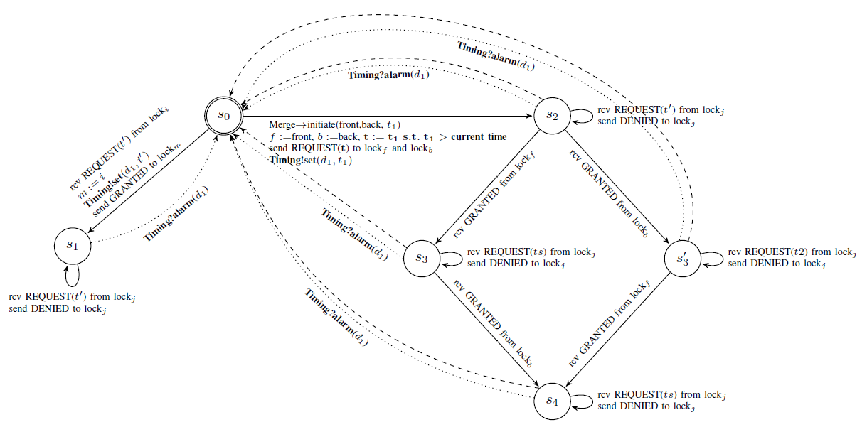
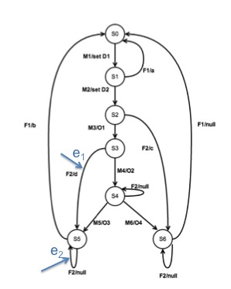
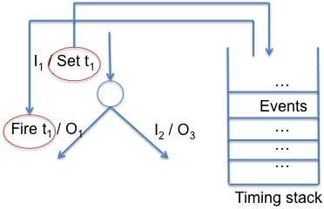
Safe Collaborating Intelligent Vehicles: Synchronized Clocks
Project Number 1329593
N. F. Maxemchuk, Yitian Gu, Shou-pon Lin
Abstract
Use synchronized clocks to improve the safety of connected, intelligent vehicles that use protocols to coordinate the operation of the vehicles.
To invent communications protocols with guarantees that are difficult or impossible to obtain without synchronization.
To simplify verification and conformance testing.
Lock Protocol
Verification
A lock protocol that guarantees that a coordinated maneuver will not progress unless all of the parties are participating, and that none of the parties will release the lock before any other, even though the lock is established over an unreliable communications channel.
Guarantees:
A user can only participate in one group at a time.
No user releases a lock while any other user assumes that it is locked
All of the participants terminate the lock simultaneously even in the presence of communications failure.
Synchronized clocks simplify probabilistic verification by reducing the number of sequences that can occur when collaboration occurs over unreliable communications channels that can require message retransmissions or lost messages.
Verify the protocol by evaluating as many sequences as possible.
Probabilistic verification evaluates sequences that are more probable first, then sequences that are less likely.
Synchronous clocks reduce the number of possible sequences.
All dashed arrows consist of parallel transitions labeled with:
Rcv DENIED from lock_{f}
Rcv DENIED from lock_{b}
Liveness loss of lock_{f}
Liveness loss of lock_{b}
Interval variables:
t: initiation time of the lock
m: identifier of the master
b: identifier of the slave (back car)
f: identifier of the slave (front car)
Conformance Test
Generate test sequences to determine whether a product or system implemented by a manufacturer conforms to a specification. The tests guarantee that implementations from different manufacturers will work together.
Fail Safe Broadcast Protocol
Timers within protocol specification:
Synchronized clocks enable the broadcast system to have ordered, scheduled transmissions.
The fail safe broadcast protocol has a unique message that cannot be lost because channel errors or even the complete loss of the communications channel. This message is used to abort a coordinated maneuver and revert to a safe autonomous operation.
Each member transmits message at scheduled times.
It only transmits if it receives or recovers all previous transmissions.
If it cannot, then it stops transmitting at his turn.
Imposes constraints on test sequences. Timers must be set before they are triggered.
Postman tours may not exist for protocols with multiple timers.
Waiting for timeouts increases test time.
traversing edge 1 followed by edge 2 is not allowed
Synchronized clocks can remove timers from protocols:
Timed events are inputs to the protocol, rather being generated internally.
Use the postman package to generate test sequences for many time dependent protocols which did not have test sequences.

