Slide 1
Science of Security Academic Survey
Dan Wolf, Project Lead
Don Goff, Ph.D., Ron Ball, Linda Hart, Will Brown
October 17, 2013

Slide 2
Many academic researchers are conducting research into cybersecurity topics. Collectively, their work promises the development of a systematic body of knowledge termed the Science of Security. The current Science of Security Academic Survey project consisted of three elements: first, we conducted a systematic survey of academic researchers in computer science, electrical and computer engineering, and mathematics, to determine whether they think that a Science of Security exists or is possible. Second, we conducted an open source literature review and environmental scan of current research in science of security topics and disciplines. Third, we developed a database which will become accessible by researchers to find current research in the Science of Security and to develop collaborations. Preliminary findings strongly indicate a belief that Science of Security has underlying scientific principals and is evolving into a true science.

Slide 3
Why?
Identify basic principles of SoS
Improve the foundations
Need empirically based research
Advances in theory complement/motivate work
Create an SoS community
Identify gaps in critical research areas
Develop consensus on hard problems

Slide 4
Science of Security Academic Survey Project Goals
Determine whether a “science” of cybersecurity is possible
Help build a research community
Information source
Collaborative forum
Identify distinctions between science, engineering and technology in cybersecurity research

Slide 5
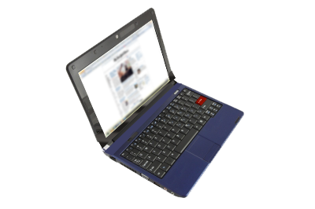
Methodology
Identify schools doing research--RU/HV, SaTC, other
Gather open source data on current research efforts
Survey major institutions to learn what they are doing and views on SoS
Analyze gaps in critical SoS areas
Create a database resource of information on research
Provide search capability on research efforts to the community
Provide metrics on current academic research by discipline, topic
Develop a sharing capability on who is doing what
Nurture research partnerships and collaboration
Develop a rubric for rigorous evaluation of SoS research efforts

Slide 6
Disciplines, Departments and Colleges Surveyed
Computer Science
Electrical and Computer Engineering
Mathematics
Selected social and interdisciplinary sciences
Further subdivisions:
Cascading tree of subdisciplines – increased granularity

Slide 7
Survey
Hosted on VO website
Sent out Questionnaire: 654 emails and 310 packets with Next Wave copies included
Followed up with additional emails and 225 snail mailings
Collected and analyzed data
Developed rubric to systematically evaluate research
95% --think the field is “scientific”

Slide 8
Results
Identified 524 research entities in the US
Developed 550 keyword phrases to characterize research efforts
Identified 67 possible entities with significant capacity to do general research in computer science, electrical and computer engineering and related mathematics
Developed a rubric to evaluate SoS efforts
Identified 55 categories of research efforts with potential for SoS
Identified 48 possible entities with significant capacity to do SoS research

Slide 9
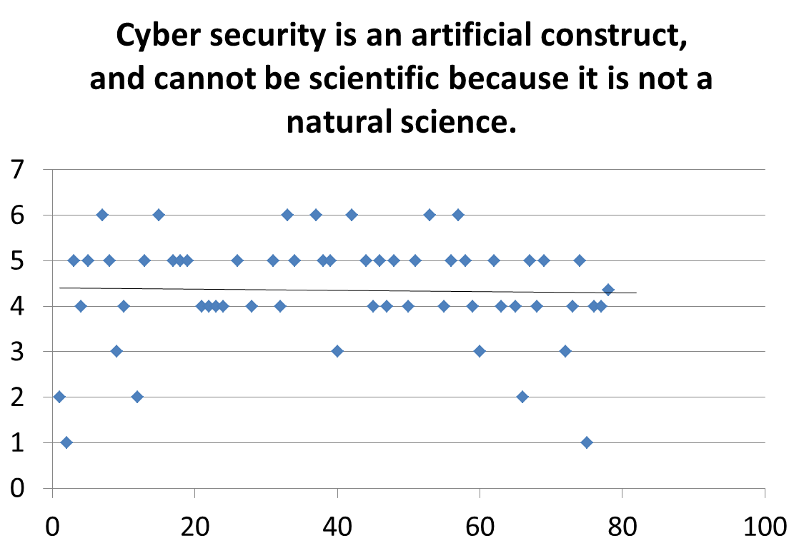
Average = 4.0

Slide 10
Constructs
1 = “Strongly Agree”
2 = “Agree”
3 = “Neither Agree nor Disagree”
4 = “Disagree”
5 = “Strongly Disagree”
6 = “Don’t Know or Not Applicable”
Therefore, lower numbers and averages indicate stronger agreement, higher numbers indicate rejection of the statement.

Slide 11
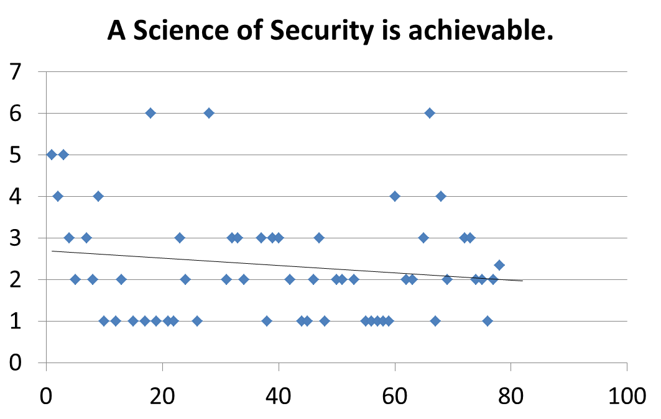
Average = 2.0

Slide 12
Zener Diode – Is it science or technology?

Slide 13
Database
Can query for specific universities, departments, research subjects, key phrases, words, or specific research teams, including multi-university activities
Gives potential to identify specific research of interest or to inform potential projects, identify collaborators or potential collaborators
Developed key word/phrase list --enables statistical analysis of research categories
Link to the VO Website with simple splash page to allow SQL queries by researchers

Slide 15
Developed keyword phrases to characterize research activities
Over 550 general keyword phrases
Subset of 55 that potentially identify basic SoS research
Next steps:
Validate keyword phrases
Do these characterize all research?
Do these help identify potential basic research related to SoS ?

Slide 16
Sample Keywords/Phrases
Secure Data Streams
Secure File Sharing
Secure Files
Secure Mobile Technologies
Secure Service-Based Systems
Secure Software
Secure Software Development
Secure Storage
Secure System Architecture
Secure System Development
Secure Wireless Networks
Security "Disciplines”
Security Architecture
Security Modeling
Security Protocols
Security Risk Management
Security Specification
Security Technology
Security Testing / Evaluation
Security/Privacy/Trust Modeling And Specification
Snake-in-the-box problem
Software assurance
Software bug prediction

Slide 17
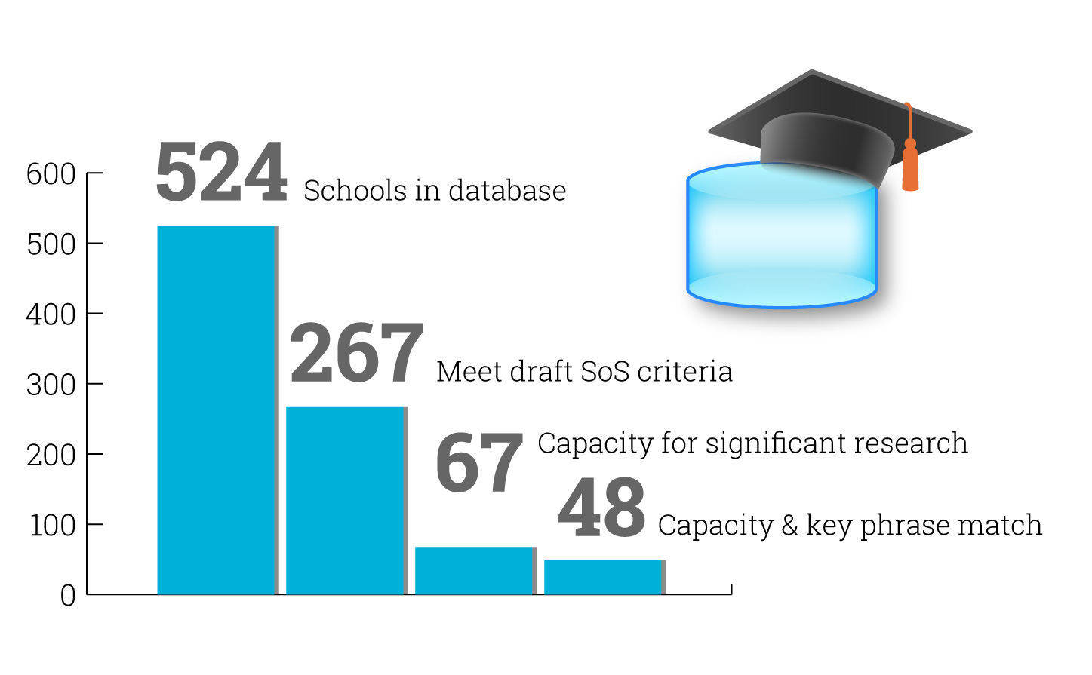
Preliminary Results (Unvalidated)

Slide 18
Next Steps
Validate characterization of institutions research efforts
Develop summary of efforts in 550 research area
Continue to evaluate academic institutions capacity to do research
Identified gaps in critical SoS research
Nurture the SoS community to do more research in critical areas
Develop an SoS sharing and partnering community
Enhance the current VO SoS portal as an info source
Validate what is SoS

Slide 19
Invitations
To join VO Website/ SoS Group:
http://cps-vo.org/group/SoS
To take the survey:
http://cps-vo.org/node/6666
To comment, email us at:
SoS.Survey@CPS-VO.org

Slide 20
Broad Objective
Create a healthy cybersecurity research community that does the following:
Soundly based empirical research is routine
Advances in theory complement/motivate empirical work
Active dialog and scientific discussion
Reasonable consensus on a set of hard problems confronting the community

Slide 23
Research Scan
Lablets
RU/VH Universities
SaTC Grantees
Other specified U.S. research programs
Yielded master list of >500 research entities
Disciplines by institution

Slide 24
DATA GATHERING Identify formal lists of research institutions Augment list with other schools with research potential Develop SoS survey Disseminate SoS info and survey Perform open source search of academic research Develop SoS Rubric Analyze survey results Characterize academic research keyword phrases Define potential SoS keyword phrases Define research capacity Rubric | DATA ORGANIZING Create MySQL database of academic research Develop sample research queries Design webpage access to MySQL database Validate open-source characterization of research institutions | DATA REPORTING Enable academic access to database info Encourage academic partnerships on SoS activities thru database Populate VO Website with SoS related info Prepare weekly highlights of SoS activities for VO Website

