Slide 1




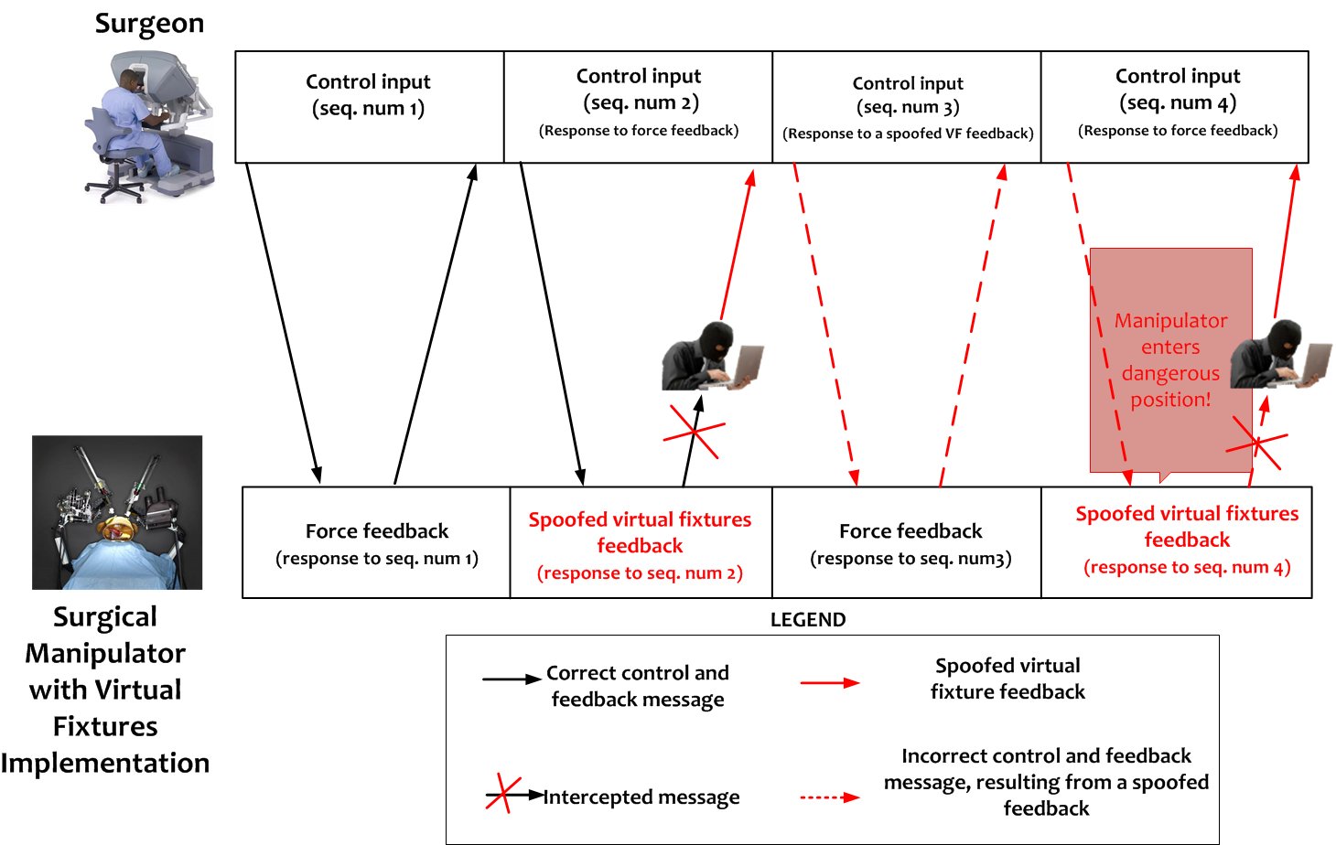
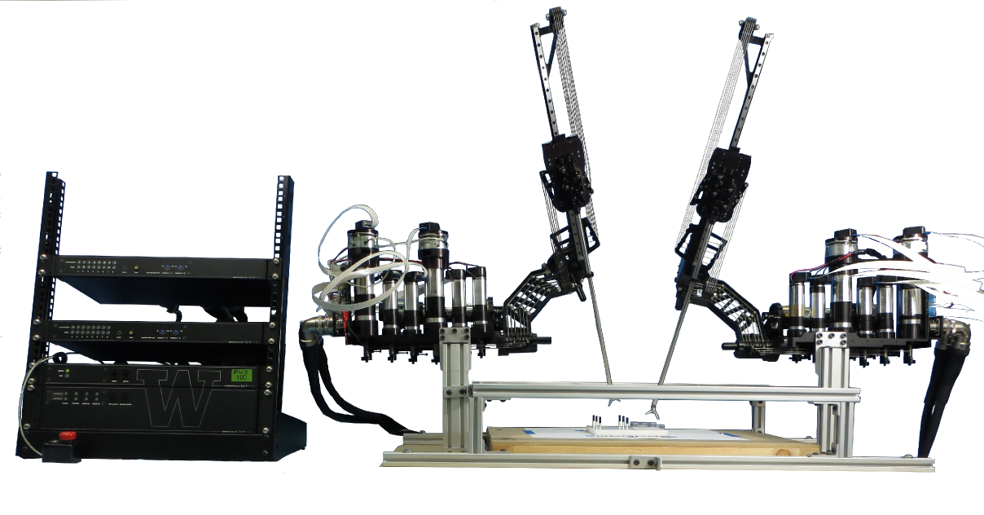

CPS: Breakthrough: Secure Telerobotics
Howard Jay Chizeck (PI) Tadayoshi Kohno (Co-PI)
chizeck@uw.edu yoshi@cs.washington.edu
University of Washington Tamara Bonaci (Grad. Research Assistant)
    tbonaci@uw.edu
Abstract
Problem: Security of Teleoperated Systems
Our Approach
This project is developing software and hardware tools to enhance security, privacy and safety of telerobotic systems. The results can be classified into tools: (1) to prevent security threats in telerobotics; (2) to monitor and detect unexpected and malicious activities; and (3) to correct for errors caused by random failures and malicious actions.
Open and uncontrollable communication medium → malicious entities (attackers) can disrupt or take over operator-robot communication
Possible threats:
  Attacks against the wireless communication (short-range attacks)
  Attacks on the operator-robot interaction through publicly available networks (long-range attacks)
  Attacks on the operator-side software
  Attacks on the manipulator-side software
  Physical attacks
Example: Spoofing attack on telerobotic system implementing haptic virtual fixtures
Research and design of secure telerobotic systems:
Proactive approach towards security → security issues are an integral part of the system design from the beginning.
  Focus on the knowledge about:
    System’s behavior (dynamics)
    Physical constraints
    Interaction between cyber and physical components
  to reduce uncertainties about the system.
Telerobotic Systems
Systems where human operators interact with distant manipulators through communication networks
Application areas:
    Robotic surgery
    Search and rescue robotics
    Military missions
    Underwater infrastructure and repair
    Hazardous environments cleanup
    Mining
    Manipulation and inspection of objects in low earth orbit
  Next generation telerobotic systems:
    Multiple operators and manipulators.
  Existing publicly available networks combined with temporary ad-hoc wireless and satellite networks to send sensory information to operators.
Project Goals
Evaluation Platform
Acknowledgement
Enhance security, privacy and safety of telerobotic systems by developing appropriate:
  Prevention tools
  Monitoring and correction tools
    Operator signatures
  Error correction tools
    Added (pseudo)random signals
Raven surgical robot
(UW BioRobotics Lab)
This work was funded by the National Science Foundation (NSF Grant 1329751 CPS: Breakthrough: Secure Telerobotics).).

