Slide 1
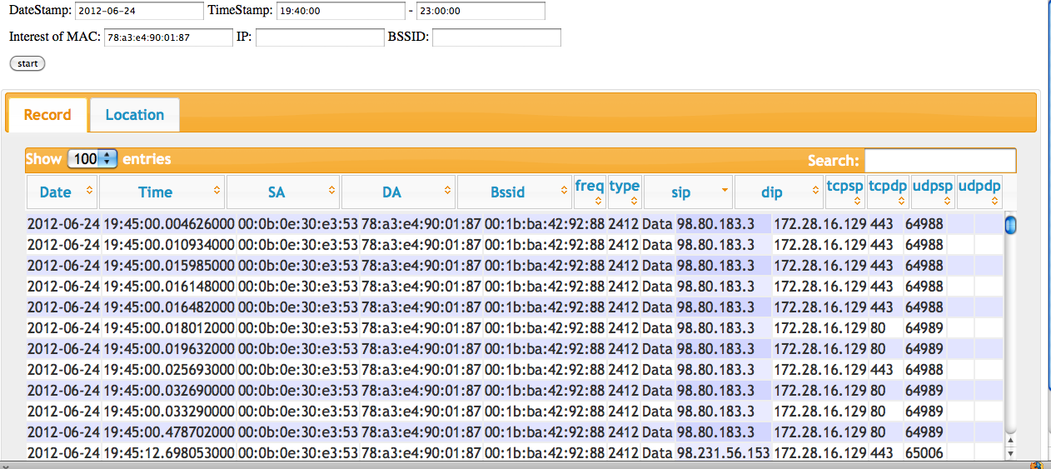
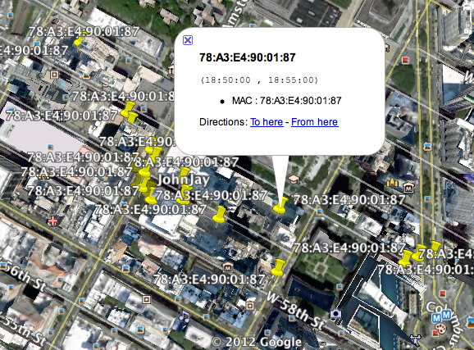
Security Monitoring for Wireless Network Forensics (SMOWF)
PIs: Ping Ji, CUNY – John Jay College of Criminal Justice
pji@jjay.cuny.edu
Background:
Broad deployment of WiFi networks makes it easy for malicious network users to camouflage their true identities ==> Conduct an attack, leave without being notices
Most open (or encrypted) wireless networks do not keep logs by default
Hard to obtain important network forensic traces
Security Monitoring System for Wireless Network Forensics (SMoWF)
Establish: a forensic wireless trace digests database
Determine: which wireless device appeared at where at when?
Need Answers For:
Whether or not a particular device was involved in a given malicious network activity?
Can this device be uniquely identified by the logs?
Where was a particular device physically located during a given event?
Moving/Static Monitoring Point
Moving/Static Monitoring Point
SMOWF
Sensor
Sensor
Pre-Processor: parse(decrypt), filter, generate digest …
… …
Pre-Processor: parse(decrypt), filter, generate digest …
Packet digest correlation, synchronize, format….
Post-Investigation
Engine
Device Localization
Device Identification
Forensic trace repository
Query generator&Search
Report & Visualization
Approach
Design a reliable network trace logging method that gathers complete wireless network packets, and keep only useful packet digests.
Design a query/search system that allows users to conduct forensic analysis efficiently and correctly based on monitored traces.
Study and implement localization algorithms that can provide the location information of a given device when necessary.
System Prototype

