Slide 1
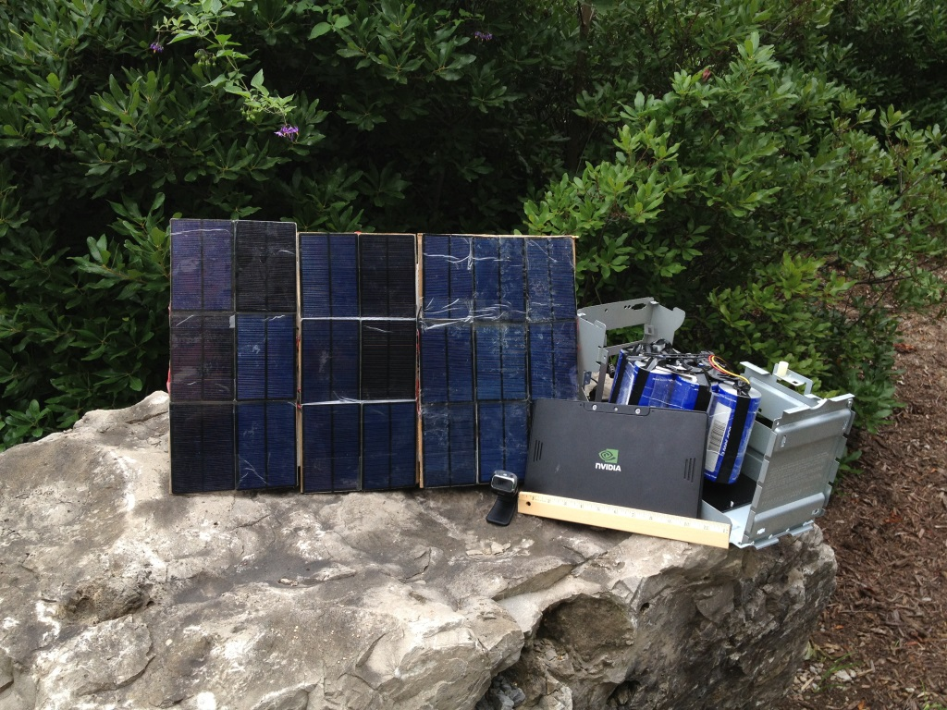
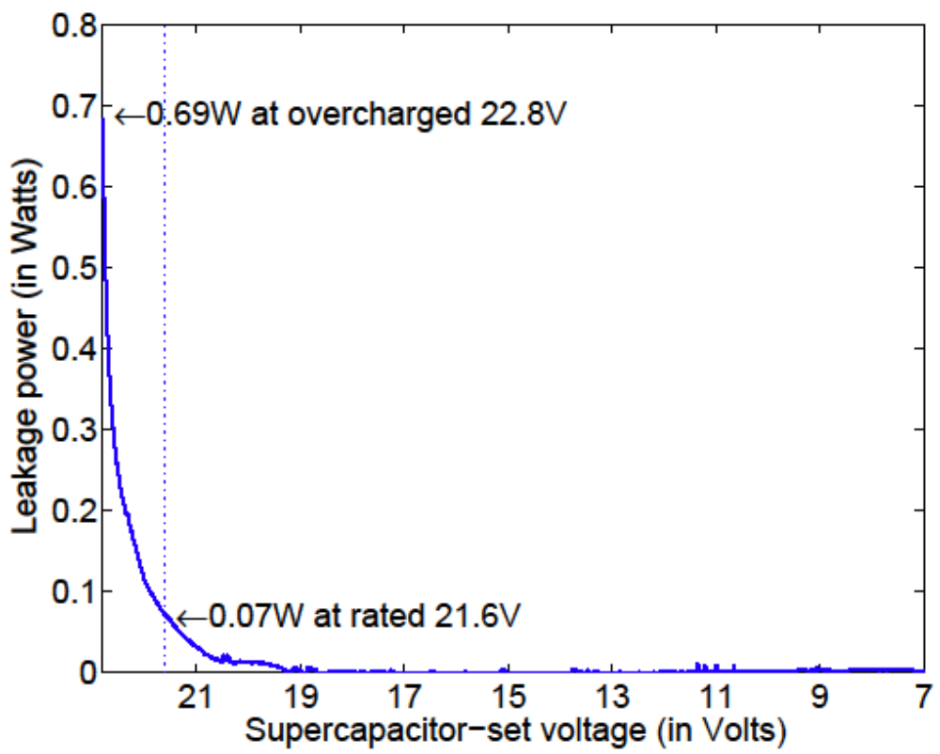
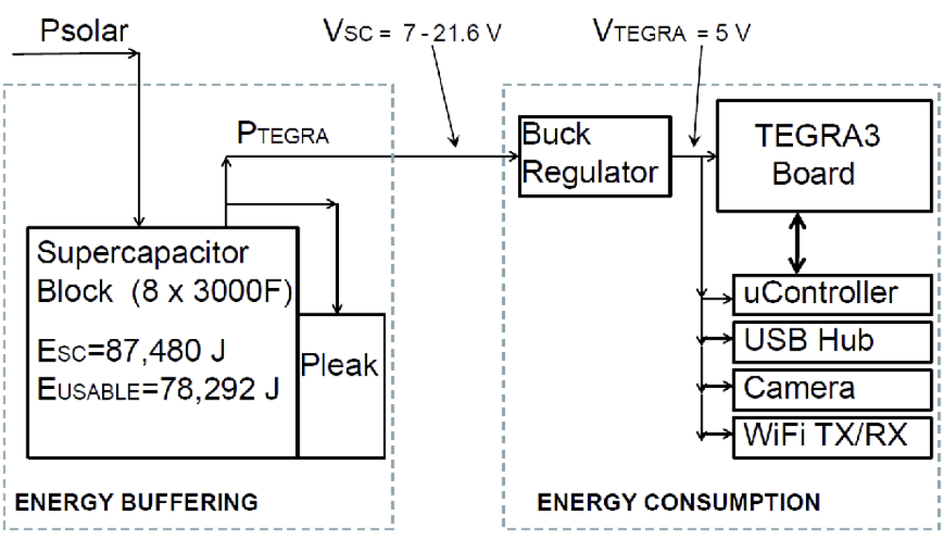
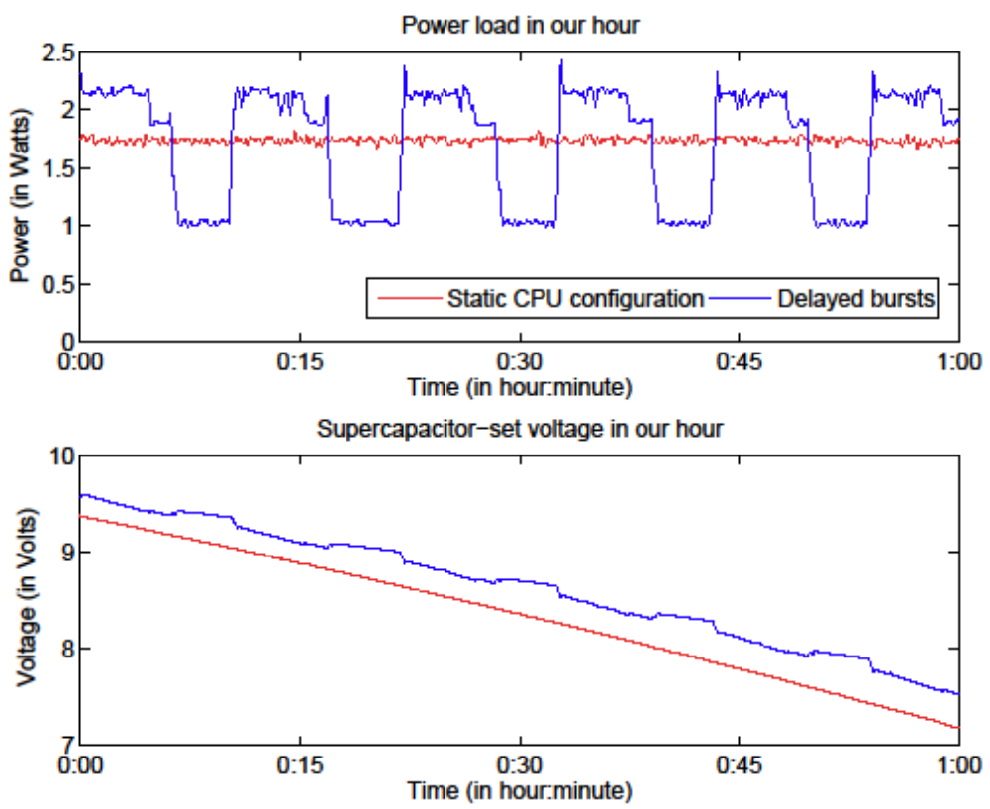
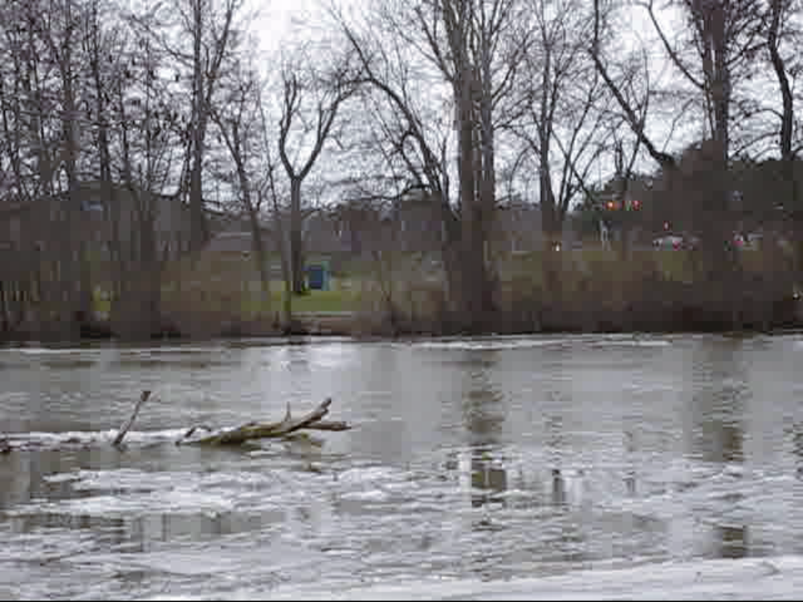
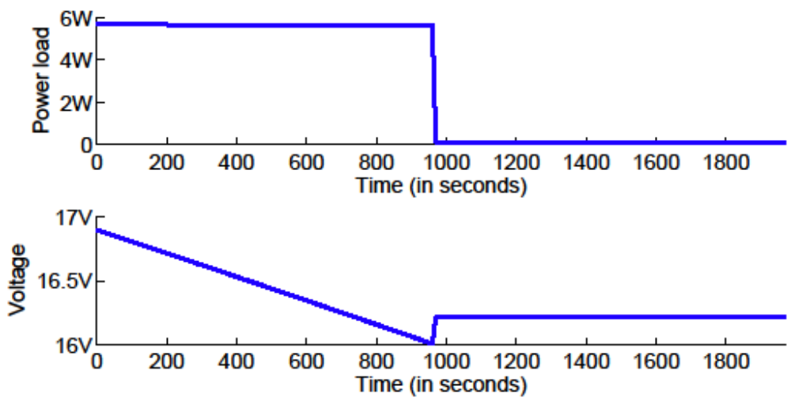
CNS-1239423: CPS: Synergy: Self-Sustainable Data-Driven Systems In the Field
Kai Shen, Wendi Heinzelman, Gaurav Sharma, and Tolga Soyata
University of Rochester
Background and Overview
Continuous, high-speed data processing in the field is important for applications such as wildlife monitoring and highway safety.
Current self-sustainable systems rely on rechargeable batteries that suffer from adverse environmental impact and limited lifetime.
We demonstrate the feasibility of using the supercapacitors as the energy buffering mechanism for continuous field operations.
We utilize synergistic software/software techniques (including system modeling).
Summary of Results
Simple voltage-to-energy relationship E=C·V²/2 in supercapacitors enable precise energy buffer modeling and time-to-depletion prediction.
Supercapacitor self-discharge (or leakage) is a minor issue in practical systems where the power consumption far exceeds the leakage.
The supercapacitor instability under varying power uses requires careful voltage-to-charge assessments.
We propose energy/QoS optimization through periodic low-power data capture and bursts of data processing at a higher CPU configuration.
Prototype System Construction
System includes the supercapacitor block for energy buffering and the Tegra3-based system for energy consumption.
Application areas for continuous data capture and processing in the field include highway traffic monitoring and motion detection through camera traps.
Supercapacitor Energy Modeling
Supercapacitor self-discharges (or leaks):
Leakage power modeling: Δt(P_{load}+P_{leakage}-P_{supply})=C(V_{t}²-V_{t+Δt}²)/2
Results: small effect on modeling accuracy when leakage is far smaller than power load
Supercapacitor instability:
Precise supercapacitor energy modeling requires that the charge is assessed only when the system stabilizes under a low power load.
Results: reduce the modeling error from 7% to 4%.
Software System Adaptation
Platforms such as Tegra3 have a wide power range at different CPU configurations and workloads (1-6W in our case).
We propose delayed burst processing where the application alternates between two phases periodically:
  a capture-only phase that stores the captured data without processing,
  and a burst processing phase that processes all previously captured data at the highest data rate allowed by the CPU configuration.
Only burst processing needs a high CPU configuration and the capture-only phase can remain at an energy-efficient low CPU configuration.
Results: delayed bursts (achieving 10.7fps) produces 56% QoS enhancement over the static configuration (achieving 6.9fps).

