Slide 1
Self-Sustainable, Low-Maintenance Data Processing in the Field
Kai Shen, University of Rochester
Group work with Tolga Soyata, Wendi Heinzelman, Gaurav Sharma, Amal Fahad, and Zhuan Chen

Slide 2
Motivating Case: Intelligent Highway
There are a lot of traffic cameras
They are dumb – simply capturing data and sending it to data center (where sophisticated things are done)
Require high-speed network connection (Mbps-order data rate), can’t be deployed in remote fields
Enable intelligent processing on data capturing devices
Analyze traffic patterns
Identify notable scenes (from vast amount of uninteresting data)
Predictive modeling and fast signaling

Slide 3
Challenges and Technologies
Self-sustainability (low-power computing, energy harvesting)
Low maintenance in the field
Software: virtualization
Easy installation/upgrade of software system/application
Fast system/application switchover without data losses
Containment and isolation of sensitive data
Hardware: supercapacitor energy buffering (no batteries)
Millions of charge cycles
Environmentally friendly

Slide 4
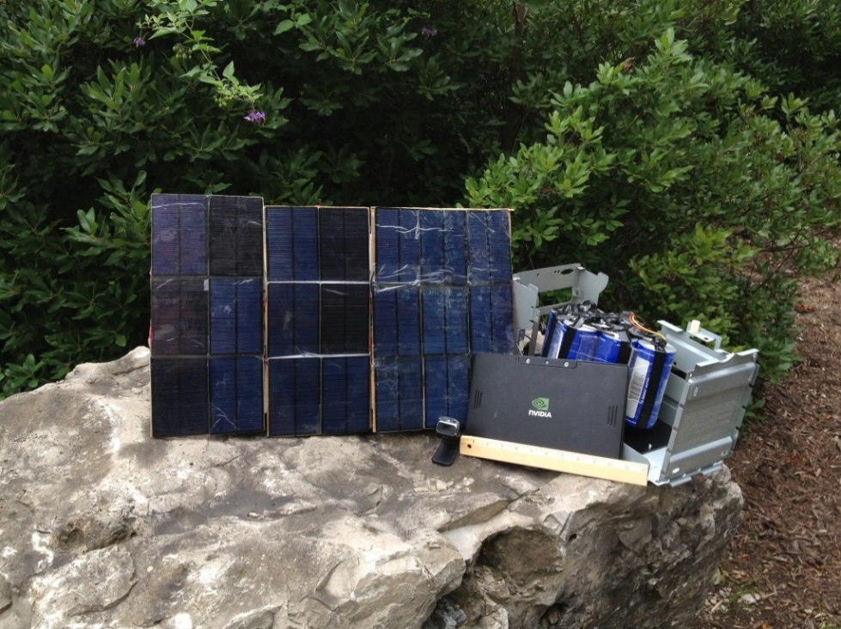
Prototype
Current platform
Nexus7 with Tegra3: 1cpu@102MHz (~0.3W) to 4cpus@1.2GHz (~4W)
Half as many supercapacitors and solar panels, half the size as shown in the picture

Slide 5
Applications
Useful when high-volume, high-speed data processing in the field is needed
Intelligent highway
Area surveillance – monitor floating logs in a river
Sciences in the field

