Slide 1
Simple Features and Simple Classifiers for Cyberphysical Systems: Applications to Seizure Detection and Prediction
Keshab K. Parhi
(Joint work with Zisheng Zhang)
Dept. of Electrical & Computer Engineering
University of Minnesota, Minneapolis
Email: parhi@umn.edu

Slide 2
Outline
Seizure Prediction and Detection Application
Feature Extraction
Feature Ranking
Classification
Low-power and Low-complexity device architecture

Slide 3
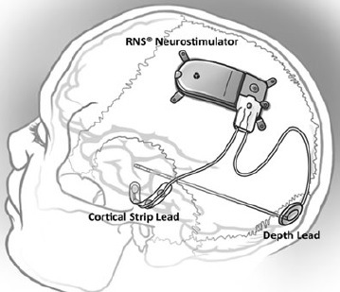
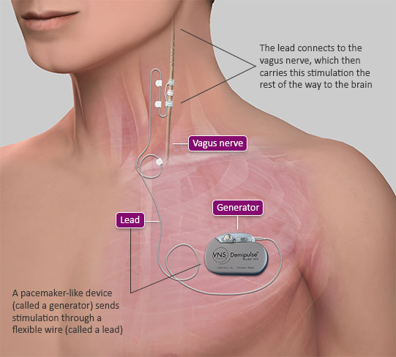
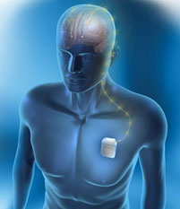
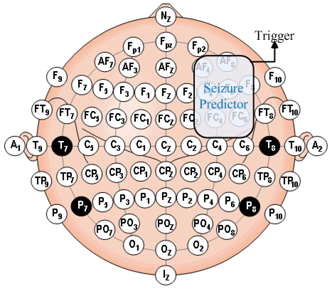
Seizure Prediction Devices
Cyberonics Vagus verve [1]
Neuropace RNS [2]
Medtronic DBS [3]
Scalp EEG seizure predictor
[1] http://us.cyberonics.com
[2] Two-year seizure reduction in adults with medically intractable partial onset epilepsy treated with responsive neurostimulation: Final results of the RNS System Pivotal trial,” by Heck, C.N., King-Stephens, D., Massey, A.D., Nair, D.R., Jobst, B.C., Barkley, G.L.,…Morrell, M.J., 2014, Epilepsia 55(3), p. 434. Copyright 2014 by Epilepsia.
[3] https://professional.medtronic.com/

Slide 4
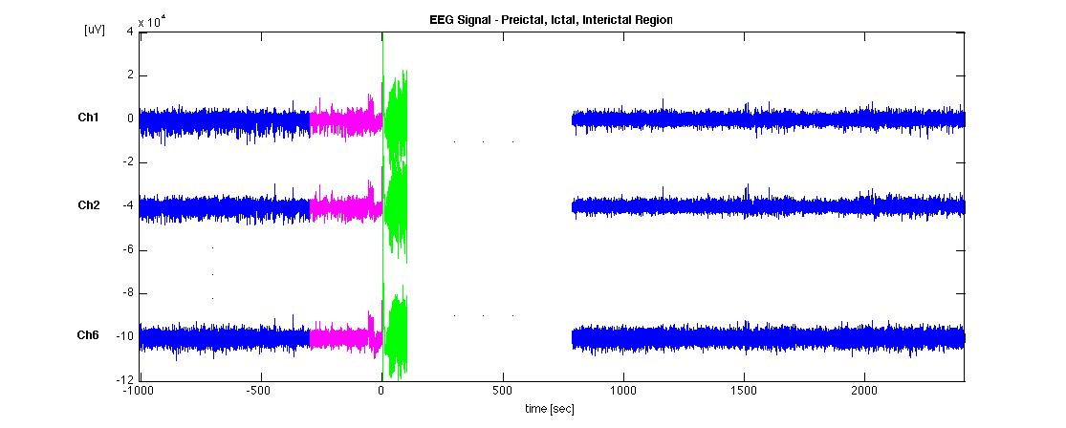
Motivation
At least
60 minute gap
Preictal
(Class +1)
Interictal
(Class -1)
A patient-specific algorithm that can reliably predict seizures
Low hardware complexity and low power consumption

Slide 5
Databases 1 and 2
Freiburg Seizure Prediction Project database
https://epilepsy.uni-freiburg.de/freiburg-seizure-predictionproject/eeg-database
Intracranial EEG (iEEG)
21 patients with medically intractable focal epilepsy
6 electrodes
Sampling frequency: 256 Hz
MIT Physionet EEG database [4]
Scalp EEG (sEEG)
23 patients with intractable seizures
23 bipolar channels
Sampling frequency: 256 Hz
[4] Ali Shoeb. Application of Machine Learning to Epileptic Seizure Onset Detection and Treatment. PhD Thesis, Massachusetts Institute of Technology, September 2009

Slide 6
Databases 3 and 4
UPenn and Mayo Clinic’s Seizure Detection Challenge database: http://www.kaggle.com/c/seizure-detection
Intracranial EEG (iEEG)
4 canine + 8 human subjects
For dogs
16 electrodes, 400 Hz
For humans
varying number of electrodes, 500 or 5000 Hz
American Epilepsy Society Seizure Prediction Challenge database: http://www.kaggle.com/c/seizure-prediction
Intracranial EEG (iEEG)
5 canine + 2 human subjects
For dogs
16 electrodes, 400 Hz
For humans
varying number of electrodes, 5000 Hz

Slide 7
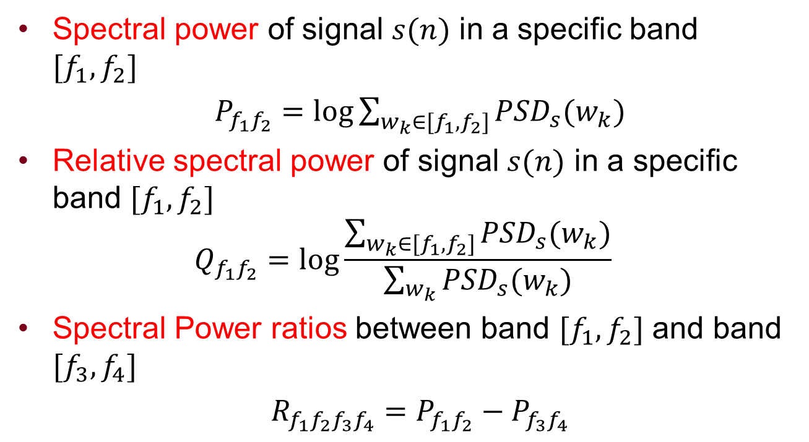
PSD Features
Spectral power of signal $s(n)$ in a specific band $[f_{1},f_{2}]$
$P_{f_{1}f_{2}}=\log{\sum_{w_{k}∈[f_{1},f_{2}]}{{PSD}_{s}(w_{k})}}$
Relative spectral power of signal $s(n)$ in a specific band $[f_{1},f_{2}]$
$$Q_{f_{1}f_{2}}=\log{\frac{\sum_{w_{k}∈[f_{1},f_{2}]}{{PSD}_{s}(w_{k})}}{\sum_{w_{k}}{{PSD}_{s}(w_{k})}}}$$
Spectral Power ratios between band $[f_{1},f_{2}]$ and band $[f_{3},f_{4}]$
$R_{f_{1}f_{2}f_{3}f_{4}}=P_{f_{1}f_{2}}−P_{f_{3}f_{4}}$

Slide 8
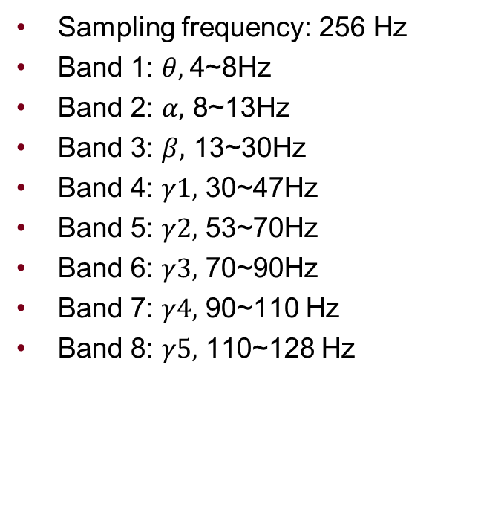
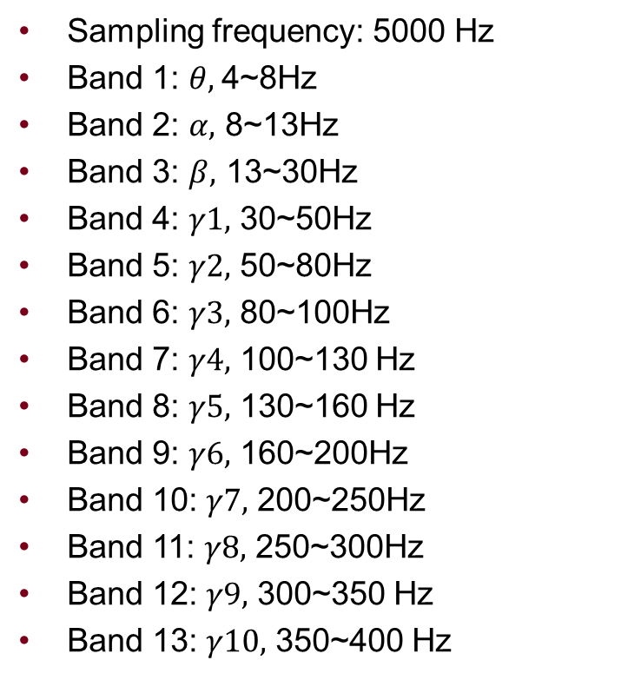
Examples of Frequency Band Partition
Sampling frequency: 256 Hz
Band 1: $θ$, 4~8Hz
Band 2: $α,$ 8~13Hz
Band 3: $β,$ 13~30Hz
Band 4: $γ1,$ 30~47Hz
Band 5: $γ2,$ 53~70Hz
Band 6: $γ3,$ 70~90Hz
Band 7: $γ4,$ 90~110 Hz
Band 8: $γ5,$ 110~128 Hz
Sampling frequency: 5000 Hz
Band 1: $θ$, 4~8Hz
Band 2: $α,$ 8~13Hz
Band 3: $β,$ 13~30Hz
Band 4: $γ1,$ 30~50Hz
Band 5: $γ2,$ 50~80Hz
Band 6: $γ3,$ 80~100Hz
Band 7: $γ4,$ 100~130 Hz
Band 8: $γ5,$ 130~160 Hz
Band 9: $γ6,$ 160~200Hz
Band 10: $γ7,$ 200~250Hz
Band 11: $γ8,$ 250~300Hz
Band 12: $γ9,$ 300~350 Hz
Band 13: $γ10,$ 350~400 Hz

Slide 9
Feature Example
Patient No. 1, MIT Database, Scalp electrode 17, $γ4$/ $γ5$

Slide 10
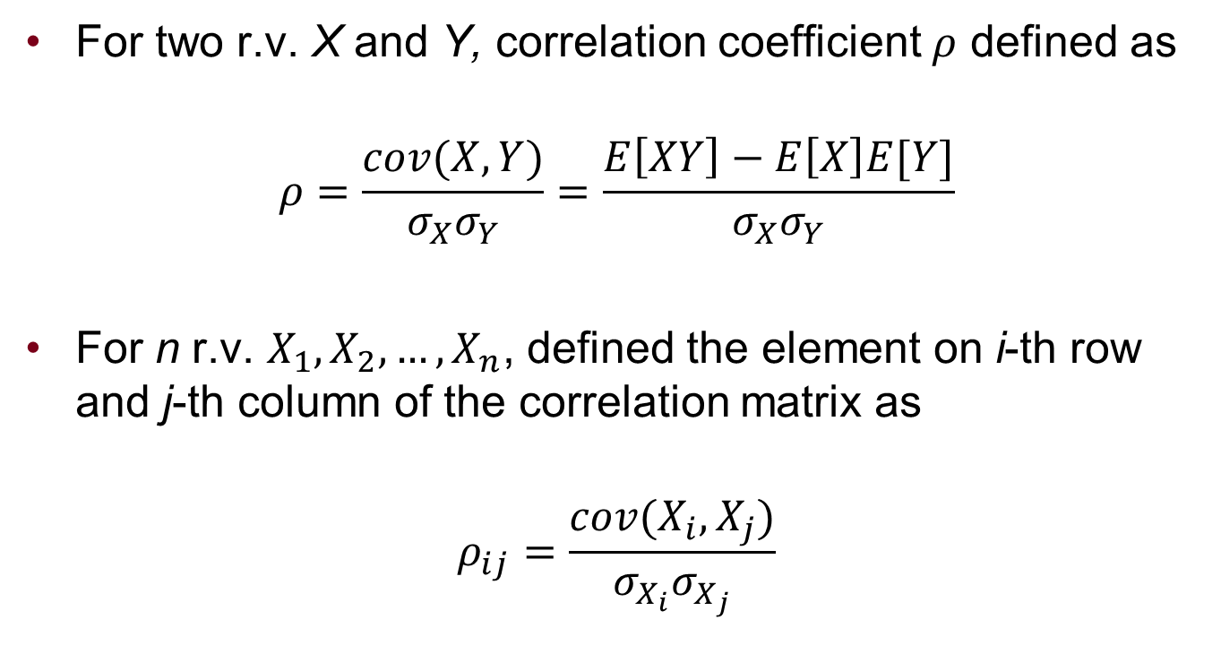
Correlation Features
For two r.v. X and Y, correlation coefficient $ρ$ defined as
$$ρ=\frac{cov(X,Y)}{σ_{X}σ_{Y}}=\frac{E\left[XY\right]−E\left[X\right]E[Y]}{σ_{X}σ_{Y}}$$
For n r.v. $X_{1},X_{2},…,X_{n}$, defined the element on i-th row and j-th column of the correlation matrix as
$$ρ_{ij}=\frac{cov(X_{i},X_{j})}{σ_{X_{i}}σ_{X_{j}}}$$

Slide 11
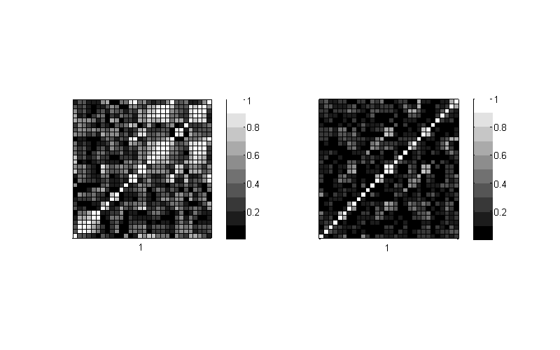
Correlation Matrix (ictal period)
Pat. No. 6, American Epilepsy Society Seizure Prediction Challenge database
Time-domain signal
Frequency-domain signal

Slide 12
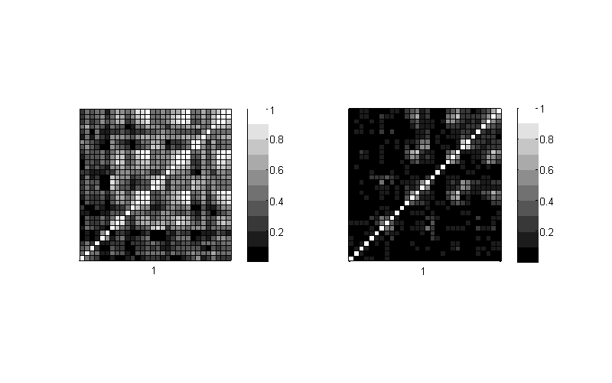
Correlation Matrix (interictal period)
Pat. No. 6, American Epilepsy Society Seizure Prediction Challenge database
Time-domain signal
Frequency-domain signal

Slide 13
Feature Ranking
F-score
LASSO
Brand and Bound (BAB) + Linear Separability
Classification and Regression Tree (CART)

Slide 14

Single Feature Selection by F-score
Patient No. 19, MIT, electrode 1, $γ1$/ $γ2$ (good prediction)

Slide 15

Feature Selection by LASSO
Freiburg, Patient No. 15, electrode 2, prediction
A single $γ2$ spectral power
$γ2$ spectral power versus $β$-to-$γ1$ spectral power ratio

Slide 16

Feature Selection by BAB
Freiburg, Patient No. 15, electrode 2, prediction
A single $γ2$ spectral power
$γ2$ spectral power versus $θ$-to-$γ1$ spectral power ratio

Slide 17
Feature Selection by CART
patient No. 7, Upenn and Mayo Clinic’s seizure detection contest.

Slide 18

Cont’d
Electrode 28, $P_{13,30}/P_{160,200}$
Electrode 27, $P_{30,50}/P_{200,250}$
Electrode 26, $P_{8,13}/P_{160,200}$

Slide 19
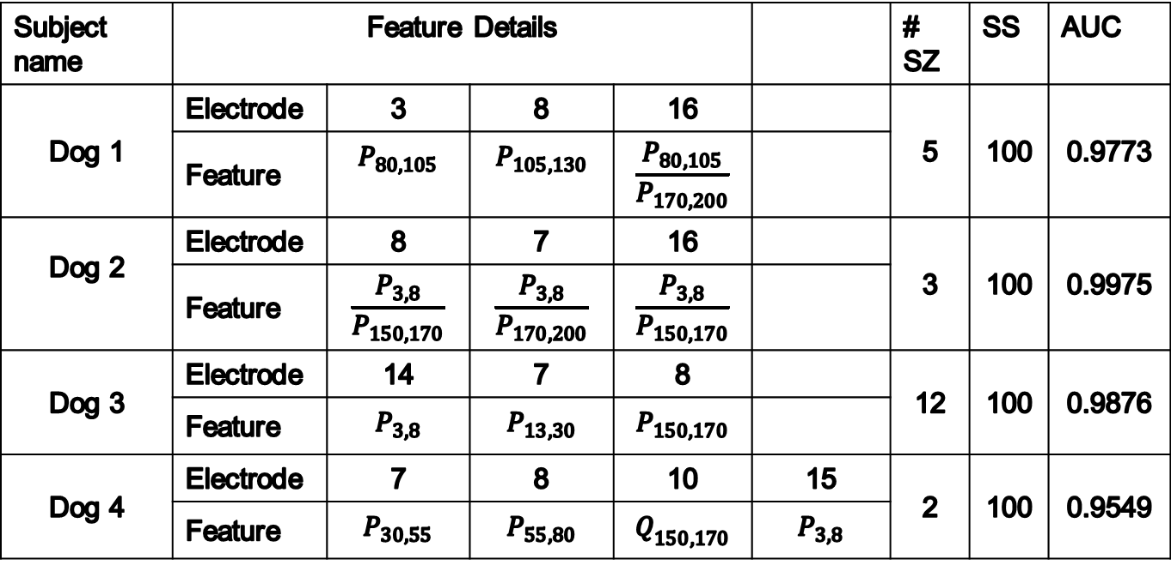
Upenn/Mayo Detection Results
Subject name | Feature Details |  |  |  |  | # SZ | SS | AUC
Dog 1 | Electrode | 3 | 8 | 16 |  | 5 | 100 | 0.9773
 | Feature
Dog 2 | Electrode | 8 | 7 | 16 |  | 3 | 100 | 0.9975
 | Feature
Dog 3 | Electrode | 14 | 7 | 8 |  | 12 | 100 | 0.9876
 | Feature
Dog 4 | Electrode | 7 | 8 | 10 | 15 | 2 | 100 | 0.9549
 | Feature

Slide 20
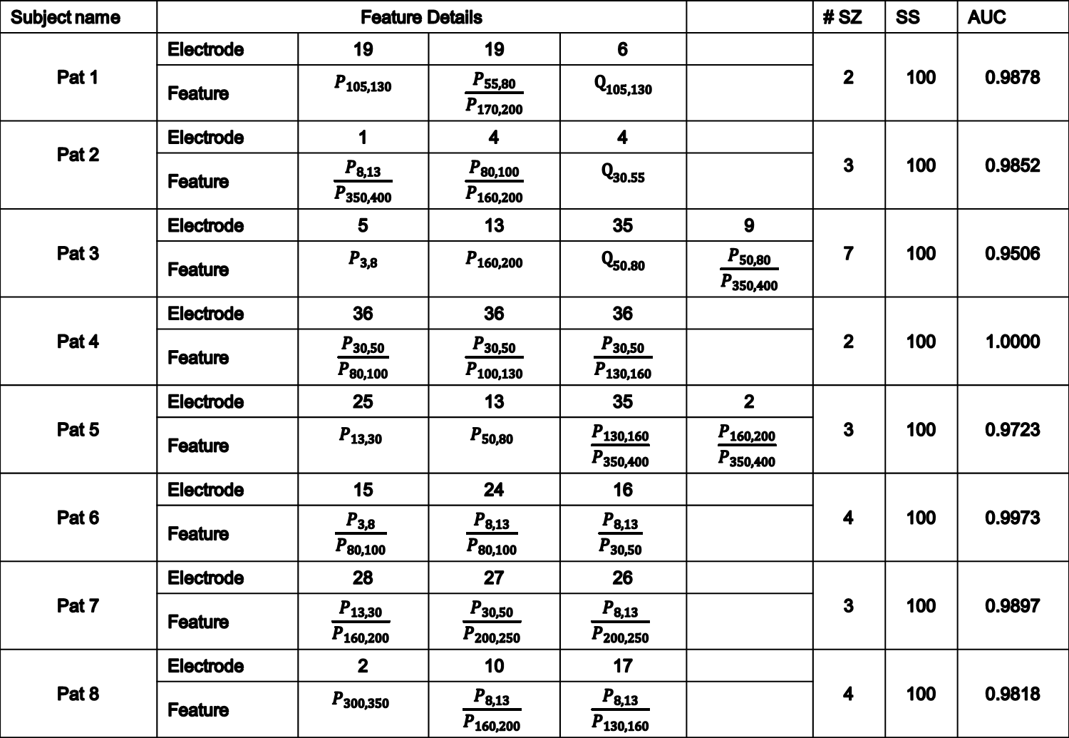
Cont’d
Subject name | Feature Details |  |  |  |  | # SZ | SS | AUC
Pat 1 | Electrode | 19 | 19 | 6 |  | 2 | 100 | 0.9878
 | Feature
Pat 2 | Electrode | 1 | 4 | 4 |  | 3 | 100 | 0.9852
 | Feature
Pat 3 | Electrode | 5 | 13 | 35 | 9 | 7 | 100 | 0.9506
 | Feature
Pat 4 | Electrode | 36 | 36 | 36 |  | 2 | 100 | 1.0000
 | Feature
Pat 5 | Electrode | 25 | 13 | 35 | 2 | 3 | 100 | 0.9723
 | Feature
Pat 6 | Electrode | 15 | 24 | 16 |  | 4 | 100 | 0.9973
 | Feature
Pat 7 | Electrode | 28 | 27 | 26 |  | 3 | 100 | 0.9897
 | Feature
Pat 8 | Electrode | 2 | 10 | 17 |  | 4 | 100 | 0.9818
 | Feature

Slide 21
Feature Selection by CART
Dog 2, American Epilepsy Society Seizure Prediction Challenge database
electrode importance

Slide 22
Upenn/Mayo Prediction Results
Subject name | Comparison |  |  |  |  |  |  |  | # SZ
 | Electrodes No. |  | # Features |  | Classifier |  | AUC
 | baseline | proposed | baseline | proposed | baseline | proposed | baseline | proposed
Dog 1 | 1 3 5 8 11 | 1 3 5 8 11 | 275 | 50 | RBF-SVM | Polynomial-SVM (d=4) | 0.9975 | 0.9934 | 4
Dog 2 | 9 11 12 15 | 9 11 12 15 | 220 | 50 | RBF-SVM | Polynomial-SVM (d=4) | 1.0000 | 0.9987 | 7
Dog 3 | 7 9 10 15 | 7 9 10 15 | 220 | 50 | RBF-SVM | Polynomial-SVM (d=4) | 0.9978 | 0.9333 | 12
Dog 4 | 3 6 7 | 3 6 7 | 155 | 35 | RBF-SVM | Polynomial-SVM (d=4) | 0.9984 | 0.9542 | 17
Dog 5 | 12 13 14 | 12 13 14 | 155 | 20 | RBF-SVM | Polynomial-SVM (d=4) | 0.9961 | 0.9698 | 5
Pat .1 | 2 13 15 | 2 13 15 | 234 | 20 | RBF-SVM | Polynomial-SVM (d=4) | 1.0000 | 1.0000 | 3
Pat. 2 | 1 12 14 | 1 12 14 | 234 | 20 | RBF-SVM | Polynomial-SVM (d=4) | 1.0000 | 1.0000 | 3

Slide 23
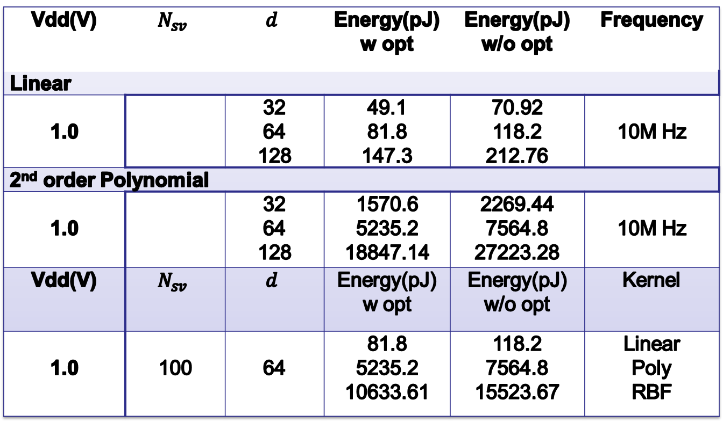
Cont’d
Vdd(V) |  |  | Energy(pJ) w opt | Energy(pJ) w/o opt | Frequency
Linear
1.0 |  | 32 64 128 | 49.1 81.8 147.3 | 70.92 118.2 212.76 | 10M Hz
2nd order Polynomial
1.0 |  | 32 64 128 | 1570.6 5235.2 18847.14 | 2269.44 7564.8 27223.28 | 10M Hz
Vdd(V) |  |  | Energy(pJ) w opt | Energy(pJ) w/o opt | Kernel
1.0 | 100 | 64 | 81.8 5235.2 10633.61 | 118.2 7564.8 15523.67 | Linear Poly RBF

Slide 24
Decision Variables
Dog 2, American Epilepsy Society Seizure Prediction Challenge database
Human 2, American Epilepsy Society Seizure Prediction Challenge database

Slide 25
Conclusion
In power-constrained CPS, feature selection is an important step
Simple classifiers with few features can achieve higher sensitivity/specificity than many features and the most powerful classifier
Low-Power architectures for a clinically acceptable seizure prediction system relies on selection of few features and simple classifiers

