Slide 1
SmartAmerica Sokwoo Rhee & Geoff Mulligan Presidential Innovation Fellows

Slide 2
The Vision of SmartAmerica
Demonstrate the benefits of interconnected Cyber-Physical Systems including improved safety, sustainability, efficiency, healthcare, and travel on the backdrop of a virtual Smart City

Slide 3
The Issue
Despite significant progress for years in Cyber-Physical Systems research and development, there is still a gap between R&D and nation-wide, across-the-board adoption of Cyber-Physical Systems in our daily life.

Slide 4
The Objective
Build an integrated Cyber-Physical Systems Framework that allows interconnection of test beds and interoperation through shared data and associated data analytics for easy integration and accelerated adoption of CPS applications.
The “Arpanet” for CPS Innovation

Slide 5
SmartAmerica Architecture
“Open, secure, high-confidence and collaborative CPS network “
SmartAmerica
Energy TBs*
Transportation TBs*
CPS
Communications
Fabric
Emergency Response System TBs*
Smart Manufacturing TBs*
Building TBs*
Healthcare TBs*
Avionics TBs*
Data Center(s)
Technology TBs*
* TBs : Testbeds can be research driven and/or commercially-driven

Slide 6
Industry EcoSystem
Example Companies
Service
GE, Boeing, GM, UTC, etc
Software / Data Analytics
IBM, Google, Microsoft, HP, etc
Communications
ATT, Cisco, Qualcomm, Verizon, etc
Hardware
Intel, AMD, etc
Provides a great opportunity for SmartAmerica

Slide 7
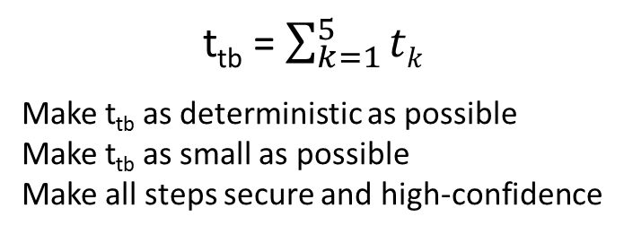
Cyber-Physical Testbed Architecture
Local Data Center/Trust Center
local data analytics
local decision making
security/privacy
communication to central data center(s)
t₃
t₂
t₄
Secure
Communication
Secure
Communication
t₁, t₅ : time delay at machines
t₂, t₄ : local communication time delay
t₃ : time delay at local data center
Machines 1
Machines 2
HMI/Communication
HMI/Communication
Security/Privacy
Security/Privacy
Data Acquisition/Control
Data Acquisition/Control
t₅
t₁
Abstraction
Abstraction
Sensor/Actuator
Sensor/Actuator

Slide 8
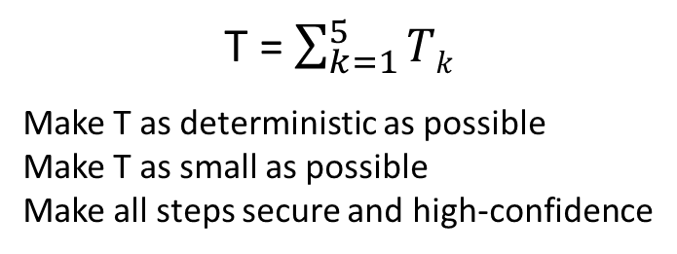
Connectivity Fabric Architecture
Central Data / Trust Center
data analytics
wide area decision making
security/privacy
time bounded communication with TBs
T₃
T₂
T₄
Secure
Communication
Secure
Communication
T₁, T₅ : time delay at testbeds
T₂, T₄ : wide area communication time delay
T₃ : time delay at central data center(s)
Testbed 1
Testbed 2
T₅
T₁
Local data center
Local data center
Machines
Machines

Slide 9
The “Challenge”
Given a “fabric” to interconnect CPS test beds and a set of real CPS test beds
Define a “scenario” that connects cross sector test beds
and
Build it to show the benefits of interconnected CPS.

Slide 10
The Virtual Cityscape
Multi Agency
NIST, NSF, DoT, HHS, DHS, DoE, Ed, …
Multi Industry
Auto, Health, Energy, Buildings, …
Interconnect city infrastructure
Key city functions:
Healthcare – e.g. Smart Hospitals
Transportation – e.g. V2V and V2I
Utilities – e.g. Smart Grid
First responders – e.g. Emergency Response

Slide 11
Example Scenario – First Responders
Disaster requiring multiple groups of Emergency Personnel
large number of casualties
Need to gather EMS and other first responders
Need to disperse EMS and injured to area medical facilities

Slide 12
The Framework
High Confidence Network (“CPS NET”)
High speed, low latency, high determinism, resiliency
Security
Private and secure communication
Communications Stack
Open standard protocols (IP Suite)
Data Architecture
Open, easy-to-use application protocol and semantic structure

Slide 13
Key Outcomes
Demonstration of a scalable, readily-accessible, nation-wide connectivity fabric for CPS
Development of examples of open, easily-usable CPS data exchange and security protocols
Identification of gaps
Presentation of model cases of the collaboration among CPS stakeholders from different sectors
Portal listing of available open CPS testbeds (optional)

Slide 14
In Summary, SmartAmerica will:
Provide integrated framework to accelerate the realization of CPS concepts
Identify and resolve technical issues for broader and faster adoption of CPS in daily life
Demonstrate benefits of interconnected, interoperable Cyber-Physical Systems
Evolve into backbone for true CPS deployment
Help industry realize the goal:
“… to enable sustained productivity growth… at a rate of two to three percentage points per year through rapid, cost-effective, evolvable design of interconnected industrial products and services…”

Slide 15
Details

Slide 16
Workshop
SmartAmerica Workshop (Nov-Dec 2013)
Invite 60-70 participants who bring in “Lego blocks” (CPS test beds, networking technologies, data analytics, etc.) for SmartAmerica
Present examples of framework and application scenarios
Get participants to generate scenarios based on the available test beds.
Select a set of “scenarios” and team members to support development

Slide 17
The Challenge Plan
Development and Execution (Dec 2013 – Mar 2014)
Implement the scenario.
Address key technical issues across teams.
Validation and Analysis (Mar-Apr 2014)
Collect scenario performance data
The outcome of the project will be reviewed and evaluated.
Resolved technical issues will be analyzed and presented
Report identified gaps and make recommendations
SmartAmerica Symposium (late Apr 2014)
Demonstrate the achievements and announce the results

Slide 18
Key Technical Outcomes
Interoperability
Open standard protocols
Easy and common data access model (URL for devices, hyperlink for devices, etc)
Functional APIs
Semantics (contents of the data)
Local area/wide area data translator (i.e. gateway)
Scalable real-time open data exchange
Flow control : push/pull, pub/sub, etc
Time determinism and latency
Discovery and overhead minimization
Examples : DDS, MQTT, AMQP, COAP, etc.
Security/privacy
Authentication, session/key management, etc
Trust center/cryptography
Data anonymization
Multi-user management and prioritization
Management of Application Scenarios and Data Analytics
Coordination of application scenarios across test beds
Data analytics and storage

Slide 19
Data In-Motion Exchange (Preliminary - Under Consideration)
Web directory of Open CPS Test Beds
Content would include each Test Beds:
Data and Data Format, API, Protocols, Security, Functionality, Design and Features
URL and Contacts
Should be searchable on any fields and categorized to easy browsing
Seeded with current set of Government funded Test Beds

Slide 20
A Scenario – Agile Manufacturing
With:
Standards for materials and design
Standards for 3D printer capabilities
Allows anyone to manufacture parts
With agile assembly
Allows everyone to manufacture products
Just in time / local manufacturing and delivery

Slide 21
The SmartAmerica Challenge will:
Drive:
Deployment of connectivity fabric
Development of standard communications, security and data exchange stacks for CPS
Thinking about “use cases”
Demonstrate benefits of CPS technologies in cross sector applications

Slide 22
Contact Info
NIST @ 2013
r1.13
Geoff Mulligan (geoff.mulligan@nist.gov)
Sokwoo Rhee (sokwoo.rhee@nist.gov)

