Slide 1
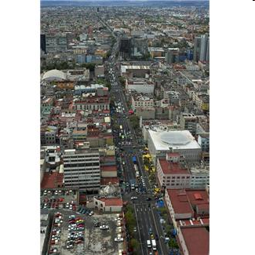
SMART CITY AS A CYBER-PHYSICAL SYSTEM
SENSOR
NETWORKS
Privacy
Data collection
Security
RESEARCH ISSUES
- Establish a Cyber-Physical
Infrastructure for urban
environments
- Fundamental research
problems in
data collection,
resource allocation,
real-time decision making,
energy management,
safety and security
Control and
Optimization
Actions
Information
Processing
BIG
DATA
Decision Making
Safety
Energy
Management
Christos G. Cassandras CISE - CODES Lab. - Boston University
Notes:
1
1

Slide 2
WHAT IS A “SMART CITY” ?
“A city well performing in a forward-looking way in [economy, people, governance, mobility, environment, and living] built on the smart combination of endowments and activities of self-decisive, independent and aware citizens.” Giffinger, R., et al, 2007
Smart Sustainable Cities use information and communication technologies (ICT) to be more intelligent and efficient in the use of resources, resulting in cost and energy savings, improved service delivery and quality of life, and reduced environmental footprint--all supporting innovation and the low-carbon economy. Cohen, B., 2014
Hitachi's vision for the Smart Sustainable City seeks to achieve concern for the global environment and lifestyle safety and convenience through the coordination of infrastructure. Smart Sustainable Cities realized through the coordination of infrastructures consist of two infrastructure layers that support consumers' lifestyles together with the urban management infrastructure that links these together using IT http://www.hitachi.com/products/smartcity/vision/concept/overview.html
“We believe a city to be smart when investments in human and social capital and traditional (transport) and modern (ICT) communication infrastructure fuel sustainable economic growth and a high quality of life, with a wise management of natural resources, through participatory governance.”
Meijer, A., and Bolivar, M.P.R., 2014
Christos G. Cassandras CISE - CODES Lab. - Boston University
Notes:
2
2

Slide 3
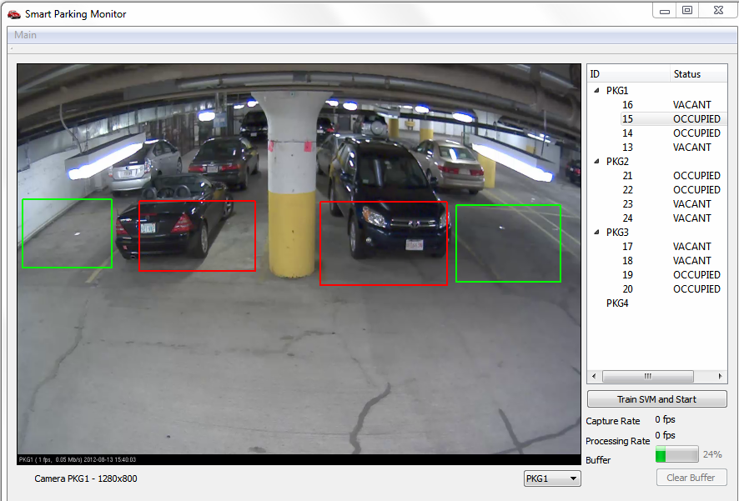
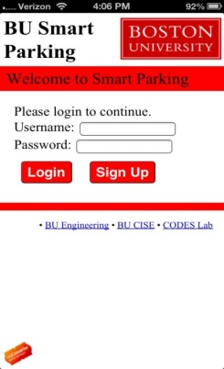
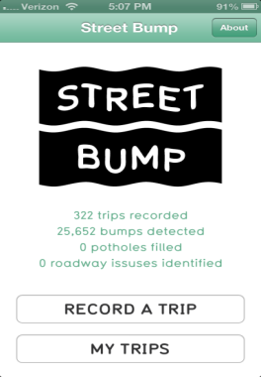
SMART CITY APPLICATIONS
SMART PARKING
ELECTRIC VEHICLE (EV) ROUTING AND
RECHARGING
STREET BUMP
TRAFFIC CONTROL
Christos G. Cassandras CISE - CODES Lab. - Boston University
Notes:
3
3

Slide 4
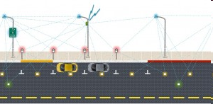
WHAT IS REALLY “SMART” ?
COLLECTING DATA IS NOT “SMART”
- JUST A NECESSARY STEP TO
BEING “SMART”
INFO
ACTION
INFO
PROCESSING DATA TO MAKE GOOD DECISIONS IS “SMART”
Christos G. Cassandras CISE - CODES Lab. - Boston University
Notes:
4
4

Slide 5
LESSONS LEARNED ABOUT SMART CITIES
“Smart” is NOT just collecting and disseminating data
– in fact that can be harmful (e.g., create extra congestion)
“Law of unintended consequences” always at work in Smart Cities
The role of Humans in Cyber-Physical Systems:
Is there an “H” (Human) or “S” (Social) missing in “CPS” ?
Fundamental Research issues:
- Detecting data sources, cooperatively collecting data safely/efficiently
- CPS security
- (Very) Dynamic Resource Allocation ⇒ new control/optim. algorithms
- Exploiting data-driven opportunities (due to “big data”)
⇒ new control/optim. algorithms
- Interdisciplinary research:
Engineering + Environmental Sciences + Social Sciences
Christos G. Cassandras CISE - CODES Lab. - Boston University
Notes:
5
5

