Slide 1
Societal and Ethical Dimensions of Emerging Technologies David J. Hess Magdalena N. Sudibjo Sociology Department Vanderbilt University

Slide 2
Outline
1. Overview of the project and the idea of societal dimensions (ELSI: ethical, legal, and social implications)
2. Overview of Connected Vehicles: Benefits and Societal Concerns
3. Overview of UAVs: Benefits and Societal Concerns
4. Overview of Transaction Energy: Benefits and Concerns
5. Summary of Hess Research of Smart Meter Opposition (as an example of how the public can mobilize)

Slide 3
1. ELSI Dimensions
Benefits: how to maximize
Concerns and risks: how to minimize
Privacy
Security
Health and environment
Equity

Slide 4
Privacy: Background
No right to privacy in the U.S Constitution
It is a derived right (from other provisions)
Legislation (e.g., Health Insurance Portability and Privacy Act)
Primary issue in the context of Internet
Data gathering by corporations
Data gathering by government

Slide 5
Security: Background
Focus here: threats to personal and public safety (hacking)
Criminal
Terrorist
Scale matters for this dimension more than for privacy (individual level)
Collective level security
Personal security (safety, crime)

Slide 6
Health & Environment: Background
Health risk types
Pollution (air, water, soil)
Accidents
Environmental risks
Natural environment
Built environment

Slide 7
Social Equity: Background
Social structure: race, gender, class, ethnicity, geographical location
Other kinds not discussed here

Slide 8
24 categories | Privacy | Security | HealthEnv | Equity
C Vehicles US
T Energy US
UAV Traffic US
C Vehicles EU
T Energy EU
UAV Traffic EU

Slide 9
2. Connected Vehicles

Slide 10
Definitions
Connected vehicles can recognize their location and their status and can communicate with each other and the surrounding Intelligent Transportation System (ITS) infrastructure.
Includes autonomous vehicles but not limited to that category (could include apps on phones or in the vehicle)

Slide 11
Benefits: Connected Vehicles
Improved safety & accident prevention
Potential to save thousands of lives each year
Improved access (for those who cannot drive)
Reduced congestion
Better commute times
Savings on vehicle miles driven (fuel savings)
Air quality (health) and greenhouse-gas emissions benefits
Long-term potential: better built environment
Reduced need for parking, new highways

Slide 12
Privacy: Connected Vehicles
Both transit-related apps and connected vehicles
Tracking of transit modes
Tracking of trips and locations
Routines
Ex. Legal implications (Restraining orders)
Vehicles that go through areas subjected to court restraining orders
Could require programming in restraining order information

Slide 13
Security: Connected Vehicles
Collective level hacking risks:
creation of congestion, accidents
Personal level hacking risks:
Data on trip records: knowing when people are not at home

Slide 14
Health & Env.: Connected Vehicles
Health 1: Traffic shifting from high to low congestion pathways
Shift in air quality and accident risk in residential neighborhoods
Litigation potential: neighborhood right to low traffic
Health 2: Accidents and autonomous vehicles
Unknown risks of interactions of autonomous and human-driver vehicles
Trolley problem revisited
Built Environment
Potential need to reshape transportation systems
Separate systems for autonomous vehicles?
Potential end of peak-car phenomenon (new levels of demand)

Slide 15
Social Equity: Connected Vehicles
Transit types
Do connected vehicles weaken support for public transit?
Apps and equity:
Premium app—fastest pathway
Free app—more congestion.
Costs
Increased cost of owning a connected vehicle
Increased insurance for human drivers
Job security: employment disruptions (trucking industry)

Slide 16
3. Unmanned Aerial Vehicle Management

Slide 17
Definitions
UAV management governs the rules and traffic of unmanned and remotely-controlled aerial vehicles (drones)

Slide 18
Benefits: UAVs
Efficient delivery of materials
Potential reduction of ground traffic congestion
Potential reduction of greenhouse-gas emissions
Risk reduction benefits
Monitor public gatherings for security threats
Monitor natural and technological sites for disaster threats (volcanoes, nuclear reactors)
Disaster relief
Search and recovery, emergency supply delivery
Business uses
Monitoring of sites (agriculture, construction)
Aerial spraying

Slide 19
Privacy: UAVs
Camera-bearing UAVs can gather personal data even if above the 200-foot altitude
New level of exposure of private persons in formerly private spaces (backyards)
Potential to record private conversations
Can vary by level of detail of photography and frequency of recording

Slide 20
Security: UAVs
Attacks at public events
Risks to airplanes landing and taking off
Crime and Delivery
Threat of porch theft
Knowing schedules and when people are at home
Potential hacking an entrance to homes and buildings
Corporate espionage
Smuggling

Slide 21
Health & Environment: UAVs
Health 1: Noise concerns as the population of UAVs increases
Health 2: Accidents
Failure of individual drones
Interactions with pets
Environment 1: Built Environment
Where to locate drone highways
Environment 2: Natural Environment
Interactions with wildlife (birds)

Slide 22
Social Equity: UAVs
Types of delivery and price premiums
Drone delivery—accessible to all residential building types?
Use of drones in surveillance of low-income groups and ethnic minority groups

Slide 23
4. Transactive Energy

Slide 24
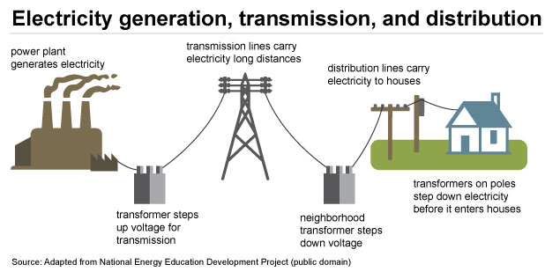
Historical Model:
Single Entity (Utility) Controlled all Aspects
https://www.eia.gov/energyexplained/index.cfm?page=electricity_delivery
Notes:
http://www.eia.gov/todayinenergy/images/2012.05.21/DailyLoadShape.png

Slide 25
Competitive
Wholesale Market
Regulated Utility:
Transmission & Distribution
Competitive
Retail Market
https://www.eia.gov/energyexplained/index.cfm?page=electricity_delivery
Notes:
http://www.eia.gov/todayinenergy/images/2012.05.21/DailyLoadShape.png

Slide 26
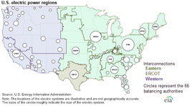
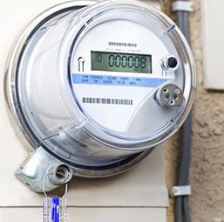
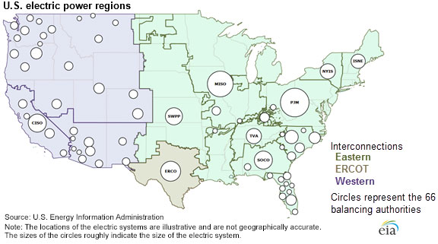
The U.S. Electricity Grid:
Balancing Authorities
https://www.eia.gov/energyexplained/index.cfm?page=electricity_delivery
Notes:
http://www.eia.gov/todayinenergy/images/2012.05.21/DailyLoadShape.png

Slide 27
Changes in the Electricity System
Historical Regime
Regulated Utility Monopoly
Centralized power generation (hydro, nuclear, fossil)
One-way transmission
Goal: provide stable, baseload power with some peaking ability
Emerging Regime
Generation, utility, and retail companies
Distributed energy resources
Two-way transmission
Management of intermittency, energy storage

Slide 28
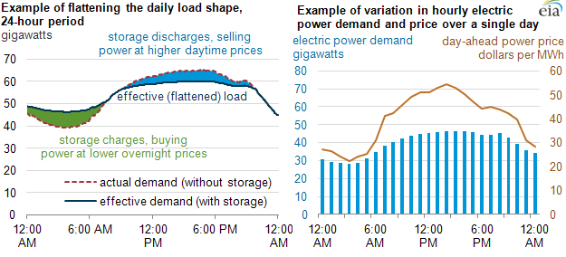
Daily Peak Load
http://www.eia.gov/todayinenergy/images/2012.05.21/DailyLoadShape.png
Notes:
http://www.eia.gov/todayinenergy/images/2012.05.21/DailyLoadShape.png

Slide 29
Transactive Energy: Definitions
Transactive energy allows the dynamic balance of supply and demand across the entire electrical infrastructure
Sale and purchase of electricity among generators, utilities, and retail electricity providers
Sale and purchase of distributed electricity (e.g., rooftop solar) from prosumers (producer-consumers) to utility (and to other prosumers)
Management of demand through incentives to consumers

Slide 30
Benefits: Transactive Energy
Security
Better response to power outages and shortages
Health-Environmental
Use of renewable energy and energy efficiency
Retiring of thermal generation→ improved air quality
Equity
Potential for price reductions for consumers

Slide 31
Two Examples Discussed Today
Distributive Energy Resources & Microgrids
Smart Meters

Slide 32
Distributed Energy Resources and Microgrids

Slide 33
Definitions
Distributed energy resources: small-scale electricity generation that can be aggregated and used to supply electricity to the grid:
Small photovoltaics, wind, hydro, geothermal
Energy efficiency
Local energy storage
Local combined heat and power
Microgrid: localized network of electricity generation that is connected to the grid but can operate in island mode (such as during power outages)

Slide 34
DER Compensation
Net metering: prosumer paid at the retail rate (very good for prosumer)
Feed-in tariff (more common in EU): prosumer paid at a set rate
Value of solar: prosumer paid at a negotiated rate based on assessment of the value of solar to the utility

Slide 35
DER Growth
Favorable and stable prices over long-term contracts
Good loan programs from government
Technology and finance sector investing heavily in “third-party ownership”

Slide 36
Concerns from Utilities
Profitability. Cost of paying for DER, especially rooftop solar under net metering rules.
Stranded assets concern.
Off-grid concern
Stability: Concerns with so much solar that the grid becomes unstable (Hawaii)
Equity: Solar customers who produce more than they consume end up using grid services for free; should have a connect charge. Otherwise, nonsolar customers pay for it.
2016. Hess, David J. “The Politics of Niche-Regime Conflicts: Distributed Solar Energy in the United States.” Environmental Innovation and Societal Transitions 19: 42-50. 10.1016/j.eist.2015.09.002.

Slide 37
Utility-Solar Industry Conflicts
Attempts to end net metering laws and block third-party ownership laws
Social movement mobilizations to protect the “right to solar” in many states
Often the coalitions have a “strange bedfellows” quality (solar industry, conservatives, environmentalists, consumer groups)
2017. David J. Hess and Kate Pride Brown. “Green Tea: Clean-Energy Conservatism as a Countermovement.” Environmental Sociology 3(1): 64-75. DOI 10.1080/23251042.2016.1227417.

Slide 38
Equity and Environmental Values
Equity
Utilities: rights of non-solar customers
Prosumers: property rights of building owners to have rooftop solar
Environmental
Benefits of encouraging renewable DER

Slide 39
Microgrids
Transactions between the microgrid and the utility
BUT Can involve transactions within the microgrid
Emerging model in Brooklyn, NY, and Landau, Germany
Peer-to-peer sale of solar within a neighborhood using blockchain technology
Security: can form island during outages
Equity: can motivate more local ownership of electricity, power to the poor in LDCs
Environmental: more renewable energy, load balancing

Slide 40
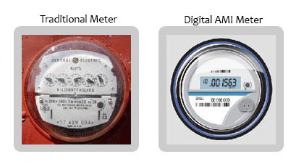
Smart Meters
n you experience an outage.)
http://www.michigan.gov/mpsc/0,4639,7-159-56137_58213---,00.html

Slide 41
Definitions
Devices that allow the transmission of information to the utility and consumer
In the U.S. generally wireless
Information feedback can encourage efficiency
Time of day pricing possible
Can allow communication with devices in the home or building
The utility can change the temperature to enable shaving of daily peak load (opt-in)

Slide 42
Privacy: Smart Meters
Electronic signature of individual appliances
Capacity to track which appliances are being used
Capacity to know who is at home and what they are doing
Depends partly on the frequency of transmission of information (e.g., hourly v. a few times per day)

Slide 43
Security: Transactive Energy
Hackers can find out who is at home and when
Government may use the information for some purposes (e.g., child custody cases—is the parent really at home?)
Hackers may be able to turn on and off devices, causing fires (furnance, ovens), etc.

Slide 44
Health & Environment
Health 1
Public opposition based on concern with microwave exposure
Standard smart meter vs. collector meters
Scientific research is weak, but public groups advocate the precautionary principle
Health 2: Accidents
Some reports of overheating and fires
Built Environment
Concern with “electrosmog”
Invisible—little public interest to date

Slide 45
Social Equity: Transactive Energy
Time of day pricing
Privileges households that have flexible hours or programmable devices
Low-income households may need to use appliances during times when prices are higher

Slide 46
Public Opposition

Slide 47
Dimensions of Anti-Smart Meter Movements
Background: spillover from opposition movements to cell-phone towers to smart-meter opposition
Condition: anger at lack of opt-out provision and mandated installation, then anger at opt-out fees
Outcome 1: Many local ordinances and resolutions against smart meters, especially in British Columbia and California
Outcome 2: Opt-out provisions are included in some state laws or regulatory policies

Slide 48
Reasons Given in 53 Local Policy Actions in California
Health (claimed headaches, etc.)
Privacy (knowing who is at home)
Accuracy (billing errors)
Security (theft, knowing when people are home)
Transmission (interference with ham radios, appliances)
Environmental (vague language about increasing the carbon footprint, rebound effect)
Safety (fire)
2014 David J. Hess and Jonathan Coley. “Wireless Smart Meters and Public Acceptance: The Environment, Limited Choices, and Precautionary Politics.” Public Understanding of Science 23(6): 688-702

Slide 49
2014 David J. Hess and Jonathan Coley. “Wireless Smart Meters and Public Acceptance: The Environment, Limited Choices, and Precautionary Politics.” Public Understanding of Science 23(6): 688-702

Slide 50
Controversial Health Claims
Utilities reject public understanding of health risks
Public concern rests on claimed ill health following installation (no epidemiological studies)
Some people claim to be electrosensitives
Scientific research is summarized in the BioInitiative Report
Applicability of most microwave research to humans and smart meters is unknown
2014 David J. Hess and Jonathan Coley. “Wireless Smart Meters and Public Acceptance: The Environment, Limited Choices, and Precautionary Politics.” Public Understanding of Science 23(6): 688-702

Slide 51
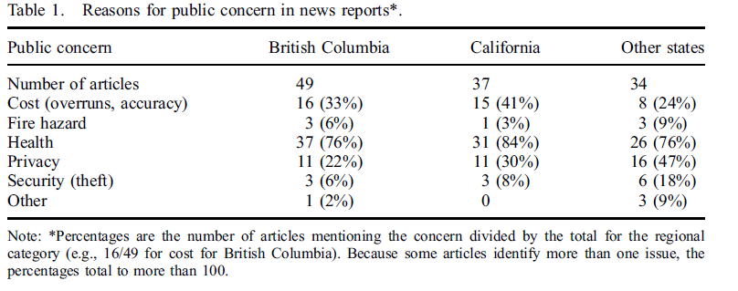
Analysis of Media Reports in North America
Hess, David J. “Smart Meters and Public Acceptance: Comparative Analysis and Governance Implications.” Health, Risk, and Society 16(3): 243-258.

Slide 52
Variation in Degree of Concern
Health concerns: higher if no opt out policy, if the opposition group is local and in North America
US: State-level groups have a broader range of concerns; local groups often more health focused.
US: right-wing groups highlight privacy.
Australia and UK (early roll-out phase): cost was primary concern
Netherlands (2006-2008): privacy
Health concerns are negligible in areas with wired systems in the US and Europe

Slide 53
Some General Conclusions
How to negotiate the relationship between expert knowledge and public concern?
Transmission model: educate the great unwashed
Results in populist backlash
Deliberative model:
Understand public concerns first
Develop opt-out & opt-in policies
Build flexibility into system design

