Slide 1
Solar Panel Reduction
Through Demand
Reduction

Slide 2
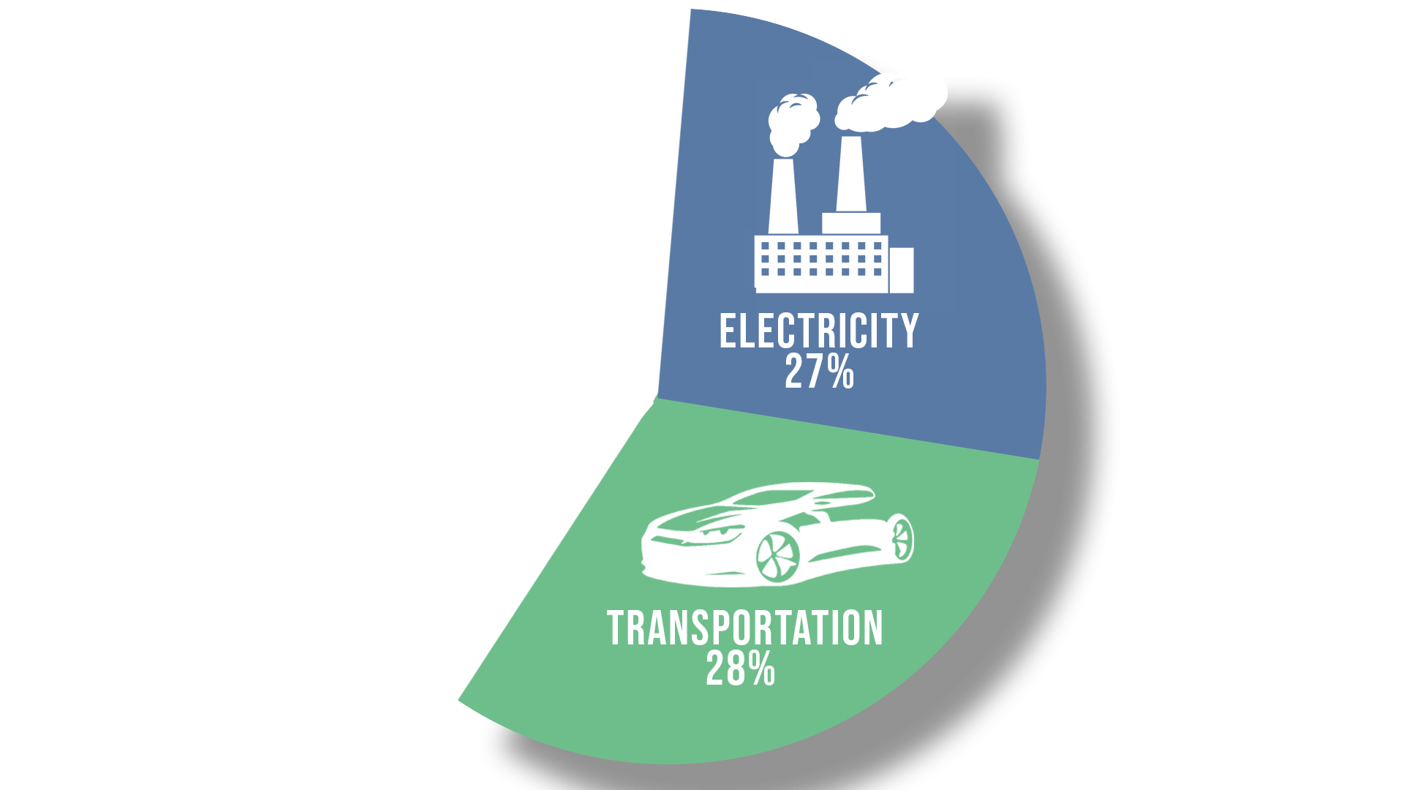
U.S Greenhouse
Gas Emissions

Slide 3
What if Solar?

Slide 4
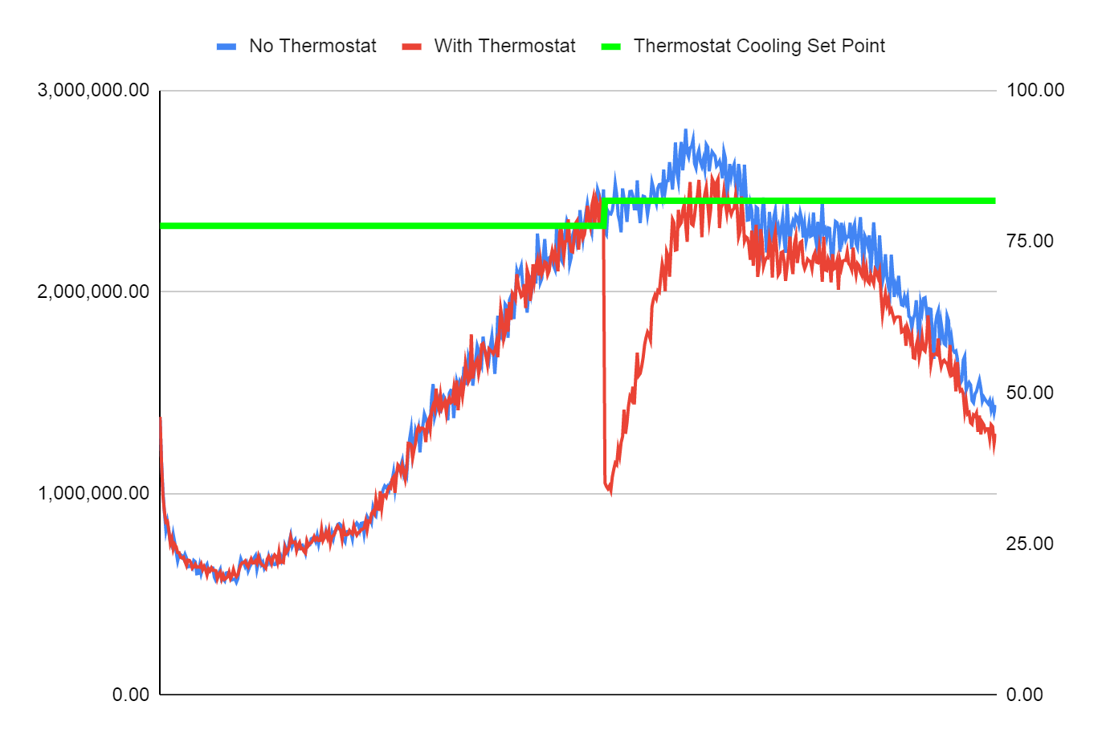
Reducing Demand
With
Price
Control
Watt/Hour
Degree in
Fahrenheit

Slide 5
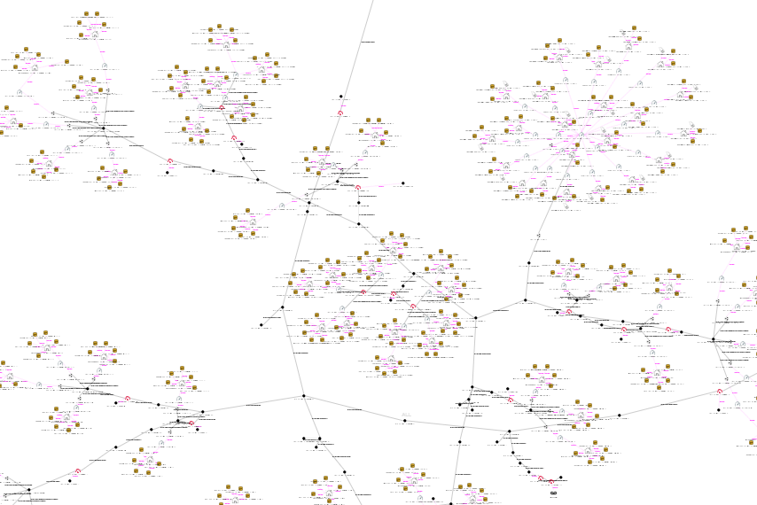
Simulation Design
Solar
Battery
Thermostat
+
+
+
No TE or SOLAR
SOLAR but no TE
SOLAR and TE

Slide 6
Demand of
edited models as
a percentage of
unedited cmodel
10kw SOLAR
but no TE
9kw SOLAR
and TE

