Slide 1
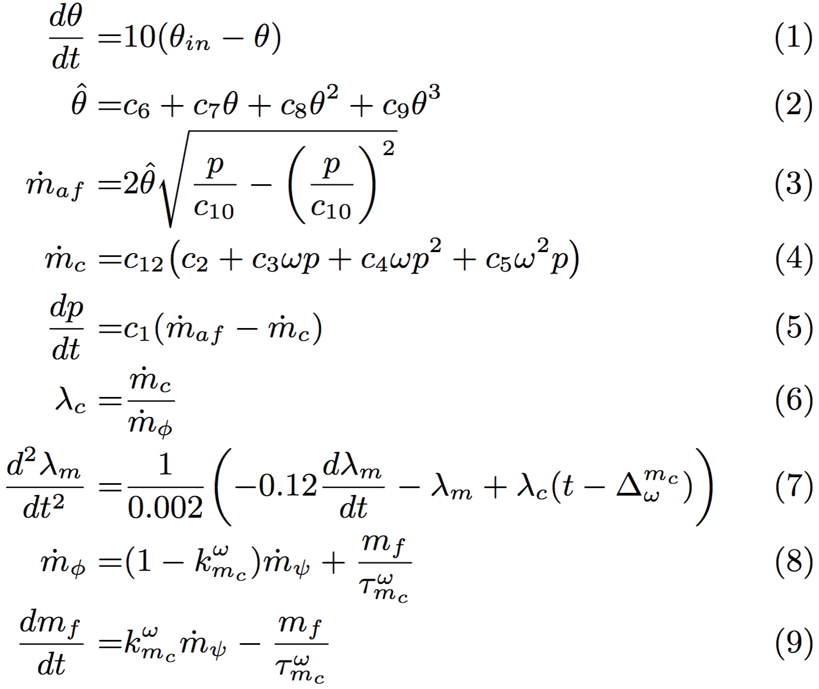
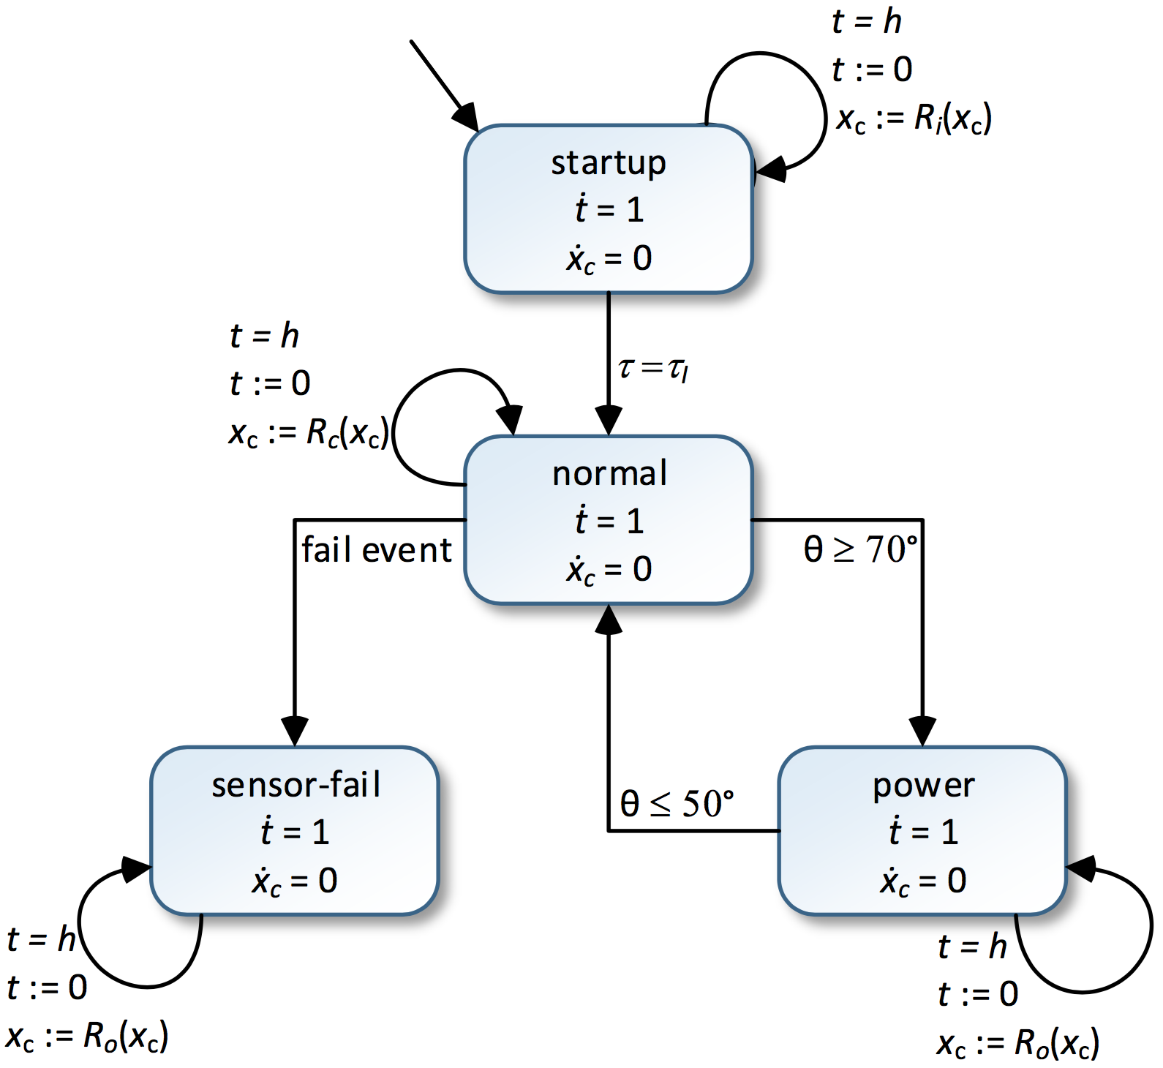
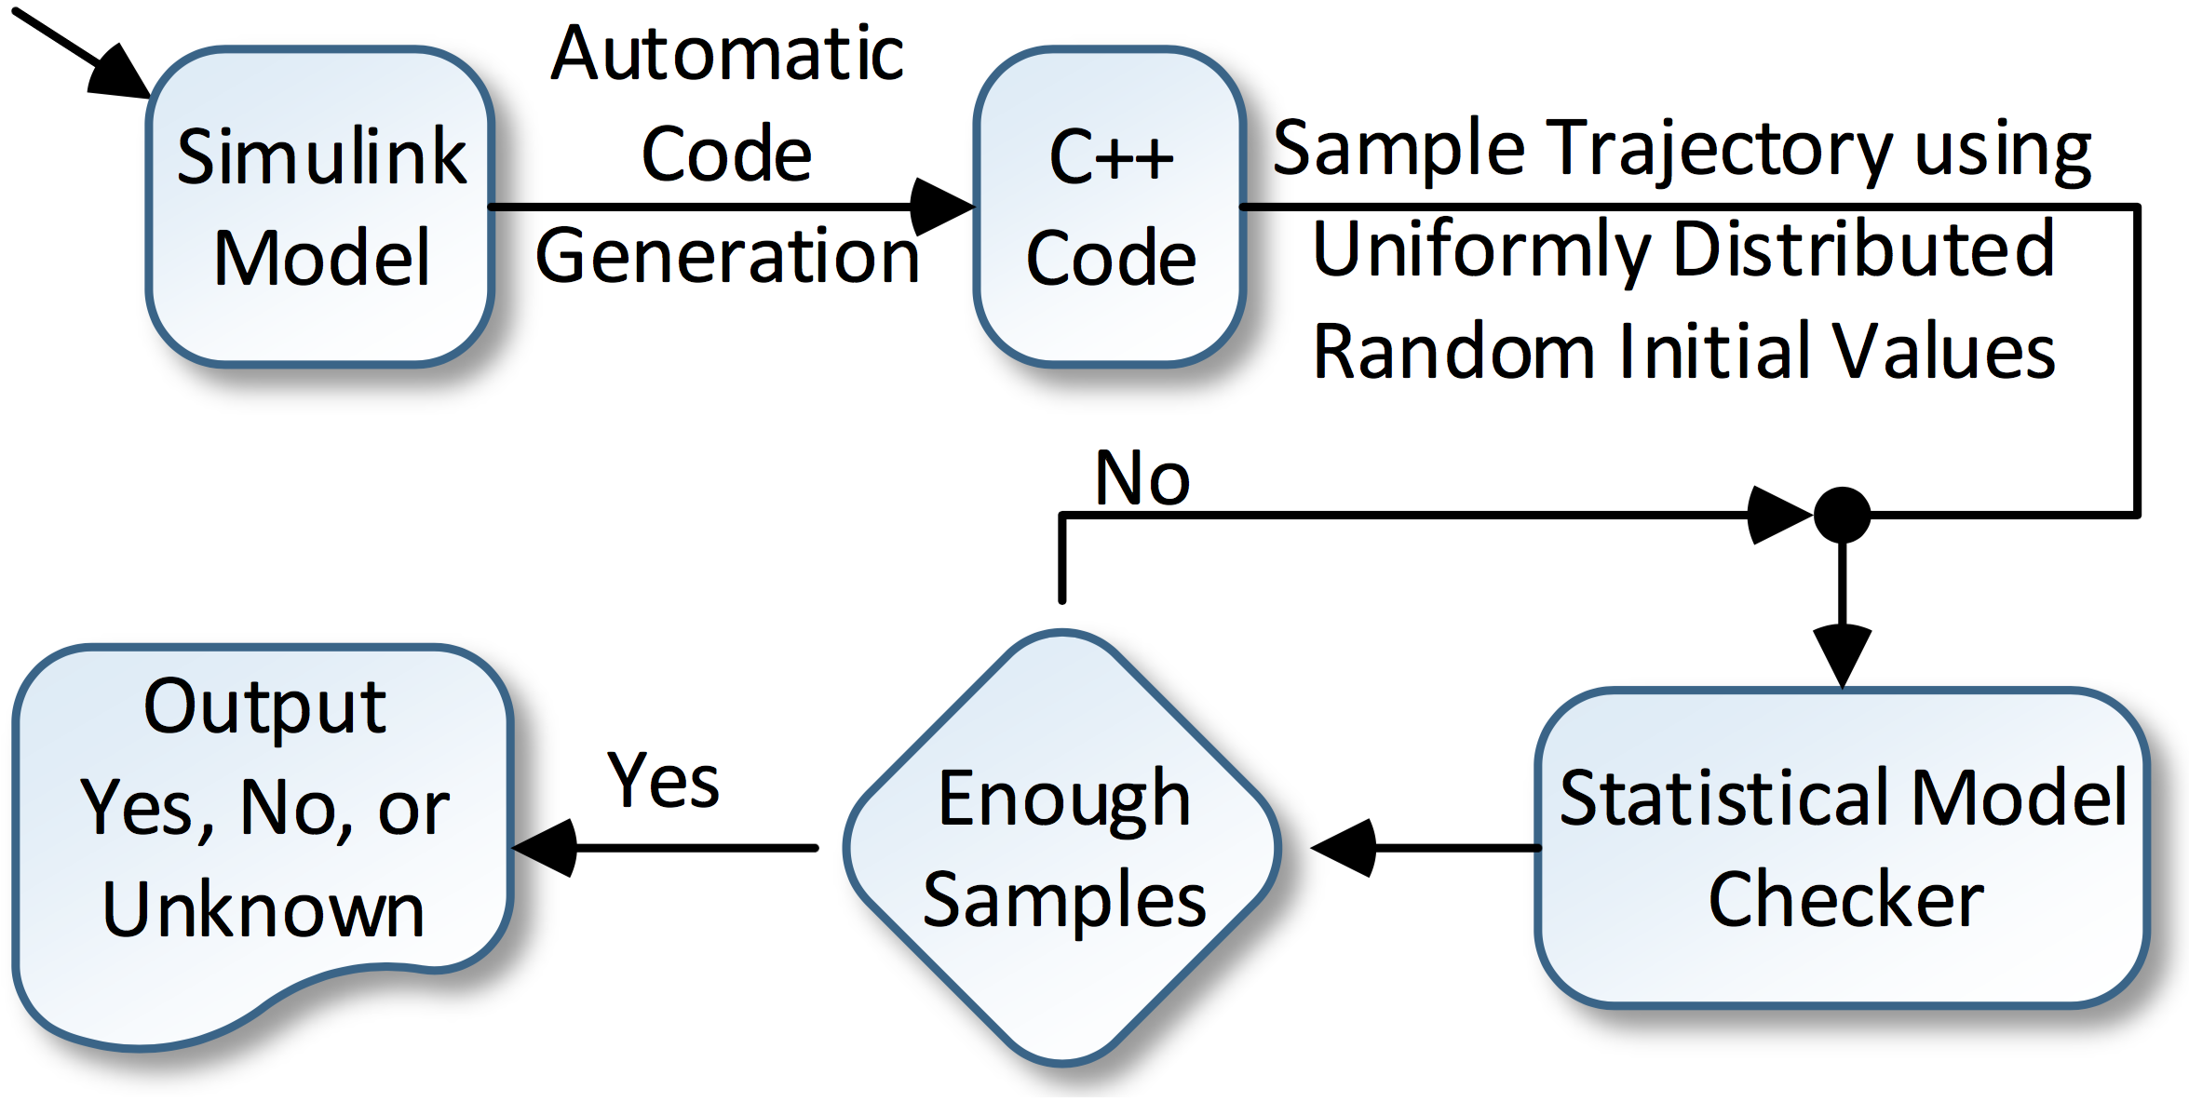
Statistical Verification of the Toyota Powertrain Control Verification Benchmark
Nima Roohi, Yu Wang, Matthew West, Geir Dullerud, Mahesh Viswanathan Department of Computer Science, Coordinate Science Laboratory, Department of Mechanical Science and Engineering, University of Illinois at Urbana-Champaign
Introduction
The powertrain control problem is one of regulating the air-to-fuel ratio in an automotive engine. A series of models of such controllers, with increasing levels of sophistication and fidelity to real-world designs, have been recently proposed by Toyota researchers as challenge problems for today’s verification technologies. In this work we present our results in verifying the most complicated of the models proposed in Toyota (Model 1) that has features like delayed differential and difference equations, look-up tables, in addition to highly non-linear continuous dynamics for the state variables.
Our approach is to simulate the C++ code generated automatically from the Simulink design of the system for randomly chosen values for the parameters of engine speed and signal profile. We then check if the sample drawn provides statistical evidence of the satisfaction of the key properties of the system, using hypothesis testing. Our analysis confirms that for at least 98% of the choices for values of the initial parameters, the key properties of the system hold. Since our analysis is statistical, there is a probability that our analysis is incorrect; this error is bounded by 0.001 for our experiments reported here.
These are the first mathematical guarantees of correctness obtained for Model 1 presented by Toyota. Previously, the falsification tool S-Taliro was used to search for possible counterexamples. Also, the significantly simpler Model 3 (with polynomial dynamics) was verified with the tool C2E2.
Semantics of STL (cont.)
Other connectives can be defined as well. $⊥≔¬⊤$, $φ∧ψ≔¬\left(¬φ∨¬ψ\right)$, $→_{ℐ}φ≔⊤𝒰_{ℐ}φ$, and $⇨_{𝒥}φ≔¬\left(→_{ℐ}¬φ\right)$. Intuitively, $→_{ℐ}φ$ means $φ$ will eventually become true during $𝒥$. And $⇨_{𝒥}φ$ means $φ$ is always true in $𝒥$.
Let $Δ:ℝ_{+}$ be a small time step. By $\left(τ,t\right)⊨_{Δ}φ$ we mean signal $τ:ℝ_{≥0}→ℝ^{X}$ satisfies formula $φ$ at time step $n$. The discrete semantics of STL is defined as follows (let $τ⊨_{Δ}φ$ denotes $\left(τ,0\right)⊨_{Δ} φ$):
Verifying satisfaction of a continuous semantics is computationally complex if not undecidable. Therefore, we would like to verify $τ⊨_{Δ}φ$ but conclude $τ⊨φ$. It is well known that if the signal $τ$ satisfies the following conditions then $τ⊨_{Δ}φ⇒τ⊨φ$.
All functions used in atomic formulas must be Lipschitz continuous. The dynamics of our system is too complex to analytically prove a bound.
We should have $Δ<\frac{1}{3}\left(sup I−inf I\right)$, for all intervals $I$in $φ$.
All intervals of $φ$ must be bounded.
The time bound $T$ must be larger than $\left|φ\right|Δ+\sum_{I:φ}{\sup{I}}$.
Requirements
The following two formulas are used to specify that the input signal $θ_{in}$ goes up or down:
A normalized error signal $μ$ that measures the error in A/F
Ratio ($λ$) (a state variable of the system) from the reference stoichiometric value $λ_{ref}$ is defined as follows:
We want to check the following two properties:
Formula 13 specifies the maximum allowed overshoot or undershoot. Formula 14 specifies that $η$ seconds after a signal rises or falls, the signal settles and remains in the settling region for at least $4$ seconds. Parameters $ε$, $λ_{ref}$, $τ_{s}$, $η$, and $T$ are set to $0.02$, $14.7$, $11$, $1$, and $50$, respectively.
We want to only check $φ$ at finite number of time points. But we don’t know Lipschitz constant for $μ$. Thus we first guess a constant $c$, and check during the simulation that our guess is valid at all continuous times. Also, if at time $nΔ$ we find out $\left|f\left(τ\left(nΔ\right)\right)\right|≤c$, we mark value of atomic proposition $f>0$as unknown at steps $n$and $n+1$. This
may result in $\left(τ⊨φ\right)≔\text{unknown}$ for some trajectories. If we want to prove probability of satisfying $φ$ is larger than a threshold, we threat unknown as false. Otherwise, we treat it as true.
Results
Suppose the actual fraction of initial states that satisfy $φ$ is $t^{′}$ and we never encounter $\left(τ⊨φ\right)≔\text{unknown}$ during our simulation. Our algorithm outputs one of 3 answers: $H_{0}≔t^{′}<1$, $H_{1}≔t^{′}>t$, or unknown, and it guarantees the followings conditions:
$$\begin{matrix}ℙ\left[result=H_{0} \right| H_{0} is false]=0 & (15) \\ ℙ\left[result=H_{1} \right| H_{1} is false]≤β & (16) \\ ℙ\left[result=unknown\right]=0 & (17)\end{matrix}$$
$β$is an input parameter to our algorithm and can be made arbitrary small at the cost of taking more samples. We set $β=0.001$ and $t=0.98$. Both Formulas 13 and 14 could be verified after 453 samples and about 2.2 and 2.8 minutes, respectively.
Figure 3. Diagram for t-step Galerkin projection
Conclusions
The results presented here are the first results providing mathematical guarantees of correctness for Model 1, the most complex design, presented by Toyota researchers in the regulating the air-to-fuel ratio in a automotive engine. Currently, our results certify that with probability more than 98%, the initial states satisfy the correctness requirements. We would like to push our analysis closer towards 100%. Naive sampling becomes infeasible in this case. We believe this problem can be solved in two complementary ways: 1. anti-correlated sampling, and 2. importance sampling.
Signal Temporal Logic (STL)
Signal Temporal Logic (STL) is used to specify predicates over real-time signal. For a hybrid automaton with state variables $X$, let $f:ℝ^{\left|X\right|}→ℝ$ be a differentiable real valued function. An atomic predicate is of the format $f>0$ or $f≥0$. Since we adopt a statistical approach, strict and non-strict inequalities are not distinguishable. Syntax of STL is defined using the following BNF grammar:
Semantics of STL
By $\left(τ,t\right)⊨φ$ we mean signal $τ:ℝ_{≥0}→ℝ^{X}$ satisfies formula $φ$ at time $t$. The continuous semantics of STL is defined as follows (let $τ⊨φ$ denotes $\left(τ,0\right)⊨φ$):
Problem Specification
The system is a hybrid input/output automaton with 4 modes. Self loops are used to model difference equations that controller uses. Dynamics of variables are specified using the following (delayed) differential equations:
Our Approach
We statistically model check the powertrain control design. More precisely, given a model $M$, STL formula $φ$and threshold $t$, we check that the measure of initial states satisfying formula larger than $t$. Our algorithm randomly simulates the model from different initial states and uses hypothesis testing and an error control method to decide whether the sample drawn provides statistical evidence for the property being checked.
Acknowledgments
The authors acknowledge partial support for this work from grants NSF CPS 1329991 and NSF CCF 1422798.

