Slide 1
Student Showcase: Teo Lee
PI: Abishek Dubey
Mentor: Sayyed M. Vazirizade

Slide 2
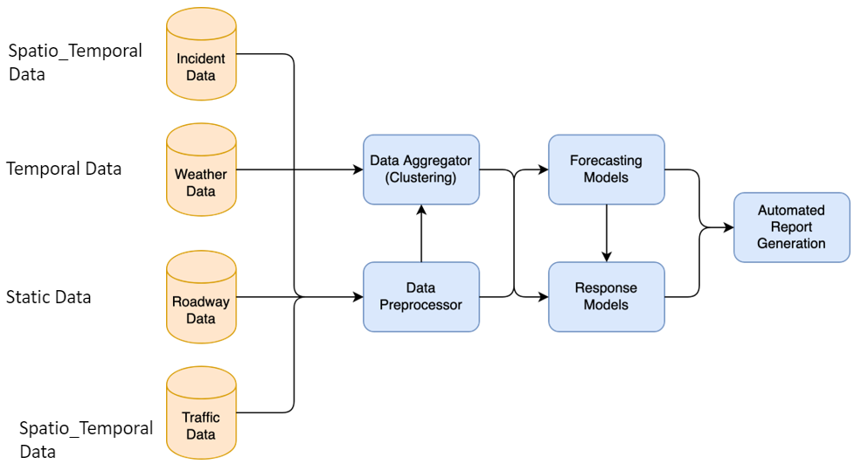
Project Description
Emergency Incident Prediction
Where can we relocate ambulances to minimize their response time to an incident?
What factors are most important when considering relocation?

Slide 3
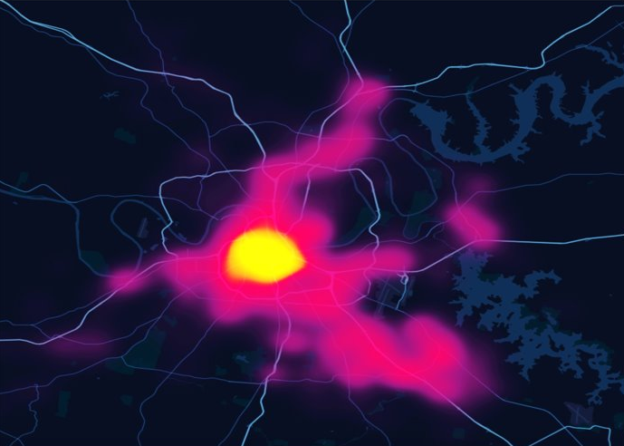
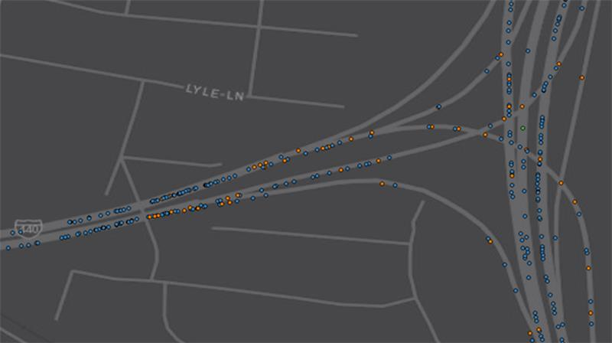
Goals
What makes a highway dangerous?
Where are the hotspots?
What factors contribute the most to highway incidents?
What makes two road segments similar?
How can we cluster segments?

Slide 4
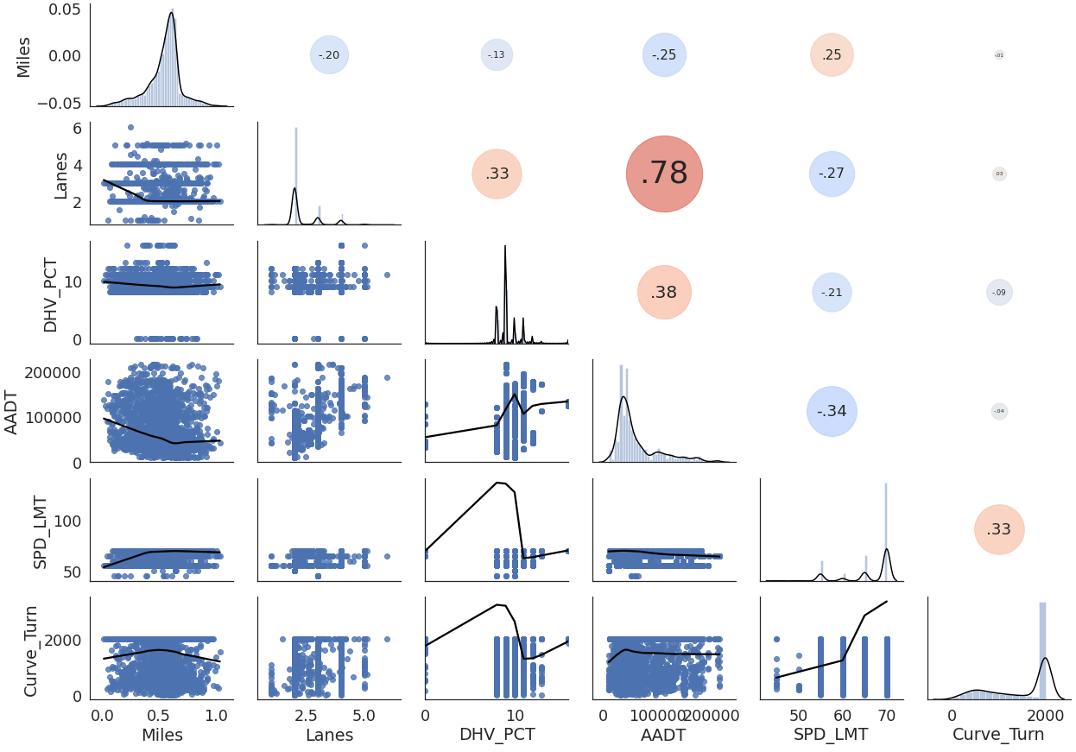
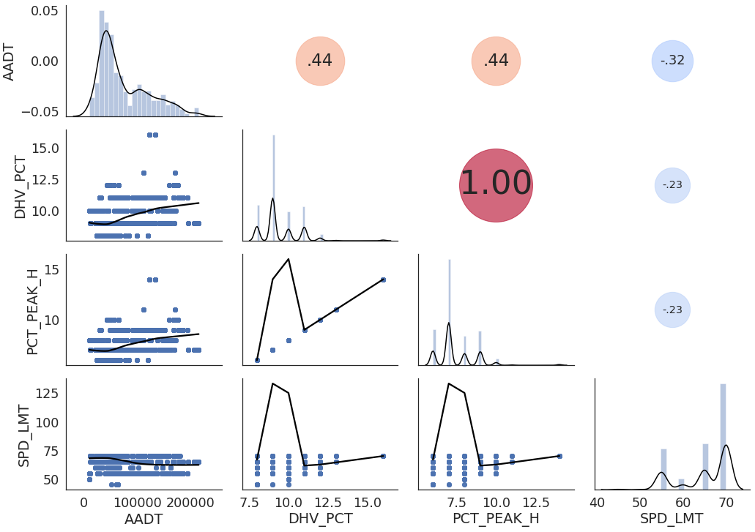
Correlation Analysis
Correlation between features
Which features are unnecessary?

Slide 5
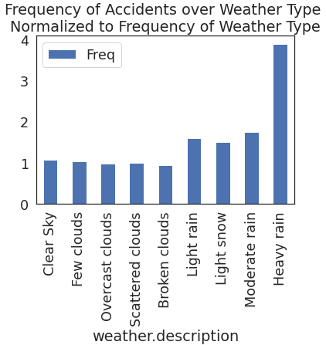
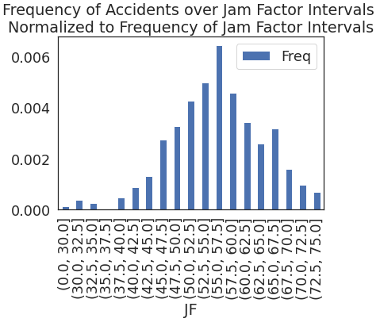
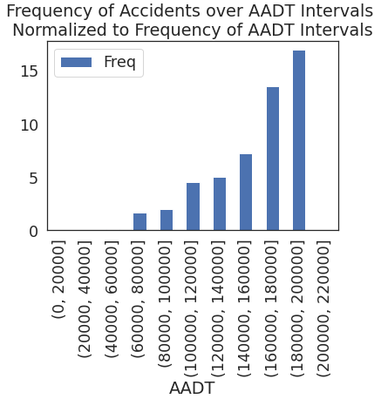
Single Feature Analysis
Informal but useful visualization for feature importance
Which features seem like good predictors of accident hotspots?

Slide 6
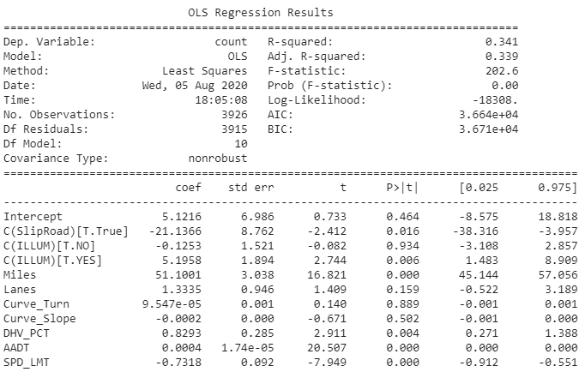
Regression Analysis
More concrete conclusions can be drawn based on statistical analysis
Note R-squared value and p-value

Slide 7
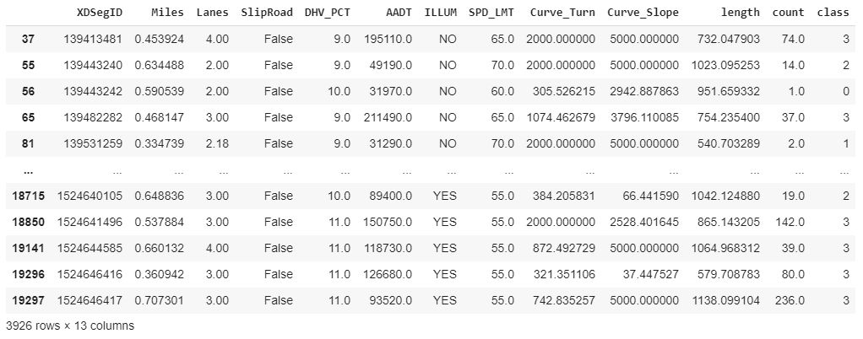
Classification/Clustering
Which feature is most important in classifying road segments?

Slide 8
Classification/Clustering
Decision Tree Classification

Slide 9
What I’ve Learned & Plans for the Future
Need lots of data to draw meaningful conclusions
Need to account for constant updates
Flexible, adaptable code
Ask for help when needed
Incorporate temporal data into a new model
Continue analysis across all of TN
Not only highways

Slide 10
Thank you!

