Slide 1
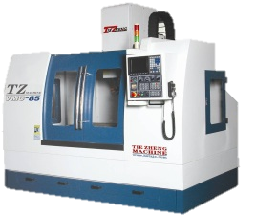
Subtractive 3D Printing
Subtractive Manufacturing
Original 3D Model
Simulated Result
Physical Part
4 hours
2 hours
10 minutes
2 hours
Traditional approach: 6 hours total (4 hours of human work)
Automated approach: 2 hours total (10 minutes of human work)

Slide 2
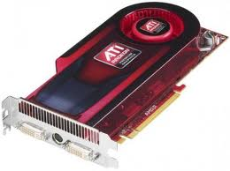
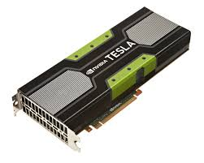
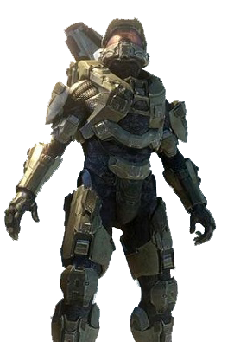
Why Now?
Analog
Digital
1D Sound
2D Images
3D Parts
GPU

Slide 3
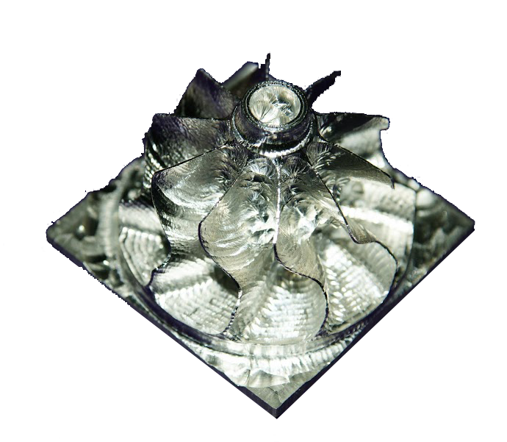
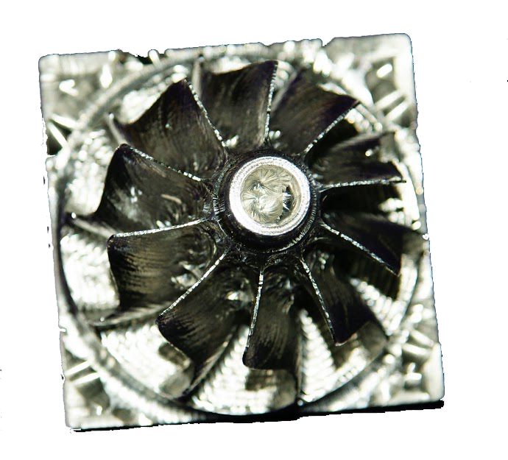
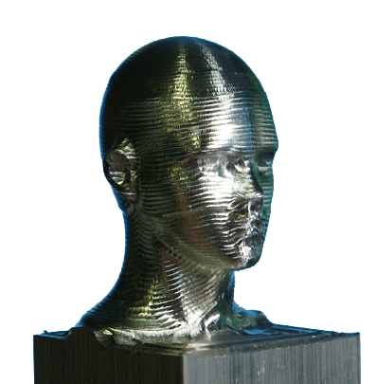
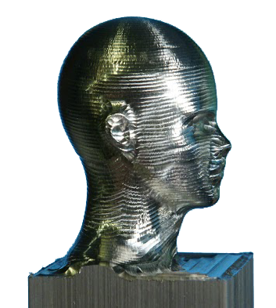
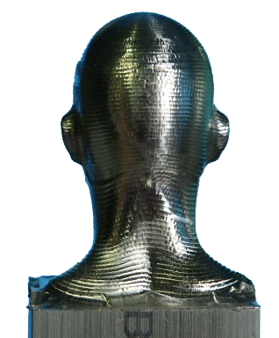
Value

Slide 4
Market
CNC Machine Tools:
$6.0 Billion/Year
NC CAM Software:
$1.5 Billion/Year
Rapid Prototyping Equipment:
$1.5 Billion/Year
$9.0 Billion/Year

Slide 5
Commercialize
Phase I: Consulting with existing Mill Owners
Phase 2: On-line Parts Ordering
Existing Competitors
Phase 3: Integration with CAD Software
“Print” button for CAD

Slide 6
Thank You
Tommy Tucker
tommy@tuckerinnovations.com

