Slide 1
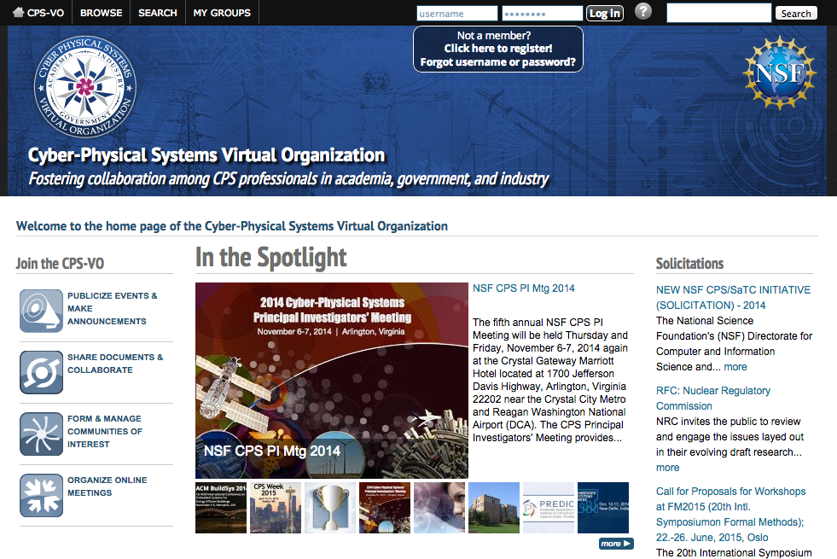
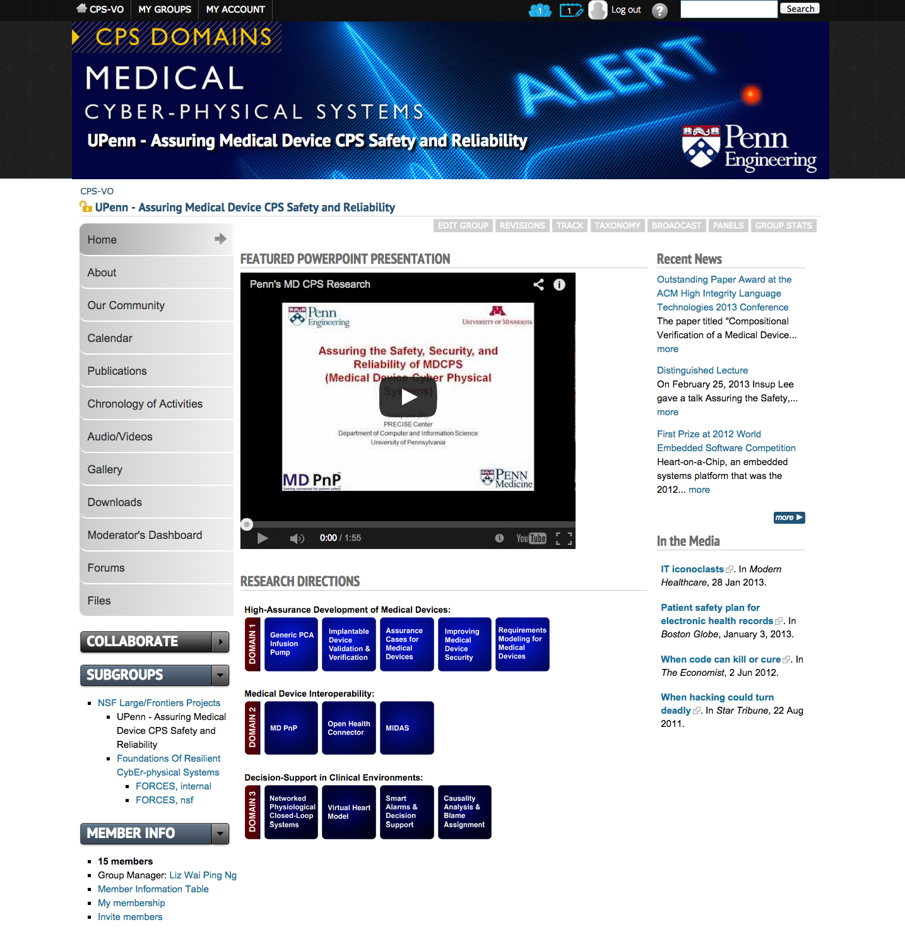
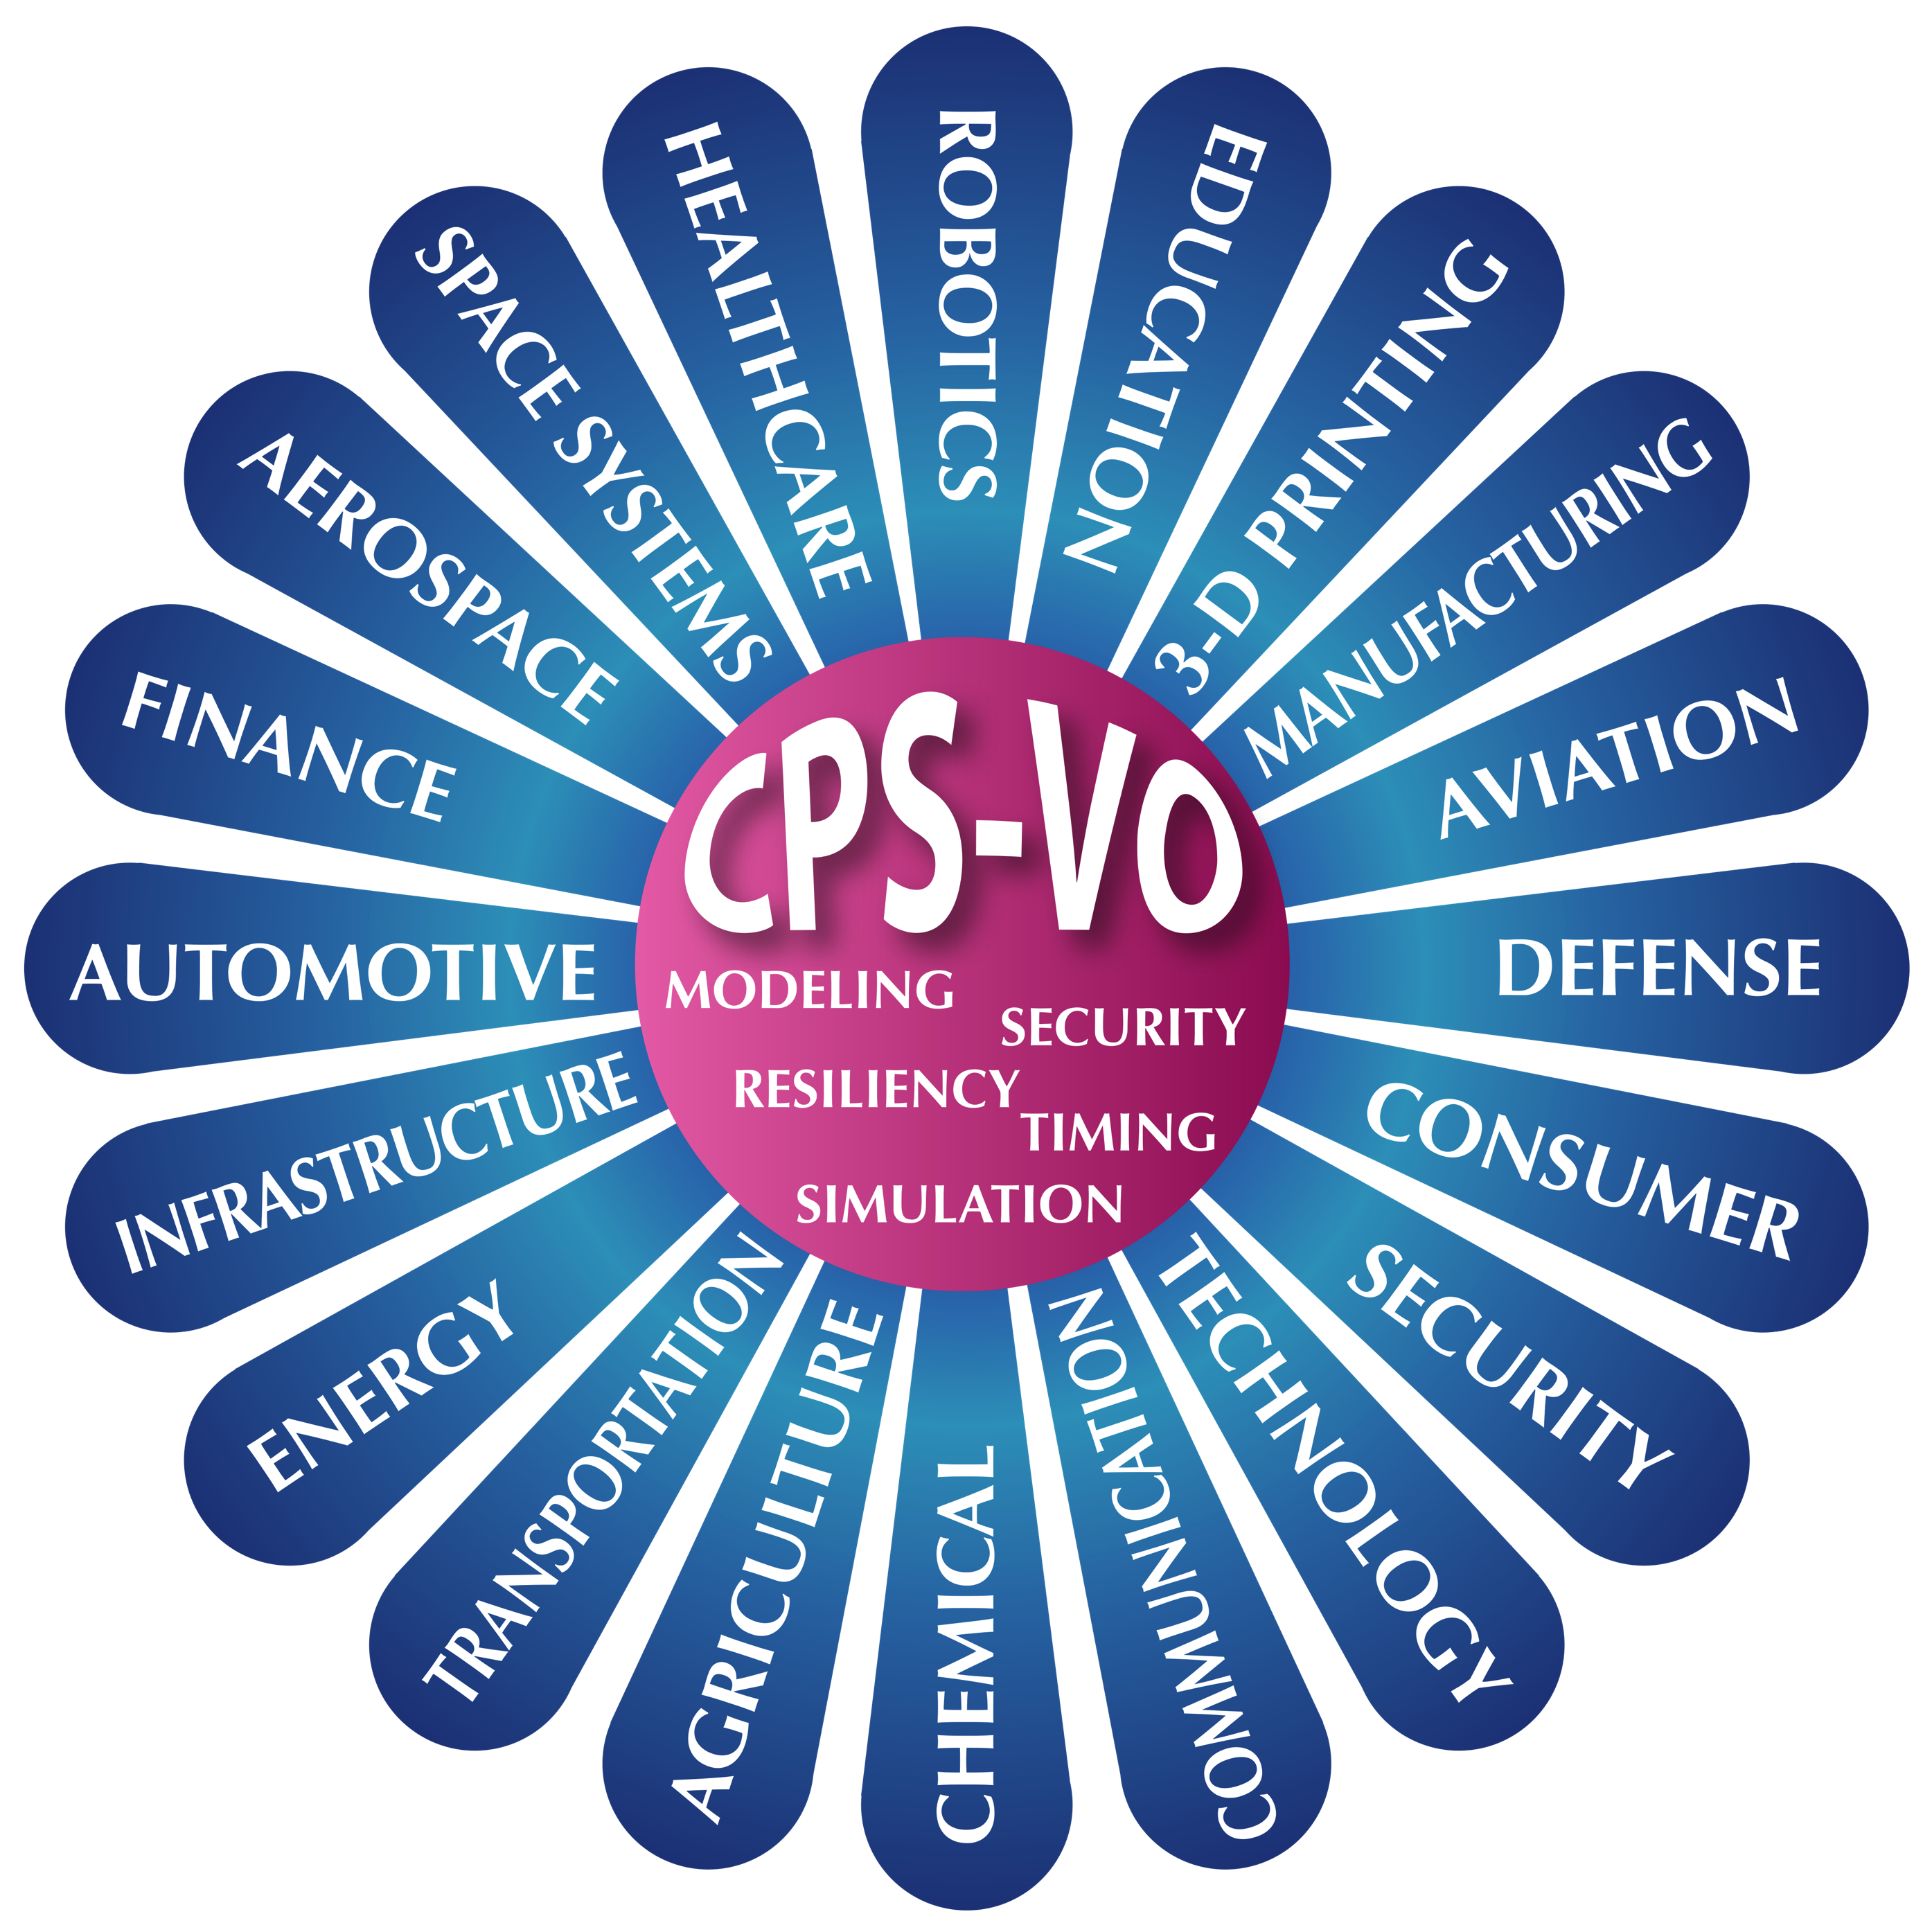
Cyber-Physical Systems Virtual Organization
CPS Principal Investigators’ Meeting
November 6-7, 2014
Arlington, Virginia
http://cps-vo.org
Chris vanBuskirk
Institute for Software Integrated Systems, Vanderbilt University
GOALS OF THE CPS-VO
EXAMPLE CPS-VO GROUPS
The Cyber-Physical Systems Virtual Organization (CPS-VO) facilitates quickly bootstrapping multi-disciplinary research communities for the developing field of cyber-physical systems. A still formidable impediment to progress in this growing field is the lack of integration and cross-fertilization of several traditionally isolated disciplines.
For example, the dearth of sufficiently rich, first-class abstractions for physical concepts such as time in practical programming tools and methodologies is telling. Similarly, systems engineers, often work in abstractions that gloss over important computational factors related to resource allocation, component availability/failures, or network delays. CPS-VO, as the electronic gathering place and clearing house for knowledge relevant to the field, helps to advance the theory and practice of Cyber-Physical Systems.
FEATURES OF THE CPS-VO
Survey Current Research - track research projects in ongoing CPS-related research programs
Review Important Announcements - get news on significant CPS-related activities
Find Out What's Happening - watch for events of interest in the community Calendar
Connect to Others - use chat, video conferencing, forums, and online networking
Share your Work - build wikis, set up special interest groups, upload files & tools, reports, multi-media
Discover Resources - search for people, papers, events, and other items of interest
Learn More - take advantage of educational resources contributed by CPS-VO members and sponsors
The Science of Security VO
DARPA AVM Program
Southeast Michigan Connected Vehicle Test Bed
National Workshops on Education, Medical Devices, Time-Critical Systems, & Energy
Software Certification Consortium
Safety Critical Software for Nuclear Reactors
TOTAL: 146 Groups

