Slide 1
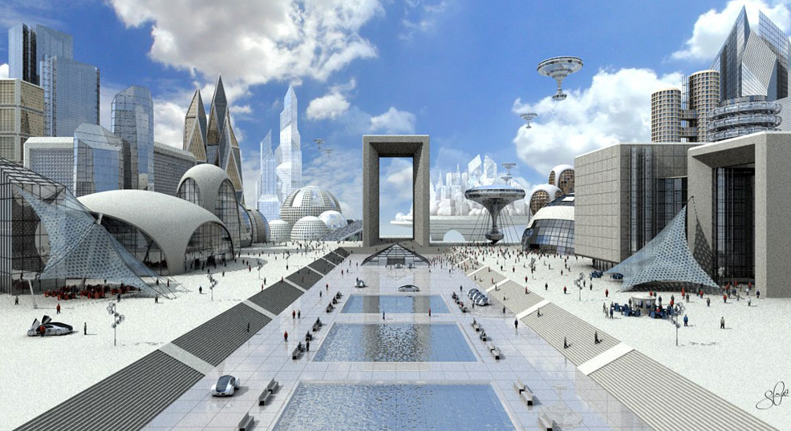
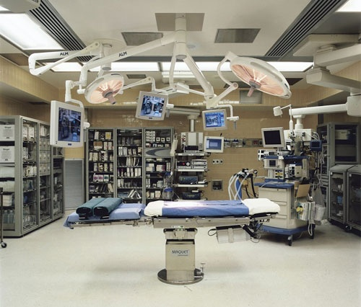
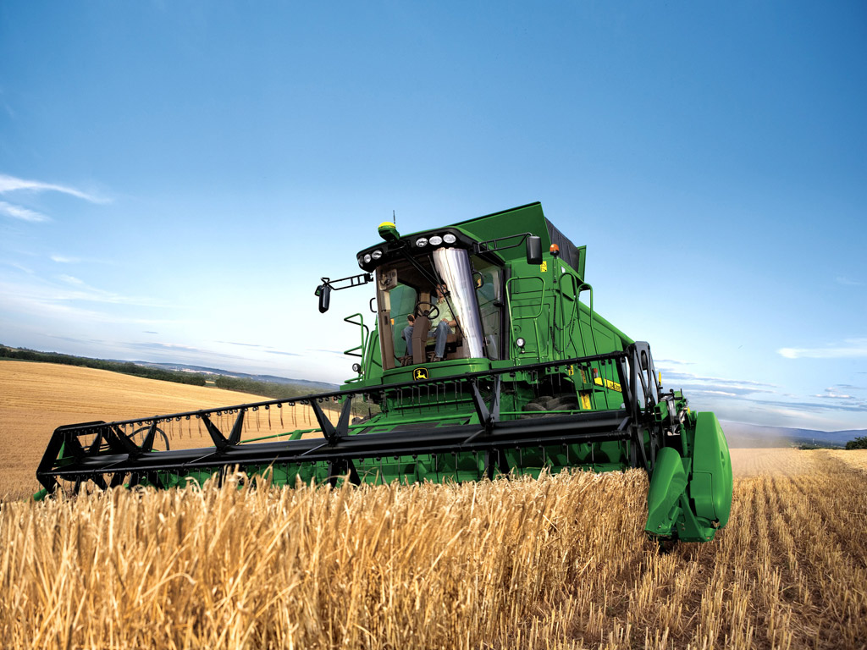
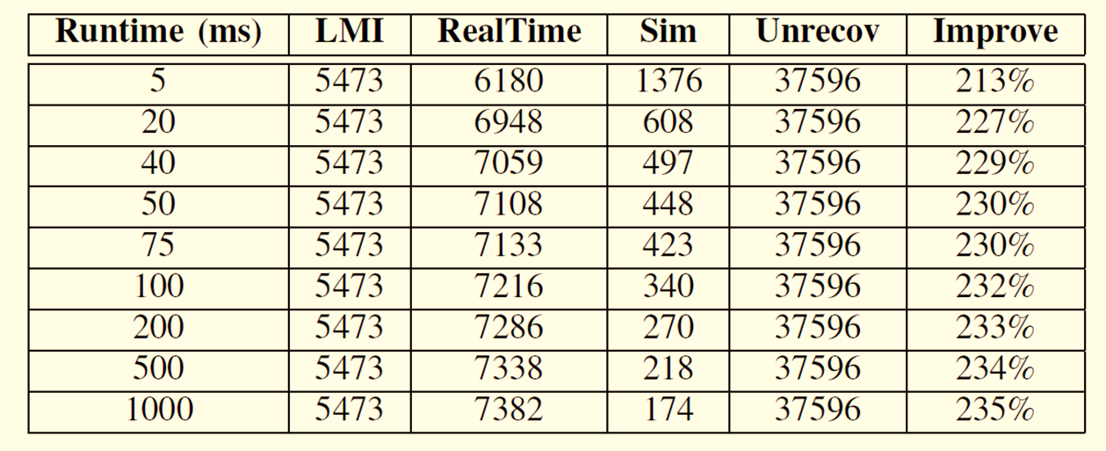
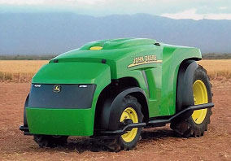
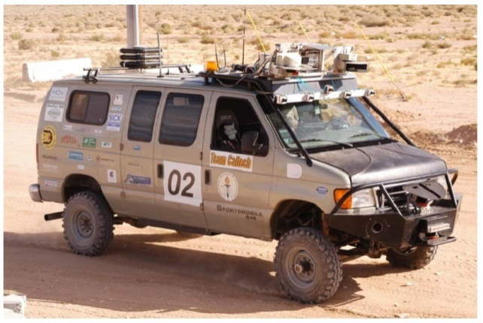
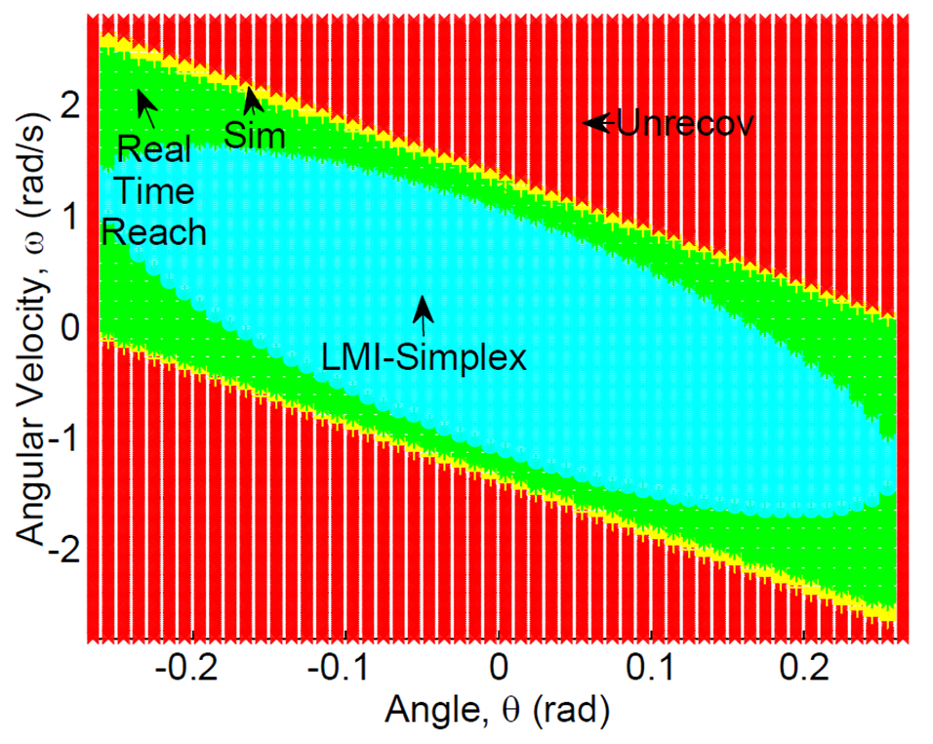
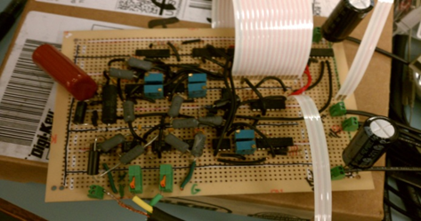
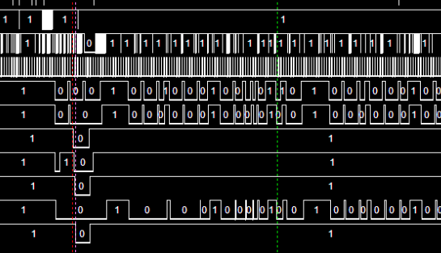
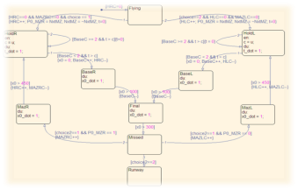
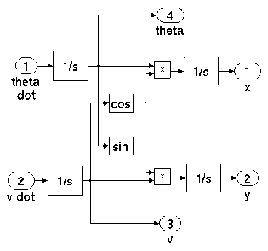
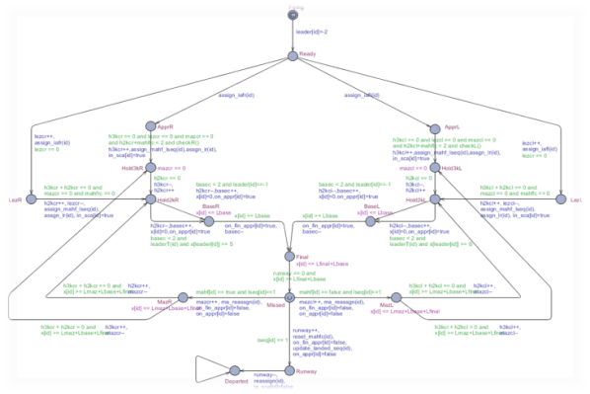
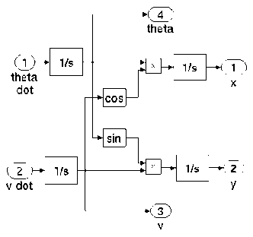
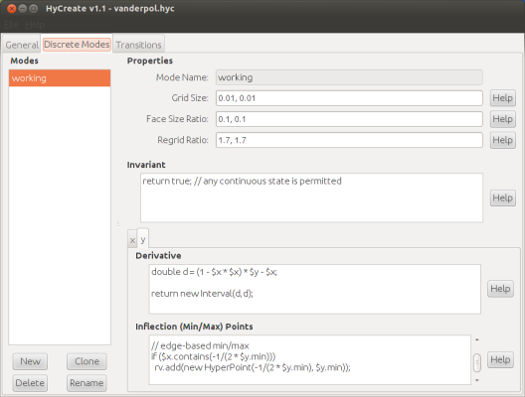
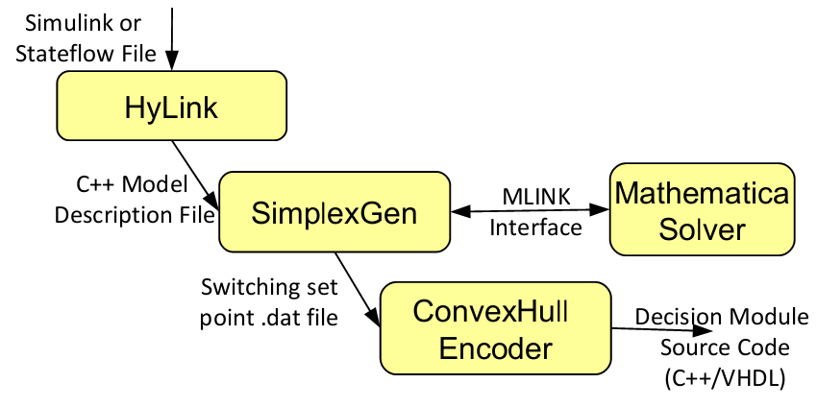
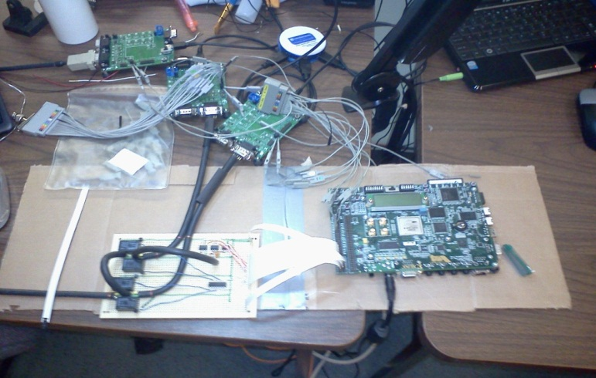
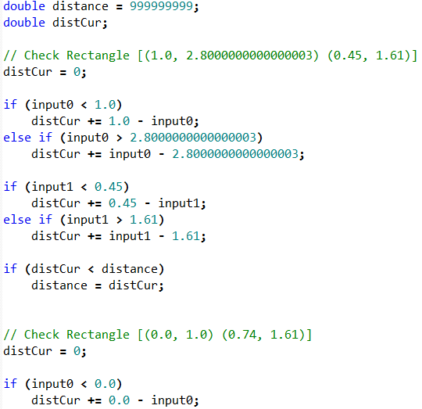
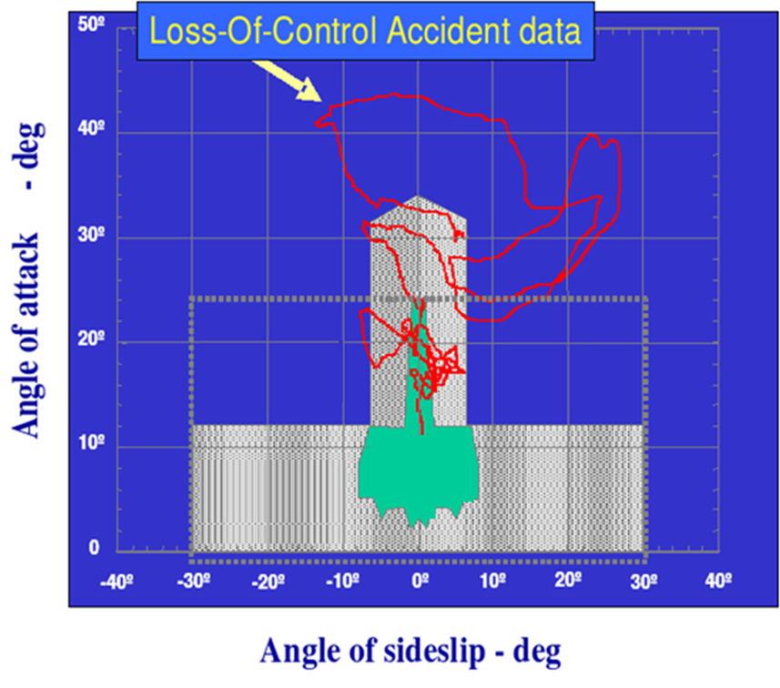
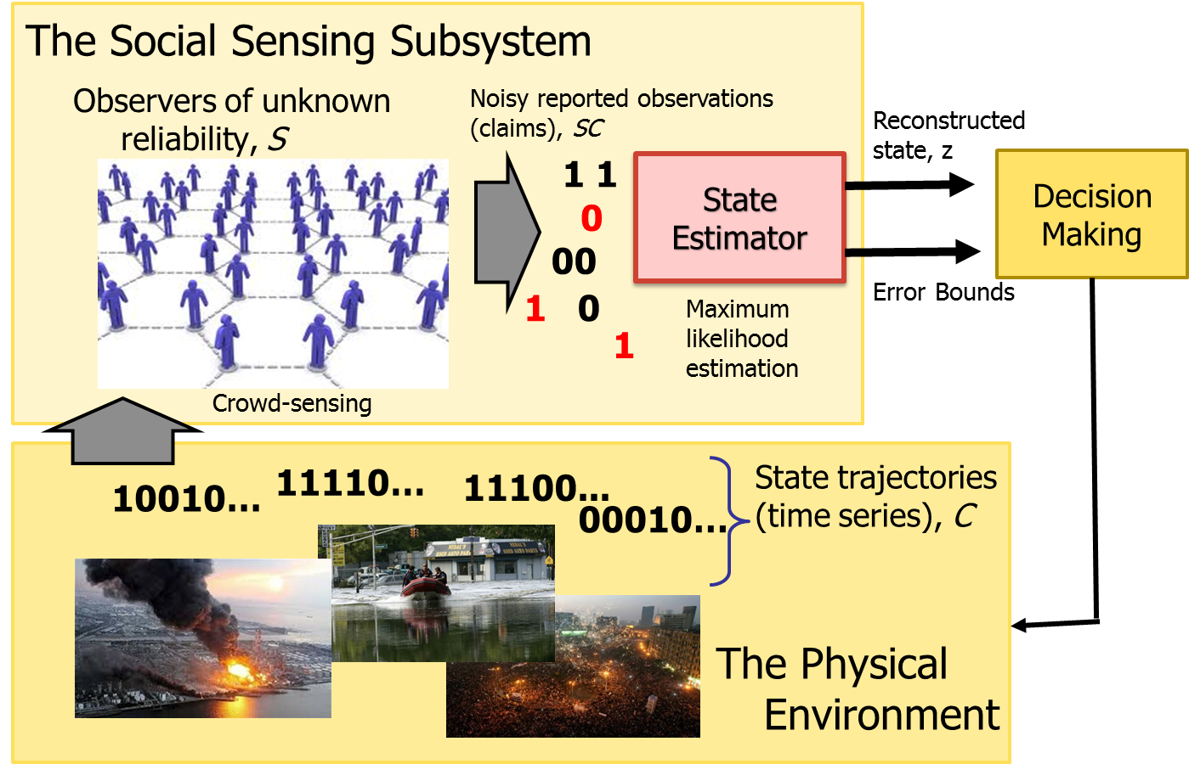
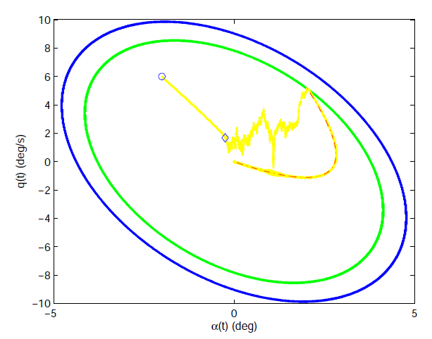
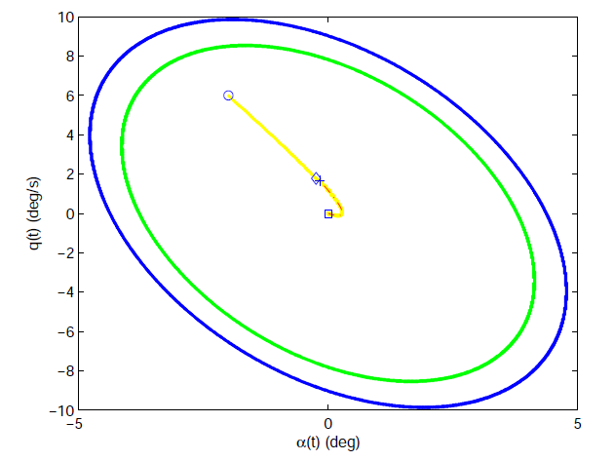
The Ectokernel Approach: A Composition Paradigm for
Building Evolvable Safety-critical Systems from Unsafe Components
Tarek Abdelzaher (PI), Marco Caccamo, Lui Sha
Department of Computer Science, University of Illinois
Safety-Critical Applications
fantasyartdesign.com
Automotive
Smart Cities
Medical
Mass
Transit
Power
Future CPS
Increased size and automation
Computational intractability to verify all code
Increased criticality, coupling and potential for failure cascades
Increased societal dependence and more dramatic consequences of software failure
Avionics
Challenge: How to build software for safety-critical CPS where majority of code cannot be verified?
Agriculture
Motivation
Preliminaries
Main Ideas
Interactive complexity increasingly plagues the design and execution of large systems
High complexity generates unexpected interaction patterns and hard-to-find bugs
Building more reliable systems entails taming interactive complexity
This project offers:
Architectural support for reducing interactive complexity
Algorithms for verifying safety guarantees in the presence of unverified code
Algorithms for diagnosing root causes of performance problems
When safety properties are about to be violated, a verified control block performs “fail-over” to a verified component, disconnecting appropriate unverified ones.
Physical connections (e.g., power grid distribution buses) in large scale CPS provide “fail-safe” remote state estimation for running local safety controllers
A diagnostic system troubleshoots the unverified component problems
Challenges:
Design of the switch logic in the “fail-over” control block
Efficient verification of core functions used for fail-over
Diagnosing root causes of bugs in the remaining unverified code
A Testbed for CAN Bus Diagnostics
Safety
Embedded Safety-Critical Application Programming Environment (ESCAPE) Toolkit
Generates provably correct safety controller code from Simulink/Stateflow models, and offers run-time checking.
Allows injecting reproducible hardware faults
Automates fault diagnosis
Tested with John Deere engineers
Bus sniffer allows to identify and locate hard to debug faults like transient frame loss due to a bad connector
Sniffer supports differential and single ended receivers to identify transient faults
Data logging is triggered by a specified event (like loss of differential signal on the bus)
Emulation Architecture
Control Block FPGA
Bus sniffing
& logging
Complex Controller PC
Simulation model Simulink/Stateflow
Rigorous mathematical model
(hybrid automatons)
Bus (CAN)
More details:
S. Bak, T. Johnson, M. Caccamo and L. Sha, "Real-Time Reachability for Verified Simplex Design“ Proceedings of the IEEE Real-Time Systems Symposium, Rome, Italy, December 2014.
Verification and Synthesis Algorithms and Software Tools
graphical interface for reachability
Simulink PC
Sensor
Messages
Actuator
Messages
Complex Controller PC
Provably Safe Controller
Fault-tolerant Control
Data Reliability Analysis
Conclusions
Mechanical faults such as engine and control surface failures have been successfully addressed by robust (adaptive) control
Limitation: cannot handle the software failure
Control software fault tolerance has been addressed by Simplex software architecture.
Limitation: cannot handle mechanical faults
Contribution: Handle both cyber faults and mechanical faults for a family of fault models
Data reliability analysis in distributed systems
Emerging distributed cyber-physical systems such as transportation, disaster response, and energy management will involve humans as distributed sensors (social sensing).
Very little is done on ensuring data reliability in such applications
A new estimation-theoretic framework is developed for jointly assessing source reliability and data correctness, while offering confidence intervals in results
Proper architecture obviates the need to verify all code
Unsafe conditions brought about by unexpected component interactions can be neutralized by cutting interaction chains that include culprit unverified code when safety is about to be violated
The cyber system fault induced physical system instability is stablized by watch and controller switching using the stability envelopes of local subsystem and the networked control subsystem
A programming environment for safety-critical cyber-physical systems that generates provably correct code
Fault-tolerant control that withstands both physical and software errors
Mathematical foundations for data reliability with humans in the loop
Status: Testbed is constructed and used for experiments with John Deere, architecture is validated, programming environments for verification are implemented, diagnostic and safety checking tools are developed
Safety Monitor
Reliable Physical State Estimation from Social Sensing
State Predictor:
Adaptive Law:
Low-Pass Filter:
Threshold
- Credibility of sources
- Correctness of claims
- Confidence intervals
More details:
Xiaofeng Wang, Naira Hovakimyan, Lui Sha: L1Simplex: fault-tolerant control of cyber-physical systems. ICCPS 2013: 41-50 (best paper nomination)
State Trajectory with Software Failures
State Trajectory with Physical Failures
Formulate the fact-finding problem as one of maximum likelihood estimation
Solve it using the Expectation Maximization (EM) algorithm
Compute a bound on estimation accuracy (using the Cramer Rao Bound)
More details: Shiguang Wang, Dong Wang, Lu Su, Lance Kaplan, Tarek Abdelzaher, "Towards Cyber-physical Systems in Social Spaces: The Data Reliability Challenge," IEEE Real-time Systems Symposium (RTSS), Rome, Italy, December 2014

