Slide 1
Internet of Safe Things
Feng Zhao
Collaborators: Borje Karlsson, Mike Liang, Nic Lane
Microsoft Research Asia
November 6, 2014

Slide 2
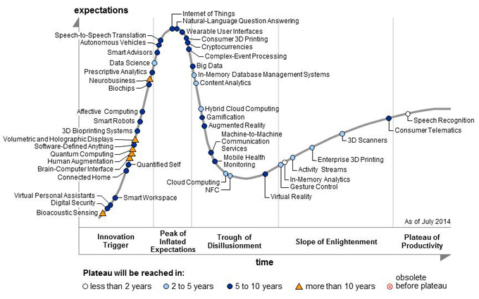
Source: Gartner Hype Cycle for Emerging Technologies 2014

Slide 3
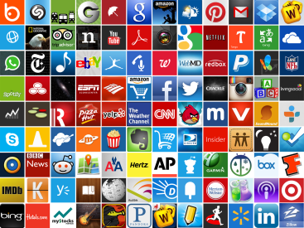
> Two Million Apps
> 500,000 Developers

Slide 4
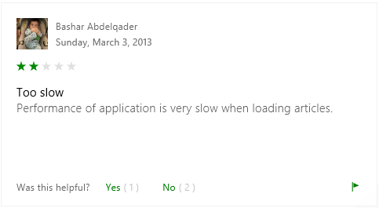
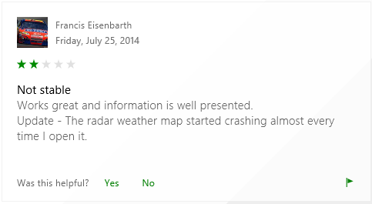
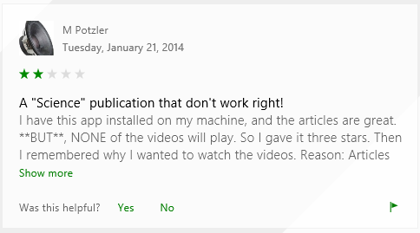
The Health of the App Eco-system Drives the Mobile Platform Success… But…
Music download apps not working
Saturday 17th of March 2012 Has anyone noticed their music download apps not working the last few days? I have Music Junk & a couple of others. When I look for a song I get a "Network Error" message. Wondering if it's just me, the phone or Sprint.
Apps Not Working Over 3G, But Work Normally Over WiFi on Galaxy Note!
Sunday 12th of August 2012 All my android apps are working on Wifi beautifully but not at all on 3g on Samsung Note GT-N7000 (Carrier - Vodafone IN)And this happened after my recent trip to Bangalore. As soon as I landed there the problem started.
mobile banking apps not working
Thursday 05th of May 2011 / forums.androidcentral.com Following the 4.1.83 update, I can no longer log into my Bank of America app. It appears that the apps from some other banks(Chase, Discover, American Express) have stopped working, as well. Anyone know of a workaround? My guess is that it's some kind of security certificate problem inside the app, because I can log into my account via the web browser, but now it flashes a security certificate error. I'd prefer to use the app, rather than the browser. posted on: Android Devices
mobile banking apps not working
Thursday 05th of May 2011 Following the 4.1.83 update, I can no longer log into my Bank of America app. It appears that the apps from some other banks(Chase, Discover, American Express) have stopped working, as well. Anyone know of a workaround? My guess is that it's some kind of security certificate problem inside the app, because I can log into my account via the web browser, but now it flashes a security certificate error. I'd prefer to use the app, rather than the browser. posted on: Android Devices

Slide 5
Smart, connected home

Slide 6
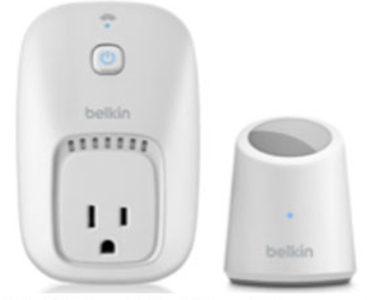
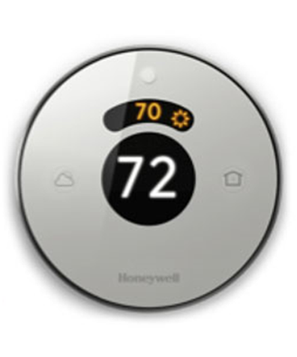
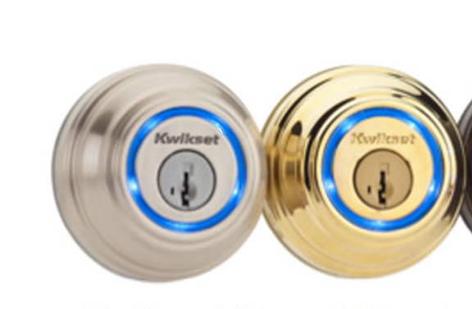
Internet of Things Ecosystem
Open Programmable Devices and Objects are here
By 2020, 26B smart devices: lights, locks, security sensors …
By 2019, 70% homes with IoT devices
Industry standards promise simple IoT inter-operability
Examples: AllJoyn, Thread, SmartThings, Open Interconnect, …
Developers and IoT Apps are coming!
1,400 global developer survey – 40% working on IoT apps today _{[Source:} _{Evans Data Corporation]}
IFTTT.com: 8,000 users targeting IoT apps; 34,000 apps built already ^{[Source: IFTTT.com]}
^{[Source: Gartner]}
^{[Source: Accenture –} ^{Acquity]}

Slide 7
Unsafe Internet of Things Environments
But! Today’s IoT systems are fundamentally unsafe and subject to a range of vulnerabilities
Study of top 10 IoT devices across multiple categories finds vulnerabilities in 70% of devices
^{[Source: HP]}

Slide 8
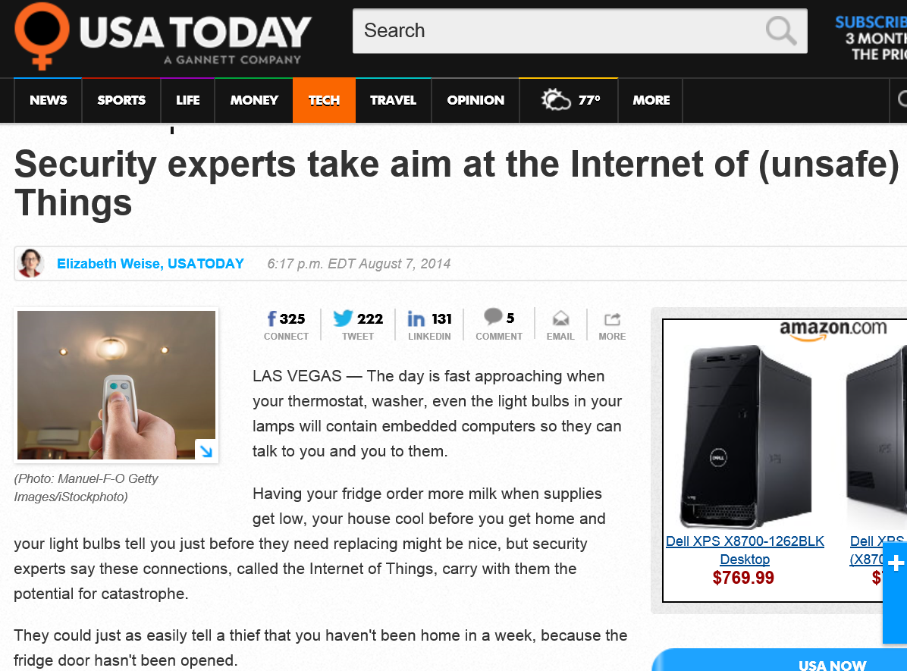

Slide 9
Unsafe Internet of Things Environments
But! Today’s IoT systems are fundamentally unsafe and subject to a range of vulnerabilities
Study of top 10 IoT devices across multiple categories finds vulnerabilities in 70% of devices
March 2014: “Remote-steering” attack demonstrated on recent car models
August 2014: IoT baby monitor in Texas hacked; parents enter room to find strangers swearing and yelling remotely at two-year old girl
October 2014: “First cyber-death [IoT related] will happen this year”
…
^{[Source: HP]}
^{[Source: Forbes]}
^{[Source: CNN]}
^{[Source: Independent} ^{(UK) ]}

Slide 10
Software testing in the wild
Complex interactions with the physical world and the users through networks, sensors, and user interfaces
This talk focuses on taming this complexity:
Contextual Fuzzing:
Automate mobile app testing with real world conditions at scale
SIFT:
Synthesize and verify key properties of IoT apps (e.g., safety, security)

Slide 11
Contextual Fuzzing: Automated Mobile App Testing at Scale

Slide 12
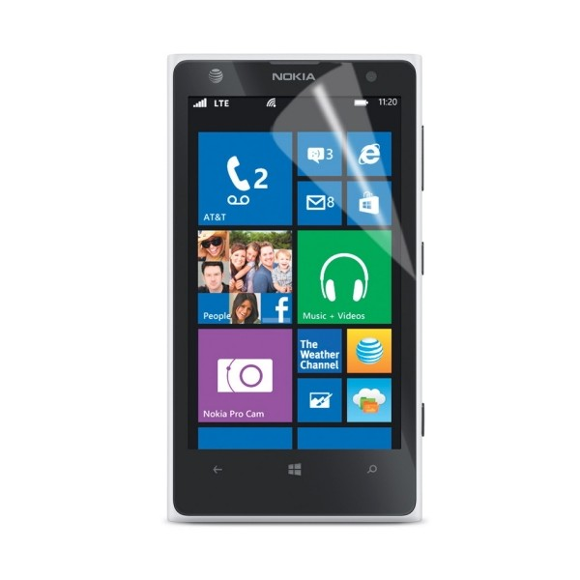
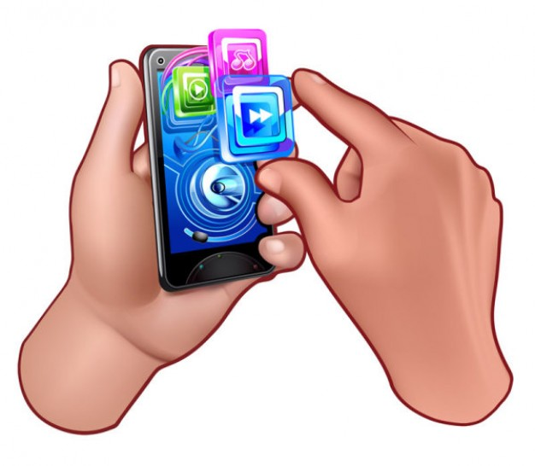
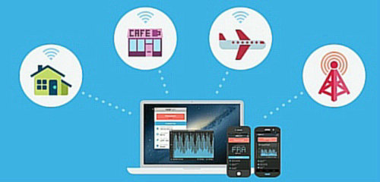
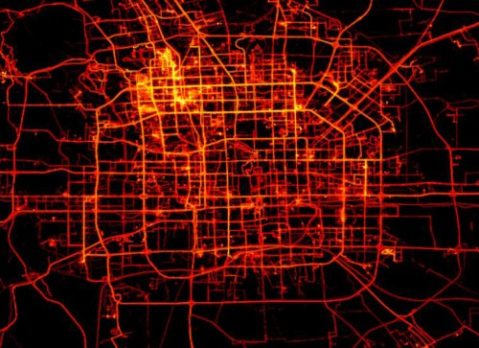
Diverse Real-world Contexts to Consider
Various inputs
Environmental conditions
Device configurations
Contextual Fuzzing
User interactions
Sensor readings
Network conditions
Geo-location
Mobility trajectory
CPU
Memory
OS

Slide 13
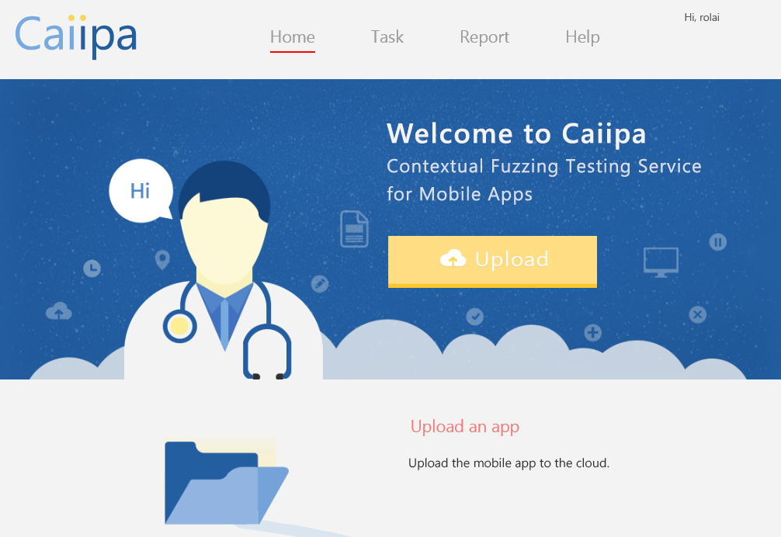
Our Cloud Testing Service – Caiipa
Sample bugs found:
Location
An app by a magazine publisher is 50% more likely to crash outside of US
Network transition
A chat app can crash when the smartphone transits from Wi-Fi to 3G

Slide 14
Design Goals
Comprehensive testing coverage (with Contextual Fuzzing)
Fuzz real-world contexts that impact an app’s behavior
Detect unexpected problems
In contrast to simply spot tests for specific failures
Timely and actionable feedback to users
Deal with test state space explosion from considering real-world contexts

Slide 15
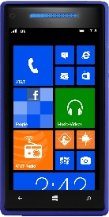
Architecture of Caiipa
1
3
User Model
Context Library
AppHost
Performance Monitoring
App Host
Context
data sources
Next test case
2
Context Prioritizer
System Perturbation
Performance Analyzer

Slide 16
Architecture of Caiipa
Store cases of real-world contexts
Network – E.g., loss rate
Geolocations
Sys config – E.g., memory
1
3
User Model
Context Library
AppHost
Performance Monitoring
App Host
Context
data sources
Next test case
2
Context Prioritizer
System Perturbation
Performance Analyzer

Slide 17
Architecture of Caiipa
1
3
User Model
Context Library
Prioritize pending test cases to run, by the potential of finding crashes
AppHost
Performance Monitoring
App Host
Context
data sources
Next test case
2
Context Prioritizer
System Perturbation
Performance Analyzer

Slide 18
Architecture of Caiipa
Perturb environmental and system configurations
Monitor system resource metrics
Network – E.g., TCP connection resets
CPU – E.g., user time
Memory – E.g., working set
Disk I/O – E.g., num bytes read/written
3
1
User Model
Context library
AppHost
Performance Monitoring
App Host
Context
data sources
Next test case
2
Context Prioritizer
System Perturbation
Performance Analyzer

Slide 19
Challenges of Contextual Fuzzing: Scalability
State space explosion from numerous real-world contexts
10,504 contextual test cases currently in our library
Solution: Test case prioritization with “app similarity sets”

Slide 20
Test Case Prioritization
Idea
Overview of steps
Run the current app under GPRS, 802.11b, and 4G test cases
Find resource-based similarity set, AppSimSet
Count crashes in pending test cases, as observed by AppSimSet
Sort pending cases in descending order
Tested apps
Context Library
Next test case
App
Context Prioritizer

Slide 21
Test Case Prioritization – App Similar Set
Idea: “Similar” apps consume system/network resources in a similar way
Outputs: One set of similar apps per resource metric
Δ app
performance counter
Step 1: Extract features
Features: Changes in resource metrics after each UI click
Step 2: Compare features across apps
Kolmogorov-Smirnov (KS) test: Comparing the CDF of two datasets
Click sequence
CDF (%)
App performance counter(s)

Slide 22
How Does Context Prioritizer Perform?
Observations
Given fixed time budget, Caiipa’s test prioritizer finds an average of 30% and 28% more crashes than Random and Vote respectively
As the time budget increases, there is a diminishing return

Slide 23
Take home messages
Comprehensive testing coverage (with Contextual Fuzzing)
Fuzz real-world contexts that impact an app’s behavior
Result: Up to 11× more crashes found when considering real-world contexts
Detect unexpected problems
In contrast to simply spot tests for specific failures
Result: 351 crashes found so far (but not yet reported by users)
Timely and actionable feedback to users
Deal with test state space explosion from considering real-world contexts
Result: Up to 30% more crashes found, under a fixed time budget
Caiipa: Automated Large-scale Mobile App Testing through Contextual Fuzzing, Mobicom 2014.

Slide 24
SIFT: Tools for Building Safe IoT

Slide 25
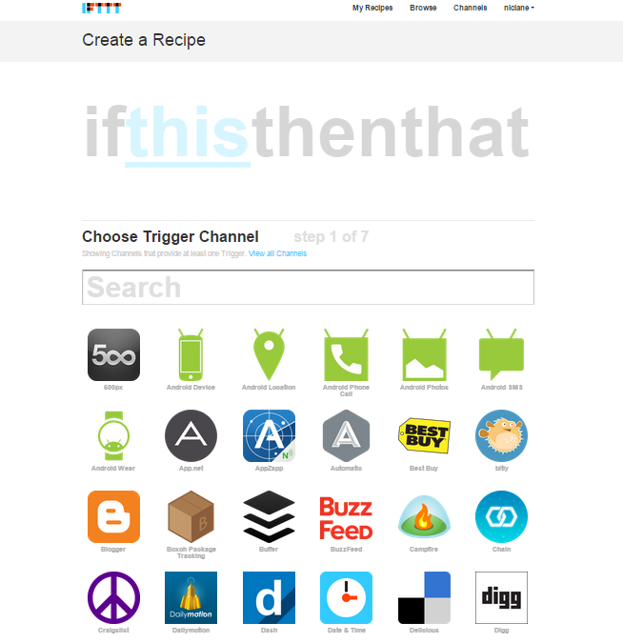
IoT Programming Tool in Reality
Browser-based IFTTT Programming
Representative Consumer Automation ^{Platform}
^{Actual User Examples}

Slide 26
Growing Safety Gap in IoT Programming Tools
Emerging safety concerns caused by IoT apps
IFTTT Examples:
How does a user know if an IoT app will run as expected in their home?
What happens to IoT apps when a device failure occurs?
If two users specify incompatible IoT app behaviors how is this resolved?
More generally:
No debugging tools
Manual checking for conflicting apps or race-conditions
No testing tools
Will an IoT app push a device outside the hardware’s operation specifications?
No feedback to user
Users must diagnose problems themselves

Slide 27
SIFT Design Goals
Automated Scalable Model Checking of:
Intra-app and Inter-app conflicts
Monitoring global policy violations
Safety-promoting Semantic Programming Assistance
Simple syntax hiding device and deployment specific details
Learning and recommending safety tested new IoT apps that automate regular user behavior
Intuitive User Safety Feedback
Targeted information detailing how safety is compromised
Suggested solution of safer alternatives

Slide 28
SIFT: Safe Internet of Things
Registry
Device Metadata
Code Library
User Policies
IoT app
Rule #1
…
Rule #n
IoT app
(Synthesized code)
Synthesis Engine
Safety Verification Engine
App Recommendation Engine
Database
Execution Engine
Sensing
Actuation

Slide 29
SIFT: Safe Internet of Things
Registry
Device Metadata
Code Library
User Policies
IoT app
Rule #1
…
Rule #n
IoT app
(Synthesized code)
Synthesis Engine
Safety Verification Engine
App Recommendation Engine
Database
Execution Engine
Sensing
Actuation
Safety Protection
Robust to IoT device failures
Users do not directly program devices – removing a source of safety errors

Slide 30
SIFT: Safe Internet of Things
Registry
Device Metadata
Code Library
User Policies
IoT app
Rule #1
…
Rule #n
IoT app
(Synthesized code)
Synthesis Engine
Safety Verification Engine
App Recommendation Engine
Database
Execution Engine
Sensing
Actuation
Safety Protection
Ensure policies (e.g., user privacy, device operating bounds) are not violated
Protect against IoT apps that cause logical inter-app conflicts and inconsistent device states

Slide 31
SIFT: Safe Internet of Things
Registry
Device Metadata
Code Library
User Policies
IoT app
Rule #1
…
Rule #n
IoT app
(Synthesized code)
Synthesis Engine
Safety Verification Engine
App Recommendation Engine
Database
Execution Engine
Sensing
Actuation
Safety Protection
Feedback to user – suggested safe app changes, including parameters, that result in safe IoT apps
Suggested apps based on user behavior: automating repeated actions IoT system observes

Slide 32
SIFT: Safety Verification Engine
Safety Verification Engine
Policies
1
Code Transformer
Intermediate code w/ flags
White-box Exploration Tool
App rule conflicts
Intermediate code w/ flags, assertions
2
IoT app
(Synthesized code)
Policy violations

Slide 33
SIFT: Safety Verification Engine
Safety Verification Engine
Policies
1
Code Transformer
Intermediate code w/ flags
White-box Exploration Tool
App rule conflicts
Intermediate code w/ flags, assertions
2
IoT app
(Synthesized code)
Policy violations
THIS : Sensing or Label
(define-fun conjecture-c1 () Bool
(=> (>= t 25)
(and (= true ac_on) (c1))
)
(assert conjecture-c1)
Too hot:
IF Temp >= 25 THEN Cool
THAT : Label or Action

Slide 34
SIFT: Model Checking Workflow
Safety policies
Translator
C# code
Compiler
IoT apps
Logic model
MSIL
Safety engine
Symbolic execution
Execution Path
Path condition
MSIL
Known Paths
New input
Solve
Constraint System
Conflicts
Unexplored path

Slide 35
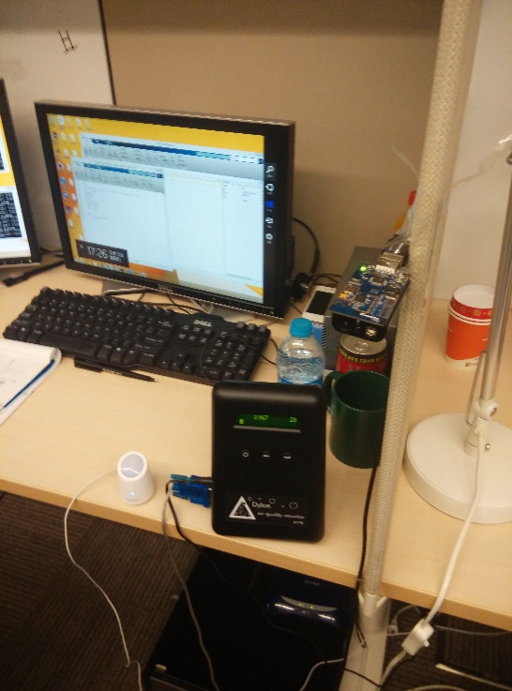
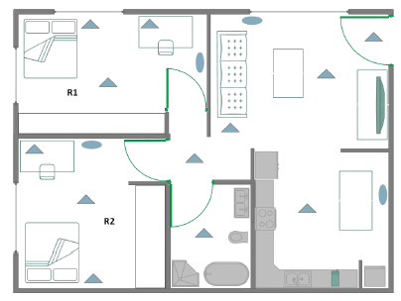
Explorations with SIFT prototype
Office Environment Deployment
Home-based User Study
Large-scale IFTTT.com workload

Slide 36
Scalable Detection of Logical Conflicts in Large-scale IoT App Dataset
Workload Mixture Trials

Slide 37
Internet of safe things: software testing at scale
Contextual Fuzzing: Automate mobile app testing with real world conditions at scale
Emulate real-world conditions
Tackle state space explosion by leveraging app similarity
Found more crashes and faster
SIFT: Provide safe IoT development and execution addressing common safety concerns
Automated scalable model checking and policy verification
Safety promoting programing assistance
User safety feedback (and suggested fixes)

Slide 38
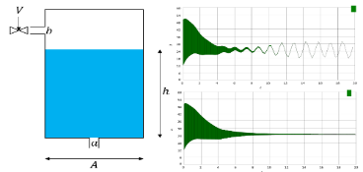
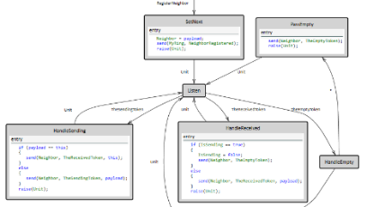
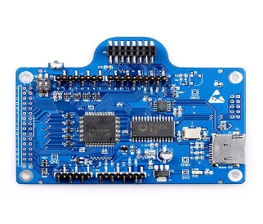
MSR Expedition on Safe CPS
Use MSR’s deep technology stack to build safe and reliable CPS quickly
From inference to awareness
How to reason about uncertainty when applying ML and vision libraries to perform sensor fusion?
From program verification to CPS verification
For CPS must consider physical dynamics. Combining best SMT solver (Z3) with ODE solvers for better symbolic model checking of hybrid systems.
From P Language to CPS controllers
P already used for industrial strength device drivers. Adding new features for distributed controllers and exploring new verification and whitebox testing techniques.
From Verve operating system to RTOS
Verve is only OS with concurrent garbage collection and provably memory safe. Would give a TCB for CPS and allow better programming languages (e.g. managed languages).

Slide 39
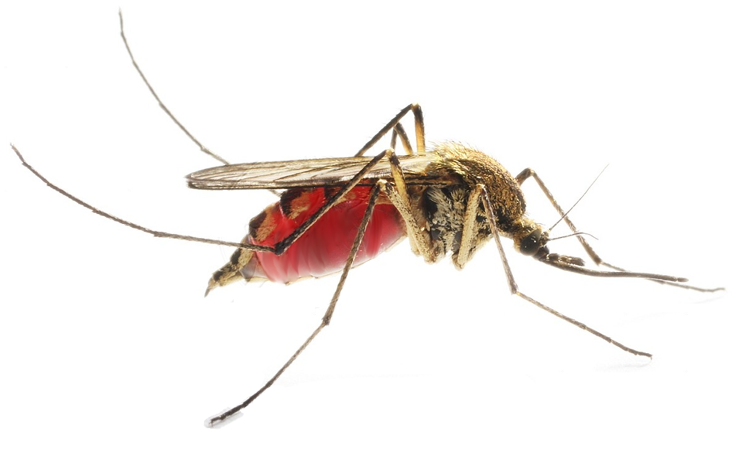
While Exploring Disruptive Applications
Will be developing disruptive test-beds. Collaborators welcome!
(POC: Ethan Jackson, ejackson@microsoft.com)
Ubiquitous pathogen surveillance
Using UAVs to monitor pathogens in the environment, trying to see outbreaks, such as Ebola, before they happen.
Pollution monitoring in urban environments
Small particulate air pollution estimated to cause 3.7 million premature deaths worldwide in 2012. Let’s fix this.
3D imaging of complex environments
Autonomous systems that provide detailed 3D maps for indoor gaming and outdoor interactions.

Slide 40
Towards Internet of Safe Things
Computing systems interact with the physical world in increasingly new and complex ways
Software flaws expose many risks, the physical world magnify them
The CPS community must develop the foundations, platforms and tools to enable building safer and more reliable systems, helping transitioning the technology to mass market production and adoption
Questions: zhao@microsoft.com

