Slide 1
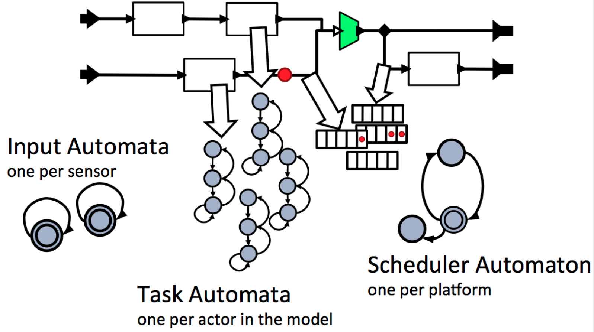



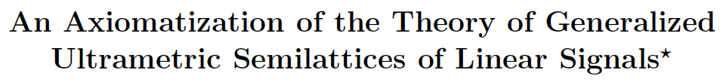
CNS 1035672
CPS: Medium: Timing-Centric Software
Edward A. Lee (PI)
Sanjit Seshia (co-PI)
Patricia Derler (postdoc)
John Eidson (VIF)
Jonathan Kotker (PhD student)
Eleftherios Matsikoudis (postdoc)
Christos Stergiou (PhD student)
Zach Wasson (PhD student)
Michael Zimmer (PhD student)
Ptides. Ptides is a programming model for the design of distributed real-time embedded systems. It is based on a discrete-event formalism augmented with real-time semantics. Ptides features explicit temporal semantics through the use of time-stamped events as well as the determinacy of execution.
Schedulability problem
A Ptides model captures the timing requirements of an application. The question of whether the program can meet those requirements when executed on a specific platform is the schedulability problem. The execution platform determines worst-case execution times WCET for each actor and event models for the sensor and network inputs (sporadic, periodic, minimum inter-arrival times etc.) The schedulability problem turns out to be rather idiosyncratic, involving complex, time-dependent release predicates and precedence. In this work we reduce the schedulability problem to a reachability problem for timed automata.
PTIDES Workflow
Schedulability Analysis
Causality Analysis
Program Analysis
Ptides Model
Code Generator
Code
PtidyOS
Software Component Library
HW Platform
Mixed Simulator
Plant Model
HW in the Loop Simulator
Network Model
Simulation
Simulation framework: Ptolemy II
Ptides director based on DE director
Ptides platform: Composite actor with local (platform) time
Top level coordination by DE director
Interaction with continuous plant models
Sensor/Actuator/Network ports
Theory of Timed Systems. A major thrust in this project is to develop a formal theory of timed systems to complement process algebras and programming language semantics. Some of the resulting papers published in the last year are shown on the right.

