Slide 1




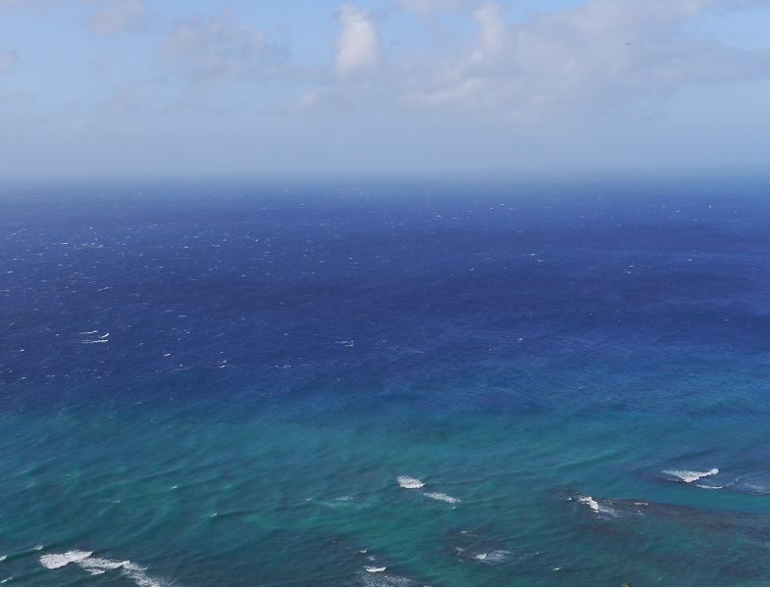
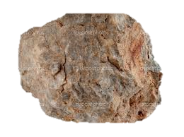

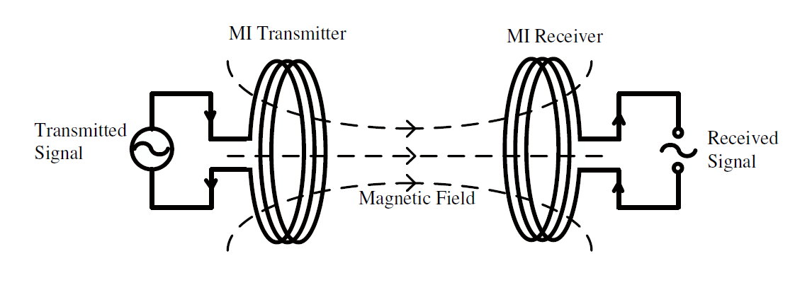


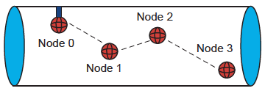
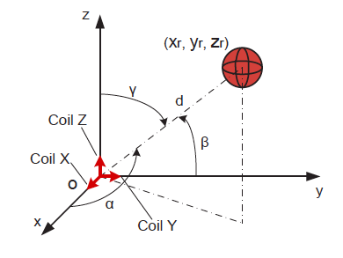
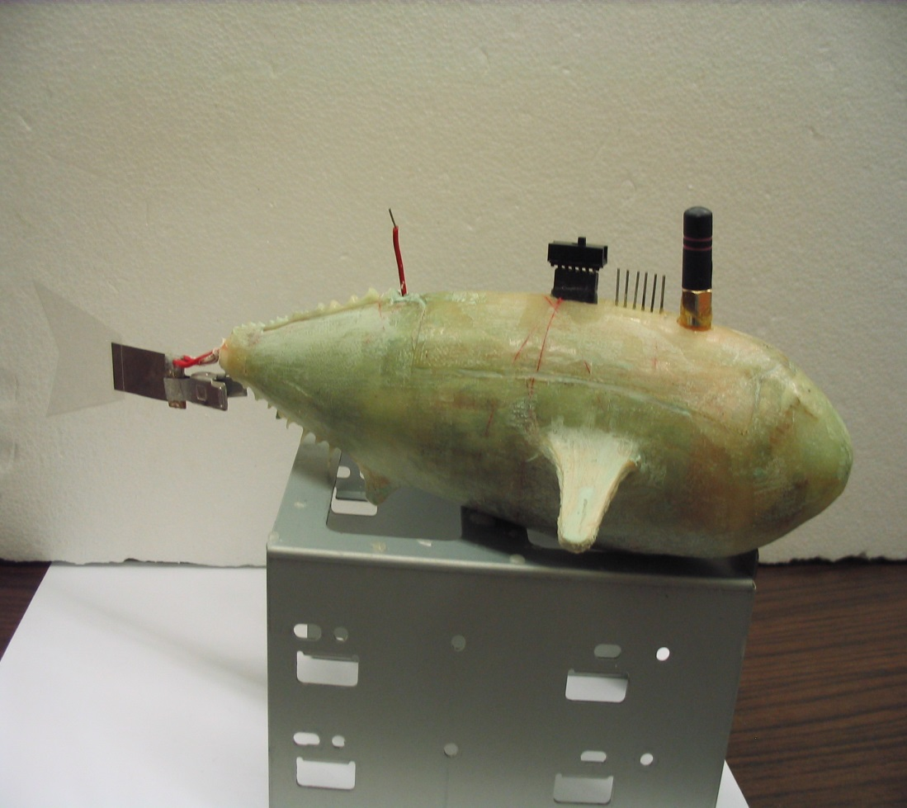
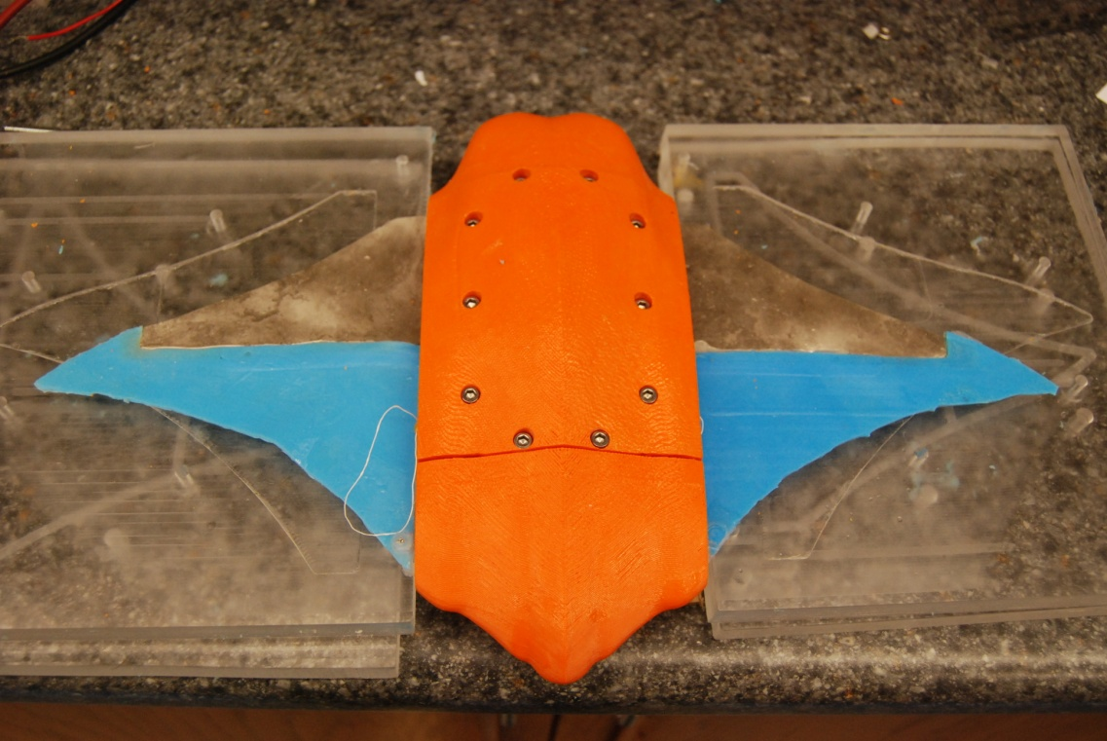
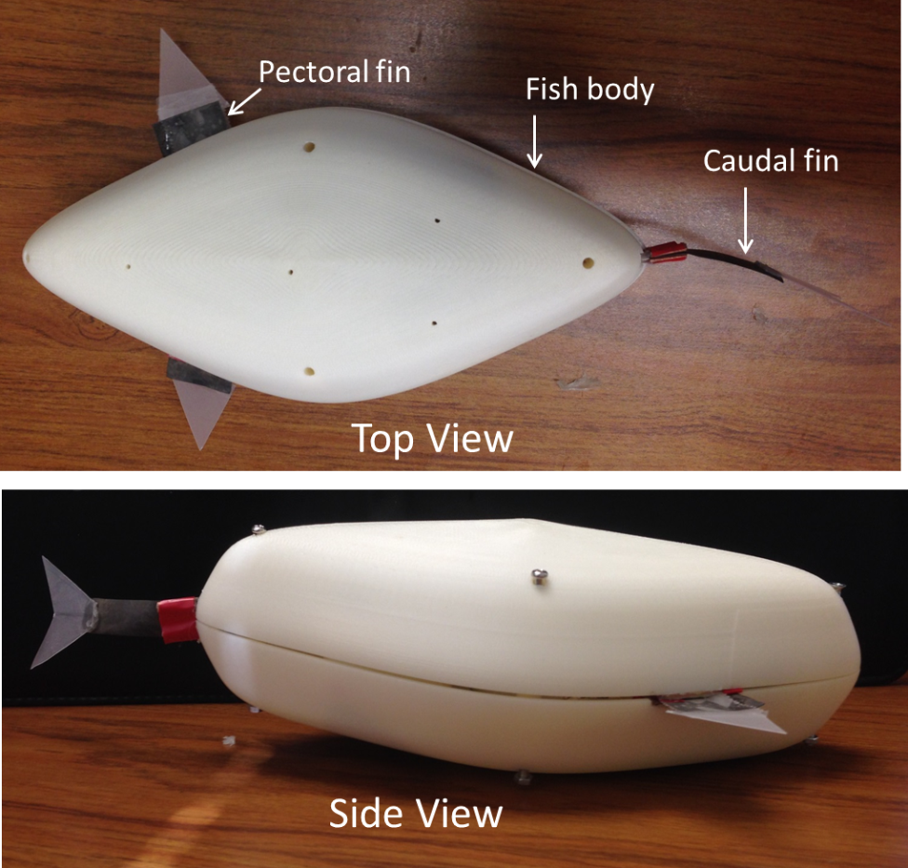
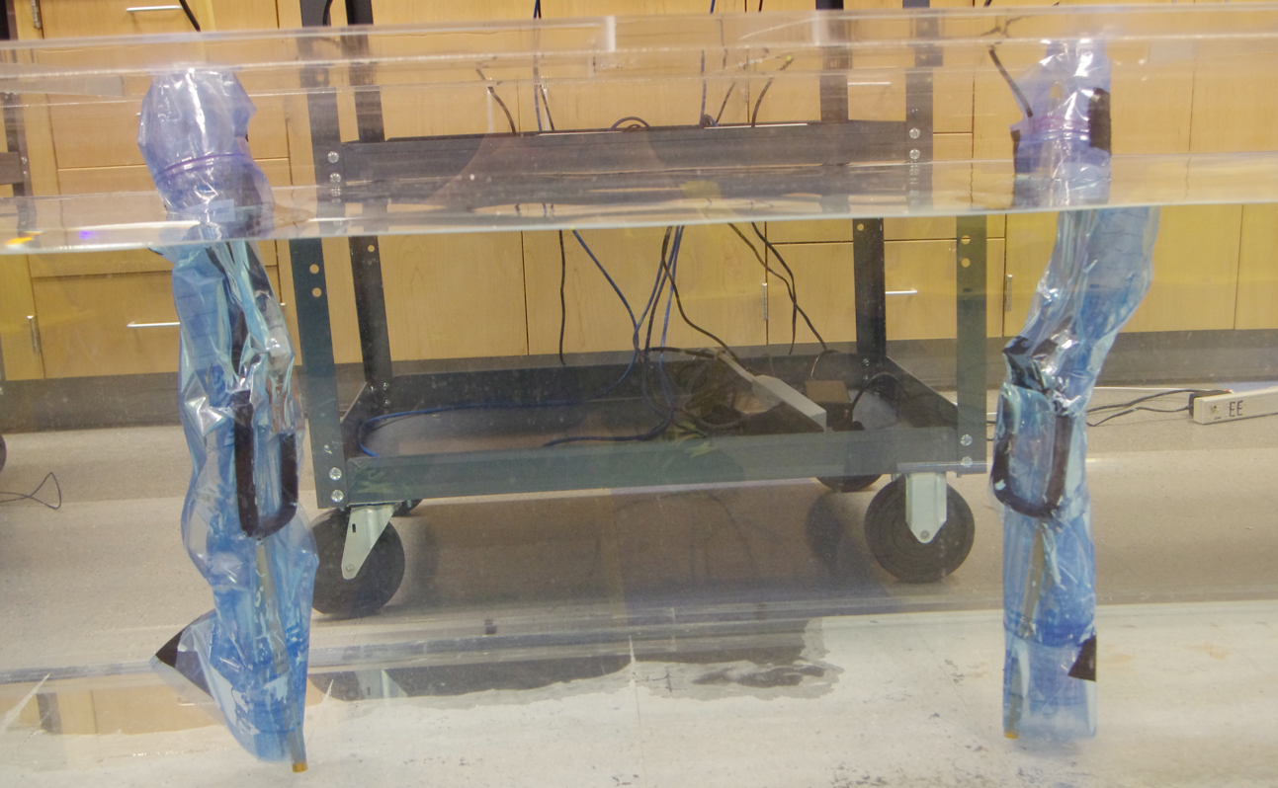
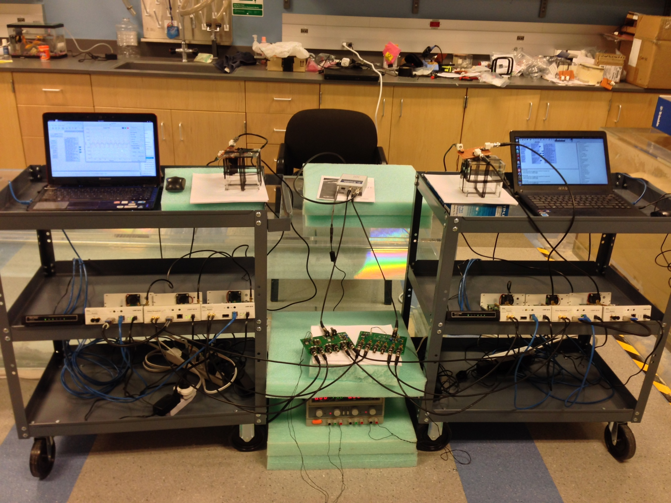
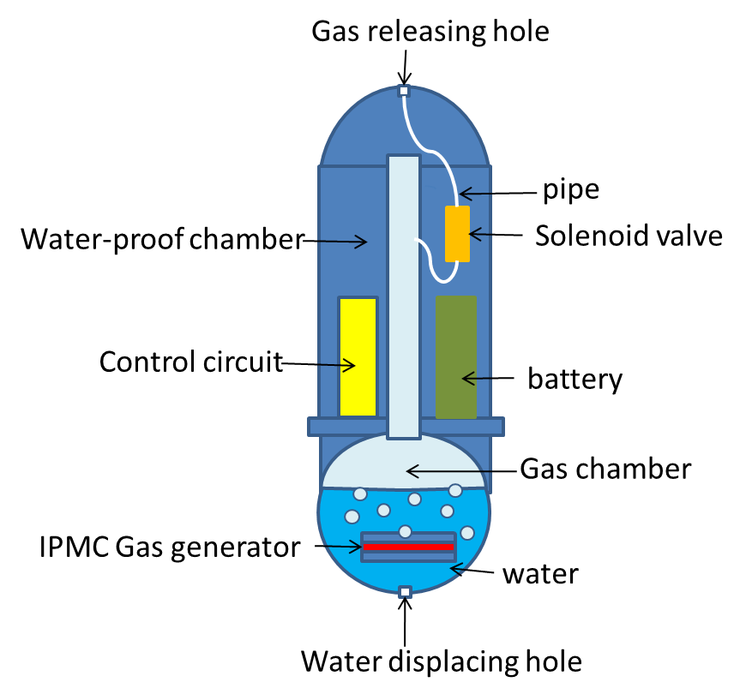
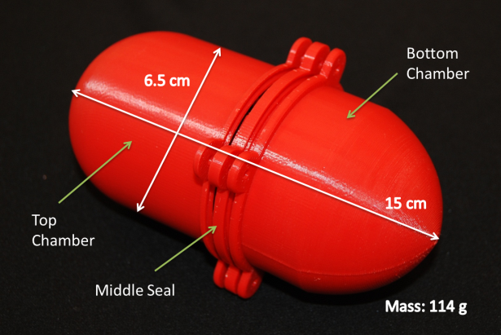
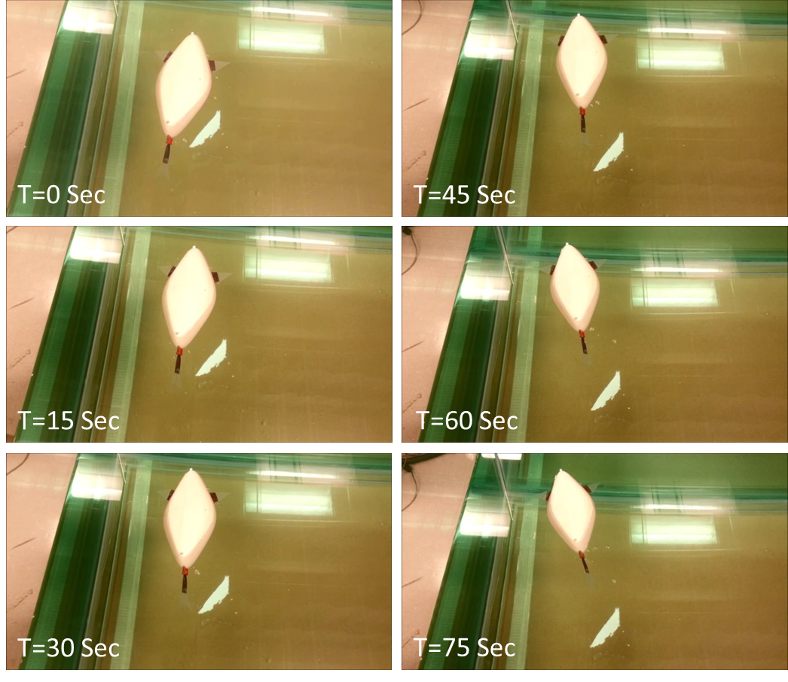

Towards Effective and Efficient Sensing-Motion Co-Design of Swarming Cyber Physical Systems
Wencen Wu* , Pu Wang**, Zheng Chen**, Animesh Chakravarthy**, Zhi Sun***
* Rensselaer Polytechnic Institute, ** Wichita State University, ***State University of New York at Buffalo
Motivations and Challenges
Objectives
The overall research objective is to establish and demonstrate a generic motion-sensing co-design procedure that
  significantly reduces the complexity of mission design for swarming CPS
  greatly facilitates the development of effective and efficient control and sensing strategies, which are computation efficient, communication light, and adaptive to various environment uncertainties
Cooperative Control and Sensing
Complex and strongly coupled sensing-motion dynamics of swarming CPS
Inherent environmental uncertainties such as communication delay and package loss, unpredictable and/or confined spaces, and highly spatially and temporally varying environments
Resource constraints of mobile computing entities such as limited computational power, communication capability, and sensing ability
Underwater Communication and Localization
Smart-material Actuated
Biorobotic Fish
Cooperative Motion and Sensing
A Generic Motion-Sensing Co-design Procedure
Efficient and Effective Cooperative Control and Sensing
MI Underwater Communications & Localization
We propose a generic sensing-motion co-design procedure that is applicable for various mission design for swarming CPS by decoupling the formation shape dynamics and translational motion dynamics of the entire swarm.
Distributed algorithms for swarming mobile agents
Robustness analysis to communication delay, package losses, and localization errors
Switching between gradient-free and gradient-based strategies to be adaptive to possibly fast-changing environment
Switching between guidance laws for obstacle avoidance and cooperative exploration control laws
The effectiveness of collaborative control in swarming CPS demands highly reliable and fast data disseminations among the robots
The challenging underwater environment prevents the direct usage of most existing communication paradigms based on electromagnetic, optimal, and acoustic waves
We will develop novel magnetic induction (MI) based underwater communication & localization solutions, which exploit the unique features of MI channel, including
Collision Avoidance
Collision avoidance is achieved using the collision cone approach, which has its roots in missile guidance, and enables the determination of analytical expressions governing the instantaneous velocity that will cause an object to lie on a collision course with another object.
Based on the collision cone equations, it is possible to synthesize analytical expressions of guidance laws for collision avoidance.
The collision avoidance algorithms need to cater to both inter-swarm as well as intra-swarm collision avoidance.
  negligible signal propagation delay
  sufficiently large bandwidth (> 20 kHz)
  & transmission range ( > 10 meters)
  very small and low cost coil antenna
  highly constant and predicable channel response in harsh environment
Mobile Sensor Networks
Sensing Dynamics
Motion Dynamics
Information State Equation
Translational Motion Dynamics
Measurement Equation
Shape Dynamics
Source Seeking
Collision Avoidance
Gradient free
Gradient based
Intra-network
Inter-network
Tri-directional coil antenna and 3D channel modeling for omnidirectional coverage in the 3D underwater environments.
Cross-layer distributed MI communication protocols for high throughput and delay-constrained inter-robot data exchange
Received magnetic field strength (RMFS)-based localization method to guarantee accurate, simple, convenient and anchor-free relative localization strategy in the 3D space
Smart-material Actuated Biorobotic Fish
We will develop a new type of robotic fish fully actuated by smart material, which are agile, 3D maneuverable, stealth, robust, and fully controllable.
We will optimize the robotic fish to meet the maneuvering requirements of cooperative control and sensing algorithms
3D Maneuverable Robotic Fish Design
Pectoral fin
Battery and micro-controller
IPMC
Caudal fin
IPMC
Clamp and Electrode
Chemical sensor
Buoyancy control device
MI-based communication and localization device
Carbon fiber reinforced PDMS
Soft PDMS
33 cm
Top View
Side View
Caudal Fin Design
Pectoral Fin Design
MI Communication and Localization Platform
IPMC
IPMC
Testbed for Pollution Source Seeking
Software-defined radio platform: USRP 210N
3 × 3 MIMO system for the tri-directional coil antenna
The platform will also be tested in the Lake La Salle at SUNY Buffalo.
21 cm
2D Maneuverable robotic fish developed at Wichita State University
Video camera1
Water pump
Passive fin
Fish body
PDMS/Bubble
Printed body
Propelled by IPMC caudal fin
Propelled by IPMC Pectoral fin
z
Salty water with red dye
IPMC enabled Buoyancy control Device
x
y
Video camera 2
Water tank

