Slide 1



Towards Next Generation Engine Control: A Spatial Big Data Approach
S. Shekhar, R. Ali and V. Gunturi
Computer Science and Engineering, Univ of Minnesota
W. Northrop and A. Kotz
Engines Laboratory, Mechanical Engineering, Univ of Minnesota

Slide 2

Acknowledgements
Center for Transportation Studies at Univ of Minneosta
Prof S. Shekhar & Prof W. Northrop are CTS scholars
V. Gunturi was Interdisciplinary doctoral fellow at CTS
National Science Foundation (CISE IIS)
“Investigating Spatial Big Data for Next Generation Routing
Services”
Ford Motors – University Research Program

Slide 3
Outline of the Talk
Brief Background
  Emerging Trend: Spatial Big Data
A Budding CPS: Engine Control Unit
Spatial Big Data driven Engine Control
Final Remarks

Slide 4
Outline of the Talk
Brief Background
  Emerging Trend: Spatial Big Data
A Budding CPS: Engine Control Unit
Spatial Big Data driven Engine Control
Final Remarks

Slide 5





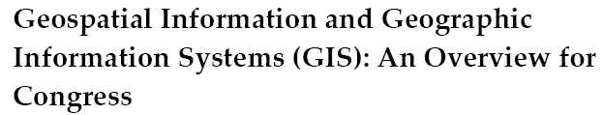
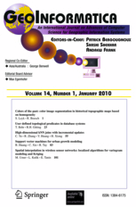




Spatial Computing: Background
Broadly defined as composed of computing activities which focus on data which either spatially or spatio-temporally oriented.

Slide 6

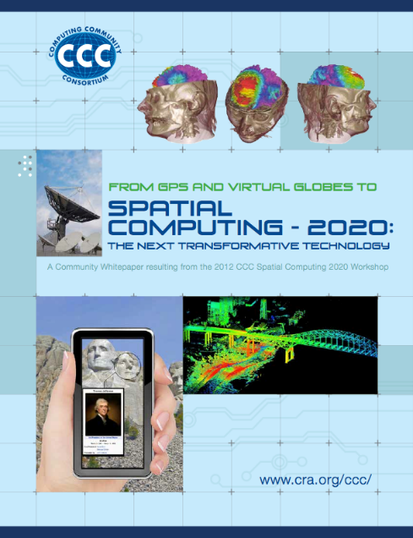
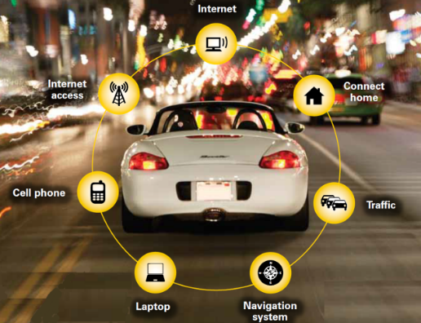
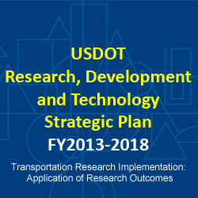
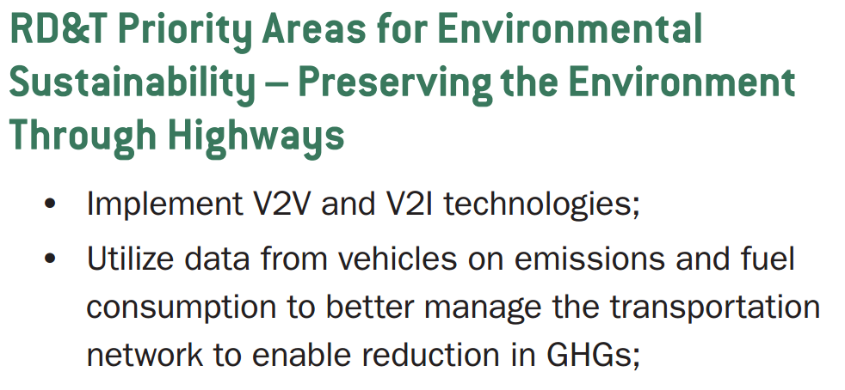
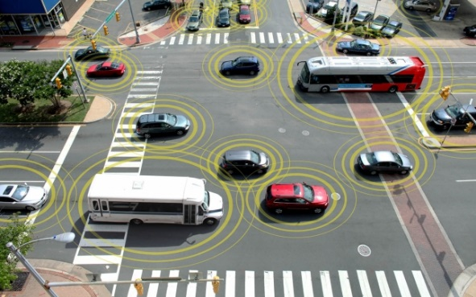

Spatial Computing: Emerging Trend in Transportation
Penetration of Internet (Internet of Things)
Several platforms are location aware (e.g., smartphones)
Many more travel phenomena are observable
Spatial Big Data!!
Source: nypost.com
Source: startupbootcamp.org
Source: geeksandbeats.com

Slide 7
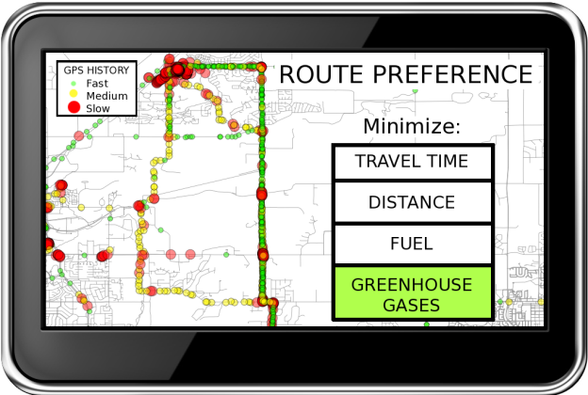
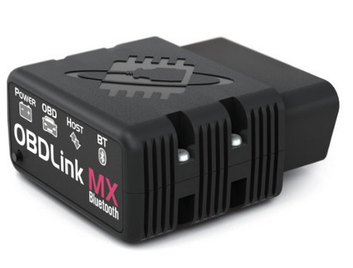
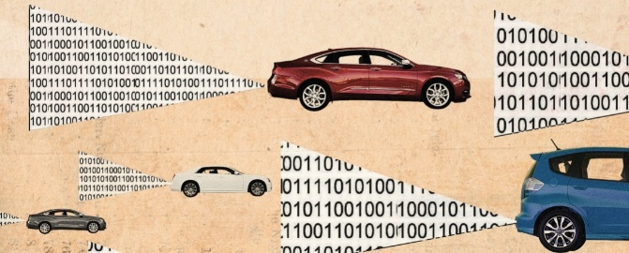
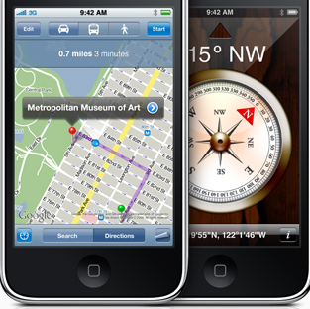
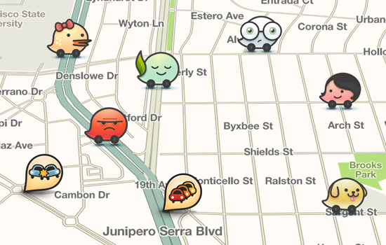
Spatial Big Data driven Eco-Routing
Spatially oriented datasets exceeding capacity of current routing systems
  Due to Volume, Velocity (Update-rate) and, Variety
Source: blogs.motortrend.com
Waze.com

Slide 8

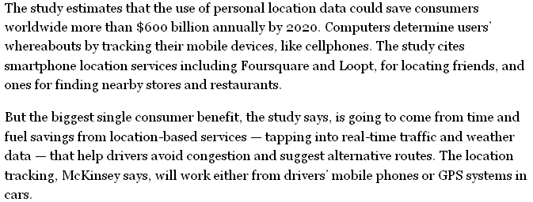




McKinsey Conjecture and Preliminary Evidence
New Ways to Exploit Raw Data May Bring Surge of Innovation,
a Study Says (May 13, 2011)
U.P.S. Embraces High-Tech Delivery Methods (July 12, 2007)
By “The research at U.P.S. is paying off. ……..— saving roughly three million gallons of fuel in good part by mapping routes that minimize left turns.”

Slide 9
Outline of the Talk
Brief Background
  Emerging Trend: Spatial Big Data
A Budding CPS: Engine Control Unit
Spatial Big Data driven Engine Control
Final Remarks

Slide 10
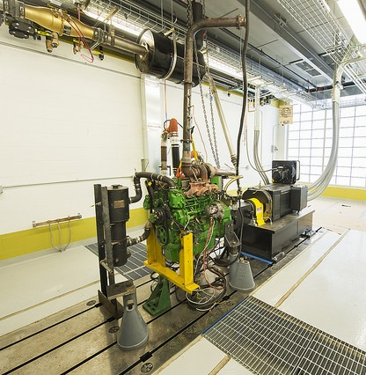
A Budding CPS: Vehicular Engine Control Unit
Background
    An electronic control unit that controls an internal combustion engine.
    Have microprocessors to process engine sensor readings in real-time to choose suitable engine-control rules.
    Current engine-control rules are fixed.
Limitations of Fixed Calibration
    Cannot adapt to variation in some real-world parameters,
    e.g., traffic, weather, elevation, driver behavior etc.
    Result in significant gap between regulated and actual GHG emissions.
Thomas Murphy Engine Research Laboratory at UMN

Slide 11

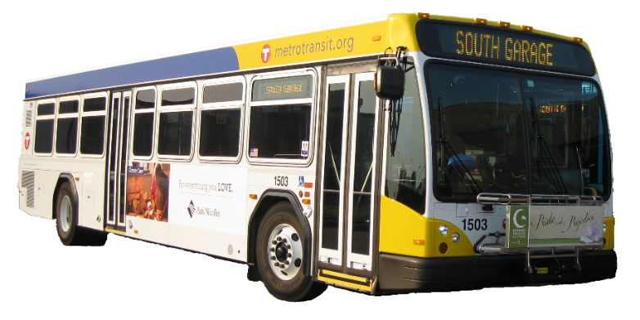
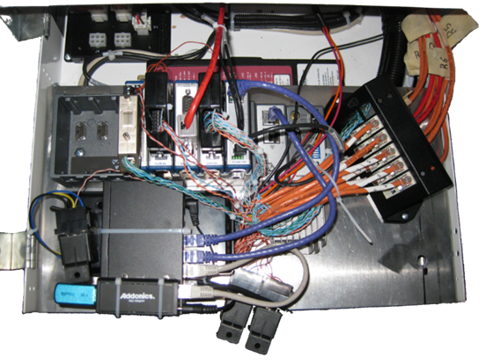
Sample Engine Sub-System Measurement Data
Engine Sub-system Measurements from Metro-Transit Buses in Twin-Cities
Sample Engine Variables:
GPS Speed and Position
Vehicle Load
Engine and Heater Fuel Flow
Exhaust Temp and Mass Flow
Intake Temp And Mass Flow
Engine Torque and RPM
Engine Coolant Temp
Odometer
….measurements on 20 engine variables

Slide 12
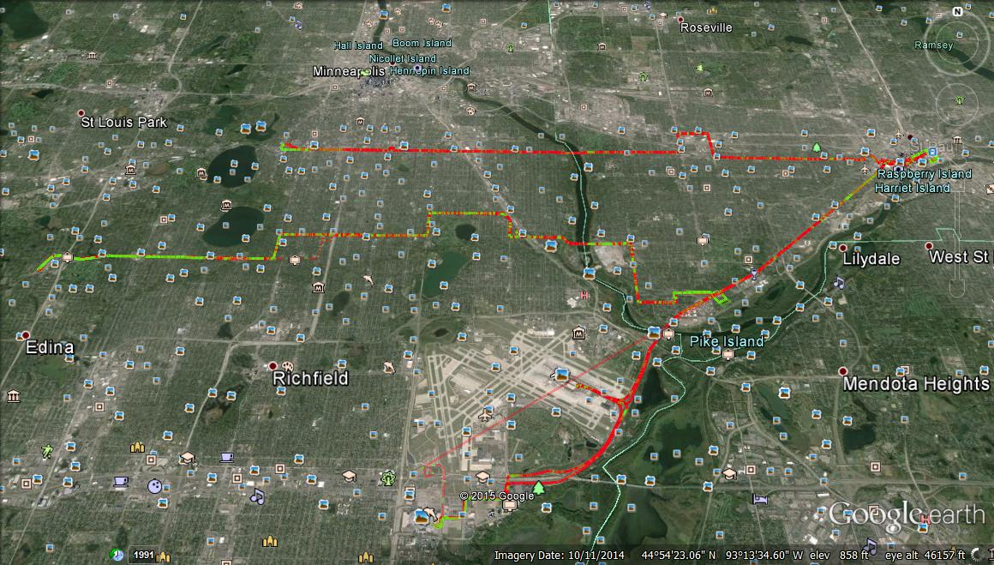
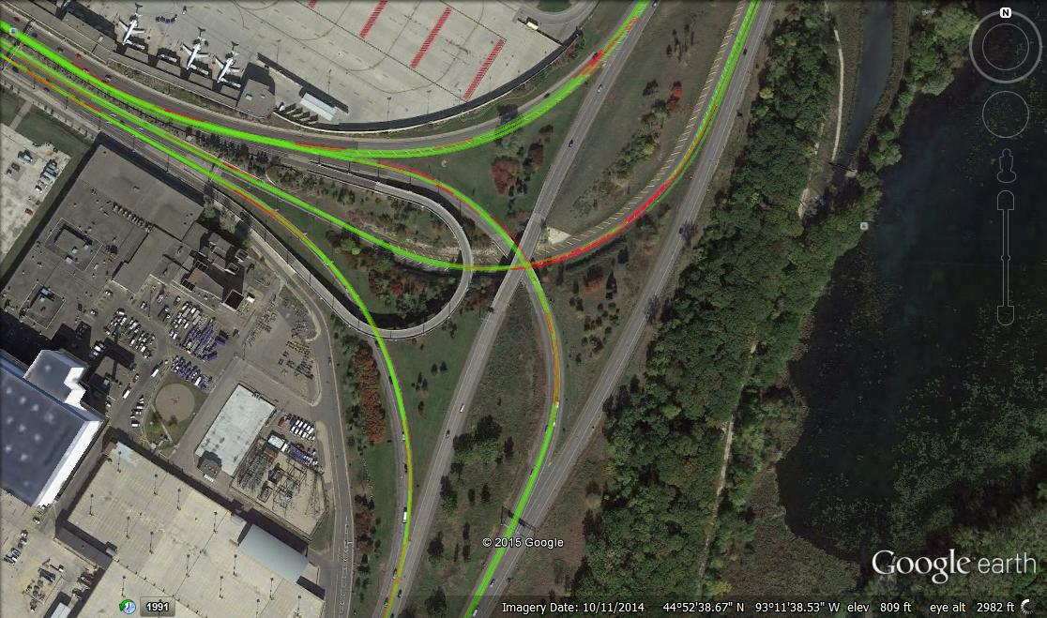
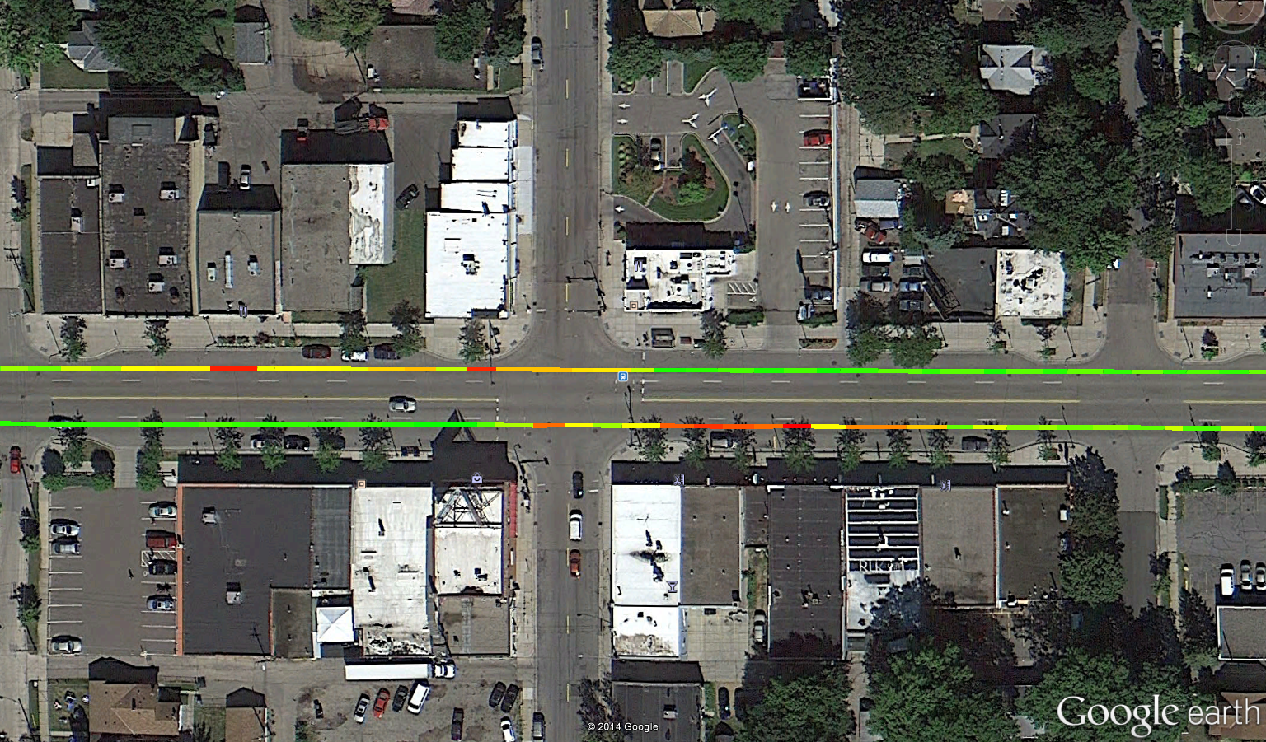
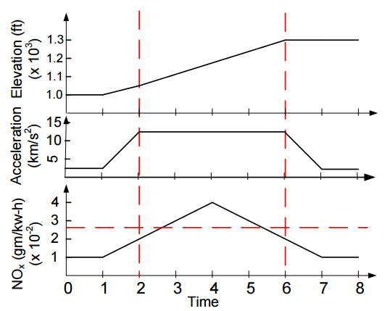
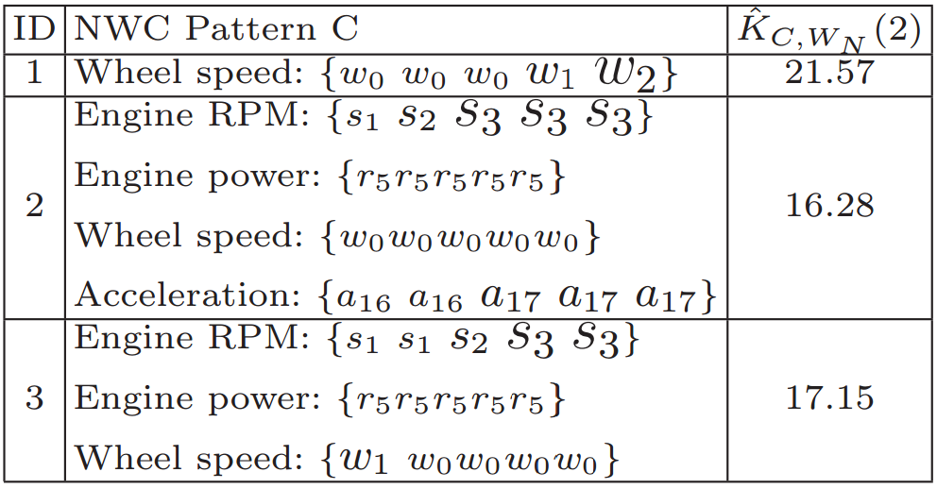
Sample Patterns in the Data
Temporal Pattern
Diesel Bus
Route 21
Route 46
Route 54
Red color indicates NO_{X} emission exceeding EPA regulations
Red color indicates NO_{X} emission exceeding EPA regulations
Mined temporal signatures of engine variables which are highly associated elevated NOx
Spatial Pattern
Emission
Hot Spots After Bus Stops
gNO_{X}/m
0.016
0.000
Hybrid Bus
Full paper in proceedings of the SSTD 2015:
“Discovering Non-compliant Window Co-occurrence Patterns: A Summary of Results,” with R. Ali, V. Gunturi and et al.

Slide 13
Outline of the Talk
Brief Background
  Emerging Trend: Spatial Big Data
A Budding CPS: Engine Control Unit
Spatial Big Data driven Engine Control
Final Remarks

Slide 14
Spatial Big Data Driven Engine Control: A Vision
Emerging big spatial datasets + Engine measurement datasets
Can reduce GHG emissions
Examples:
Make engine control rules context aware
  Geo-fencing → ECU switches to low emission rules near schools etc.
Learn novel, useful and interesting engine control rules
  Exploiting spatial data mining techniques
  Harness location-aware engine measurement data & spatio-temporal context datasets (traffic, elevation changes, weather)
  Explore spatio-temporal co-occurrences of engine behavior and spatial-temporal context

Slide 15

Some Open Challenges
Large Sizes of Datasets
Currently one Year of data
  Approximately 37GB per bus
  Over 8 million data points
Potential size over ~100 million US light-duty vehicles
Assumptions of Classical Techniques
Classical data mining techniques make assumptions (e.g., i.i.d) → Could violate laws of Engine Science
Resulting patterns not interpretable by Engine scientists
Proposed Solution:
Physics-Aware Big Data Analytics
~${10}^{15}$data items
per year

Slide 16
From Data Analytics to a CPS: Challenges
Physics-Aware big data analytics
  Generate engine control rules based on history of travel
Engine rules may have to be changed in real-time!!
  Hardware support?
Can the rules be embedded as circuits?
  Tradeoff between rule complexity and value
Learning of rules
  on board computer vs Cloud infrastructure
Privacy Concerns
  Can the rules learnt for a vehicle/driver be transferred in a privacy protected manner?
We are looking for collaborators!

Slide 17
Outline of the Talk
Brief Background
  Emerging Trend: Spatial Big Data
A Budding CPS: Engine Control Unit
Spatial Big Data driven Engine Control
Final Remarks

Slide 18
Final Remarks and
Inviting Potential Partners
Increased proliferation of location aware sensors
  Generate Spatial Big Data
Spatial Big Data driven analytics can add value to CPS
Frequent patterns in data can guide decisions in real time control
Challenges
  High frequency sampling → large data volume
  Physical nature of phenomena → Violate assumptions of current techniques
Physics Aware Big Data Analytics
Several open CPS questions
Looking for partners interested in near real-time Engine control

