Slide 1
Towards the future of “Making”: Convergence
Towards “Making” the future: Convergence
Karthik Ramani
Donald W Feddersen Professor of Mechanical Engineering
Professor of Electrical and Computer Engineering (by Courtesy)
Purdue University
https://engineering.purdue.edu/cdesign

Slide 2
What is common among all current CPS contexts? What changes with D&M?
Cyber-Physical Systems (CPS): Orchestrating networked computational resources with physical systems [Edward A. Lee, Sanjit A. Seshia]
Contexts: Already existing things/systems that are made to be improved or optimized (knowledge not new)
CPS in D&M: Orchestrating the creation of products with networked computational resources with physical systems and humans in the loop
Contexts: The creation and making of things with embedded software and electronics in a more open way
Notes:
All of you are experts in abstractions – because CS or CE forces you to abstract – algorithms or automata.
Engineering does not teach through abstractions…if you did it is only PDE – but also you have the physical reality – mechanics, statics, dynamics, controls leading to robotics.
What are the contexts of CPS: similar, can be changed…towards a more flexible architectures for designing, developing, validating, and making (manufacturing)…

Slide 3
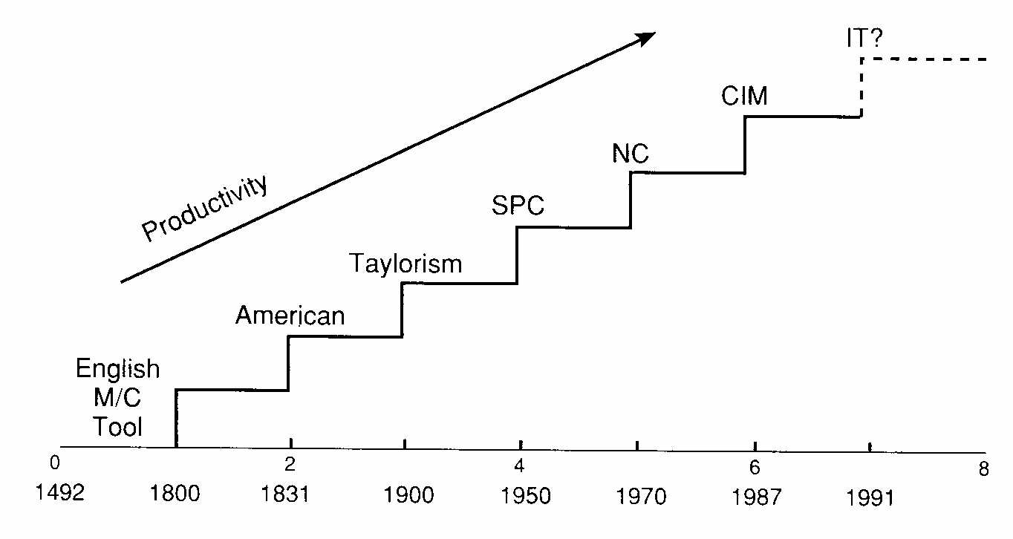
Changing the context: Innovation and Productivity Follows Paradigm Shifts
CPS
IT /Internet
Adapted and modified from Professor Jayakumar, Harvard Business School
Notes:
Because of the expertise, equipment, costs and even funding for producing things on large scale has been rather closed in the past it has been dominated by large companies and trained professionals…but that can be changed by CPS. We learnt how to use the web for discovering and create things and work together on the web. CPS can change the way we create, distribute and consume, and maintain products…and it is starting to happen trends – and lots of people and companies can be enabled by CPS…
Power belongs to the one who innovates: transforms knowledge to products and processes creating value to consumers
D&M and Innovation creates value to the economy and our economy is fully dependant on it
Lecture based knowledge is a commodity (coursera)…Hence Innovation becomes important and it follows design and making (creative manufacturing)
Manufacturing not just of parts: of embedded systems! (software + electronics + parts = information products)
During revolutions in science the discovery of anomalies leads to a whole new paradigm that changes the rules of the game and the "map" directing new research, asks new questions of old data, and moves beyond the puzzle-solving of normal science. (KUHN)
Changing contexts! We need to design the science.

Slide 4
Competing: Time & Responsiveness
Customization
Increasing Flexibility & Responsiveness
Product Variety
Outsourcing
Notes:
Design and local manufacture of products quickly --- for local consumption, the time as well as energy for transportation becomes a part of the cost.

Slide 5
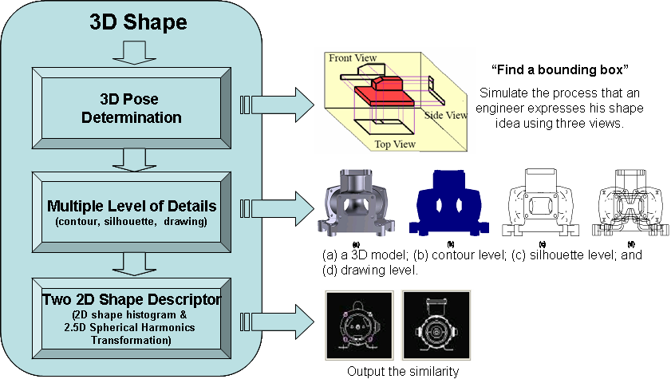
One of our proposed methods (a decade ago)
Most Highly Cited Paper Awards Computer Aided Design [Elsevier, #13 ranked of over 200
CS Journal, The Times Higher Education]
Notes:
Components and basic ideas:
Our method is also a kind of 2D view based method. However, as compared with the previous methods, our method has the following advantages: ……
Based on our method, we have developed a prototype system. It has three key components. The 3D pose determination algorithm is used to determine three orthogonal directions, along which only three or six views will be generated. Unlike the previous method, we not only consider the contour information, but also the silhouette and 2D drawing-like view. All these information describes a 3D shape from different levels. Finally, to compute the similarity between the contour, silhouette and drawing, we proposed two kinds of shape descriptors. Later I will introduce them.

Slide 6
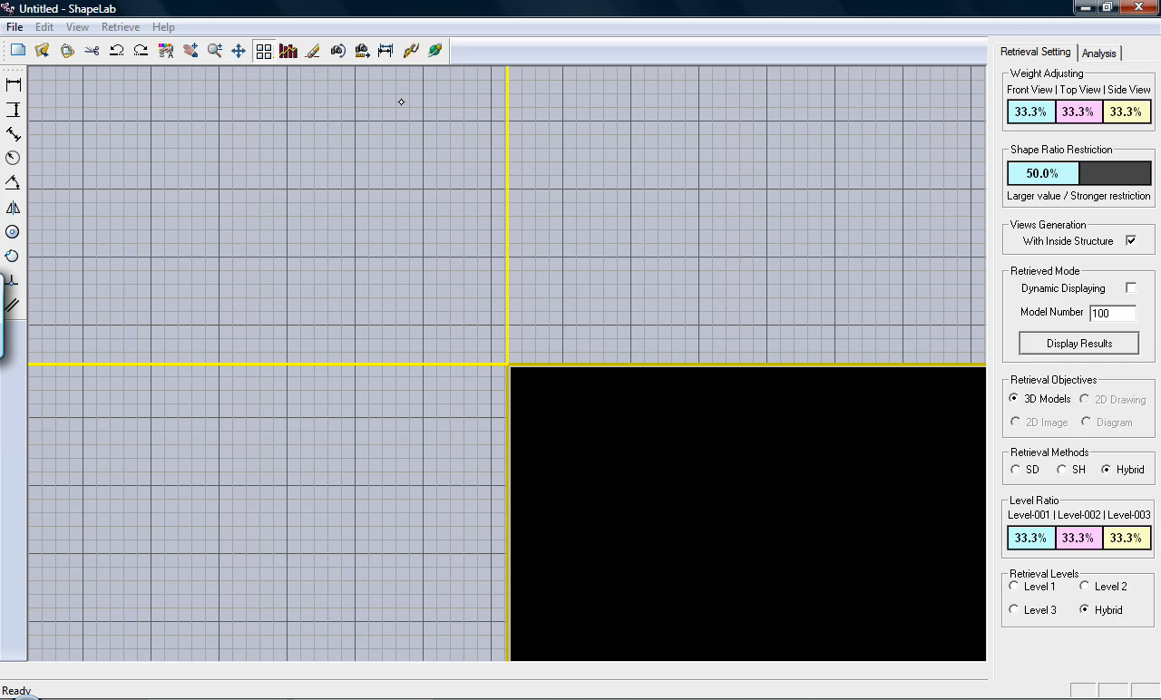
Early prototype of VizSeek

Slide 7























Information Technology Paradigms
Communication
Virtual
Worlds
Micro-
blogging
Citizen
Science
Social
Networking
App
Development
Discussion
Social
Media
Participation
Sharing
Crowdsourcing
3D Model
Sharing
Reviews/ Recommendation
Photo/Video
Sharing
Collaborative
Filtering
Content
Publishing
Role of Individuals:
Consumers → Participants in the Product Development Process
Publishing
Ref: “Complex Systems Engineering by Self-Organized Virtual Communities”. Jitesh Panchal [Adapted from Don Crowther]
© 2012 Karthik Ramani
Notes:
Emergence of social networks and associated products that have evolved/ been created around it

Slide 8
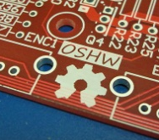










Design & Manufacturing Paradigms
Vendor-Enterprise-Consumer
Communication
?
Open funding networks
Testimonials
Makers movement
Business
Networking
Micro- manufacturing
Forums
Business
Enterprise
Vendor+Consumer
Participation
Open Platforms
Crowdsourcing
3D Model
Sharing
Reviews/ Recommendation
Specifications
Sharing
Collaborative
Filtering
Content
Publishing
?
?
Role of Individuals:
Consumers → Participants in the Product Development Process
Prototyping
© 2012 Karthik Ramani
Notes:
How can we map the architecture that has benefited consumers in the IT paradigm onto the Manufacturing paradigm so that it would benefit vendors? The figure shows examples that already exist:
Arduino, Reprap – prototyping platforms
GrabCAD, Sketchup – Open repositories for CAD models, Open source CAD software
Quirky, Innocentive – Crowdsourcing platforms
Local Motors – Open manufacturing (micro factories)
Make:, Open source hardware – Open platforms/ communities for prototyping
Kickstarter, Imaginestics, Alibaba – platforms for vendor networks, venture funding etc
No platforms currently exist for collaborative filtering/ vendor suggestion based on feedback, content publishing, testimonials in the manufacturing realm

Slide 9
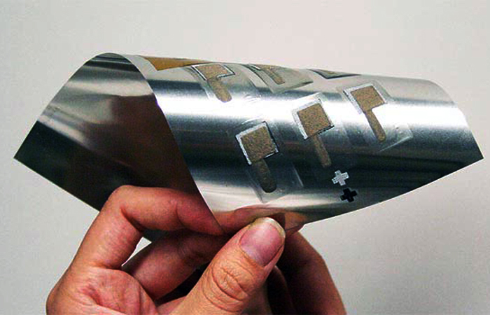
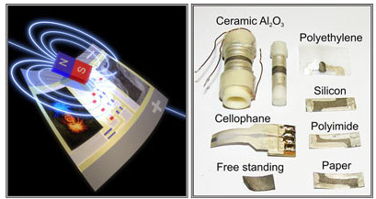
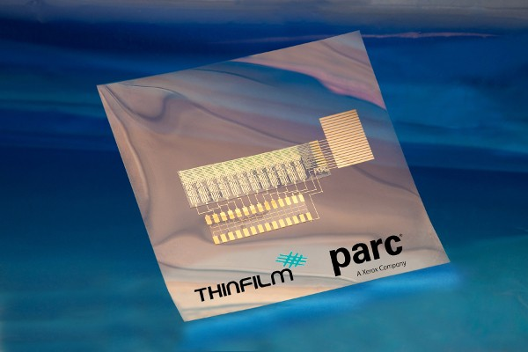
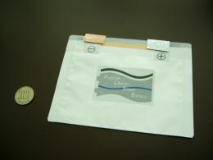
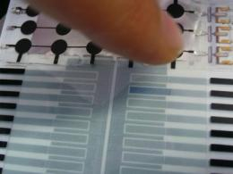
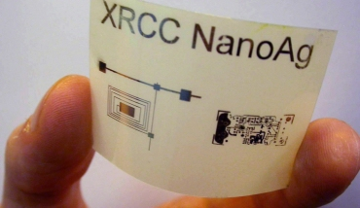
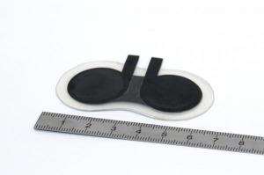
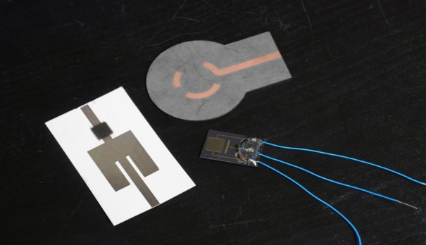
Manufacturing In 2D-3D：Current and Future Trends
Printable batteries
Printable Sensors
Printable Circuits
Rechargeable battery with
zinc electrode [UC Berkeley, 2012]
The First printable magnetic sensor
[IFW-Dresden, Germany, 2012]
Printable circuit incorporating organic,
rewritable memory & transistor [ThinFilm, 2011]
Pyroelectrical and piezoelectrical
sensor by screen printing [ISC, Germany, 2011]
Conductive ink for printing circuits
[Xerox, 2009]
Lithium-polymer battery for
flexible displays [AMIC, Japan, 2010]
Images from:
http://www.engadget.com/tag/printable+circuits/
http://www.dailycal.org
http://phys.org
ww.gizmag.com
http://www.sciencedaily.com
http://www.nanowerk.com/spotlight/spotid=26011.php
http://news.xerox.com/pr/xerox/NR_2009Oct27_
Xerox_Scientists_Develop_Silver_Ink.aspx
Multilayer battery by silk-screen printing
[ENAS, Germany, 2009]
Ink-jet printable ammonia sensor
for communication device [GTRI, US, 2011]

Slide 10
Tying Information and Manufacturing: some parallels
one → one
Enterprise to
consumer
one → many
Enterprise to
consumers
many → one → many
Vendors to enterprise to
consumers
many → one → one
Vendors to enterprise to
consumer
many → many → one
Vendors to enterprises to
consumer
© 2012 Karthik Ramani
Notes:
The new open pardigm where software and electronics are a part of the product --- necessitates the CPS community to be more involved in this paradigm shif. New paradigm shits and changes are an opportunity to enter. Showing the evolution of manufacturing paradigms and interpretation in terms of vendor-enterprise-consumer interaction in the product cycle. The figure depicts the product varieties starting from mass production to the future paradigm of open architecture product systems. The bottom one/many mapping illustrates how starting from one to one enterprise consumer interaction from pre mass production era the current shift should be aligned towards many vendors interacting with many eneterprises to address a single consumer.

Slide 11




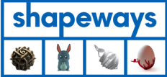

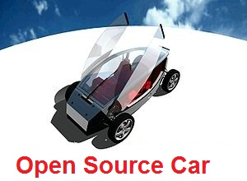
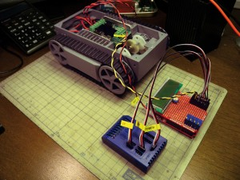

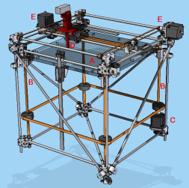

Innovation by Self-organized Virtual Communities
Information-based products
Virtual Design-Manufacturing Ecosystems
Open Source Software
Innovation by
Self-organized Communities
SourceForge has 2 million registered users and 300,000+ registered projects – July 2011
Open Source Hardware/Physical Products
“… physical products are information products during the design stage…”
[von Hippel, 2005]
Ref: “Complex Systems Engineering by Self-Organized Virtual Communities”. Jitesh Panchal
© 2012 Karthik Ramani
Notes:
From Dr.Panchal’s notes: Take the example of Wikipedia… Linux… These are information-based products developed by self-organized virtual communities… Increasingly, self-organized communities are being utilized for developing physical products such as electronics prototyping platforms, 3D printers and open source cars. This is not surprising because during the design stage, physical products are also information products.
====================================================
With the emergence of Web 2.0, a totally different kind of organizational form is emerging. It is based on self-organized communities of masses of people rather than hierarchies…
Some of these products have been as successful (or more successful) than those developed by hierarchical organizations.
===============
Web 2.0 – Sharing of information and content
Open source software
Open encyclopedias
Crowdsourcing
Open innovation
Facebook revolution (Egypt)
Individual being empowered … Democratization of Innovation!

Slide 12
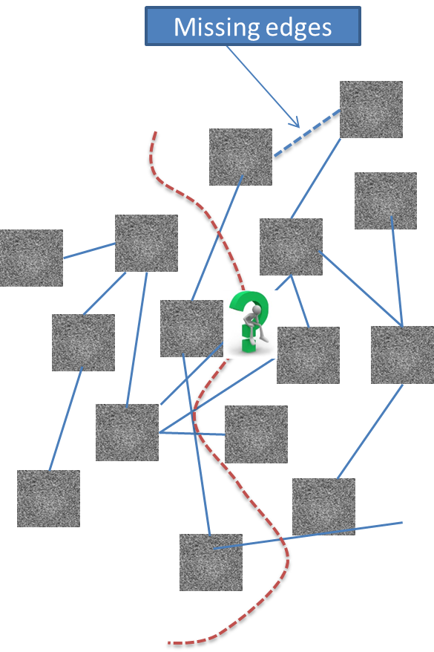






























































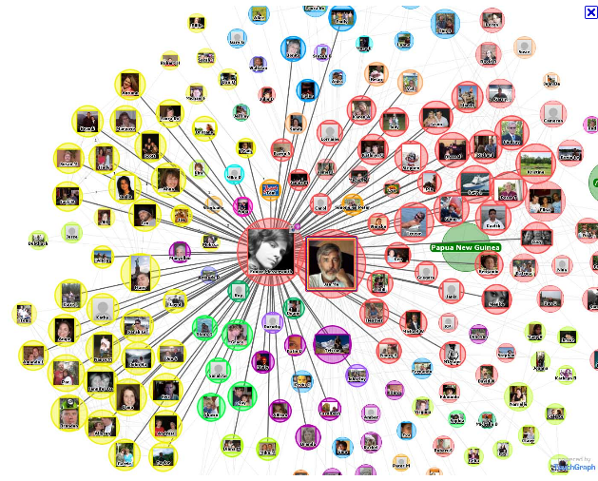
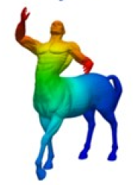

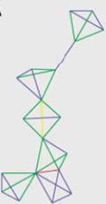
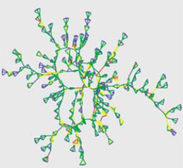
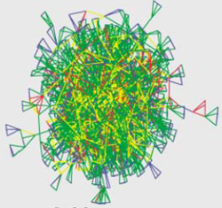
Properties of social networks relevant to manufacturing
Bearings
Wheels
Recommender systems for linking vendors and manufacturers
Discs
Flanges
Gears
Cylindrical-
Parts
Nuts
Centrality Indices for identifying key vendors
Network evolution models for predicting the scope of open-architecture
Leveraging diffusion distances used in geometry for robust product planning
Barabasi and Albert. Science (1999) 286 509-512
Yi Fang, Mengtian Sun, Minhyong Kim, Wen Jiang and Karthik Ramani, Heat-passing framework for assumption-free interpretation of data in networks, submitted to PAMI, 2011
© 2012 Karthik Ramani
Notes:
Current state of the art social network analysis tools that can be used for creating open architecture systems. 1) Centrality indices for identifying key components or vendors in product cycle. 2) Using netflix type recommender systems for linking vendors and manufacturers. 3) Using kernels and associated distance metrics for product planning. 4) using preferrential attachment/ forest fire and related network evolution models for predicting the growth of open architecture participation platforms.

Slide 13
Challenges to open-source collaboration environments
Business models
Psychological (Incentives)
Legal
Sociological (Trust)
Product Development Process
Supporting Platforms
Education/ Training
Reproduced with permission from Dr.Jitesh Panchal, Purdue University
Challenges specific to ‘tangible’ products:
Compatibility: standardization of dimensions, component interfaces, materials etc.
Overhead: Higher investment in manufacturing and supply chain
Perceived risk
© 2012 Karthik Ramani
Notes:
In addition to the current challenges to open source software collaboration environments, open source hardware faces additional challenges. Standardized practices in software modules and architecture can be implemented more effectively than in design and manufacturing. In addition to component and material compatibility in terms of form and fit, other constraints like tolerances, space/packaging issues, structural integrity and safety issues and regulations make the transition more difficult. In addition, the high investment required in manufacturing and supply chain increase the perceived risk.

Slide 14
First steps: Open-source hardware
Most projects use existing Free and Open Source Software (FOSS) licenses
TAPR Open Hardware License used to address creation of tangible things:
“ …it forbids anyone who receives rights under the OHL to deny any other licensee those same rights to copy, modify, and distribute documentation, and to make, use and distribute products based on that documentation.”
(from www.tapr.org)
Suggested business models:
Focus on hardware, allow individuals to build designs around it
Create a design community around their hardware
Focus also on services like design consulting
© 2012 Karthik Ramani
Notes:
The first steps towards open-source hardware were taken in the electronics domain and has led to the TAPR (Tucson Amateur Packet Radio) open hardware license is based on patent law rather than copyright law (which is what open-source software is based on). Business models have already adapted to open hardware. For example, arduino focuses on design consulting and on hardware, but allows individuals to build their own designs around it. In addition, they have a copyright on the use of the “Arduino” name: only products that are designed in-house are allowed to bear the Arduino name. This strategy of deciding what to make in-house and what to outsource / crowdsource has been discussed in the concept of Fine and Whitney’s “Industry Clockspeed” (refer next slide)

Slide 15
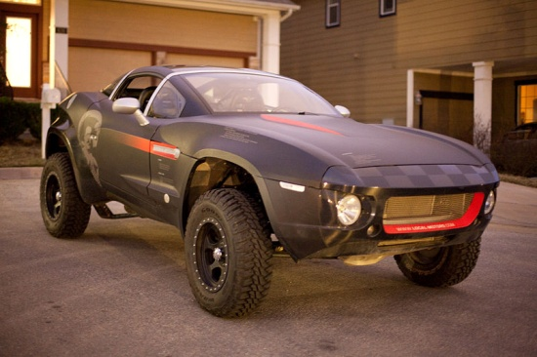
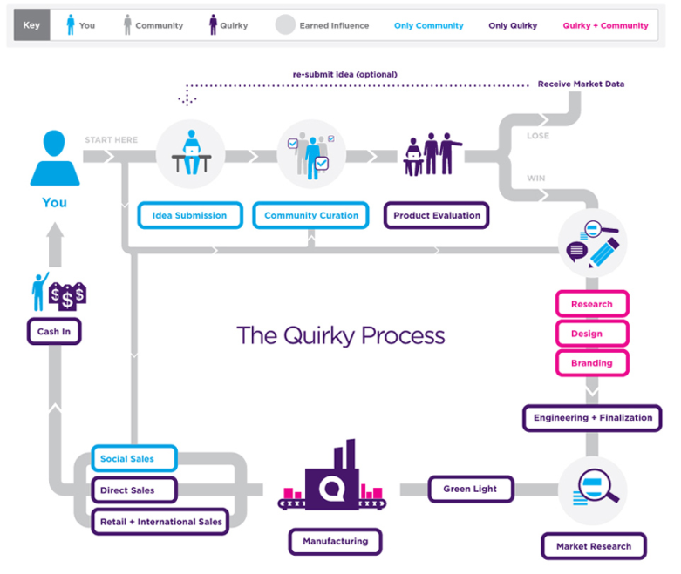
Clockspeed: the crowdsourcing version
Local Motors company:
Combination of:
Crowdsourcing (shape and style) +
professional engineering (performance and safety) +
micro-manufacturing
Quirky:
Combination of:
Crowdsourcing (design ideas + curating, sales) +
In-house (evaluation, engineering, manufacturing, sales)
Ref: http://www.wired.com/magazine/2010/01/ff_newrevolution/; http://www.quirky.com/learn
Image source: http://en.wikipedia.org/wiki/Local_Motors
© 2012 Karthik Ramani
Notes:
Fine and Whitney show that the true core competency of a company at any time is in determining what to make in-house and what to outsource. This model extends to crowdsourcing as well, as seen in the examples of Local Motros, where the shape and style of the vehicle is crowdsourced, while components critical to the performance and safety of the vehicle are either done in-house or through professional consultants and stock car component providers. The engine, for example, is an existing BMW engine in this off-roader by Local Motors.
Quirky uses a combinaton of crowdsourced idea generation and selection for products, and uses in-house engineering teams to evaluate, generate specifications, and handle the market research and manufacturing. These are first steps into developing viable models towards open manufacturing

Slide 16
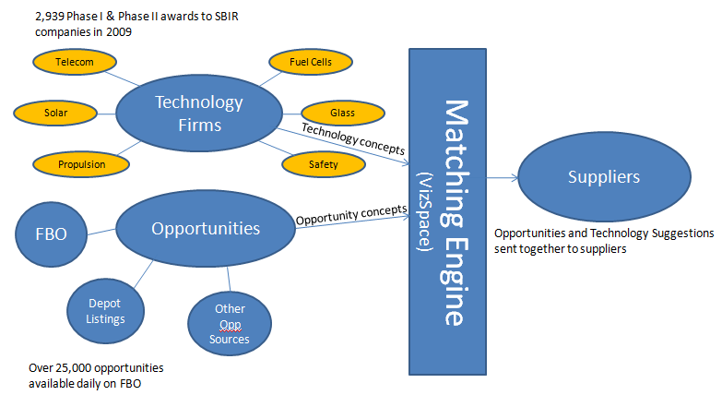
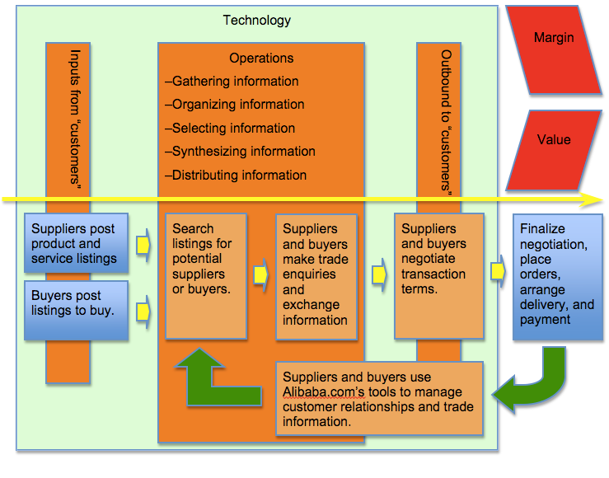

Social networking in the supply chain
Using ontology for concept matching and social networking for suggesting technology to suppliers
Network of suppliers and buyers with listings, matches, and information exchange enabled through the company software
Ref: http://www.imaginestics.com/Images/Small%20Business%20Technology%20Transition%20White%20Paper%20-%20Imaginestics.pdf, Li Z, Raskin V, Ramani K. Developing engineering ontology for information retrieval. Journal of Computing and Information Science in Engineering 2008;8(1), Alibaba.com Case Write: A Consideration of a the Virtual Service Value Chain. John Haase, 2009)
© 2012 Karthik Ramani
Notes:
Organizations like Imaginestics and Alibaba take advantage of social networking models do develop vendor networks and connect them with OEMs and Opportunity providers. Imaginestics uses ontologies (developed in Prof.Ramani’s lab) to identify and match technologies from the opportunity space (provided by government organizations like DARPA) and based on the identified technologies, both match vendors and suggest technologies they could use.
Alibaba uses a social network model to match requirements of buyers and OEMs with vendors based on capabilities and services offered. To make this model truly scale-free, a trust-based network is required where vendors allow publishing of information otherwise not kept open, like customer ratings, ratings for individual services, etc.

Slide 17
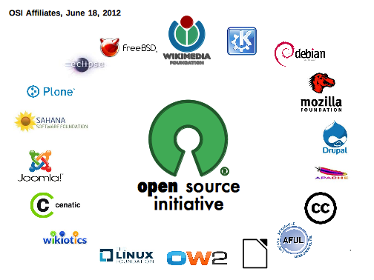
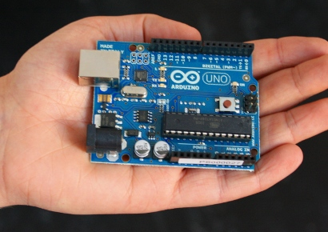
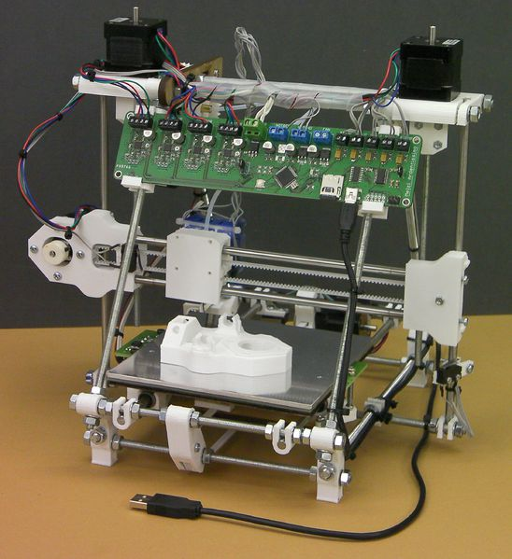
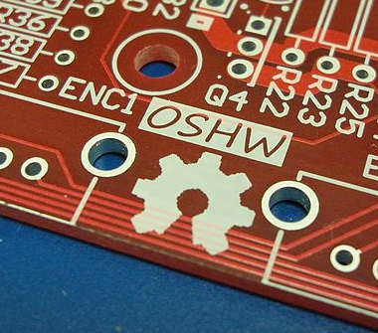
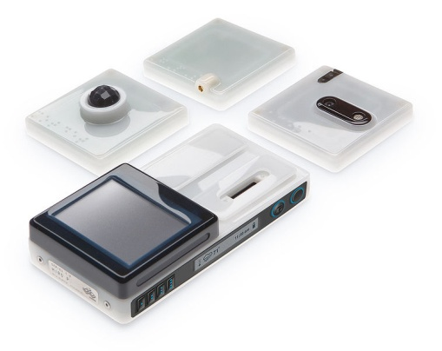
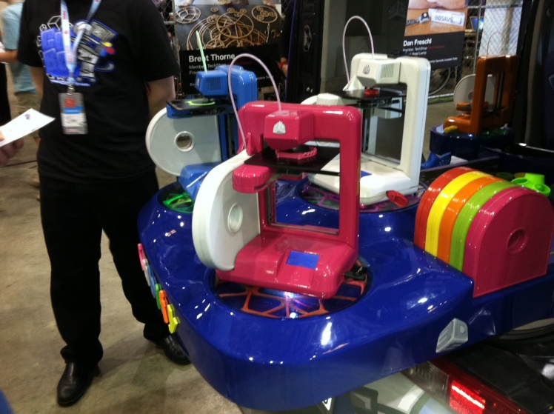
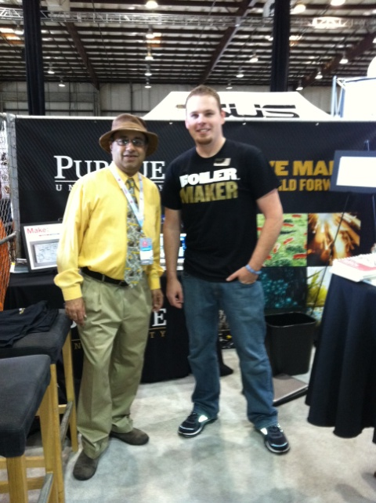
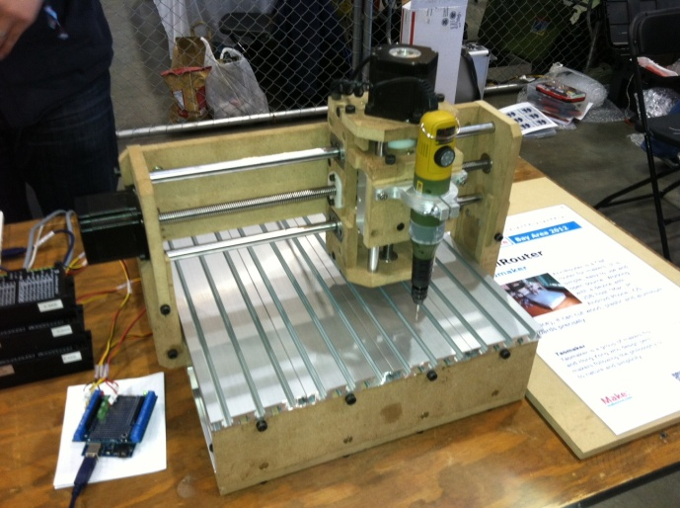

Enabling the “Do-it-Yourself” prototyping paradigm
Communities
Platforms
© 2012 Karthik Ramani
Notes:
Another paradigm that will play an important role is the do-it-yourself model that has rapidly become popular, like Make: magazine’s open communities of designers and innovators who are able to build prototypes at low cost. Most of this is made possible because of the open source hardware and software communities and models discussed in previous slides. Such platforms and communities blur the distinction between individual consumers and inventors, and with the rising community of more knowledgeable and discerning consumers, this may be a good model to develop scale-free networks of “makers” and innovators.

Slide 18

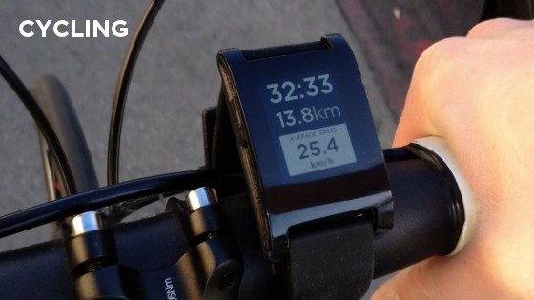

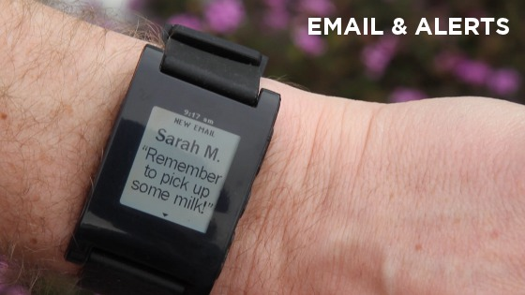
Open platform for funding innovation
Democratizing innovation
Infrastructure for realizing ideas
Quick and Widespread dissemination of ideas
e.g. Pebble: E-Paper Watch for iPhone and Android
Raised over $3 Million in Four Days
Over $10 million to date
© 2012 Karthik Ramani
Notes:
Open platforms like Kickstarter are enabling individuals to float their ideas better. Thanks to the maker community, the barrier to making prototypes has come down. This in turn provides better information to investors, who, based on the crowdsourced “voting” and popularity of product ideas, can make decisions on what to and what not to fund.
All the above models are developing in pockets, and are rapidly reaching a form where they could all be integrated into a true open design and manufacturing network where individuals as well as vendors could participate in developing, prototyping, marketing, manufacturing, and finally delivering new and innovative products to consumers.

Slide 19
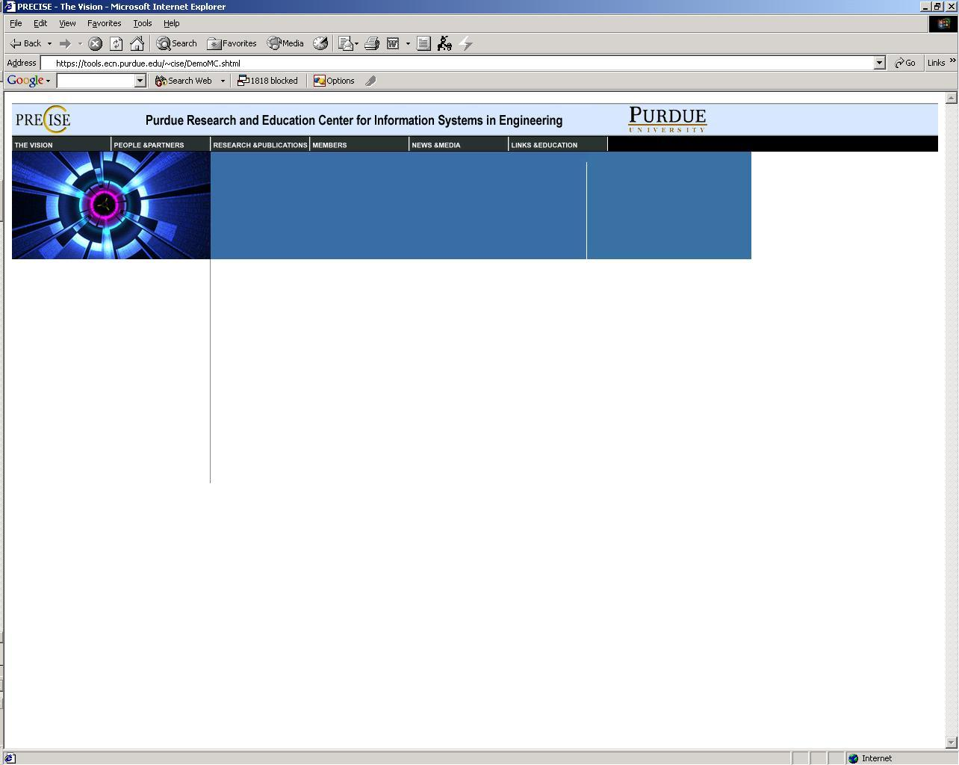
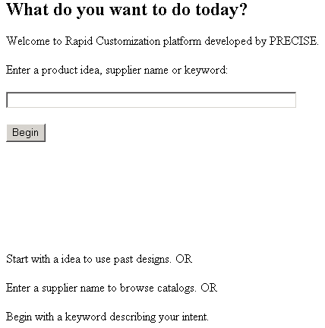
Geared Transmission
User enters product description
© 2012 Karthik Ramani
Notes:
Set of slides from Srikanth’s presentation on a rapid configuration platform, which could be used to “configure” a virtual assembly of parts based on a company’s requirements. These would then be used to generate specificiations and BoMs which will then be matched to suitable vendors in an existing network. Such a service takes models like those used by imaginestics and Alibaba to the next level, making open manfacturing truly viable.

Slide 20
Please wait while we search for concepts
Done
. . .
© 2012 Karthik Ramani

Slide 21
Searching for “Geared Transmission"...
Search Complete.
10 Concepts found...
Displaying...Done
Concept Chosen.
Reading Concept...
User chooses best concept
User can modify concept
© 2012 Karthik Ramani

Slide 22
Design Parameters & Constraints
Searching for “Geared Transmission"...
Search Complete.
10 Concepts found...
Displaying...Done
Concept Chosen.
Reading Concept...
Retrieving Global Constraints...
© 2012 Karthik Ramani

Slide 23
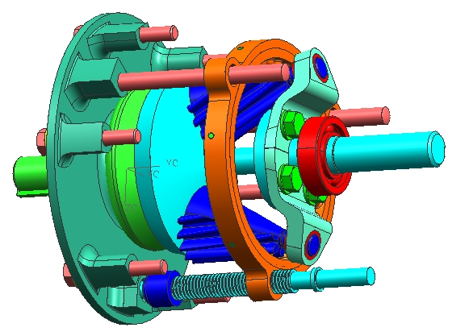
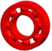
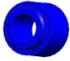

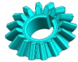
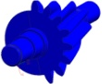

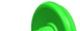



Viable Configured Product
Searching for “Geared Transmission"...
Search Complete.
10 Concepts found...
Displaying...Done
Concept Chosen.
Reading Concept...
Retrieving Global Constraints...
Searching for suppliers... 28 found.
Extracting components from suppliers... Done
Generating Model.
Bearings
Customized Catalog
Ball Bearing from CIE Bearing
Bearing from Timken
Gears
Gear from Cincinnati
Gear from Fairfield
Gear from Boston Gear
Gear from Boston Gear
Finalize
Shafts
Shaft from
© 2012 Karthik Ramani

Slide 24






BoM is generated across diverse suppliers
10 Concepts found...
Displaying...Done
Concept Chosen.
Reading Concept...
Retrieving Global Constraints...
Searching for suppliers... 28 found.
Extracting components from suppliers... Done
Generating Model.
Creating Bill of Material... Done
Bearings
(5) Bolt P/N 967830 | (5) Bolt P/N 933042
(2) Bevel Gear P/N 59002B | (2) Conical Gear P/N 57330V
(2) Ball Bearing P/N 15902 | (1) Keyed Shaft P/N 23901
(2) Journal Bearing P/N 15900
(1) Outer Casing P/N 14902 | (1) Face Plate P/N 13202
Ball Bearing from CIE Bearing
Bearing from Timken
Gears
Gear from Cincinnati
Gear from Fairfield
Gear from Boston Gear
Gear from Boston Gear
RFQ
Shafts
Shaft from
© 2012 Karthik Ramani

Slide 25
Thank You!
Your Request has been forwarded to the suppliers. Your order will be confirmed soon.
© 2012 Karthik Ramani

Slide 26
Dassault Systèmes
Parametric Technology Corporation
Siemens PLM Software
Acquisition/ Partnership
Product
Acquisition/ Partnership
Product
Acquisition/ Partnership
Product
CATIA®
CAD (since 1981)
CDRS
Pro/ENGINEER®
CAD (since 1988)
Unigraphics™
CAD (since 1975)
1997
1998
1999
2000
2001
2002
2003
2004
2005
2006
2007
2008
2009
2010
SolidWorks
SolidWorks®
CAD
Rasna
Pro/Mechanica®
FEA
Enovia™
PLM
Windchill®
PLM
Intergraph
Solid Edge™
CAD
Heide Corp
Knowledge Fusion
KBE Programming
Deneb Robotics
Delmia™
Factory Simulation
Nitidus
Windchill® Project Link
Project Collaboration
SDRC
NX™ I-DEAS
FE Analysis
KTI
Knowledgeware
KBE Programming
Teamcenter™
PLM
Ohio Design Automation
InterComm Expert™
Electronics design
Abaqus
Simulia™
FE Analysis
Tecnomatix
Tecnomatix™
Factory Simulation
MathSoft
Mathcad®
Engg. calculation tool
Synapsis Technology
Teamcenter™ for
Environmental Compliance
Priware
Circuitworks
Electronics design
Synapsis Technology
InSight®
Product Analytics
Zuken
NX™ PCB Exchange
Electronics design
PE International
SustainabilityXpress®
Environmental Impact Analysis
Planet Metrics
InSight®
Environmental Compliance™
Legend:
CAD
CAE
PLM
Programming
Sustainable design
Company

Slide 27
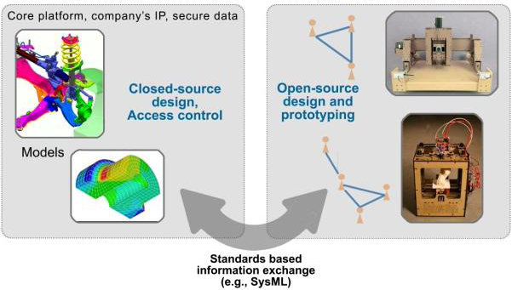
Open-and-closed systems
Platforms with a core and “APPS” with multi-company models for
product innovation
Notes:
Core platform with apps for customization as well as development. One company model to many company model…in product development and manufacturing.

Slide 28
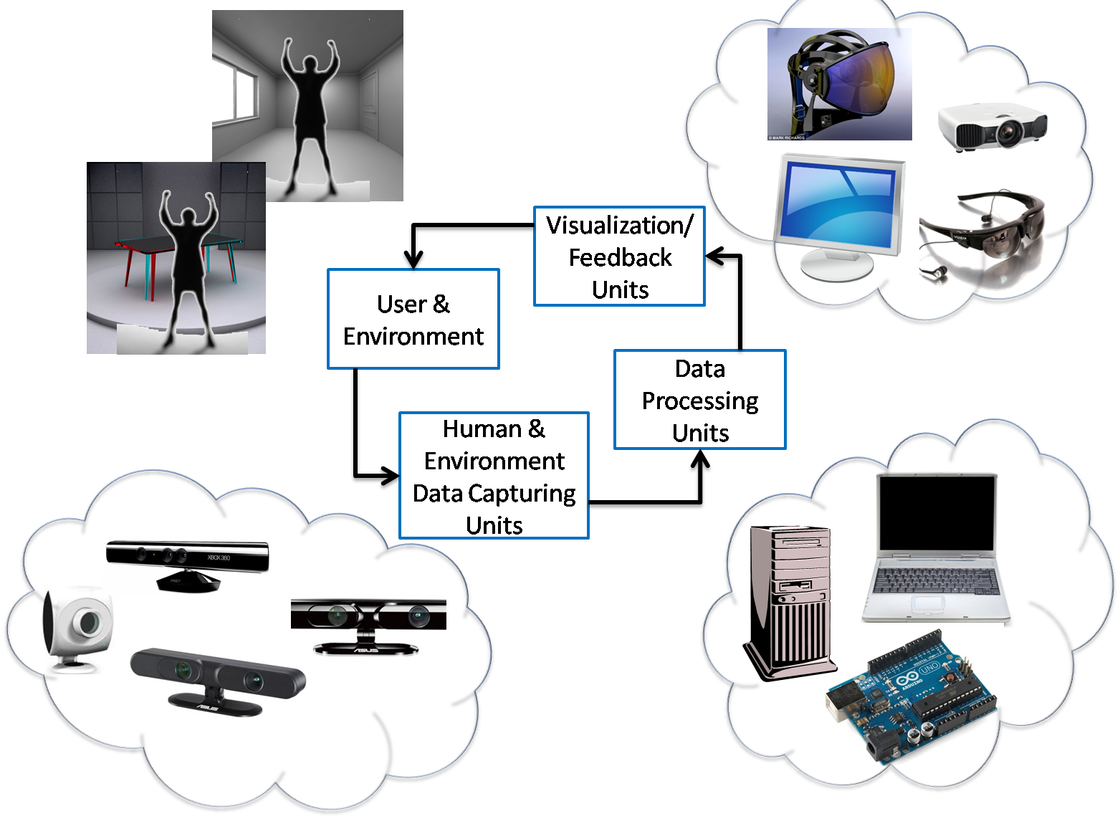

Slide 29
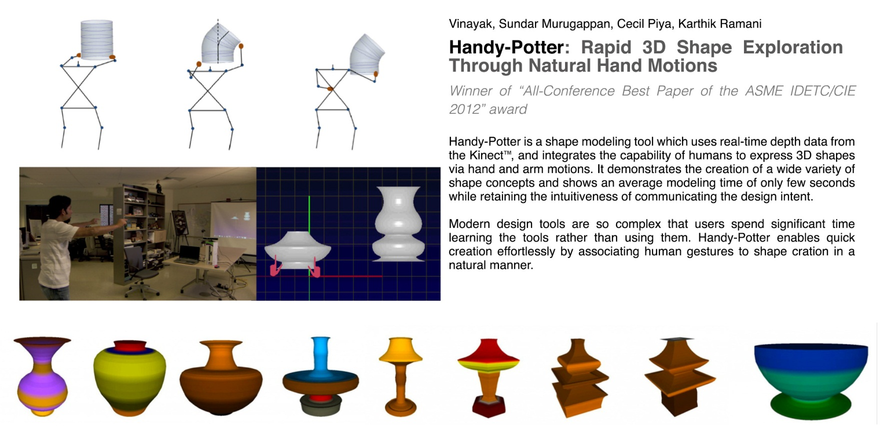


Handy-Potter: Rapid 3D Shape Exploration Through Natural Hand Motions
Vinayak, Sundar Murugappan, Cecil Piya, Karthik Ramani
Handy-Potter: Rapid 3D Shape Exploration Through Natural Hand Motions
Proceedings of the ASME 2012 International Design Engineering Technical Conferences & Computers and Information in Engineering Conference IDETC/CIE 2012, August 12-15, 2012, Chicago, Illinois, US

Slide 30
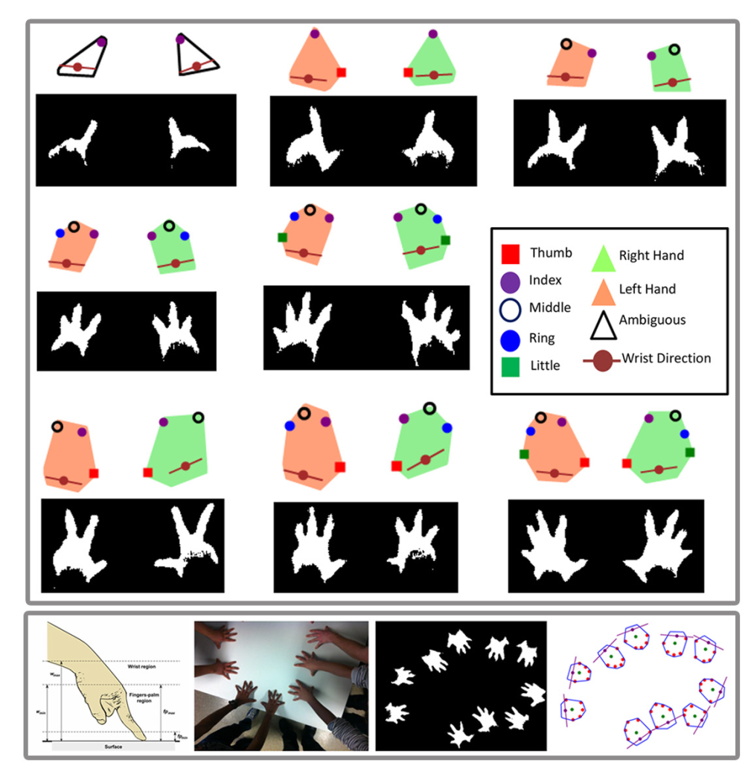
Murugappan, S., Vinayak, Elmqvist, N., Ramani, K., Recovering Touch Posture and Identity Using Depth Cameras on a Pen+Touch Tabletop Interface, Proceedings of the ACM Conference on User Interface Software and Technology, 2012

Slide 31
Challenges and Opportunities
A Flexible Architecture for Open Source Communities in D&M creation CPS [old top down vs. innovation based on evolution based on self organization]
Model systems with embedded problems that represent scaled or complex systems
Core research to create ideas for tools and methods that will allow for creative exploration of a multitude of “X” CPS products
Computational architectures and business models.
Social, economic and business evolution: problem has to be explored

Slide 32
Acknowledgements
Vinayak, Sundar Murugappan, Cecil Piya, Senthil Chandrasegaran, Ayan Sinha
Purdue University, School of Mechanical Engineering, Donald W. Feddersen Chair Endowment
NSF (EAGER/IDR), NSF IIS (HCI), NSF IIS (Cyberlearning), NSF CMMI (EDI), NSF CMMI (MMP/EDI), NSF (IIP/Icorps), NSF (IGERT)

