Slide 1
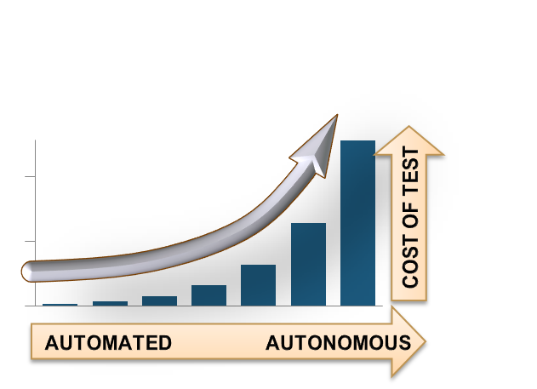
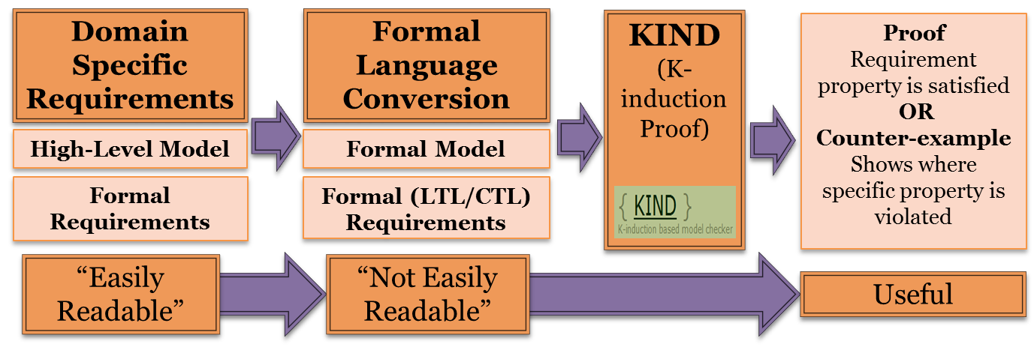
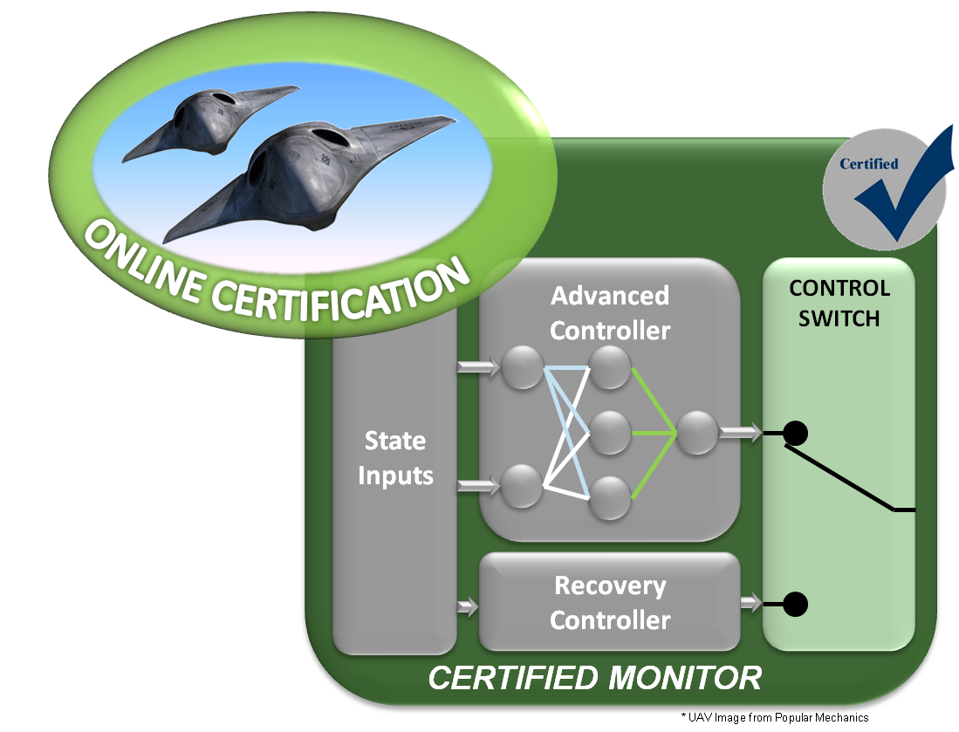
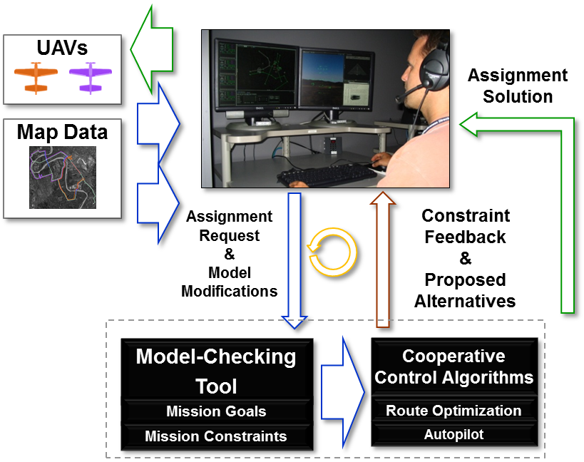
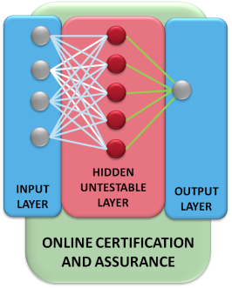
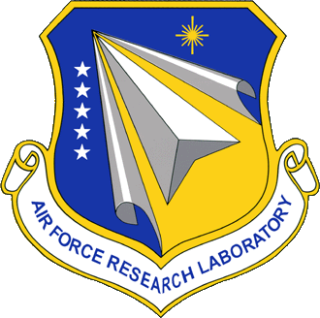
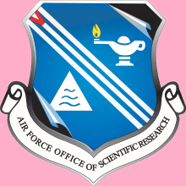
Trust and Certification of Autonomous Systems
“It is possible to develop systems having high levels of autonomy, but it is the lack of V&V methods that prevents all but relatively low levels of autonomy from being certified for use”
– Air Force’s 2010 Technology Horizons Report
Key Challenges
Insufficient tools to V&V highly complex, software-intensive systems
Adaptive / learning systems and uncertain environments yield “near infinite state” systems
System composition results in potentially hazardous emergent behavior
Formal Design and Verification
Exhaustive Test
Analysis
Augment test through Formal Proof
Formally define and validate requirements to reduce implementation errors and cost early
Identify boundaries around unverifiable / learning software
Human-Automation
Run Time Assurance
Provides real-time “model checking” type tool for human-automation mission planning
Use formal methods as framework for:
Use real world Integrated Collision Avoidance System to apply Formal Requirements Analysis Methods
Offline Assurance
Researching methods to reduce, validate, and clarify integrated collision avoidance requirements
Run Time Assurance
Communicating operator intent
Verifying/generating solutions
Providing feedback on mission feasibility
Optimize test through Automatic test case generation / reduction
“Shift in Assurance Paradigm”
Monitor an ensure safe behavior of an unverified system in real time
Enable complexity and adaptation for greater performance without exhaustive testing
“Design of Experiments” for non-deterministic, software intensive systems
Systems of Systems Certification
Individual Certifications
“Correct by Construction” Model-Based Design
Certification Evidence Reuse
Identification and avoidance of undesired emergent behavior
System of Systems Certification
Key Government Partners
Distribution A. Approved for public release distribution unlimited. (88ABW-2013-4233, 26 Sep 2013)

