Slide 1
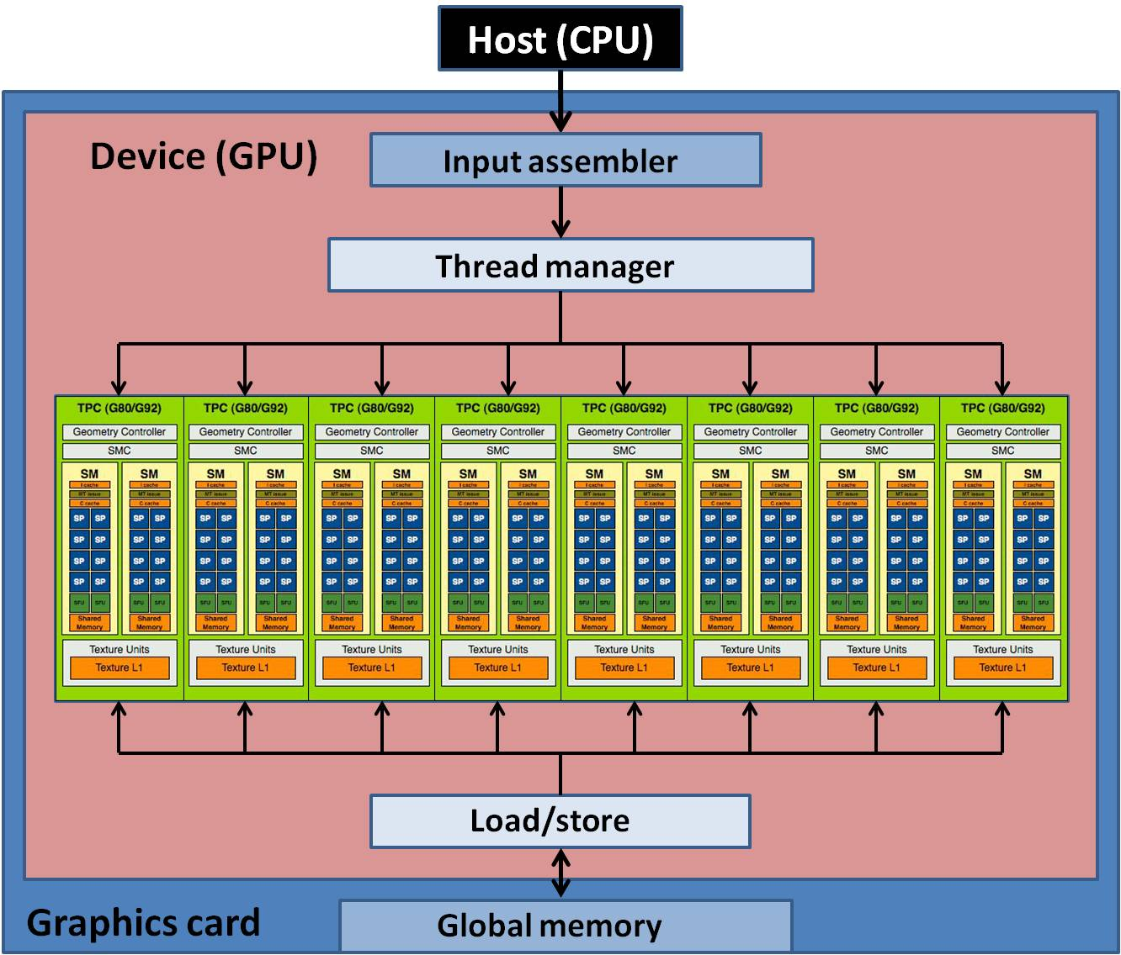
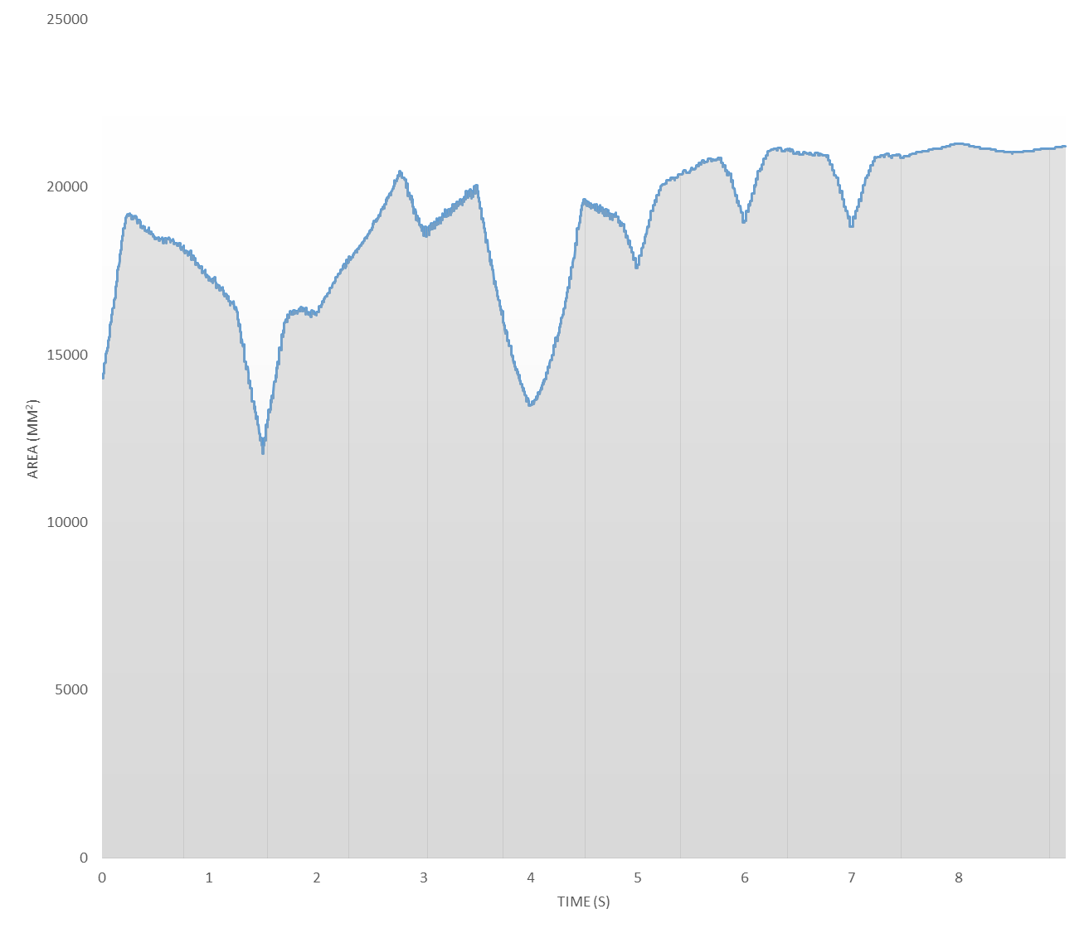
Tumor and Organs at Risk Motion: An Opportunity for Better DMLC IMRT Delivery Systems
Ovidiu Daescu, Computer Science, University of Texas at Dallas
Lech Papiez, School of Health Sciences, Purdue University
Introduction
IMRT Simulation
Kinetic Data Structures
Extensions
Intensity-modulated radiation therapy or IMRT is a form of radiation based teletherapy used to treat various forms of cancer. Radiation therapy works by exposing the cancerous cells to a dosage of ionizing radiation in order to damage the diseased cells enough to induce cell death or apoptosis. Beam based radiation therapy is applied by using a linear accelerator or LINAC that is mounted on a movable gantry to generate a beam of radiation that can be targeted onto a malignant tumor.
One of the primary challenges when designing treatment plans is to ensure that a high enough radiation dosage is absorbed by the tumor to cause damage to the cancer cells while preventing healthy tissues from absorbing too much radiation, as this can cause damaging effects to the patient. Designing the optimal treatment plan is a difficult task; radiation dosages must be constrained to be such that the tumor receives a conformal dose of radiation above a clinically defined threshold while not exceeding the dose limits that healthy tissues can absorb. There is special concern with preventing radiation exposure to certain healthy structures known as organs at risk or OARs.
IMRT can be augmented by using a set of movable metal leaf pairs that open and close to block certain parts of the radiation beam, called a multi-leaf collimator or MLC. Using dynamic multi-leaf collimation or DMLC allows the beam to be shaped to the cross-section of the tumor as it appears in the beam’s eye view or BEV⁷. This allows to shield healthy tissue from the beam, improving the quality of treatment. It does not prevent exposure to tissues that may overlap the tumor in the BEV, however.
Another issue with planning IMRT treatments is that the targeted tumor and surrounding healthy tissues are often non-static. Motion of the tumor and the patient’s organs due to involuntary movement such as breathing and heartbeat can complicate treatment plans. We have designed and implemented algorithms that can be used to track organ motion and calculate when the least amount of overlap between the tumor and healthy tissues occurs in the BEV. During this period of time we can turn on the radiation beam or increase the radiation dose with the least risk of exposing the healthy tissues and OARs
The program loads 3D images in DICOM format and can simulate the absorption of radiation by each voxel in the DICOM image. It is able to generate a height map where height corresponds to the radiation absorbed by each voxel. This intensity map is useful for planning and adjusting IMRT treatments. The user may scroll through each axial slice of the DICOM image to view the intensity map of each slice as the treatment progresses. Multiple treatment plans (up to four) can be compared side by side. Future plans for this simulation will allow users to view the treatment at multiple levels of granularity as well as edit treatment plans.
We were also able to apply parallel programming methods to improve performance of intensity map computation⁴. We used the NVIDIA CUDA architecture to accelerate the program by computing per voxel intensity accumulation in parallel threads. We implemented both CPU and GPU algorithms for parallel programming and found that the optimized GPU algorithm performed the best. We have previously developed this parallel programming template to address the template matching problem^{5,6}
We applied our parallel programming template to improve performance¹, this time using the OpenCL library to implement parallelism. OpenCL has the advantage of working on more than one type of GPU architecture and is open source. As the computation of certificate failure times within a stable motion interval do not depend on each other it is possible to compute these times in parallel. We tested our algorithm on three different graphics processors and observed that there is little increase in performance for low vertex counts. In fact, the GPU algorithm performed worse than the CPU algorithm. This is likely due to the time it takes to copy memory to the GPU. For high vertex counts a significant increase is observed, however.
Figure 3: Screenshots of the 2D KDS moving polygon implementation. A red outline indicates a target polygon and blue indicates a non-target. Violet bounded regions are areas of overlap. The right figure shows the model on the left after two layers of subdivision are applied
To design the KDS, we observe that changes in the region of overlap (the intersection between a target and non-target) typically occur when collisions occur between a vertex of one polygon and an edge of the other. Our certificate is the distance between a vertex and edge, and when this distance is zero the certificate fails
We have previously developed a KDS that does this under the restriction that all polygons move along a single axis³. We extended this to allow dual-axis motion to find a more complete solution². We observed a large performance increase in our KDS algorithm over a naïve algorithm. The current version is able to track the structure of the intersection region.
In order to test how well the algorithm performs when the number of moving vertices is scaled, we implemented a simple subdivision method that doubles the number of vertices in each polygon and repositions the vertices to create a smoothing effect. We can now easily compute the area of each overlap and sum the results. We sample the area at small intervals and find the minimum of the samples to find an approximation for the best beam on time for the treatment plan. Overlap area for OARs are weighted more heavily
Future work will focus on improving the efficiency of the KDS data structure.
Figure 6: Results of applying GPU acceleration algorithms to certificate computation. For low vertex examples, gains are minimal compared to the CPU algorithm. High vertex counts yield substantial performance improvements.
References
D. Allen, and O. Daescu, “Radiation Therapy Optimization with GPU Programming,” International Conference on Parallel and Distributed Processing Techniques and Applications, 2014.
D. Allen, and O. Daescu, “Optimization of IMRT treatment plan with Kinetic Data Structures,” 4th IEEE International Conference on Computational Advances in Bio and Medical Sciences, 2014.
D. Allen, and O. Daescu, “Radiation Therapy Simulation and Optimization Using Kinetic Polygon Modeling,” IEEE International Conference on Information Reuse and Integration, 2013.
J. S. Kirtzic, D. Allen, and O. Daescu, “Applying the Parallel GPU Model to Radiation Therapy Treatment,” International Conference on Parallel and Distributed Processing Techniques and Applications, 2013.
J. S. Kirtzic and O. Daescu, “A parallel algorithm development model for the GPU architecture,” International Conference on Parallel and Distributed Processing Techniques and Applications, 2012.
R. Anderson, J. Kirtzic, and O. Daescu, “Applying parallel design techniques to template matching with GPUs,” in High Performance Computing for Computational Science–VECPAR 2010: 9th International Conference, 2010.
D. Rangaraj, G. Palaniswaamy, and L. Papiez, “DMLC IMRT delivery to targets moving in 2D in beam’s eye view,” Medical physics,vol. 35, p. 3765, 2008.
L. Guibas. “Kinetic data structures,” In Handbook of Data Structures and Applications. CRC Press, 2004.
IMRT Simulation
Figure 2: NVIDIA CUDA architecture used for the development of our parallel programming algorithm. This table shows the results of applying our GPU model to the intensity mapping algorithm., with comparison between Naïve CPU and GPU methods and optimized CPU and GPU methods. The greatest performance boost was found with the optimized GPU algorithm.
In order to assist with the development of treatment plans we developed our own suite of programs designed to simulate an IMRT plan.
Kinetic Data Structures
In order to track areas of overlap between the target tumor and healthy tissues, we turn to Kinetict Data Structures. A Kinetic Data Structure or KDS involves a set of constraints called Certificates that are used to validate some underlying property of moving geometric data over time⁸. When the constraint is broken the certificate is said to fail and the underlying property must be updated to maintain the validity of the KDS.
The KDS verifies the combinatorial structure of the overlap between the target and healthy tissue. This allows us to find the time of minimum overlap. We model the cross-sections of the tissues in the BEV as polygons and construct a KDS that keeps track of the intersections between target polygons and other non-targets as they move along pre-set flight paths obtained by 4D medical image data of the patient. Such data can be obtained by recording CT or MRI image data of the patient before planning treatment
Figure 4: KDS vs. Non-KDS performance data. The average time to compute the intersection area is much smaller for the KDS algorithm
Acknowledgments
Figure 1: Screenshot of the interface of the IMRT treatment plan simulator. The top left quadrant shows slices of the 3D patient image, the top right shows the leaf positions of the MLC. Bottom right shows the intensity map of radiation absorbed by a slice of the image, and bottom left shows the position of the gantry
The following students in Daescu's lab contributed to this work: David Allen, Steven Kirtzic, Sairam Behera, Marko Zivanik, Yam Ki Cheung, and Tyler Adams.
Figure 5: Computation of the (weighted) minimal area of overlap time. The area of overlap is sampled at regular intervals to find an approximation of the true minimum

