Slide 1
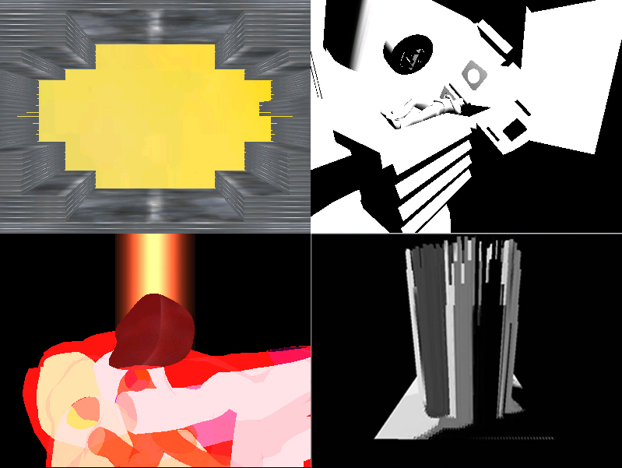
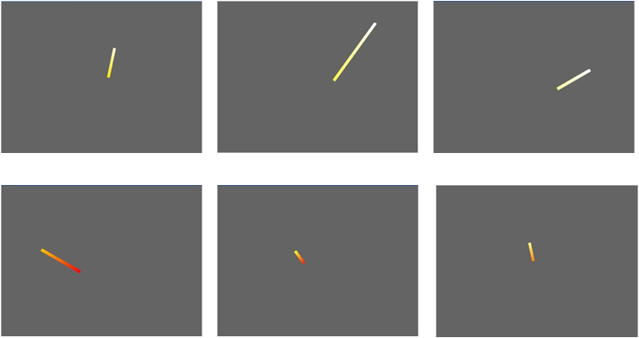
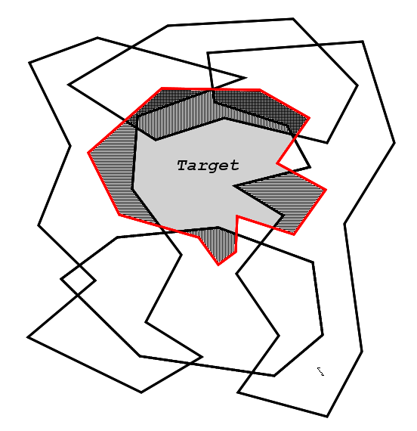
Collaborative Research: Tumor and Organs at Risk Motion:
An Opportunity for Better DMLC IMRT Delivery Systems
Ovidiu Daescu
Computer Science
University of Texas at Dallas
Lech Papiez
Radiation Oncology
UT Southwestern Medical Center
Rigid Target – motion of object defined by the translational motion of center of mass before delivery
For photon arc delivery – what matters is the position of target projection on plane passing through isocenter
and perpendicular to central axis of the current beam direction
GPU acceleration and its application to the simulation of treatment planning
Moving regions approach
Kinetic bichromatic circular separability
Optimal delivery of modulated arc therapy (VMAT) for moving targets
Target Motion
Current Work
2D motion (projection)
CM
3D motion
IMRTVision: A treatment visualization system
GPU accelerated intensity mapping
Problem: While our visualization system, and in particular our intensity mapping and accumulation algorithm, works fairly well under low to medium work-loads, at medium to high levels of computational complexity, such as those of high-resolution images, the simulation begins to experience noticeable lag
Solution: Utilize the high-performance, low-cost capabilities of commodity GPUs to handle the majority of the data-parallel computations being done for the intensity and accumulation mapping
Goal: To create a treatment plan simulation system that allows physicians to visualize and compare multiple treatments simultaneously
Approach: Create a multi-grained, fully-navigable 3D simulation which uses patient treatment plan data to visualize various
At the core of the system is an intensity mapping and dosage accumulation algorithm which shows radiation dosage to the target and surrounding tissues as it accumulates
Moving regions approach
Kinetic data structures
As the polygons translate, A_{i}(t) changes combinatorially only if a point of some polygon enters the inner space of another polygon – marking a collision
These critical events can be kept track of with a Kinetic Data Structure or KDS
The KDS maintains a set of certificates that ensure the validity of A_{i}(t)
Whenever a certificate fails the KDS allows for the efficient repair and updating of A_{i}(t)
During the period of time between certificate failures, A_{i}(t) is a smooth function and can be minimized
The entire function can be minimized by finding the minimum of the minima collected for each of these time periods
Objective: Approximate the shapes of the tumor and surrounding tissues as a collection of moving polygons
Under conditions where polygons are translating with constant, known velocities it is possible to calculate the area of intersection between the tumor (the target) polygon and the other polygons in the system
The area of intersection function over time A_{i}(t) is minimized during the time that the tumor is most exposed
The time at which A_{i}(t) is minimized is optimal for radiation delivery as the radiation exposure of healthy surrounding tissues is also minimized
Kinetic bichromatic circular separability
Objective: Given two sets of moving points, red and blue, compute the smallest circle that encloses all red points and as few blue points as possible
We keep track of optimal circle(s) at any given time t by identifying events at which the number of points, either red or blue, enclosed by the currently optimal circle changes
For each point’s trajectory we considered the three possible cases separately:
the trajectory does not intersect the smallest enclosing circle (MEC) of red points or the convex hull(CH) of red points
the trajectory intersects MEC, but not CH
the trajectory intersects both MEC and CH
The problem has a wide range of applications including: biomedical engineering, image processing and military planning.
Optimal delivery of VMAT for moving targets
g
Allowed speed variation at (t₇,g₅) for gantry arriving at (t₇,g₅) from (t₅,g₄) when acceleration constraint imposed
Speed range for grid point (t₃,g₃) acceleration unrestricted motion
t

